Slide 1
3. Parsing
Prof. O. Nierstrasz
Thanks to Jens Palsberg and Tony Hosking for their kind permission to reuse and adapt the CS132 and CS502 lecture notes.
http://www.cs.ucla.edu/~palsberg/
http://www.cs.purdue.edu/homes/hosking/

Slide 2
Roadmap
Context-free grammars
Derivations and precedence
Top-down parsing
Left-recursion
Look-ahead
Table-driven parsing
See, Modern compiler implementation in Java (Second edition), chapter 3.

Slide 3
Roadmap
Context-free grammars
Derivations and precedence
Top-down parsing
Left-recursion
Look-ahead
Table-driven parsing

Slide 4
The role of the parser
performs context-free syntax analysis
guides context-sensitive analysis
constructs an intermediate representation
produces meaningful error messages
attempts error correction

Slide 5
Syntax analysis
Context-free syntax is specified with a context-free grammar.
Formally a CFG G = (V_{t},V_{n},S,P), where:
V_{t} is the set of terminal symbols in the grammar (i.e.,the set of tokens returned by the scanner)
V_{n}, the non-terminals, are variables that denote sets of (sub)strings occurring in the language. These impose a structure on the grammar.
S is the goal symbol, a distinguished non-terminal in V_{n} denoting the entire set of strings in L(G).
P is a finite set of productions specifying how terminals and non-terminals can be combined to form strings in the language. Each production must have a single non-terminal on its left hand side.
The set V = V_{t} ∪ V_{n} is called the vocabulary of G

Slide 6
Notation and terminology
a, b, c, … ∈ V_{t}
A, B, C, … ∈ V_{n}
U, V, W, … ∈ V
α, β, γ, … ∈ V*
u, v, w, … ∈ V_{t} *
If A → γ then αAβ ⇒ αγβ is a single-step derivation using A → γ
⇒* and ⇒⁺ denote derivations of ≥0 and ≥1 steps
If S ⇒* β then β is said to be a sentential form of G
L(G) = { w ∈ V_{t} * ⏐ S ⇒⁺ w }, w in L(G) is called a sentence of G
NB: L(G) = { β ∈ V* ⏐ S ⇒* β } ∩ V_{t} *

Slide 7
Syntax analysis
Grammars are often written in Backus-Naur form (BNF).
Example:
In a BNF for a grammar, we represent
non-terminals with <angle brackets> or CAPITAL LETTERS
terminals with typewriter font or underline
productions as in the example
<goal> ::= <expr>
<expr> ::= <expr> <op> <expr>
| num
| id
<op> ::= +
| —
| *
| /
Notes:
This describes simple expressions over numbers and identifiers.

Slide 8
Scanning vs. parsing
Where do we draw the line?
term ::= [a-zA-Z] ( [a-zA-Z] | [0-9] )*
| 0 | [1-9][0-9]*
op ::= + | — | * | /
expr ::= (term op)* term
Regular expressions:
Normally used to classify identifiers, numbers, keywords …
Simpler and more concise for tokens than a grammar
More efficient scanners can be built from REs
CFGs are used to impose structure
Brackets: (), begin … end, if … then … else
Expressions, declarations …
Factoring out lexical analysis simplifies the compiler
Notes:
Syntactic analysis is complicated enough: grammar for C has around 200 productions.

Slide 9
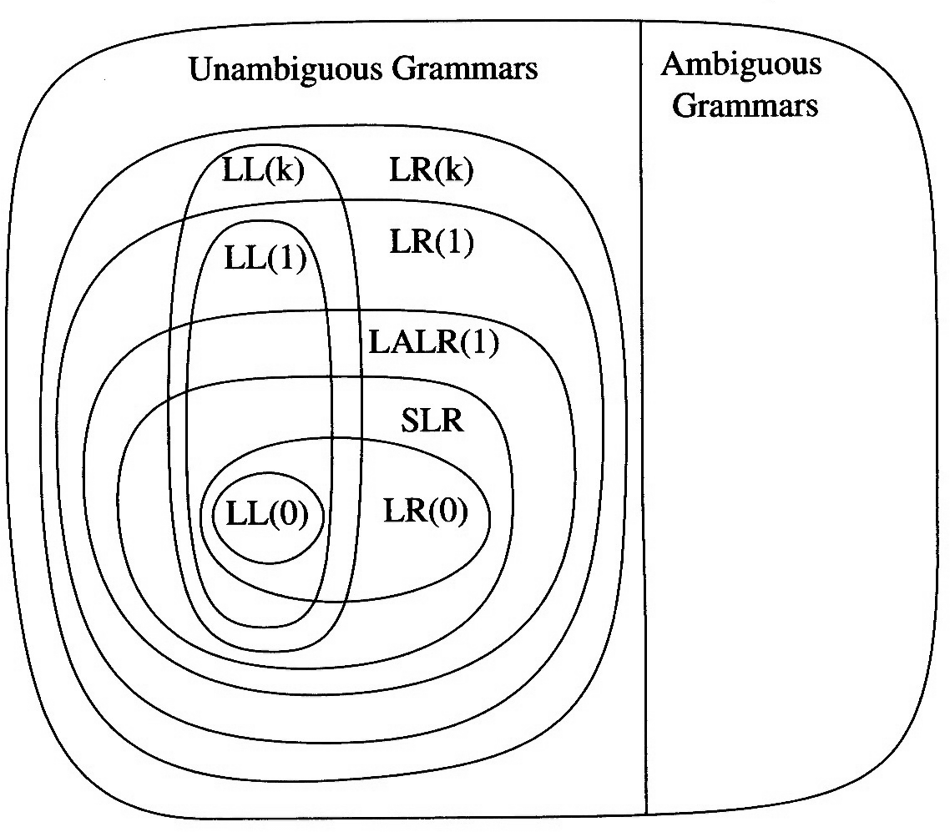
Hierarchy of grammar classes
LL(k):
Left-to-right, Leftmost derivation, k tokens lookahead
LR(k):
Left-to-right, Rightmost derivation, k tokens lookahead
SLR:
Simple LR (uses “follow sets”)
LALR:
LookAhead LR (uses “lookahead sets”)
http://en.wikipedia.org/wiki/LL_parser …

Slide 10
Roadmap
Context-free grammars
Derivations and precedence
Top-down parsing
Left-recursion
Look-ahead
Table-driven parsing

Slide 11
Derivations
We can view the productions of a CFG as rewriting rules.
<goal> ⇒ <expr>
⇒ <expr> <op> <expr>
⇒ <expr> <op> <expr> <op> <expr>
⇒ <id,x> <op> <expr> <op> <expr>
⇒ <id,x> + <expr> <op> <expr>
⇒ <id,x> + <num,2> <op> <expr>
⇒ <id,x> + <num,2> * <expr>
⇒ <id,x> + <num,2> * <id,y>
We have derived the sentence: x + 2 * y
We denote this derivation (or parse) as: <goal> ⇒* id + num * id
The process of discovering a derivation is called parsing.

Slide 12
Derivation
At each step, we choose a non-terminal to replace.
This choice can lead to different derivations.
Two strategies are especially interesting:
Leftmost derivation: replace the leftmost non-terminal at each step
Rightmost derivation: replace the rightmost non-terminal at each step
The previous example was a leftmost derivation.

Slide 13
Rightmost derivation
For the string: x + 2 * y
<goal> ⇒ <expr>
⇒ <expr> <op> <expr>
⇒ <expr> <op> <id,y>
⇒ <expr> * <id,y>
⇒ <expr> <op> <expr> * <id,y>
⇒ <expr> <op> <num,2> * <id,y>
⇒ <expr> + <num,2> * <id,y>
⇒ <expr> + <num,2> * <id,y>
⇒ <id,x> + <num,2> * <id,y>
Again we have: <goal> ⇒* id + num * id

Slide 14
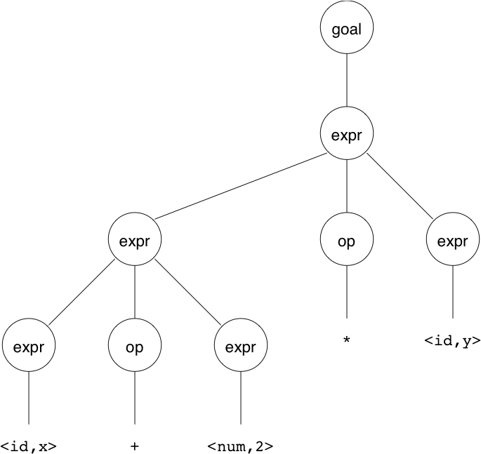
Precedence
Treewalk evaluation computes: (x+2)*y
Should be: x+(2*y)

Slide 15
Precedence
Our grammar has a problem: it has no notion of precedence, or implied order of evaluation.
To add precedence takes additional machinery:
<goal> ::= <expr>
<expr> ::= <expr> + <term>
| <expr> - <term>
| <term>
<term> ::= <term> * <factor>
| <term> / <factor>
| <factor>
<factor> ::= num
| id
This grammar enforces a precedence on the derivation:
terms must be derived from expressions
forces the “correct” tree

Slide 16
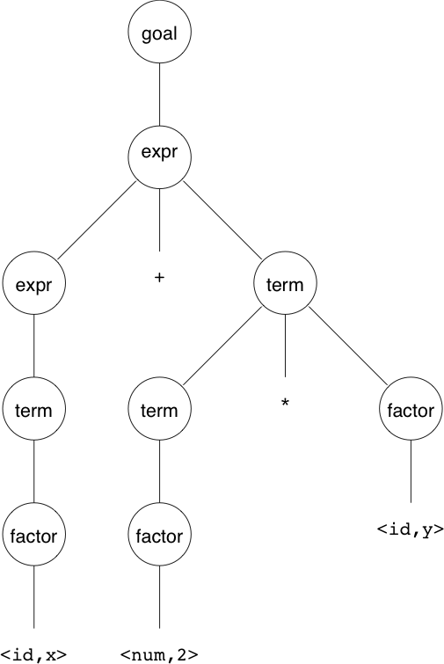
Forcing the desired precedence
Now, for the string: x + 2 * y
<goal> ⇒ <expr>
⇒ <expr> + <term>
⇒ <expr> + <term> * <factor>
⇒ <expr> + <term> * <id,y>
⇒ <expr> + <factor> * <id,y>
⇒ <expr> + <num,2> * <id,y>
⇒ <term> + <num,2> * <id,y>
⇒ <factor> + <num,2> * <id,y>
⇒ <id,x> + <num,2> * <id,y>
Again we have: <goal> ⇒* id + num * id,
but this time with the desired tree.

Slide 17
Ambiguity
If a grammar has more than one derivation for a single sentential form, then it is ambiguous
<stmt> ::= if <expr> then <stmt>
| if <expr> then <stmt> else <stmt>
| …
Consider: if E₁ then if E₂ then S₁ else S₂
This has two derivations
The ambiguity is purely grammatical
It is called a context-free ambiguity

Slide 18
Resolving ambiguity
Ambiguity may be eliminated by rearranging the grammar:
<stmt> ::= <matched>
| <unmatched>
<matched> ::= if <expr> then <matched> else <matched>
| …
<unmatched> ::= if <expr> then <stmt>
| if <expr> then <matched> else <unmatched>
This generates the same language as the ambiguous grammar, but applies the common sense rule:
match each else with the closest unmatched then

Slide 19
Ambiguity
Ambiguity is often due to confusion in the context-free specification. Confusion can arise from overloading, e.g.:
In many Algol-like languages, f could be a function or a subscripted variable.
Disambiguating this statement requires context:
need values of declarations
not context-free
really an issue of type
a = f(17)
Rather than complicate parsing, we will handle this separately.

Slide 20
Roadmap
Context-free grammars
Derivations and precedence
Top-down parsing
Left-recursion
Look-ahead
Table-driven parsing

Slide 21
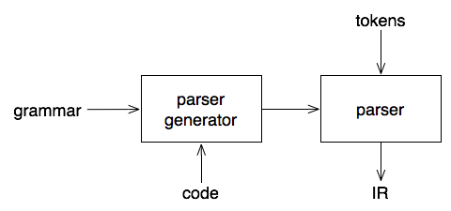
Parsing: the big picture
Our goal is a flexible parser generator system

Slide 22
Top-down versus bottom-up
Top-down parser:
starts at the root of derivation tree and fills in
picks a production and tries to match the input
may require backtracking
some grammars are backtrack-free (predictive)
Bottom-up parser:
starts at the leaves and fills in
starts in a state valid for legal first tokens
as input is consumed, changes state to encode possibilities (recognize valid prefixes)
uses a stack to store both state and sentential forms

Slide 23
Top-down parsing
A top-down parser starts with the root of the parse tree, labeled with the start or goal symbol of the grammar.
To build a parse, it repeats the following steps until the fringe of the parse tree matches the input string
At a node labeled A, select a production A → α and construct the appropriate child for each symbol of α
When a terminal is added to the fringe that doesn’t match the input string, backtrack
Find the next node to be expanded (must have a label in V_{n})
The key is selecting the right production in step 1
⇒ should be guided by input string

Slide 24
Simple expression grammar
Recall our grammar for simple expressions:
<goal> ::= <expr>
<expr> ::= <expr> + <term>
| <expr> - <term>
| <term>
<term> ::= <term> * <factor>
| <term> / <factor>
| <factor>
<factor> ::= num
| id
Consider the input string x — 2 * y

Slide 25
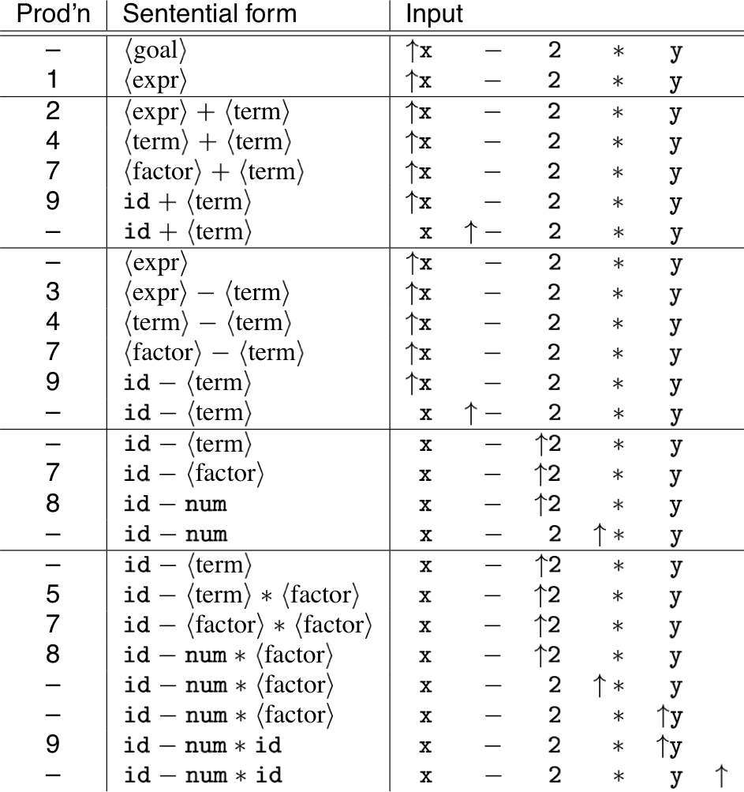
Top-down derivation
Notes:
The horizontal lines denote the backtracking points.
Whenever a token cannot be read, or input is left, then we must backtrack to an alternative rule.

Slide 26
Roadmap
Context-free grammars
Derivations and precedence
Top-down parsing
Left-recursion
Look-ahead
Table-driven parsing

Slide 27
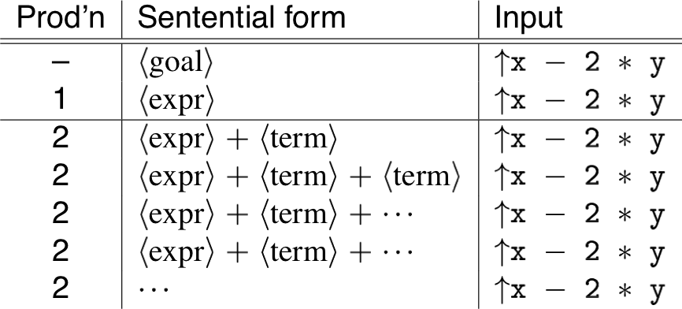
Non-termination
Another possible parse for x — 2 * y
If the parser makes the wrong choices, expansion doesn´t terminate!

Slide 28
Left-recursion
Top-down parsers cannot handle left-recursion in a grammar
Formally, a grammar is left-recursive if
∃A ∈ V_{n} such that A ⇒⁺ Aα for some string α
Our simple expression grammar is left-recursive!

Slide 29
Eliminating left-recursion
To remove left-recursion, we can transform the grammar
<foo> ::= <foo> α
| β
<foo> ::= β <bar>
<bar> ::= α <bar>
| ε
NB: α and β do not start with <foo>!

Slide 30
Example
<expr> ::= <expr> + <term>
| <expr> - <term>
| <term>
<term> ::= <term> * <factor>
| <term> / <factor>
| <factor>
<expr> ::= <term> <expr´>
<expr´> ::= + <term> <expr´>
| - <term> <expr´>
| ε
<term> ::= <factor> <term´>
<term´> ::= * <term´>
| / <term´>
| ε
With this grammar, a top-down parser will
terminate
backtrack on some inputs

Slide 31
Example
This cleaner grammar defines the same language:
<goal> ::= <expr>
<expr> ::= <term> + <expr>
| <term> - <expr>
| <term>
<term> ::= <factor> * <term>
| <factor> / <term>
| <factor>
<factor> ::= num
| id
It is:
right-recursive
free of ε productions
Unfortunately, it generates different associativity.
Same syntax, different meaning!

Slide 32
Example
Our long-suffering expression grammar :
<goal> ::= <expr>
<expr> ::= <term> <expr´>
<expr´> ::= + <term> <expr´>
| - <term> <expr´>
| ε
<term> ::= <factor> <term´>
<term´> ::= * <term´>
| / <term´>
| ε
<factor> ::= num
| id
Recall, we factored out left-recursion

Slide 33
Roadmap
Context-free grammars
Derivations and precedence
Top-down parsing
Left-recursion
Look-ahead
Table-driven parsing

Slide 34
How much look-ahead is needed?
We saw that top-down parsers may need to backtrack when they select the wrong production
Do we need arbitrary look-ahead to parse CFGs?
in general, yes
use the Earley or Cocke-Younger, Kasami algorithms
Aho, Hopcroft, and Ullman, Problem 2.34 Parsing, Translation and Compiling, Chapter 4
Fortunately
large subclasses of CFGs can be parsed with limited lookahead
most programming language constructs can be expressed in a grammar that falls in these subclasses
Among the interesting subclasses are:
LL(1): Left to right scan, Left-most derivation, 1-token look-ahead; and
LR(1): Left to right scan, Right-most derivation, 1-token look-ahead

Slide 35
Predictive parsing
Basic idea:
For any two productions A → α | β, we would like a distinct way of choosing the correct production to expand.
For some RHS α ∈ G, define FIRST(α) as the set of tokens that appear first in some string derived from α
I.e., for some w ∈ V_{t}*, w ∈ FIRST(α) iff α ⇒*wγ
Key property:
Whenever two productions A → α and A → β both appear in the grammar, we would like:
FIRST(α) ∩ FIRST(β) = ∅
This would allow the parser to make a correct choice with a look-ahead of only one symbol!
The example grammar has this property!

Slide 36
Left factoring
What if a grammar does not have this property?
Sometimes, we can transform a grammar to have this property:
For each non-terminal A find the longest prefix α common to two or more of its alternatives.
if α ≠ ε then replace all of the A productions A → αβ₁ | αβ₂ | … | αβ_{n} with A → α A´
A´ → β₁ | β₂ | … | β_{n} where A´ is fresh
Repeat until no two alternatives for a single non-terminal have a common prefix.

Slide 37
Example
Consider our right-recursive version of the expression grammar :
<goal> ::= <expr>
<expr> ::= <term> + <expr>
| <term> - <expr>
| <term>
<term> ::= <factor> * <term>
| <factor> / <term>
| <factor>
<factor> ::= num
| id
To choose between productions 2, 3, & 4, the parser must see past the num or id and look at the +, —, * or /.
FIRST(2) ∩ FIRST(3) ∩ FIRST(4) ≠ ∅
This grammar fails the test.
Notes:
NB: This grammar is right-associative.

Slide 38
Example
Two non-terminals must be left-factored:
<expr> ::= <term> + <expr>
| <term> - <expr>
| <term>
<term> ::= <factor> * <term>
| <factor> / <term>
| <factor>
<expr> ::= <term> <expr´>
<expr´> ::= + <expr>
| - <expr>
| ε
<term> ::= <factor> <term´>
<term´> ::= * <term>
| / <term>
| ε

Slide 39
Example
Substituting back into the grammar yields
<goal> ::= <expr>
<expr> ::= <term> <expr´>
<expr´> ::= + <expr>
| - <expr>
| ε
<term> ::= <factor> <term´>
<term´> ::= * <term>
| / <term>
| ε
<factor> ::= num
| id
Now, selection requires only a single token look-ahead.
NB: This grammar is still right-associative.

Slide 40
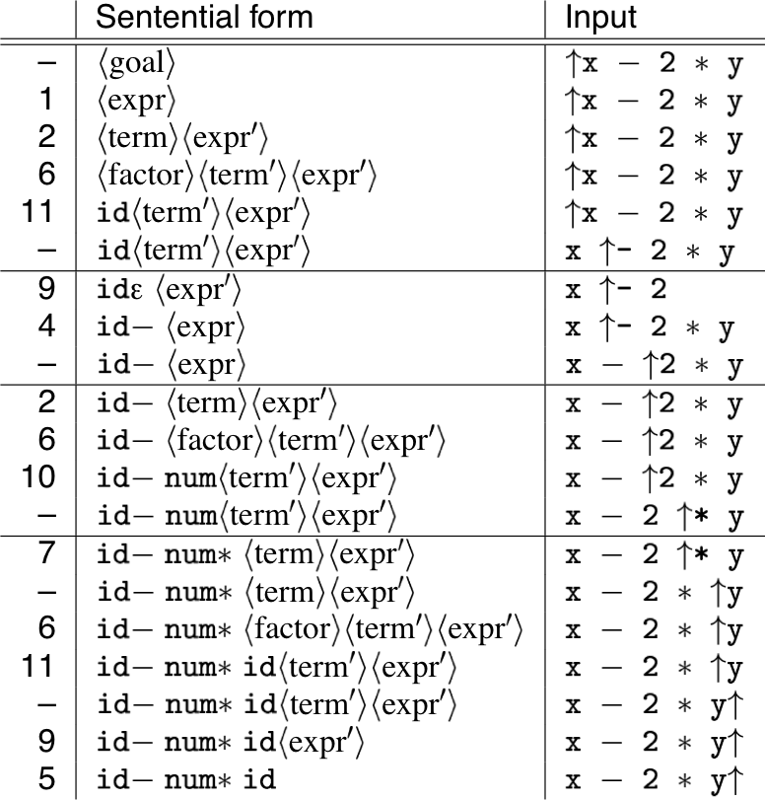
Example derivation
The next symbol determines each choice correctly.

Slide 41
Back to left-recursion elimination
Given a left-factored CFG, to eliminate left-recursion:
if ∃ A → Aα then replace all of the A productions A → Aα | β | … | γ with A → NA´ N → β | … | γ A´ → αA´ | ε where N and A´ are fresh
Repeat until there are no left-recursive productions.

Slide 42
Generality
Question:
By left factoring and eliminating left-recursion, can we transform an arbitrary context-free grammar to a form where it can be predictively parsed with a single token look-ahead?
Answer:
Given a context-free grammar that doesn’t meet our conditions, it is undecidable whether an equivalent grammar exists that does meet our conditions.
Many context-free languages do not have such a grammar:
{a^{n}0b^{n} | n>1 } ∪ {a^{n}1b^{2n} | n ≥ 1 }
Must look past an arbitrary number of a’s to discover the 0 or the 1 and so determine the derivation.

Slide 43
Roadmap
Context-free grammars
Derivations and precedence
Top-down parsing
Left-recursion
Look-ahead
Table-driven parsing

Slide 44
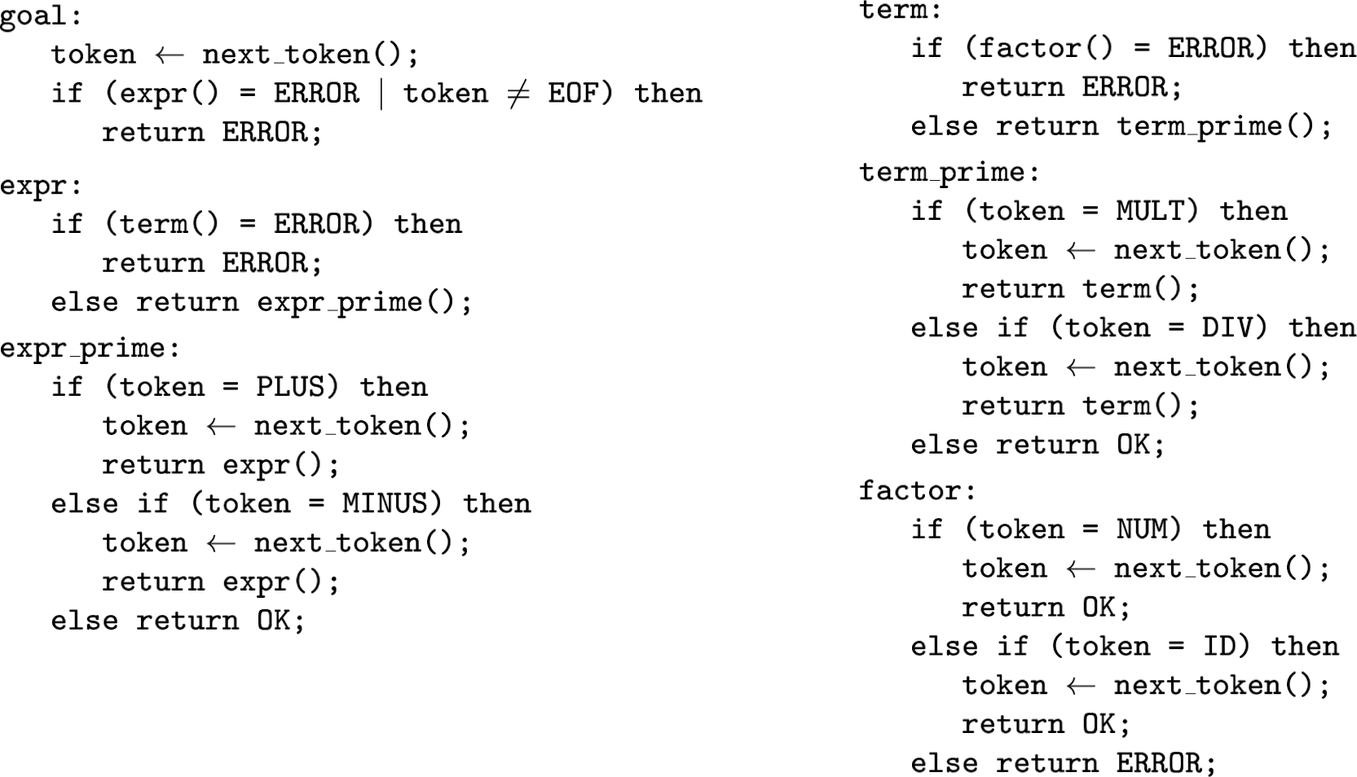
Recursive descent parsing
Now, we can produce a simple recursive descent parser from the (right- associative) grammar.

Slide 45
Building the tree
One of the key jobs of the parser is to build an intermediate representation of the source code.
To build an abstract syntax tree, we can simply insert code at the appropriate points:
factor() can stack nodes id, num
term_prime() can stack nodes *, /
term() can pop 3, build and push subtree
expr_prime() can stack nodes +, -
expr() can pop 3, build and push subtree
goal() can pop and return tree

Slide 46
Non-recursive predictive parsing
Observation:
Our recursive descent parser encodes state information in its run- time stack, or call stack.
Using recursive procedure calls to implement a stack abstraction may not be particularly efficient.
This suggests other implementation methods:
explicit stack, hand-coded parser
stack-based, table-driven parser

Slide 47
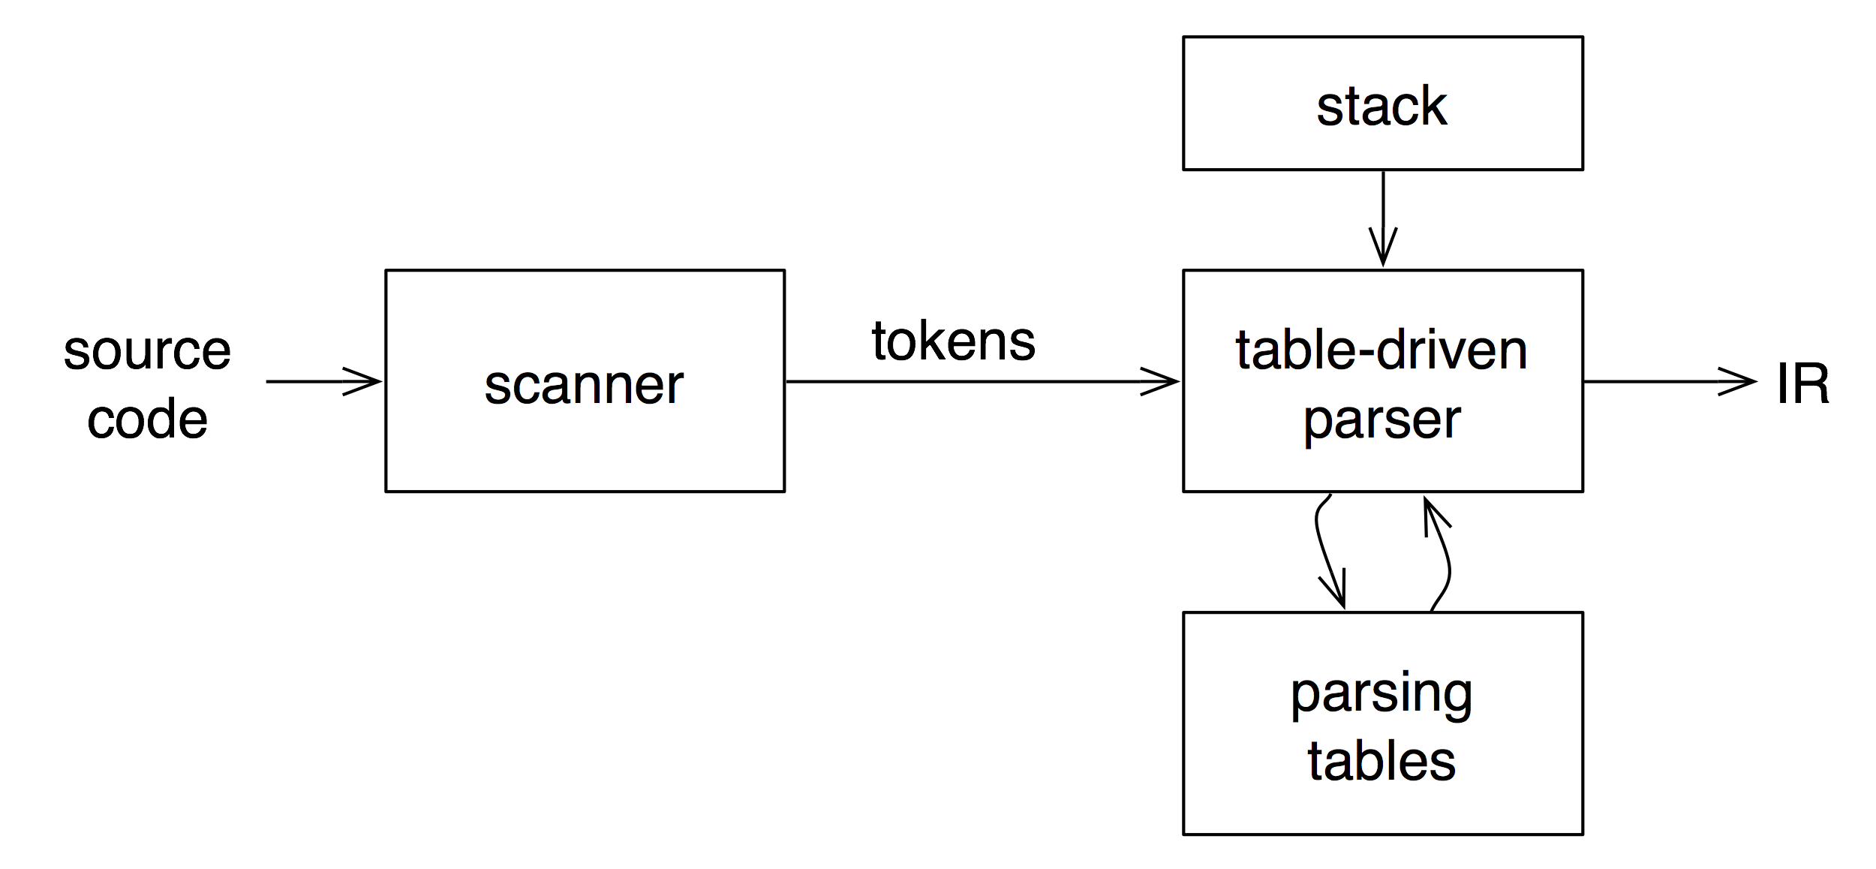
Non-recursive predictive parsing
Now, a predictive parser looks like:
Rather than writing code, we build tables.
Building tables can be automated!

Slide 48
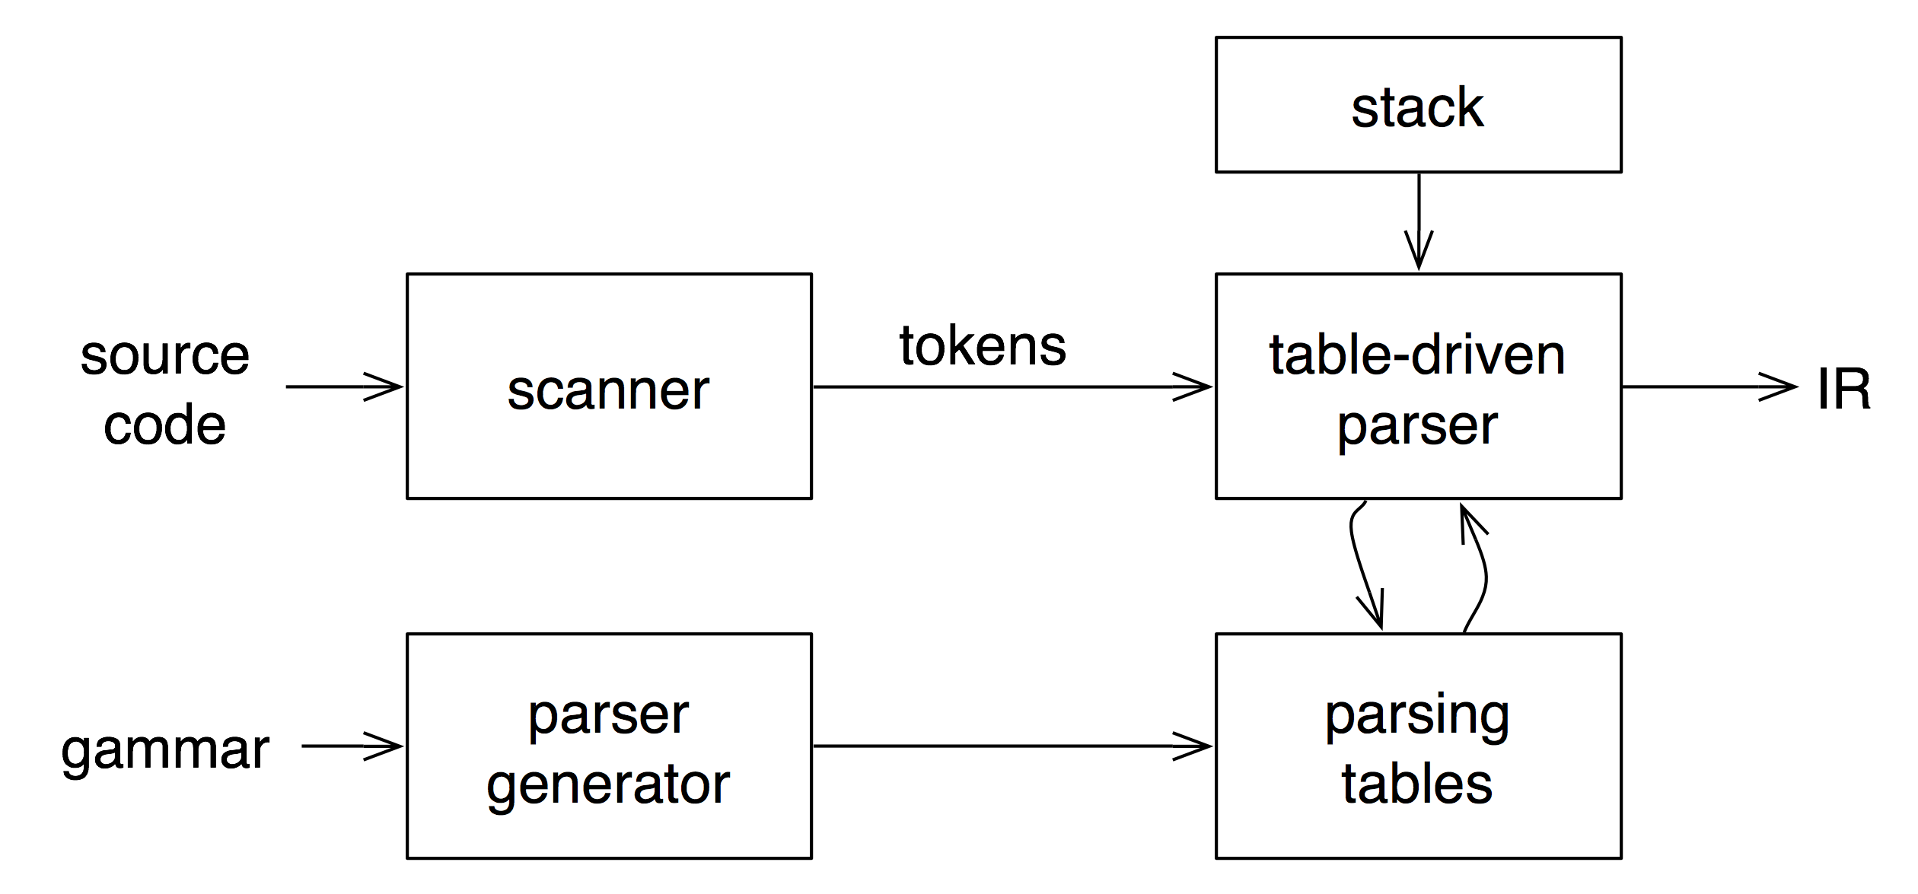
Table-driven parsers
A parser generator system often looks like:
grammar
This is true for both top-down (LL) and bottom-up (LR) parsers

Slide 49
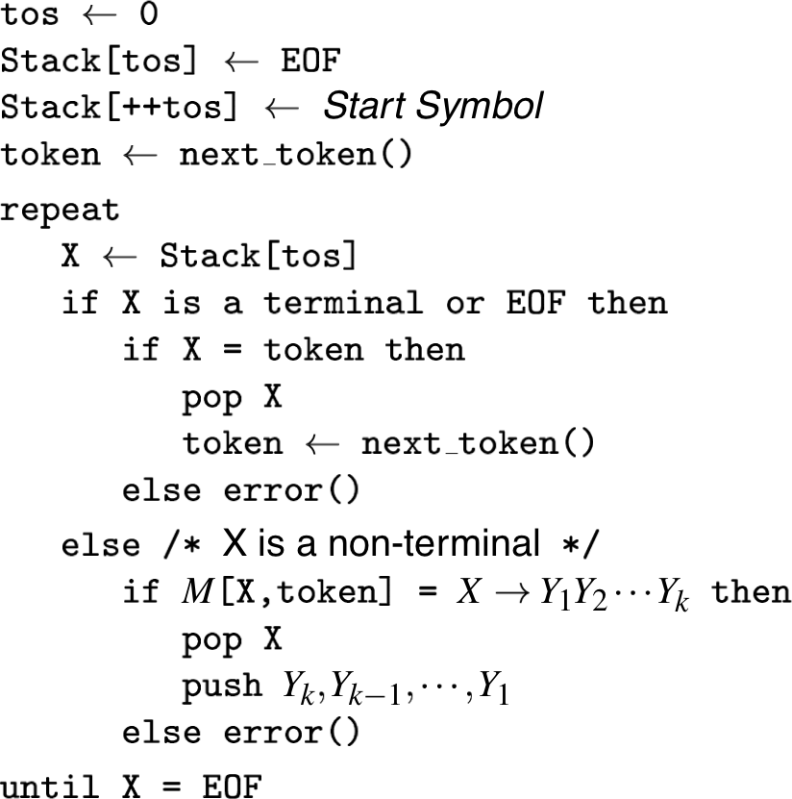
Non-recursive predictive parsing
Input: a string w and a parsing table M for G

Slide 50
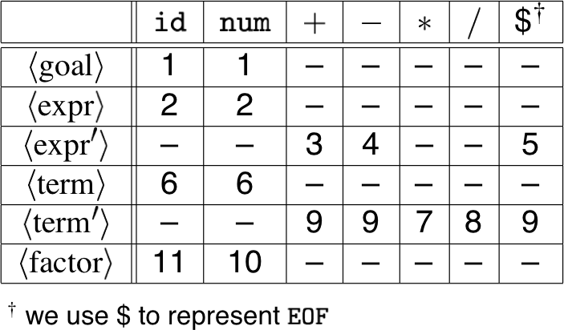
Non-recursive predictive parsing
What we need now is a parsing table M.
Our expression grammar :
Its parse table:
<goal> ::= <expr>
<expr> ::= <term> <expr´>
<expr´> ::= + <expr>
| - <expr>
| ε
<term> ::= <factor> <term´>
<term´> ::= * <term>
| / <term>
| ε
<factor> ::= num
| id

Slide 51
FIRST
For a string of grammar symbols α, define FIRST(α) as:
the set of terminal symbols that begin strings derived from α: { a ∈ V_{t} | α ⇒* aβ }
If α ⇒* ε then ε ∈ FIRST(α)
FIRST(α) contains the set of tokens valid in the initial position in α.
To build FIRST(X):
If X ∈ V_{t}, then FIRST(X) is { X }
If X → ε then add ε to FIRST(X)
If X → Y₁ Y₂ … Y_{k}
Put FIRST(Y₁) — {ε} in FIRST(X)
∀i: 1 < i ≤ k, if ε ∈ FIRST(Y₁) ∩ … ∩ FIRST(Y_{i-1}) (i.e., Y₁ Y₂ … Y_{i-1} ⇒* ε) then put FIRST(Y_{i}) — {ε} in FIRST(X)
If ε ∈ FIRST(Y₁) ∩ … ∩ FIRST(Y_{k}) then put ε in FIRST(X)
Repeat until no more additions can be made.

Slide 52
FOLLOW
For a non-terminal A, define FOLLOW(A) as:
the set of terminals that can appear immediately to the right of A in some sentential form
I.e., a non-terminal’s FOLLOW set specifies the tokens that can legally appear after it.
A terminal symbol has no FOLLOW set.
To build FOLLOW(A):
Put $ in FOLLOW(<goal>)
If A → αBβ:
Put FIRST(β) – {ε} in FOLLOW(B)
If β = ε (i.e., A → αB) or ε ∈ FIRST(β) (i.e., β ⇒* ε) then put FOLLOW(A) in FOLLOW(B)
Repeat until no more additions can be made

Slide 53
LL(1) grammars
Previous definition:
A grammar G is LL(1) iff. for all non-terminals A, each distinct pair of productions A → β and A → γ satisfy the condition FIRST(β) ∩ FIRST(γ) = ∅
But what if A ⇒* ε?
Revised definition:
A grammar G is LL(1) iff. for each set of productions A → α₁ | α₂ | … | α_{n}
FIRST(α₁), FIRST(α₂), …, FIRST(α_{n}) are pairwise disjoint
If α_{i} ⇒* ε then FIRST(α_{j}) ∩ FOLLOW(A) = ∅, ∀ 1≤j≤n, i≠j
NB: If G is ε-free, condition 1 is sufficient
FOLLOW(A) must be disjoint from FIRST(a_{j}), else we do not know whether to go to a_{j} or to take a_{i} and skip to what follows.
Notes:
FOLLOW(A) must be disjoint from FIRST(aj), else we do not know whether to go to aj or to take ai and skip to what follows.

Slide 54
Properties of LL(1) grammars
No left-recursive grammar is LL(1)
No ambiguous grammar is LL(1)
Some languages have no LL(1) grammar
A ε–free grammar where each alternative expansion for A begins with a distinct terminal is a simple LL(1) grammar.
Example:
S → aS | a
is not LL(1) because FIRST(aS) = FIRST(a) = { a }
S → aS´
S´ → aS | ε
accepts the same language and is LL(1)

Slide 55
LL(1) parse table construction
Input: Grammar G
Output: Parsing table M
Method:
∀ production A → α:
∀a ∈ FIRST(α), add A → α to M[A,a]
If ε ∈ FIRST(α):
∀b ∈ FOLLOW(A), add A → α to M[A,b]
If $ ∈ FOLLOW(A), add A → α to M[A,$]
Set each undefined entry of M to error
If ∃M[A,a] with multiple entries then G is not LL(1).
NB: recall that a, b ∈ V_{t}, so a, b ≠ ε

Slide 56
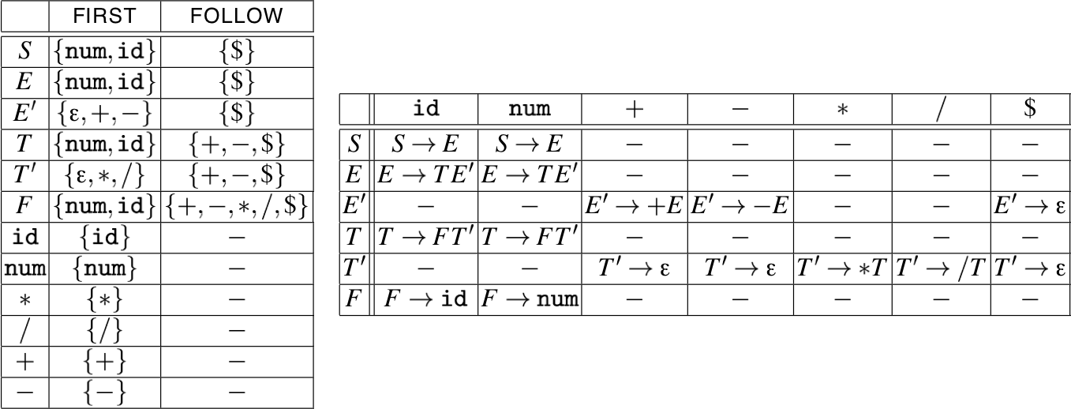
Example
Our long-suffering expression grammar:
S → E
E → TE´
E´ → +E | —E | ε
T → FT´
T´ → * T | / T | ε
F → num | id

Slide 57
A grammar that is not LL(1)
<stmt> ::= if <expr> then <stmt>
| if <expr> then <stmt> else <stmt>
| …
Left-factored:
<stmt> ::= if <expr> then <stmt> <stmt´> | …
<stmt´> ::= else <stmt> | ε
Now, FIRST(<stmt´>) = { ε, else }
Also, FOLLOW(<stmt´>) = { else, $}
But, FIRST(<stmt´>) ∩ FOLLOW(<stmt´>) = { else } ≠ ∅
On seeing else, conflict between choosing
<stmt´> ::= else <stmt> and <stmt´> ::= ε
⇒ grammar is not LL(1)!
Notes:
NB: Fix, as before, is to put priority on <stmt´> ::= else <stmt> to associate else with closest previous then.

Slide 58
Error recovery
Key notion:
For each non-terminal, construct a set of terminals on which the parser can synchronize
When an error occurs looking for A, scan until an element of SYNC(A) is found
Building SYNC(A):
a ∈ FOLLOW(A) ⇒ a ∈ SYNC(A)
place keywords that start statements in SYNC(A)
add symbols in FIRST(A) to SYNC(A)
If we can’t match a terminal on top of stack:
pop the terminal
print a message saying the terminal was inserted
continue the parse
I.e., SYNC(a) = V_{t} – {a}
Notes:
NB: popping the terminal means we matched it – since it wasn’t really there, in effect we have inserted it

Slide 59
What you should know!
What are the key responsibilities of a parser?
How are context-free grammars specified?
What are leftmost and rightmost derivations?
When is a grammar ambiguous? How do you remove ambiguity?
How do top-down and bottom-up parsing differ?
Why are left-recursive grammar rules problematic?
How do you left-factor a grammar?
How can you ensure that your grammar only requires a look-ahead of 1 symbol?

Slide 60
Can you answer these questions?
Why is it important for programming languages to have a context-free syntax?
Which is better, leftmost or rightmost derivations?
Which is better, top-down or bottom-up parsing?
Why is look-ahead of just 1 symbol desirable?
Which is better, recursive descent or table-driven top-down parsing?
Why is LL parsing top-down, but LR parsing is bottom up?

Slide 61
License
http://creativecommons.org/licenses/by-sa/3.0/
Attribution-ShareAlike 3.0 Unported
You are free:
to Share — to copy, distribute and transmit the work
to Remix — to adapt the work
Under the following conditions:
Attribution. You must attribute the work in the manner specified by the author or licensor (but not in any way that suggests that they endorse you or your use of the work).
Share Alike. If you alter, transform, or build upon this work, you may distribute the resulting work only under the same, similar or a compatible license.
For any reuse or distribution, you must make clear to others the license terms of this work. The best way to do this is with a link to this web page.
Any of the above conditions can be waived if you get permission from the copyright holder.
Nothing in this license impairs or restricts the author's moral rights.

