Slide 1
6. Intermediate Representation
Prof. O. Nierstrasz
Thanks to Jens Palsberg and Tony Hosking for their kind permission to reuse and adapt the CS132 and CS502 lecture notes.
http://www.cs.ucla.edu/~palsberg/
http://www.cs.purdue.edu/homes/hosking/
SSA lecture notes by Marcus Denker

Slide 2
Roadmap
Intermediate representations
Static Single Assignment
See, Modern compiler implementation in Java (Second edition), chapters 7-8.

Slide 3
Roadmap
Intermediate representations
Static Single Assignment

Slide 4
Why use intermediate representations?
Software engineering principle
break compiler into manageable pieces
Simplifies retargeting to new host
isolates back end from front end
Simplifies support for multiple languages
different languages can share IR and back end
Enables machine-independent optimization
general techniques, multiple passes
Notes:
NB: dropped old point 2 “allow a complete pass before code is emitted – lets compiler consider more than one option” (too vague)
New point 3 replaces old point 4 “simplifies poly-language/architecture problem” (myth)

Slide 5
IR scheme
front end produces IR
optimizer transforms IR to more efficient program
back end transforms IR to target code

Slide 6
Kinds of IR
Abstract syntax trees (AST)
Linear operator form of tree (e.g., postfix notation)
Directed acyclic graphs (DAG)
Control flow graphs (CFG)
Program dependence graphs (PDG)
Static single assignment form (SSA)
3-address code
Hybrid combinations

Slide 7
Categories of IR
Structural
graphically oriented (trees, DAGs)
nodes and edges tend to be large
heavily used on source-to-source translators
Linear
pseudo-code for abstract machine
large variation in level of abstraction
simple, compact data structures
easier to rearrange
Hybrid
combination of graphs and linear code (e.g. CFGs)
attempt to achieve best of both worlds

Slide 8
Important IR properties
Ease of generation
Ease of manipulation
Cost of manipulation
Level of abstraction
Freedom of expression (!)
Size of typical procedure
Original or derivative
Subtle design decisions in the IR can have far-reaching effects on the speed and effectiveness of the compiler!
➔ Degree of exposed detail can be crucial

Slide 9
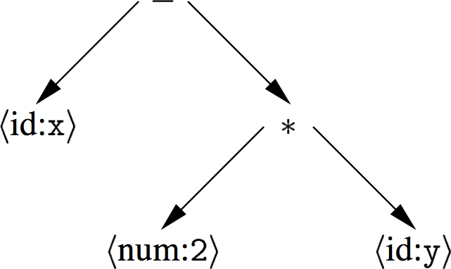
Abstract syntax tree
An AST is a parse tree with nodes for most non-terminals removed.
Since the program is already parsed, non-terminals needed to establish precedence and associativity can be collapsed!
A linear operator form of this tree (postfix) would be:
x 2 y * -

Slide 10
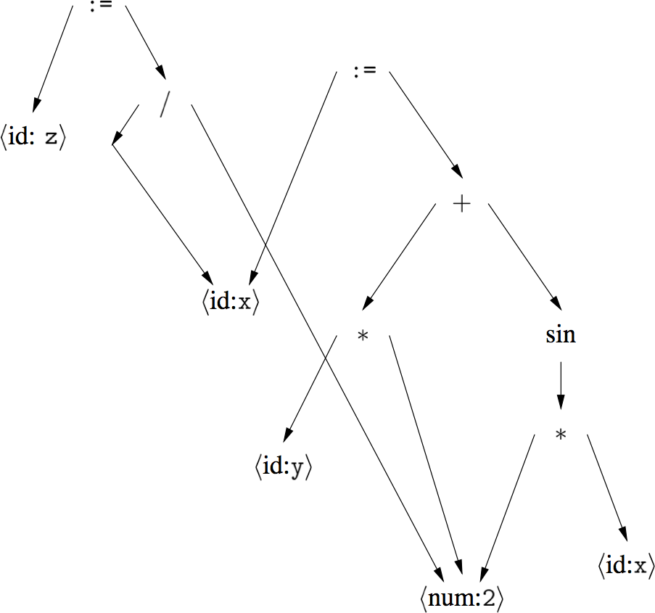
Directed acyclic graph
A DAG is an AST with unique, shared nodes for each value.
x := 2 * y + sin(2*x)
z := x / 2

Slide 11
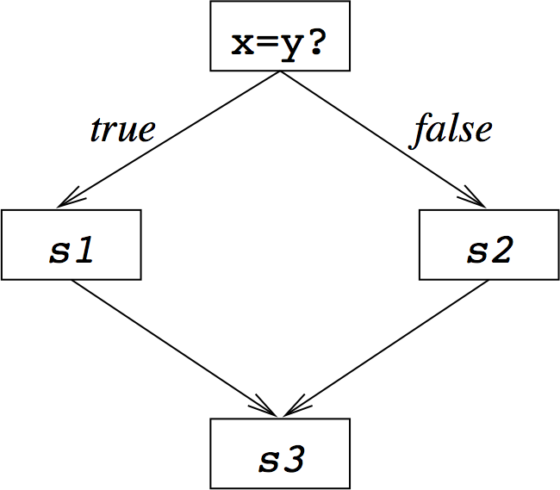
Control flow graph
A CFG models transfer of control in a program
nodes are basic blocks (straight-line blocks of code)
edges represent control flow (loops, if/else, goto …)
if x = y then
S1
else
S2
end
S3

Slide 12
3-address code
Statements take the form: x = y op z
single operator and at most three names
t1 = 2 * y
t2 = x – t1
x – 2 * y
Advantages:
compact form
names for intermediate values

Slide 13
Typical 3-address codes
assignments | x = y op z
 | x = op y
 | x = y[i]
 | x = y
branches | goto L
conditional branches | if x relop y goto L
procedure calls | param x param y call p
address and pointer assignments | x = &y *y = z

Slide 14
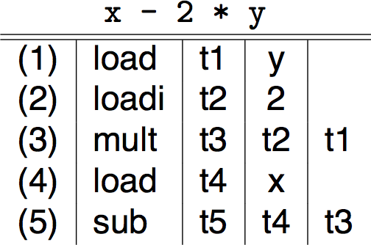
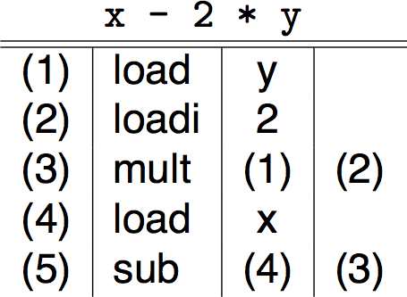
3-address code — two variants
Quadruples
Triples
simple record structure
easy to reorder
explicit names
table index is implicit name
only 3 fields
harder to reorder

Slide 15
IR choices
Other hybrids exist
combinations of graphs and linear codes
CFG with 3-address code for basic blocks
Many variants used in practice
no widespread agreement
compilers may need several different IRs!
Advice:
choose IR with right level of detail
keep manipulation costs in mind

Slide 16
Roadmap
Intermediate representations
Static Single Assignment

Slide 17
Static Single Assignment Form
SSA
Goal: simplify procedure-global optimizations
Definition:
Program is in SSA form if every variable
is only assigned once
© Marcus Denker
17

Slide 18
Static Single Assignment (SSA)
Each assignment to a temporary is given a unique name
All uses reached by that assignment are renamed
Compact representation
Useful for many kinds of compiler optimization …
Ron Cytron, et al., “Efficiently computing static single assignment form and the control dependence graph,” ACM TOPLAS., 1991. doi:10.1145/115372.115320
x := 3;
x := x + 1;
x := 7;
x := x*2;
x₁ := 3;
x₂ := x₁ + 1;
x₃ := 7;
x₄ := x₃*2;
➔
http://en.wikipedia.org/wiki/Static_single_assignment_form

Slide 19
Why Static?
SSA
Why Static?
We only look at the static program
One assignment per variable in the program
At runtime variables are assigned multiple times!
© Marcus Denker
19

Slide 20
Example: Sequence
SSA
Easy to do for sequential programs:
Original
SSA
a := b + c
b := c + 1
d := b + c
a := a + 1
e := a + b
a₁ := b₁ + c₁
b₂ := c₁ + 1
d₁ := b₂ + c₁
a₂ := a₁ + 1
e₁ := a₂ + b₂
© Marcus Denker
20
Notes:
SSA form makes clear that a2 is not the same as a1, so easier for analysis

Slide 21
Example: Condition
SSA
Conditions: what to do on control-flow merge?
Original
SSA
if B then
a := b
else
a := c
end
… a …
if B then
a₁ := b
else
a₂ := c
End
… a? …
© Marcus Denker
21
Notes:
is it a1 or is it a2?

Slide 22
Solution: Φ-Function
SSA
Conditions: what to do on control-flow merge?
Original
SSA
if B then
a := b
else
a := c
end
… a …
if B then
a₁ := b
else
a₂ := c
End
a₃ := Φ(a₁,a₂)
… a₃ …
© Marcus Denker
22
Notes:
is it a1 or is it a2?

Slide 23
The Φ-Function
SSA
Φ-functions are always at the beginning of a basic block
Select between values depending on control-flow
a_{k+1} := Φ(a₁…a_{k}): the block has k preceding blocks
PHI-functions are evaluated simultaneously within a basic block.
© Marcus Denker
23
Notes:
PHI functions evaluated simultaneously within one basic block

Slide 24
SSA and CFG
SSA
SSA is normally used for control-flow graphs (CFG)
Basic blocks are in 3-address form
© Marcus Denker
24

Slide 25
Recall: Control flow graph
SSA
A CFG models transfer of control in a program
nodes are basic blocks (straight-line blocks of code)
edges represent control flow (loops, if/else, goto …)
if x = y then
S1
else
S2
end
S3
© Marcus Denker
25

Slide 26
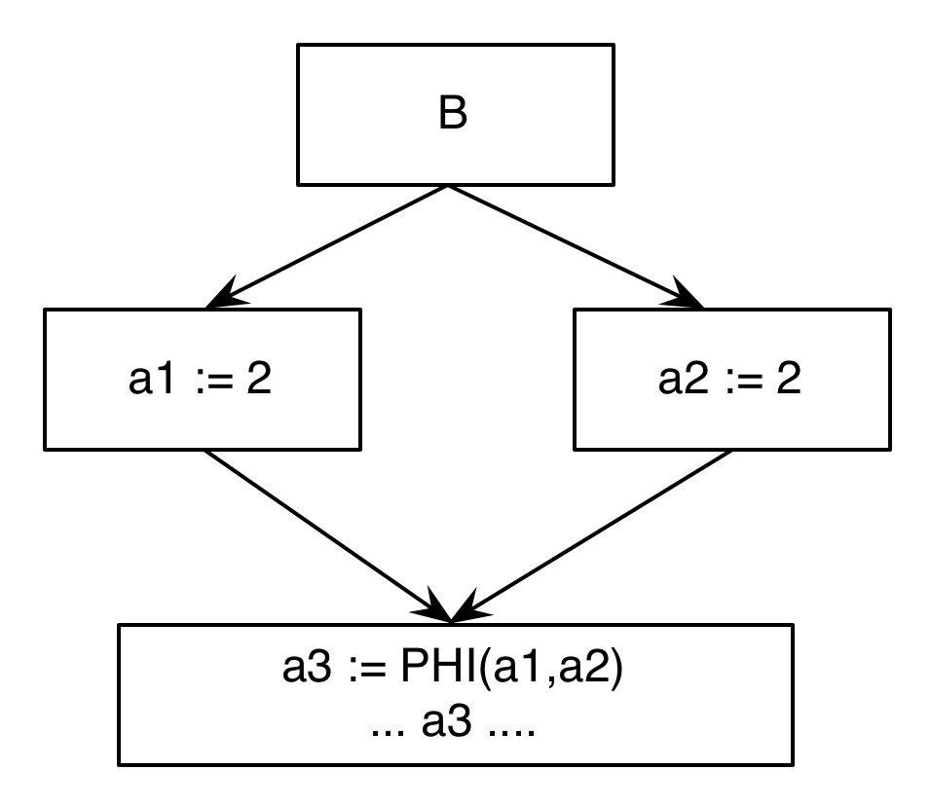
SSA: a Simple Example
SSA
if B then
a1 := 1
else
a2 := 2
End
a3 := PHI(a1,a2)
… a3 …
© Marcus Denker
26

Slide 27
Recall: IR
Intermediate Representation
front end produces IR
optimizer transforms IR to more efficient program
back end transform IR to target code
© Oscar Nierstrasz
27

Slide 28
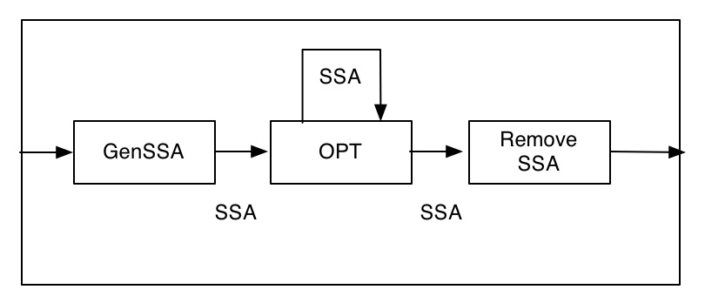
SSA as IR
SSA
© Marcus Denker
28
Notes:
Current trend in compiler community is to use SSA as *the* IR for everything in back end.
(NB: for compilers that generate machine code, not those that generate bytecode.)

Slide 29
Transforming to SSA
SSA
Problem: Performance / Memory
Minimize number of inserted Φ-functions
Do not spend too much time
Many relatively complex algorithms
We do not go too much into detail
See literature!
© Marcus Denker
29

Slide 30
Minimal SSA
SSA
Two steps:
Place Φ-functions
Rename Variables
Where to place Φ-functions?
We want minimal amount of needed Φ
Save memory
Algorithms will work faster
© Marcus Denker
30

Slide 31
Path Convergence Criterion
SSA
There should be a Φ for a at node Z if:
There is a block X containing a definition of a
There is a block Y (Y ≠ X) containing a definition of a
There is a nonempty path P_{xz} of edges from X to Z
There is a nonempty path P_{yz} of edges from Y to Z
Path P_{xz} and P_{yz} do not have any nodes in common other than Z
The node Z does not appear within both P_{xz} and P_{yz} prior to the end (although it may appear in one or the other)
X
Y
Z
© Marcus Denker
31

Slide 32
Iterated Path-Convergence
SSA
Inserted Φ is itself a definition!
While there are nodes X,Y,Z satisfying conditions 1-5
and Z does not contain a phi-function for a
do
insert PHI at node Z.
A bit slow, other algorithms
used in practice
© Marcus Denker
32

Slide 33
Example (Simple)
SSA
1. block X contains a definition of a
2. block Y (Y ≠ X) contains a definition of a.
3. path P_{xz} of edges from X to Z.
4. path P_{yz} of edges from Y to Z.
5. Path P_{xz} and P_{yz} do not have any nodes in common other than Z
6. Node Z does not appear within both P_{xz} and P_{yz} prior to the end
© Marcus Denker
33

Slide 34
Dominance Property of SSA
SSA
Dominance: node D dominates node N if every path from the start node to N goes through D.
(“strictly dominates”: D ≠ N)
Dominance Property of SSA:
If x is used in a Phi-function in block N, then the node defining x dominates every predecessor of N.
If x is used in a non-Phi statement in N, then the node defining x dominates N
“Definition dominates use”
© Marcus Denker
34
Notes:
Dominance is a property of basic blocks. (one Node dominates a set of nodes).
For the dominance property, „definition of x“ thus means the basic block in which x is defined.

Slide 35
Dominance and SSA Creation
SSA
Dominance can be used to efficiently build SSA
Φ-Functions are placed in all basic blocks of the Dominance Frontier
DF(D) = the set of all nodes N such that D dominates an immediate predecessor of N but does not strictly dominate N.
© Marcus Denker
35

Slide 36
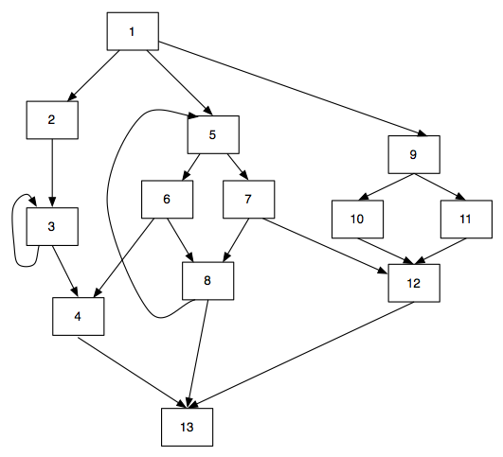
SSA
Dominance and SSA Creation
© Marcus Denker

Slide 37
SSA
Dominance and SSA Creation
Node 5 dominates all nodes in the gray area
© Marcus Denker

Slide 38
SSA
Dominance and SSA Creation
Follow edges leaving the region dominated by node 5 to the region not strictly dominated by 5.
DF(5)= {4, 5, 12, 13}
© Marcus Denker

Slide 39
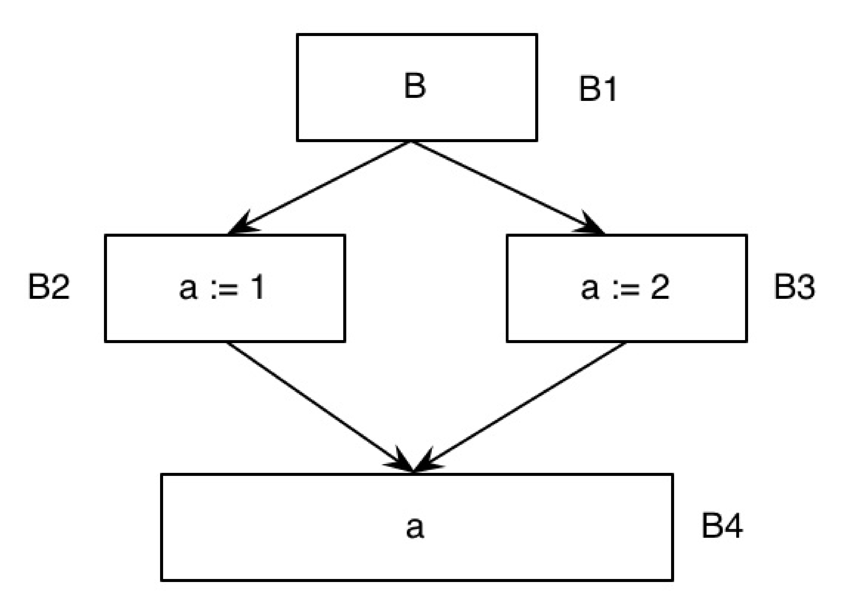
Simple Example
SSA
DF(B1)=
DF(B2)=
DF(B3)=
DF(B4)=
© Marcus Denker

Slide 40
Simple Example
SSA
DF(B1)={?}
DF(B2)=
DF(B3)=
DF(B4)=
© Marcus Denker

Slide 41
Simple Example
SSA
DF(B1)={}
DF(B2)=
DF(B3)=
DF(B4)=
© Marcus Denker

Slide 42
Simple Example
SSA
DF(B1)={}
DF(B2)={?}
DF(B3)=
DF(B4)=
© Marcus Denker

Slide 43
Simple Example
SSA
DF(B1)={}
DF(B2)={B4}
DF(B3)=
DF(B4)=
© Marcus Denker

Slide 44
Simple Example
SSA
DF(B1)={}
DF(B2)={B4}
DF(B3)={B4}
DF(B4)=
© Marcus Denker

Slide 45
Simple Example
SSA
DF(B1)={}
DF(B2)={B4}
DF(B3)={B4}
DF(B4)={}
© Marcus Denker

Slide 46
Simple Example
SSA
DF(B1)={}
DF(B2)={B4}
DF(B3)={B4}
DF(B4)={}
PHI-Function needed in B4 (for a)
© Marcus Denker

Slide 47
Properties of SSA
SSA
Simplifies many optimizations
Every variable has only one definition
Every use knows its definition, every definition knows its uses
Unrelated variables get different names
Examples:
Constant propagation
Value numbering
Invariant code motion and removal
Strength reduction
Partial redundancy elimination
Next Week!
© Marcus Denker
47

Slide 48
SSA in the Real World
SSA
Invented end of the 80s, a lot of research in the 90s
Used in many modern compilers
ETH Oberon 2
LLVM
GNU GCC 4
IBM Jikes Java VM
Java Hotspot VM
Mono
Many more…
© Marcus Denker
48

Slide 49
Transforming out-of SSA
SSA
Processor cannot execute Φ-Function
How do we remove it?
© Marcus Denker
49

Slide 50
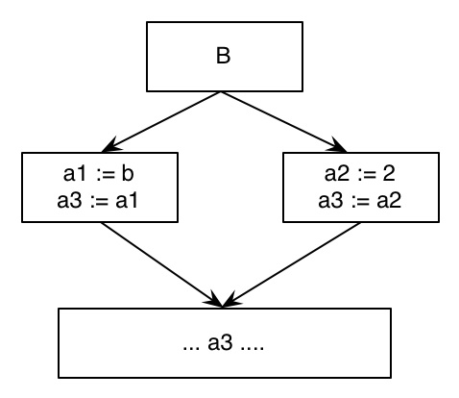
Simple Copy Placement
SSA
© Marcus Denker
50

Slide 51
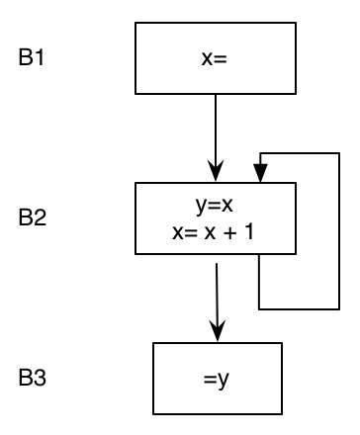
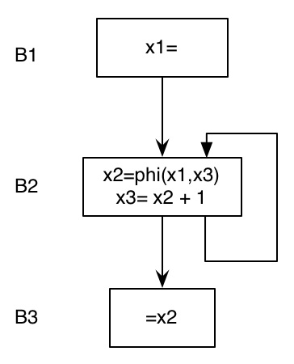
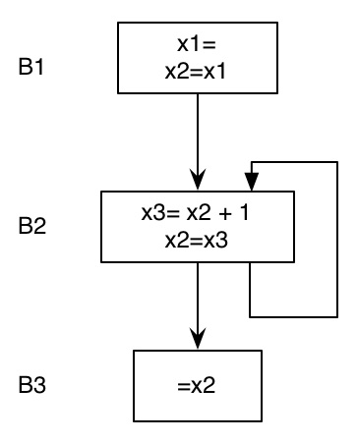
Problems
SSA
Copies need to be removed
Wrong in some cases after reordering of code
Original
SSA with opt
Φ removed
© Marcus Denker
51
Notes:
wrong result in final version

Slide 52
Φ-Congruence
SSA
Idea: transform program so that all variables in Φ are the same:
a1 = Φ(a1, a1)
a1 = a1
Insert Copies
Rename Variables
© Marcus Denker
52

Slide 53
Φ-Congruence: Definitions
SSA
Φ-connected(x):
a3 = Φ(a1, a2)
a5 = Φ(a3, a4)
a1, a4 are connected
Φ-congruence-class:
Transitive closure of Φ-connected(x).
© Marcus Denker
53

Slide 54
Φ-Congruence Property
SSA
Φ-congruence property:
All variables of the same congruence class can be
replaced by one representative variable without
changing the semantics.
SSA without optimizations has Φ-congruence
property
Variables of the congruence class never live
at the same time (by construction)
© Marcus Denker
54

Slide 55
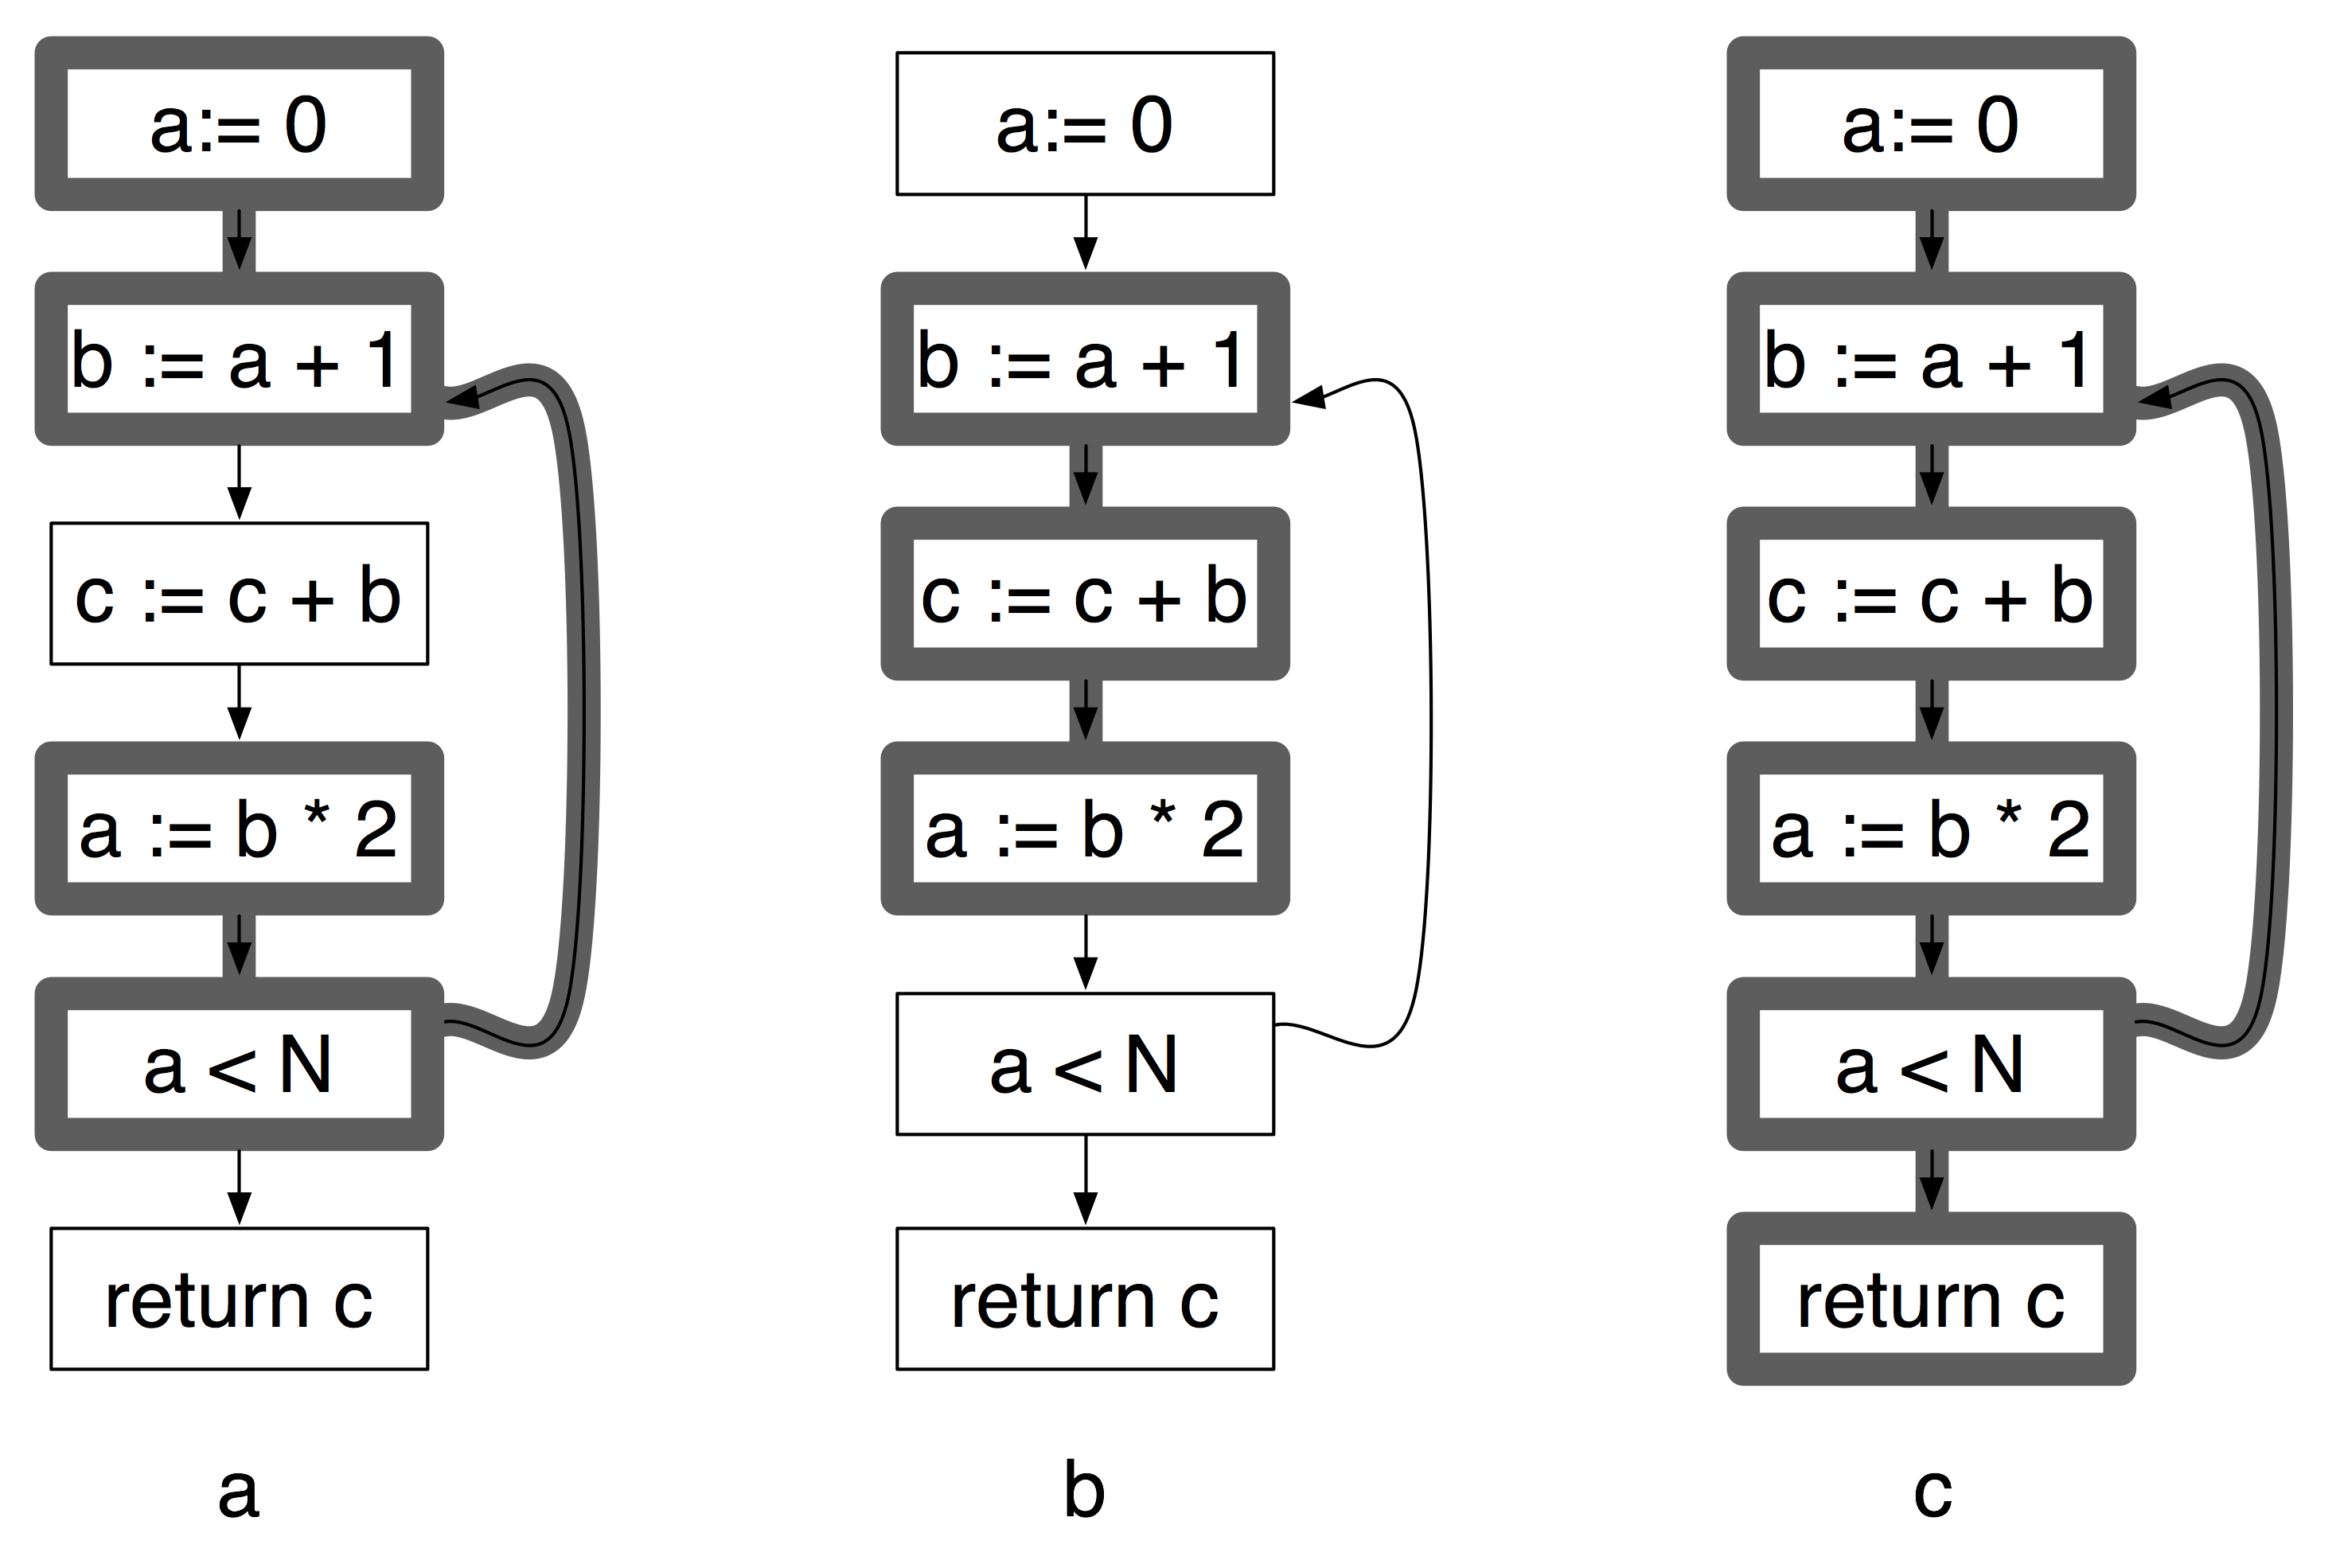
Liveness
Code Generation
A variable v is live on edge e if there is a path from e to a use of v not passing through a definition of v
a and b are never live at the same time, so two registers suffice to hold a, b and c
© Oscar Nierstrasz
55
Notes:
55

Slide 56
Interference
SSA
a, c live at the same time: interference
© Marcus Denker
56
Notes:
56

Slide 57
Φ-Removal: Big picture
CSSA: SSA with Φ-congruence-property.
directly after SSA generation
no interference
TSSA: SSA without Φ-congruence-property.
after optimizations
Interference
Transform TSSA into CSSA (fix interference)
Rename Φ-variables
Delete Φ

Slide 58
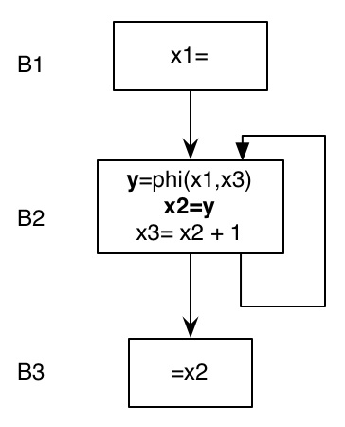
Example: Problematic case
SSA
X2 and X3 interfere
Solution: Break up
© Marcus Denker
58
Notes:
Problem was that the move caused x2 and x3 to interfere.
Places far fewer copies than the copy algorithm shown earlier.

Slide 59
SSA and Register Allocation
SSA
Idea: remove Φ as late as possible
Variables in Φ-function never live at the same time!
Can be stored in the same register
Do register allocation on SSA!
© Marcus Denker
59
Notes:
So, don’t remove PHI functions before register allocation! Keep them till end.
(Many reasons to keep SSA as IR for various phases in the back end.)

Slide 60
SSA: Literature
SSA
Books:
- SSA Chapter in Appel
Modern Compiler Impl. In Java
- Chapter 8.11 Muchnik:
Advanced Compiler Construction
SSA Creation:
Cytron et. al: Efficiently computing Static Single
Assignment Form and the Control Dependency Graph
(TOPLAS, Oct 1991)
PHI-Removal: Sreedhar et at. Translating out of Static Single
Assigment Form (LNCS 1694)
© Marcus Denker
60

Slide 61
Summary
SSA
SSA, what it is and how to create it
Where to place Φ-functions?
Transformation out of SSA
Placing copies
Remove Φ
Next Week: Optimizations
© Marcus Denker
61

Slide 62
What you should know!
Why do most compilers need an intermediate representation for programs?
What are the key tradeoffs between structural and linear IRs?
What is a “basic block”?
What are common strategies for representing case statements?
When a program has SSA form.
What is a Φ-function.
When do we place Φ-functions
How to remove Φ-functions

Slide 63
Can you answer these questions?
Why can’t a parser directly produced high quality executable code?
What criteria should drive your choice of an IR?
What kind of IR does JTB generate?
Why can we not directly generate executable code from SSA?
Why do we use 3-adress code and CFG for SSA?

Slide 64
License
http://creativecommons.org/licenses/by-sa/3.0/
Attribution-ShareAlike 3.0 Unported
You are free:
to Share — to copy, distribute and transmit the work
to Remix — to adapt the work
Under the following conditions:
Attribution. You must attribute the work in the manner specified by the author or licensor (but not in any way that suggests that they endorse you or your use of the work).
Share Alike. If you alter, transform, or build upon this work, you may distribute the resulting work only under the same, similar or a compatible license.
For any reuse or distribution, you must make clear to others the license terms of this work. The best way to do this is with a link to this web page.
Any of the above conditions can be waived if you get permission from the copyright holder.
Nothing in this license impairs or restricts the author's moral rights.

