Slide 1
9. Bytecode and Virtual Machines
Original material prepared by Adrian Lienhard and Marcus Denker

Slide 2

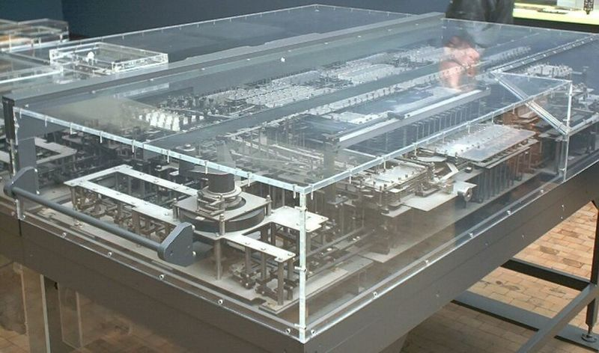
Birds-eye view
A virtual machine is an abstract computing architecture supporting a programming language in a hardware-independent fashion
Z1, 1938

Slide 3

Roadmap
Introduction
Bytecode
The heap store
Interpreter
Automatic memory management
Threading System
Optimizations

Slide 4
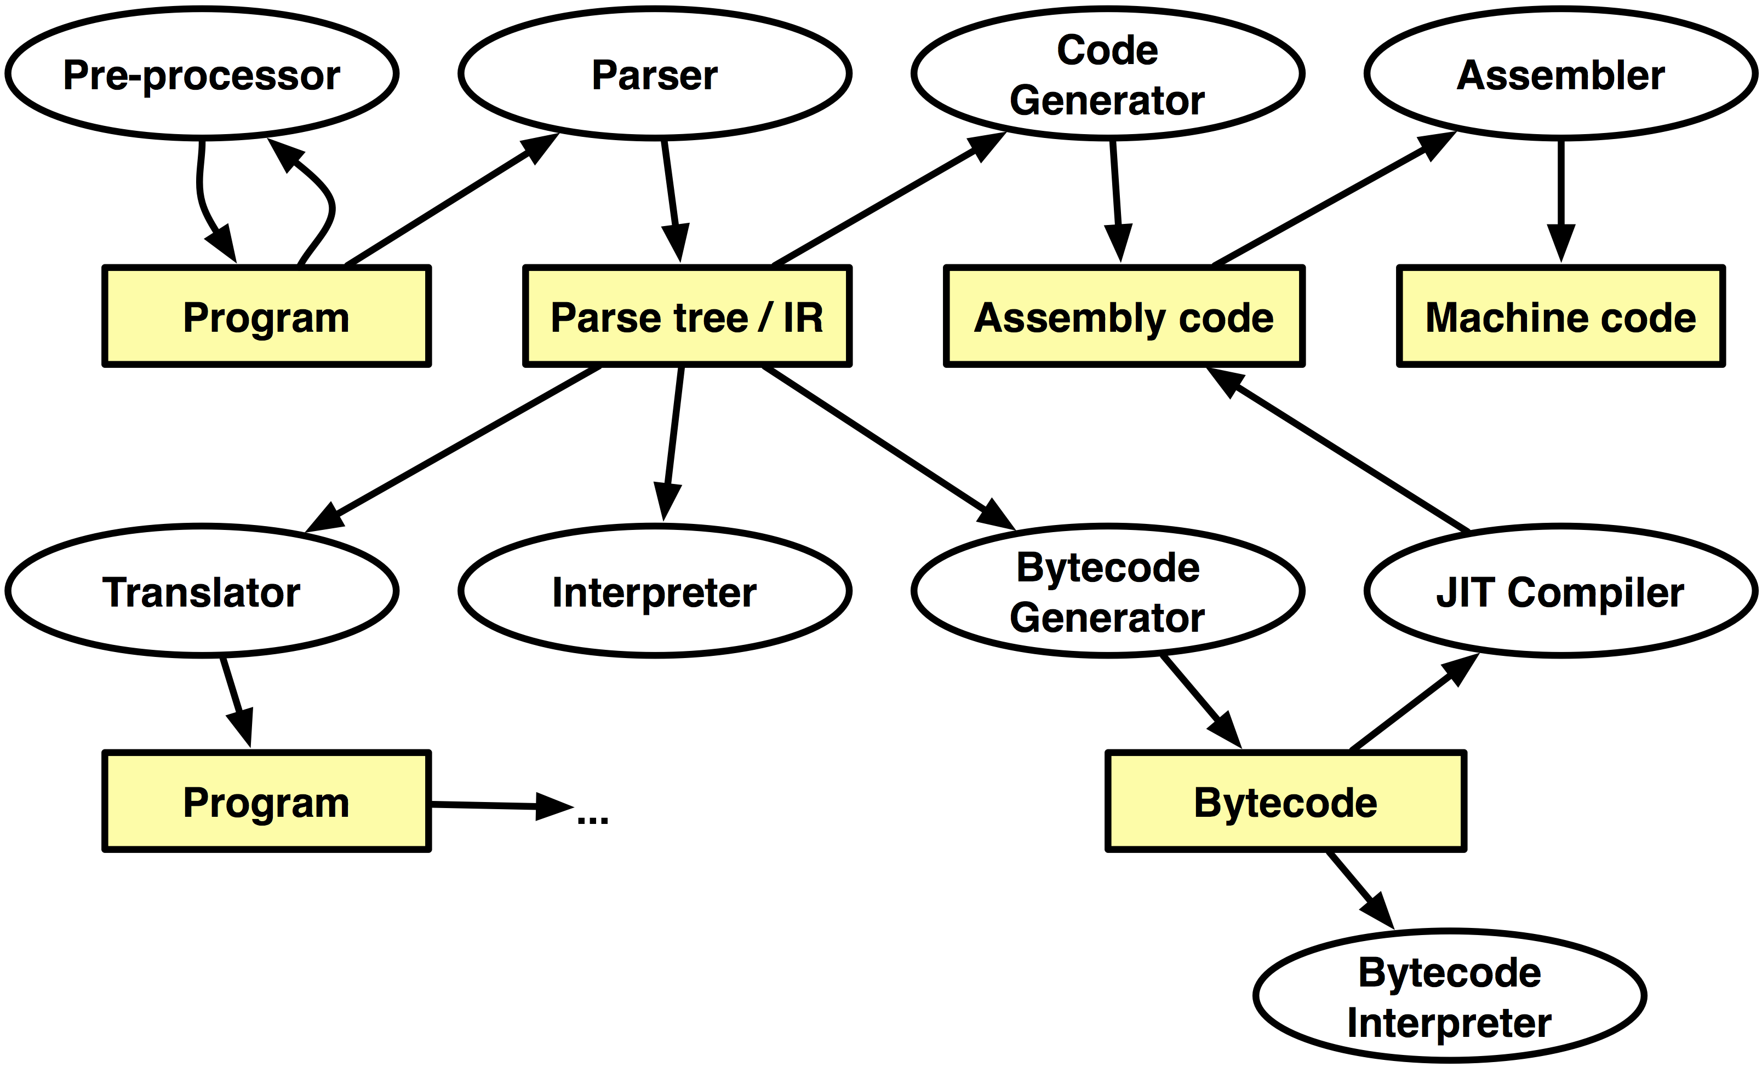
Implementing a Programming Language

Slide 5
How are VMs implemented?
Typically using an efficient and portable language
such as C, C++, or assembly code
Pharo VM platform-independent part written in Slang:
– subset of Smalltalk, translated to C
– core: 600 methods or 8k LOC in Slang
– Slang allows one to simulate VM in Smalltalk

Slide 6
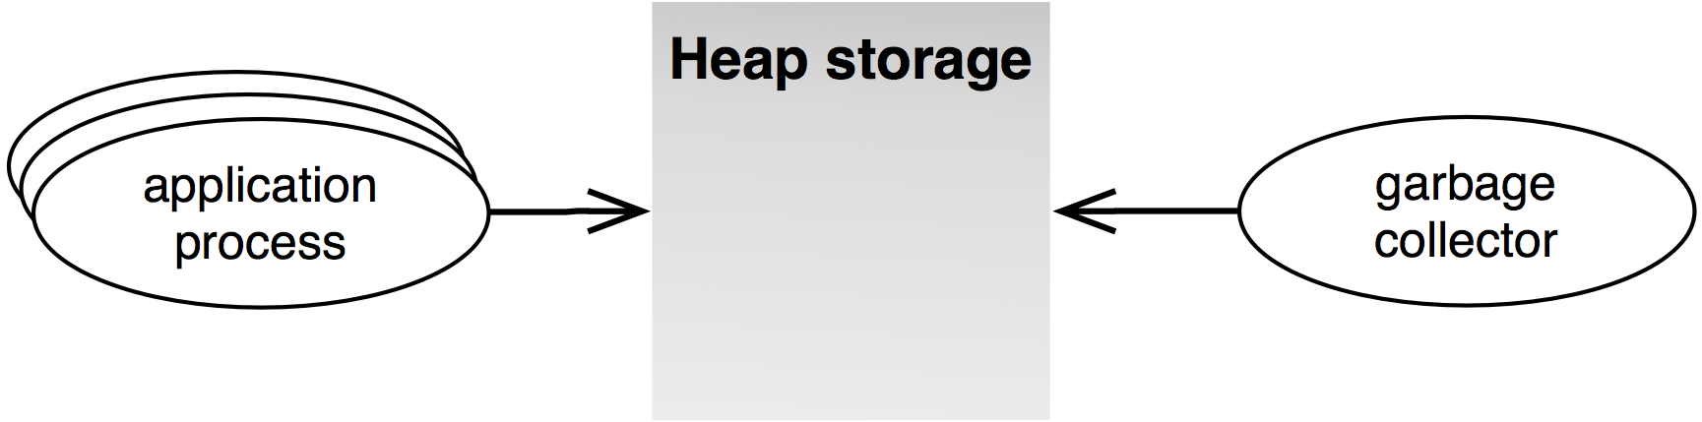
Main Components of a VM
The heap store
Interpreter
Automatic memory management
Threading System

Slide 7
Pros and Cons of the VM Approach
Pros
Platform independence of application code
“Write once, run anywhere”
Simpler programming model
Security
Optimizations for different hardware architectures
Cons
Execution overhead
Not suitable for system programming

Slide 8
Roadmap
Introduction
Bytecode
The heap store
Interpreter
Automatic memory management
Threading System
Optimizations

Slide 9
Reasons for working with Bytecode
Generating Bytecode
  Implementing compilers for other languages
  Experimentation with new language features
Parsing and Interpretation:
  Analysis (e.g., self and super sends)
  Decompilation (for systems without source)
  Printing of bytecode
  Interpretation: Debugger, Profiler

Slide 10
The Pharo Virtual Machine
Virtual machine provides a virtual processor
  Bytecode: The “machine-code” of the virtual machine
Smalltalk (like Java): Stack machine
  easy to implement interpreters for different processors
  most hardware processors are register machines
Pharo VM: Implemented in Slang
  Slang: Subset of Smalltalk. (“C with Smalltalk Syntax”)
  Translated to C

Slide 11
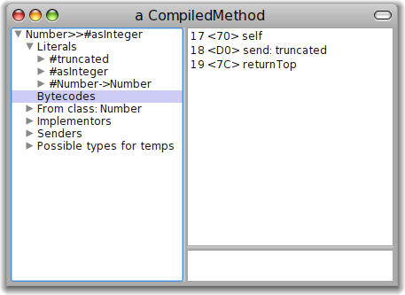
Bytecode in the CompiledMethod
CompiledMethod format:
Header
Literals
Bytecode
Trailer
Number of
temps, literals...
Array of all
Literal Objects
Pointer to
Source
(Number>>#asInteger) inspect
(Number methodDict at: #asInteger) inspect

Slide 12
Bytecodes: Single or multibyte
Different forms of bytecodes:
  Single bytecodes:
    Example: 112: push self
  Groups of similar bytecodes
    16: push temp 1
    17: push temp 2
    up to 31
  Multibyte bytecodes
    Problem: 4 bit offset may be too small
    Solution: Use the following byte as offset
    Example: Jumps need to encode large jump offsets
Type | Offset
4 bits | 4 bits

Slide 13
Example: Number>>asInteger
Smalltalk code:
Symbolic Bytecode
Number>>asInteger
"Answer an Integer nearest
the receiver toward zero."
^self truncated
17 <70> self
18 <D0> send: truncated
19 <7C> returnTop

Slide 14
Example: Step by Step
17 <70> self
  The receiver (self) is pushed on the stack
18 <D0> send: truncated
  Bytecode 208: send literal selector 1
  Get the selector from the first literal
  start message lookup in the class of the object that is on top of the stack
  result is pushed on the stack
19 <7C> returnTop
  return the object on top of the stack to the calling method

Slide 15
Pharo Bytecode
256 Bytecodes, four groups:
  Stack Bytecodes
    Stack manipulation: push / pop / dup
  Send Bytecodes
    Invoke Methods
  Return Bytecodes
    Return to caller
  Jump Bytecodes
    Control flow inside a method

Slide 16
Stack Bytecodes
Push values on the stack
  e.g., temps, instVars, literals
  e.g: 16 - 31: push instance variable
Push Constants
  False/True/Nil/1/0/2/-1
Push self, thisContext
Duplicate top of stack
Pop

Slide 17
Sends and Returns
Sends: receiver is on top of stack
  Normal send
  Super Sends
  Hard-coded sends for efficiency, e.g. +, -
Returns
  Return top of stack to the sender
  Return from a block
  Special bytecodes for return self, nil, true, false (for efficiency)

Slide 18
Jump Bytecodes
Control Flow inside one method
  Used to implement control-flow efficiently
  Example:
^ 1<2 ifTrue: ['true']
17 <76> pushConstant: 1
18 <77> pushConstant: 2
19 <B2> send: <
20 <99> jumpFalse: 23
21 <20> pushConstant: 'true'
22 <90> jumpTo: 24
23 <73> pushConstant: nil
24 <7C> returnTop

Slide 19
Roadmap
Introduction
Bytecode
The heap store
Interpreter
Automatic memory management
Threading System
Optimizations

Slide 20
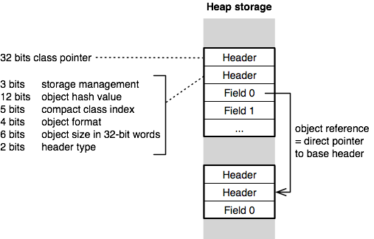
Object Memory Layout
32-bit direct-pointer scheme
Reality is more complex:
– 1-word header for instances of compact classes
– 2-word header for normal objects
– 3-word header for large objects

Slide 21
Different Object Formats
fixed pointer fields
indexable types:
– indexable pointer fields (e.g., Array)
– indexable weak pointer fields (e.g., WeakArray)
– indexable word fields (e.g., Bitmap)
– indexable byte fields (e.g., ByteString)
Object format (4bit)
0 no fields
1 fixed fields only
2 indexable pointer fields only
3 both fixed and indexable pointer fields
4 both fixed and indexable weak fields
6 indexable word fields only
8-11 indexable byte fields only
12-15 ...

Slide 22
Iterating Over All Objects in Memory
“Answer the first object on the heap”
anObject someObject
“Answer the next object on the heap”
anObject nextObject
Excludes small integers!
SystemNavigation>>allObjectsDo: aBlock
| object endMarker |
object := self someObject.
endMarker := Object new.
[endMarker == object]
whileFalse: [aBlock value: object.
object := object nextObject]
|count|
count := 0.
SystemNavigation default allObjectsDo:
[:anObject | count := count + 1].
Count
529468
Notes:
|count|
count := 0.
SystemNavigation default allObjectsDo: [:anObject | count := count + 1].
count
-> 529468

Slide 23
Roadmap
Introduction
Bytecode
The heap store
Interpreter
Automatic memory management
Threading System
Optimizations

Slide 24
Stack vs. Register VMs
VM provides a virtual processor that interprets bytecode instructions
Stack machines
Smalltalk, Java and most other VMs
Simple to implement for different hardware architectures
Very compact code
Register machines
Potentially faster than stack machines
Only few register VMs, e.g., Parrot VM (Perl6)
Notes:
Register machine has “unbounded” registers.

Slide 25
Interpreter State and Loop
Interpreter state
– instruction pointer (ip): points to current bytecode
– stack pointer (sp): topmost item in the operand stack
– current active method or block context
– current active receiver and method
Interpreter loop
1. branch to appropriate bytecode routine
2. fetch next bytecode
3. increment instruction pointer
4. execute the bytecode routine
5. return to 1.

Slide 26
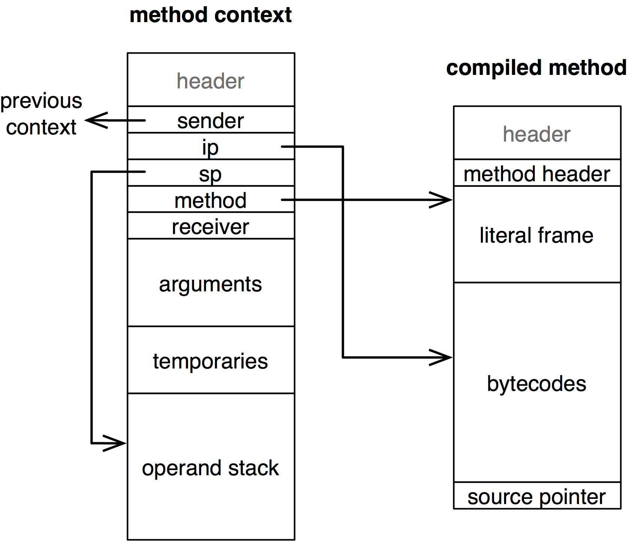
Method Contexts
method header:
– primitive index
– number of args
– number of temps
– large context flag
– number of literals

Slide 27
Stack Manipulating Bytecode Routine
Example: bytecode <70> self
Interpreter>>pushReceiverBytecode
self fetchNextBytecode.
self push: receiver
Interpreter>>push: anObject
sp := sp + BytesPerWord.
self longAt: sp put: anObject

Slide 28
Stack Manipulating Bytecode Routine
Example: bytecode <01> pushRcvr: 1
Interpreter>>pushReceiverVariableBytecode
self fetchNextBytecode.
self pushReceiverVariable: (currentBytecode bitAnd: 16rF)
Interpreter>>pushReceiverVariable: fieldIndex
self push: (
self fetchPointer: fieldIndex ofObject: receiver)
Interpreter>>fetchPointer: fieldIndex ofObject: oop
^ self longAt: oop + BaseHeaderSize + (fieldIndex * BytesPerWord)
Notes:
Blue book p 598

Slide 29
Message Sending Bytecode Routine
1. find selector, receiver and its class
2. lookup message in the method dictionary of the class
3. if method not found, repeat this lookup in successive superclasses; if superclass is nil, instead send #doesNotUnderstand:
4. create a new method context and set it up
5. activate the context and start executing the instructions in the new method
Example: bytecode <E0> send: hello
Notes:
Blue book p 604

Slide 30
Message Sending Bytecode Routine
Example: bytecode <E0> send: hello
Interpreter>>sendLiteralSelectorBytecode
selector := self literal: (currentBytcode bitAnd: 16rF).
argumentCount := ((currentBytecode >> 4) bitAnd: 3) - 1.
rcvr := self stackValue: argumentCount.
class := self fetchClassOf: rcvr.
self findNewMethod.
self executeNewMethod.
self fetchNewBytecode
E0(hex) = 224(dec)
= 1110 0000(bin)
E0 AND F = 0
=> literal frame at 0
((E0 >> 4) AND 3) - 1 = 1
=> 1 argument
This routine (bytecodes 208-255) can use any of the first 16 literals and pass up to 2 arguments

Slide 31
Primitives
Primitive methods trigger a VM routine
and are executed without a new
method context unless they fail
Improve performance (arithmetics, at:, at:put:, ...)
Do work that can only be done in VM (new object creation,
process manipulation, become, ...)
Interface with outside world (keyboard input, networking, ...)
Interact with VM plugins (named primitives)
ProtoObject>>nextObject
<primitive: 139>
self primitiveFailed

Slide 32
Roadmap
Introduction
Bytecode
The heap store
Interpreter
Automatic memory management
Threading System
Optimizations

Slide 33
Automatic Memory Management
Tell when an object is no longer used and then recycle the memory
Challenges
– Fast allocation
– Fast program execution
– Small predictable pauses
– Scalable to large heaps
– Minimal space usage

Slide 34
Main Approaches
1. Reference Counting
2. Mark and Sweep

Slide 35
Reference Counting GC
Idea
For each store operation increment count field in header of newly stored object
Decrement if object is overwritten
If count is 0, collect object and decrement the counter of each object it pointed to
Problems
Run-time overhead of counting (particularly on stack)
Inability to detect cycles (need additional GC technique)

Slide 36
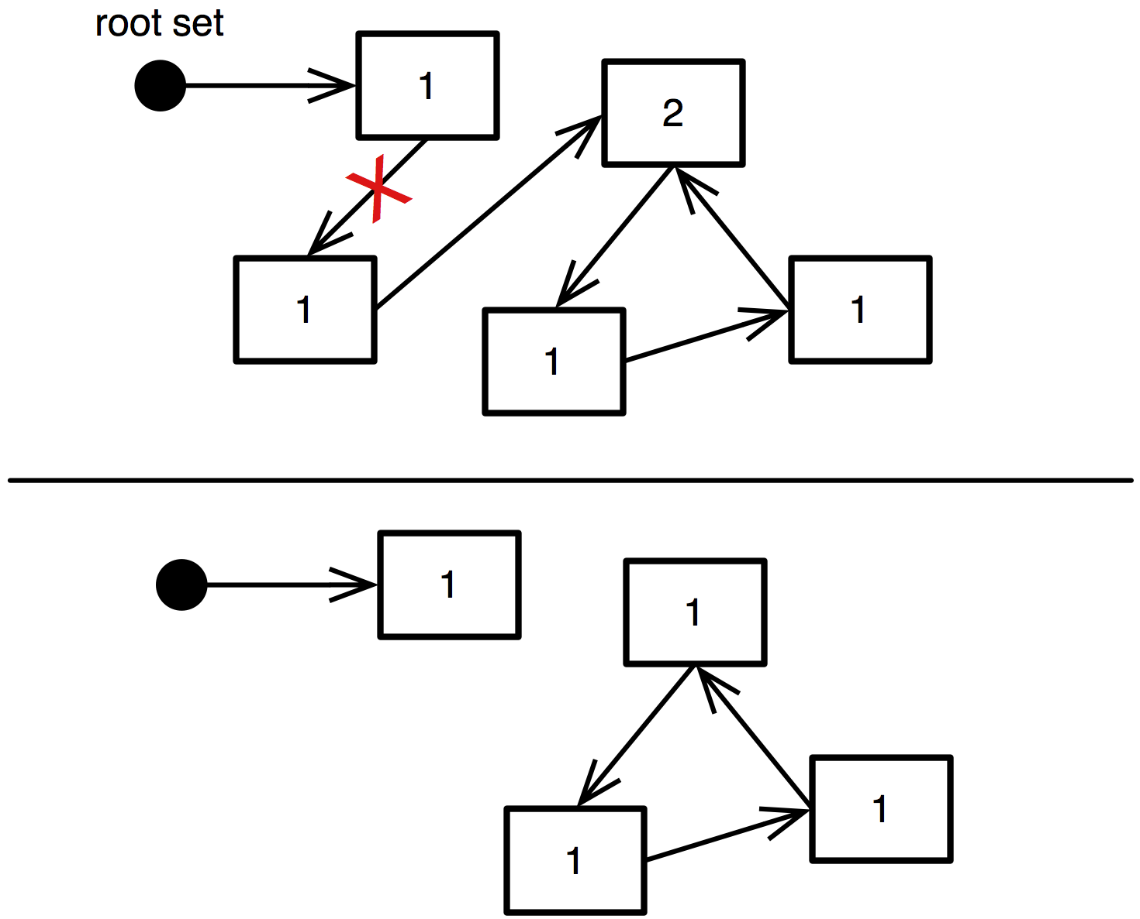
Reference Counting GC

Slide 37
Mark and Sweep GC
Idea
Suspend current process
Mark phase: trace each accessible object leaving a mark in the object header (start at known root objects)
Sweep phase: all objects with no mark are collected
Remove all marks and resume current process
Problems
Need to “stop the world”
Slow for large heaps ➔generational collectors
Fragmentation ➔compacting collectors

Slide 38
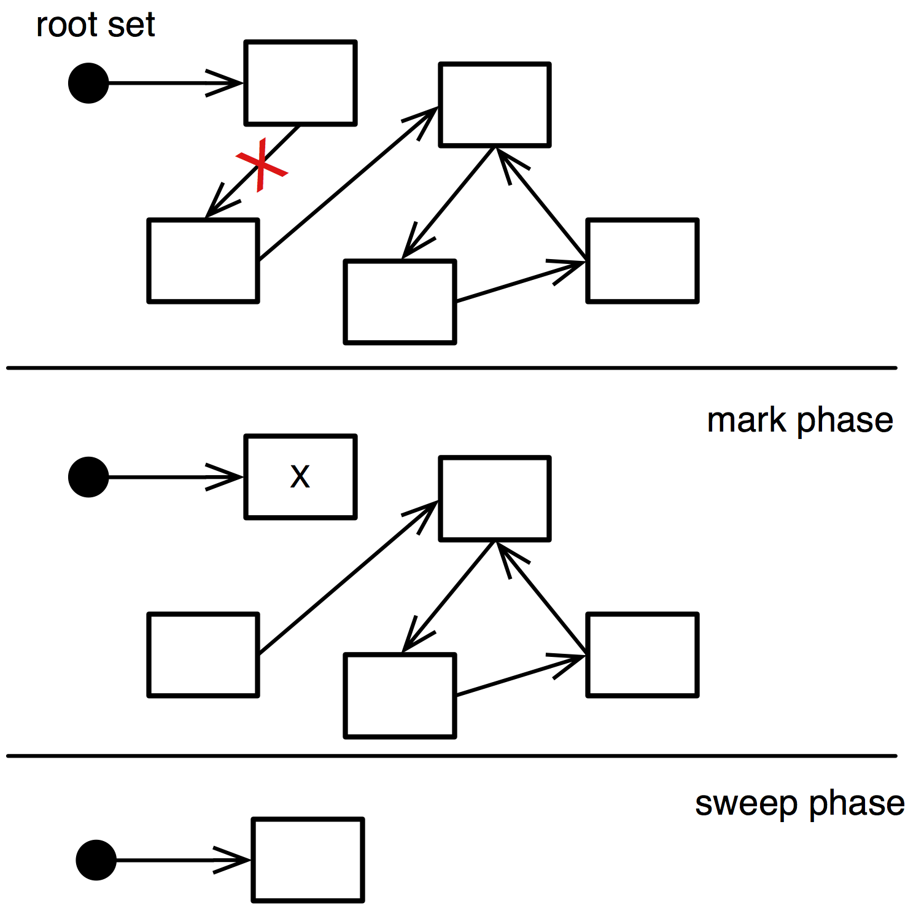
Mark and Sweep GC

Slide 39
Generational Collectors
Most new objects live very short lives; most older objects live forever [Ungar 87]
Idea
Partition objects into generations
Create objects in young generation
Tenuring: move live objects from young to old generation
Incremental GC: frequently collect young generation (very fast)
Full GC: infrequently collect young+old generation (slow)
Difficulty
Need to track pointers from old to new space

Slide 40
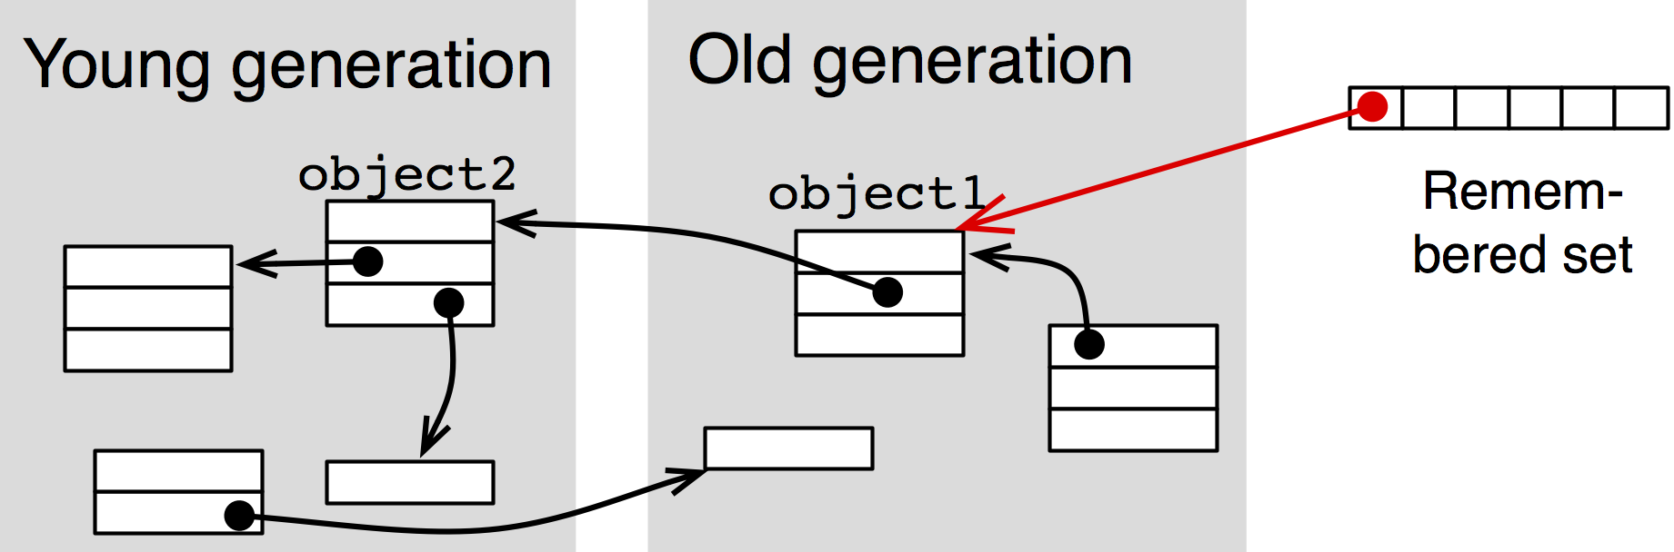
Generational Collectors: Remembered Set
Write barrier: remember objects with old-young pointers:
On each store check whether
stored object (object2) is young and
storer (object1) is old
If true, add storer to remembered set
When marking young generation, use objects in remembered set as additional roots
object1.f := object2

Slide 41
Compacting Collectors
Idea
During the sweep phase all live objects are packed to the beginning of the heap
Simplifies allocation since free space is in one contiguous block
Challenge
Adjust all pointers of moved objects
  – object references on the heap
  – pointer variables of the interpreter!

Slide 42
The Pharo GC
Pharo: mark and sweep compacting collector with two generations
Cooperative, i.e., not concurrent
Single threaded

Slide 43
When Does the GC Run?
– Incremental GC on allocation count or memory needs
– Full GC on memory needs
– Tenure objects if survivor threshold exceeded
“Incremental GC after this many allocations”
SmalltalkImage current vmParameterAt: 5
“Tenure when more than this many objects survive”
SmalltalkImage current vmParameterAt: 6
4000
2000

Slide 44
VM Memory Statistics
SmalltalkImage current vmStatisticsReportString
memory 20,245,028 bytes
old 14,784,388 bytes (73.0%)
young 117,724 bytes (0.6%)
used 14,902,112 bytes (73.6%)
free 5,342,916 bytes (26.4%)
GCs 975 (48ms between GCs)
full 0 totalling 0ms (0.0% uptime)
incr 975 totalling 267ms (1.0% uptime), avg 0.0ms
tenures 14 (avg 69 GCs/tenure)
Since last view 90 (54ms between GCs)
uptime 4.8s
full 0 totalling 0ms (0.0% uptime)
incr 90 totalling 29ms (1.0% uptime), avg 0.0ms
tenures 1 (avg 90 GCs/tenure)

Slide 45
Memory System API
“Force GC”
Smalltalk garbageCollectMost
Smalltalk garbageCollect
“Is object in remembered set, is it young?”
Smalltalk rootTable includes: anObject
Smalltalk isYoung: anObject
“Various settings and statistics”
SmalltalkImage current getVMParameters
”Do an incremental GC after this many allocations”
SmalltalkImage current vmParameterAt: 5 put: 4000.
”Tenure when more than this many objects survive the GC”
SmalltalkImage current vmParameterAt: 6 put: 2000.
”Grow/shrink headroom”
SmalltalkImage current vmParameterAt: 25 put: 4*1024*1024.
SmalltalkImage current vmParameterAt: 24 put: 8*1024*1024.

Slide 46
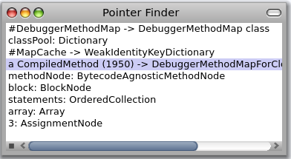
Finding Memory Leaks
I have objects that do not get collected. What’s wrong?
– maybe object is just not GCed yet (force a full GC!)
– find the objects and then explore who references them
PointerFinder finds a path from a root to some object
PointerFinder on:
AssignmentNode someInstance
PointerExplorer new openExplorerFor: AssignmentNode someInstance

Slide 47
Roadmap
Introduction
Bytecode
The heap store
Interpreter
Automatic memory management
Threading System
Optimizations

Slide 48
Threading System
Multithreading is the ability to create concurrently
running “processes”
Non-native threads (green threads)
  – Only one native thread used by the VM
  – Simpler to implement and easier to port
Native threads
  – Using the native thread system provided by the OS
  – Potentially higher performance

Slide 49
Pharo: Green Threads
Each process has its own execution stack, ip, sp, ...
There is always one (and only one) running process
Each process behaves as if it owns the entire VM
Each process can be interrupted (➔context switching)

Slide 50
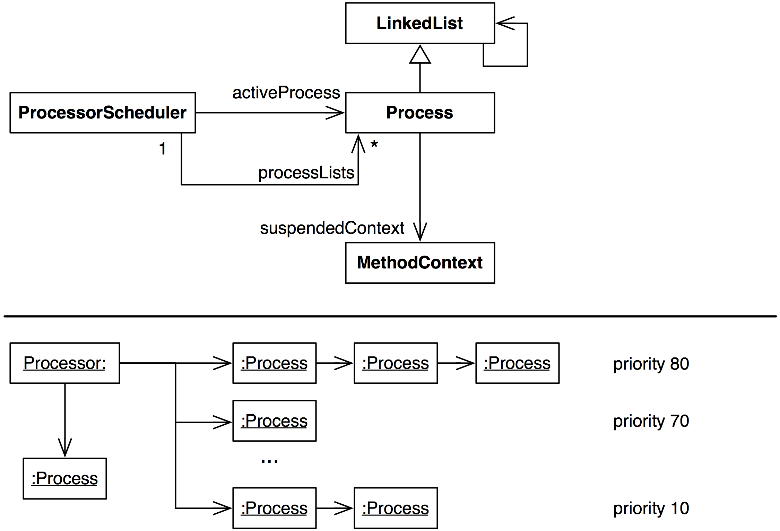
Representing Processes and Run Queues

Slide 51
Context Switching
Interpreter>>transferTo: newProcess
store the current ip and sp registers to the current context
store the current context in the old process’ suspendedContext
change Processor to point to newProcess
load ip and sp registers from new process’ suspendedContext
When you perform a context switch, which process should run next?

Slide 52
Process Scheduler
Cooperative between processes of the same priority
Preemptive between processes of different priorities
Context is switched to the first process with highest priority when:
– current process waits on a semaphore
– current process is suspended or terminated
– Processor yield is sent
Context is switched if the following process has a higher priority:
– process is resumed or created by another process
– process is resumed from a signaled semaphore
When a process is interrupted, it moves to the back of its run queue

Slide 53
Example: Semaphores and Scheduling
here := false.
lock := Semaphore forMutualExclusion.
[lock critical: [here := true]] fork.
lock critical: [
self assert: here not.
Processor yield.
self assert: here not].
Processor yield.
self assert: here
When is the forked process activated?

Slide 54
Roadmap
Introduction
Bytecode
The heap store
Interpreter
Automatic memory management
Threading System
Optimizations

Slide 55
Many Optimizations...
Method cache for faster lookup: receiver's class + method selector
Method context cache (as much as 80% of objects created are context objects!)
Interpreter loop: 256 way case statement to dispatch bytecodes
Quick returns: methods that simply return a variable or known constant are compiled as a primitive method
Small integers are tagged pointers: value is directly encoded in field references. Pointer is tagged with low-order bit equal to 1. The remaining 31 bit encode the signed integer value.
...

Slide 56
Optimization: JIT (not in Pharo)
Idea: Just In Time Compilation
Translate unit (method, loop, ...) into native machine code at runtime
Store native code in a buffer on the heap
Challenges
Run-time overhead of compilation
Machine code takes a lot of space (4-8x compared to bytecode)
Deoptimization (for debugging) is very tricky
Adaptive compilation: gather statistics to compile only units that
are heavily used (hot spots)

Slide 57
References
Virtual Machines, Iain D. Craig, Springer, 2006
Back to the Future – The Story of Squeak, A Practical Smalltalk Written in Itself, Ingalls et al, OOPSLA ’97
Smalltalk-80, the Language and Its Implementation (AKA “the Blue Book”), Goldberg, Robson, Addison-Wesley, ’83
  http://stephane.ducasse.free.fr/FreeBooks/BlueBook/Bluebook.pdf
The Java Virtual Machine Specification, Second Edition
  http://java.sun.com/docs/books/jvms/
Stacking them up: a Comparison of Virtual Machines, Gough, IEEE’01
Virtual Machine Showdown: Stack Versus Registers, Shi, Gregg, Beatty, Ertl, VEE’05

Slide 58
What you should know!
What is the difference between the operand stack and the execution stack?
How do bytecode routines and primitives differ?
Why is the object format encoded in a complicated 4bit pattern instead of using regular boolean values?
Why is the object address not suitable as a hash value?
What happens if an object is only weakly referenced?
Why is it hard to build a concurrent mark sweep GC?
What does cooperative multithreading mean?
How do you protect code from concurrent execution?

Slide 59
Can you answer these questions?
There is a lot of similarity between VM and OS design. What are the common components?
Why is accessing the 16th instance variable of an object more efficient than the 17th?
Which disastrous situation could occur if a local C pointer variable exists when a new object is allocated?
Why does #allObjectsDo: not include small integers?
What is the largest possible small integer?

Slide 60

License
http://creativecommons.org/licenses/by-sa/3.0/
Attribution-ShareAlike 3.0 Unported
You are free:
  to Share — to copy, distribute and transmit the work
  to Remix — to adapt the work
Under the following conditions:
  Attribution. You must attribute the work in the manner specified by the author or licensor (but not in any way that suggests that they endorse you or your use of the work).
  Share Alike. If you alter, transform, or build upon this work, you may distribute the resulting work only under the same, similar or a compatible license.
For any reuse or distribution, you must make clear to others the license terms of this work. The best way to do this is with a link to this web page.
Any of the above conditions can be waived if you get permission from the copyright holder.
Nothing in this license impairs or restricts the author's moral rights.

