Slide 1
12. Program Transformation
Prof. O. Nierstrasz

Slide 2
Roadmap
Program Transformation
Refactoring
Aspect-Oriented Programming
Outlook

Slide 3
Links
Program Transformation:
http://swerl.tudelft.nl/bin/view/Pt
http://www.program-transformation.org/
Stratego:
http://strategoxt.org/
TXL:
http://www.txl.ca/
Refactoring:
http://www.ibm.com/developerworks/library/os-ecref/
http://recoder.sourceforge.net/wiki/
http://www.refactory.com/RefactoringBrowser/
AOP:
http://www.eclipse.org/aspectj/

Slide 4
Roadmap
Program Transformation
Introduction
Stratego/XT
TXL
Refactoring
Aspect-Oriented Programming
Outlook
Thanks to Eelco Visser and Martin Bravenboer for their kind permission to reuse and adapt selected material from their Program Transformation course.
http://swerl.tudelft.nl/bin/view/Pt

Slide 5
What is “program transformation”?
Program Transformation is the process of transforming one program to another.
Near synonyms:
Metaprogramming
Generative programming
Program synthesis
Program refinement
Program calculation

Slide 6
Applications of program transformation
Translation
Migration
Synthesis
Refinement
Compilation
Reverse Engineering
Decompilation
Architecture Extraction
Visualization
Program Analysis
Control flow
Data flow
Rephrasing
Normalization
Simplification
Desugaring
Aspect Weaving
Optimization
Specialization
Inlining
Refactoring
Improvement
Obfuscation
Reengineering
Notes:
Refinement — transform high-level spec down to an implementation that fulfils requirements
Renovation — reengineering

Slide 7
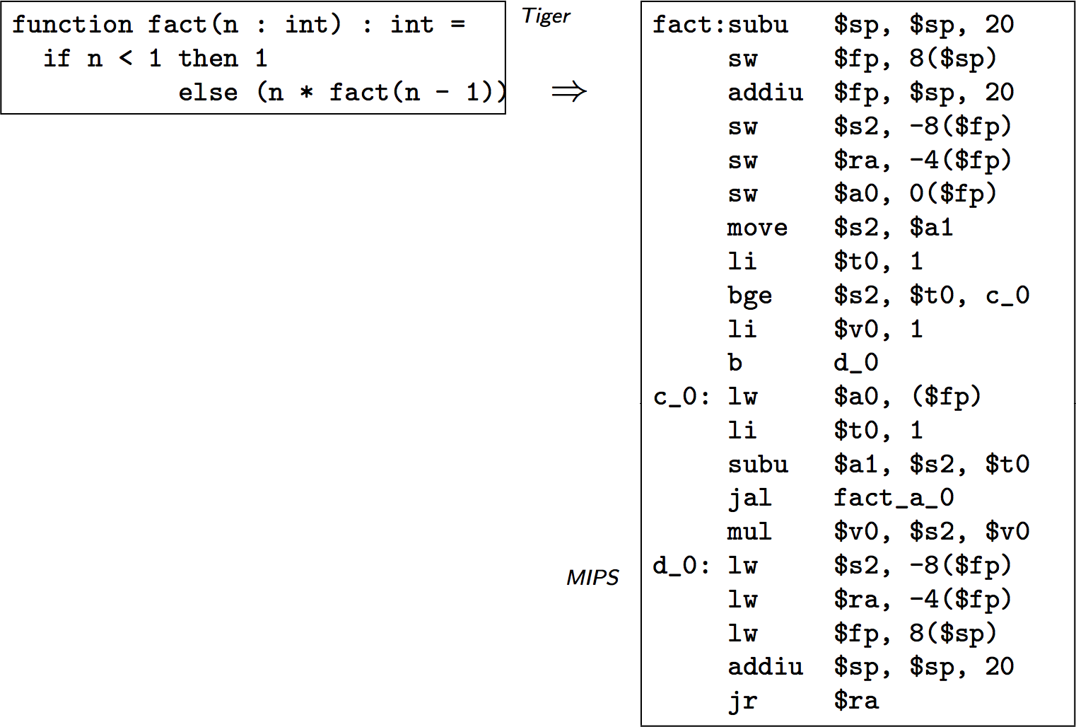
Translation — compilation
http://www.cs.uu.nl/docs/vakken/pt/slides/PT05-ProgramTransformation.pdf

Slide 8
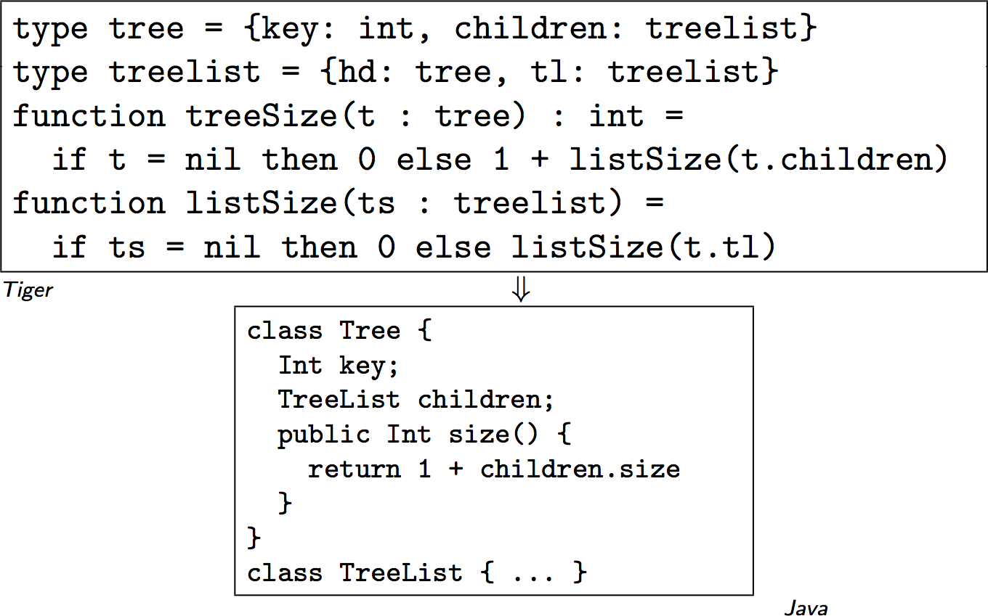
Translation — migration from procedural to OO
http://www.cs.uu.nl/docs/vakken/pt/slides/PT05-ProgramTransformation.pdf

Slide 9
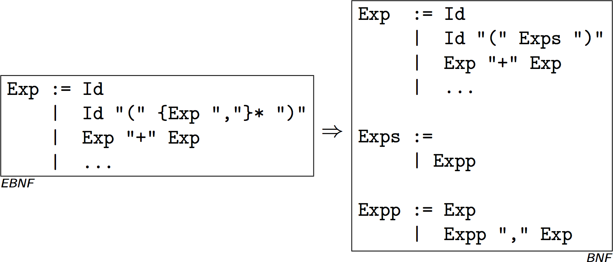
Rephrasing — desugaring regular expressions
http://www.cs.uu.nl/docs/vakken/pt/slides/PT05-ProgramTransformation.pdf

Slide 10
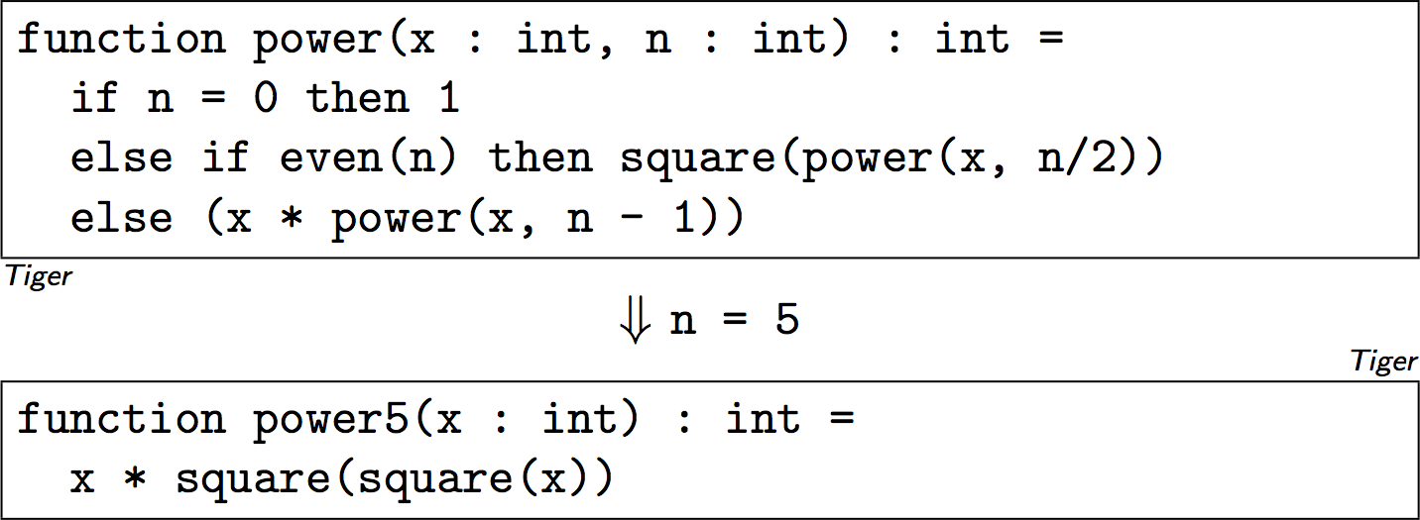
Rephrasing — partial evaluation
http://www.cs.uu.nl/docs/vakken/pt/slides/PT05-ProgramTransformation.pdf

Slide 11
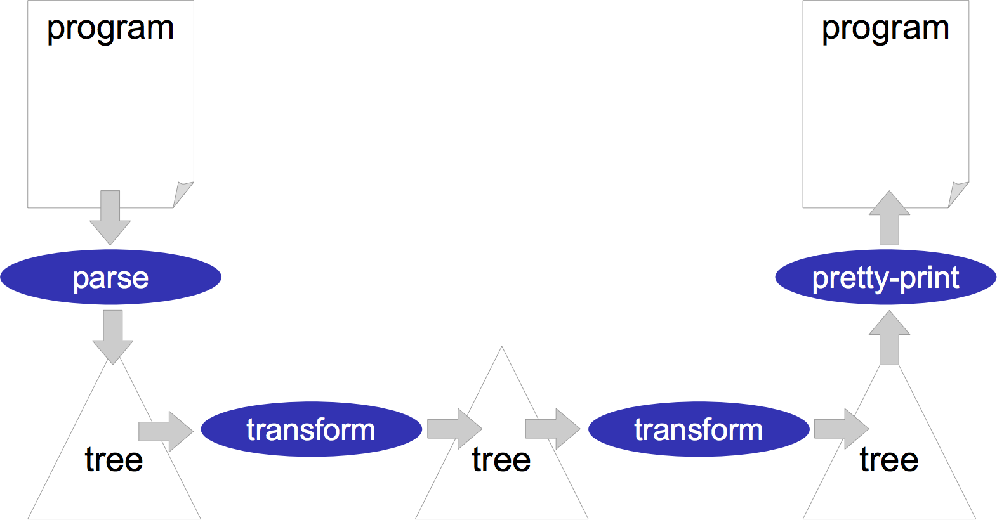
Transformation pipeline
http://losser.st-lab.cs.uu.nl/~mbravenb/PT05-Infrastructure.pdf
Notes:
This general scheme applies to Stratego, TXL and various other systems.
Transformation systems and languages may support or automate different parts of this pipeline.
If the source language is fixed, then a fixed parser and pretty-printer may be used.
If the source and target languages are arbitrary, then there should be support to specify grammars
and automatically generate parsers and pretty-printers.

Slide 12
Roadmap
Program Transformation
Introduction
Stratego/XT
TXL
Refactoring
Aspect-Oriented Programming
Outlook
Thanks to Eelco Visser and Martin Bravenboer for their kind permission to reuse and adapt selected material from their Program Transformation course.
http://swerl.tudelft.nl/bin/view/Pt

Slide 13
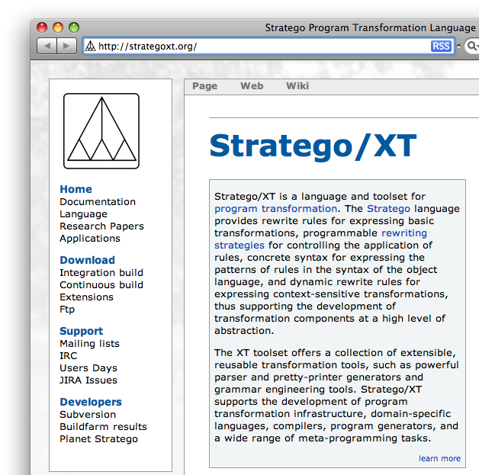
Stratego/XT
Stratego
A language for specifying program transformations
term rewriting rules
programmable rewriting strategies
pattern-matching against syntax of object language
context-sensitive transformations
XT
A collection of transformation tools
parser and pretty printer generators
grammar engineering tools
http://strategoxt.org/

Slide 14
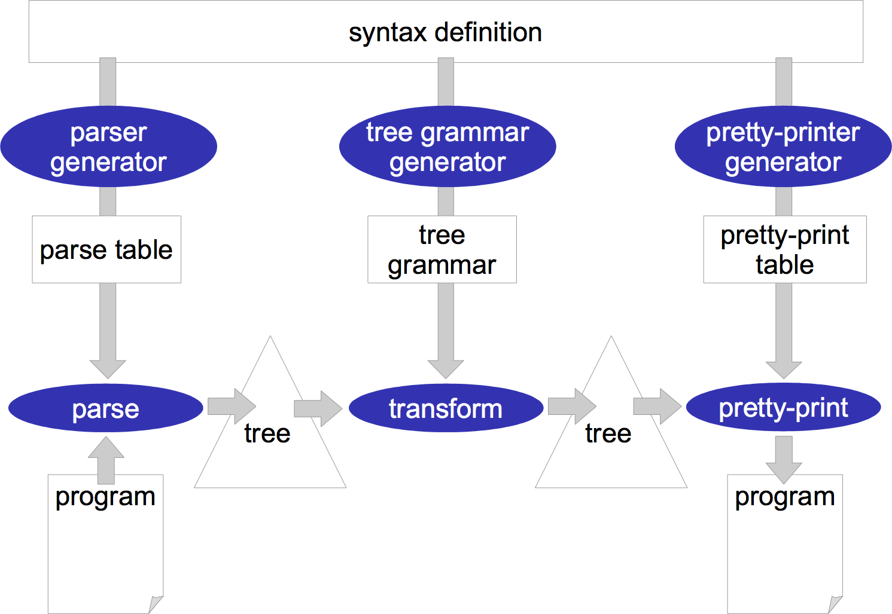
Stratego/XT
http://losser.st-lab.cs.uu.nl/~mbravenb/PT05-Infrastructure.pdf
Notes:
Parser and basic pretty-printer 100% generated.
Language specific support for transformations generated.

Slide 15
Parsing
module Exp
exports
context-free start-symbols Exp
sorts Id IntConst Exp
lexical syntax
[\ \t\n] -> LAYOUT
[a-zA-Z]+ -> Id
[0-9]+ -> IntConst
context-free syntax
Id -> Exp {cons("Var")}
IntConst -> Exp {cons("Int")}
"(" Exp ")" -> Exp {bracket}
Exp "*" Exp -> Exp {left, cons("Mul")}
Exp "/" Exp -> Exp {left, cons("Div")}
Exp "%" Exp -> Exp {left, cons("Mod")}
Exp "+" Exp -> Exp {left, cons("Plus")}
Exp "-" Exp -> Exp {left, cons("Minus")}
context-free priorities
{left:
Exp "*" Exp -> Exp
Exp "/" Exp -> Exp
Exp "%" Exp -> Exp
}
> {left:
Exp "+" Exp -> Exp
Exp "-" Exp -> Exp
}
File: Exp.sdf
Rules translate terms to terms
Stratego parses any context-free language using Scannerless Generalized LR Parsing
Notes:
See the Makefile for the steps needed to run this.
GLR parsing essential does a parallel, breadth-first LR parse to handle ambiguity.
http://en.wikipedia.org/wiki/GLR_parser

Slide 16
Testing
testsuite Exp
topsort Exp
test eg1 parse
"1 + 2 * (3 + 4) * 3 - 1"
->
Minus(
Plus(
Int("1")
, Mul(
Mul(Int("2"), Plus(Int("3"), Int("4")))
, Int("3")
)
)
, Int("1")
)
File: Exp.testsuite

Slide 17
Running tests
pack-sdf -i Exp.sdf -o Exp.def
including ./Exp.sdf
sdf2table -i Exp.def -o Exp.tbl -m Exp
SdfChecker:error: Main module not defined
--- Main
parse-unit -i Exp.testsuite -p Exp.tbl
-----------------------------------------------------------------------
executing testsuite Exp with 1 tests
-----------------------------------------------------------------------
* OK : test 1 (eg1 parse)
-----------------------------------------------------------------------
results testsuite Exp
successes : 1
failures : 0
-----------------------------------------------------------------------
Pack the definitions
Generate the parse table
Run the tests

Slide 18
Interpretation example
module ExpEval
imports libstratego-lib
imports Exp
rules
convert : Int(x) -> <string-to-int>(x)
eval : Plus(m,n) -> <add>(m,n)
eval : Minus(m,n) -> <subt>(m,n)
eval : Mul(m,n) -> <mul>(m,n)
eval : Div(m,n) -> <div>(m,n)
eval : Mod(m,n) -> <mod>(m,n)
strategies
main = io-wrap(innermost(convert <+ eval))
File: ExpEval.str
File: ultimate-question.txt
1 + 2 * (3 + 4) * 3 - 1
Stratego separates the specification of rules (transformations) from strategies (traversals). In principle, both are reusable.

Slide 19
Strategies
A strategy determines how a set of rewrite rules will be used to traverse and transform a term.
innermost
top down
bottom up
repeat
…

Slide 20
Running the transformation
sdf2rtg -i Exp.def -o Exp.rtg -m Exp
SdfChecker:error: Main module not defined
--- Main
rtg2sig -i Exp.rtg -o Exp.str
strc -i ExpEval.str -la stratego-lib
[ strc | info ] Compiling 'ExpEval.str'
[ strc | info ] Front-end succeeded : [user/system] = [0.56s/0.05s]
[ strc | info ] Optimization succeeded -O 2 : [user/system] = [0.00s/0.00s]
[ strc | info ] Back-end succeeded : [user/system] = [0.16s/0.01s]
gcc -I /usr/local/strategoxt/include -I /usr/local/strategoxt/include -I /usr/local/strategoxt/include -Wall -Wno-unused-label -Wno-unused-variable -Wno-unused-function -Wno-unused-parameter -DSIZEOF_VOID_P=4 -DSIZEOF_LONG=4 -DSIZEOF_INT=4 -c ExpEval.c -fno-common -DPIC -o .libs/ExpEval.o
gcc -I /usr/local/strategoxt/include -I /usr/local/strategoxt/include -I /usr/local/strategoxt/include -Wall -Wno-unused-label -Wno-unused-variable -Wno-unused-function -Wno-unused-parameter -DSIZEOF_VOID_P=4 -DSIZEOF_LONG=4 -DSIZEOF_INT=4 -c ExpEval.c -o ExpEval.o >/dev/null 2>&1
gcc .libs/ExpEval.o -o ExpEval -bind_at_load -L/usr/local/strategoxt/lib /usr/local/strategoxt/lib/libstratego-lib.dylib /usr/local/strategoxt/lib/libstratego-lib-native.dylib /usr/local/strategoxt/lib/libstratego-runtime.dylib -lm /usr/local/strategoxt/lib/libATerm.dylib
[ strc | info ] C compilation succeeded : [user/system] = [0.31s/0.36s]
[ strc | info ] Compilation succeeded : [user/system] = [1.03s/0.42s]
sglri -p Exp.tbl -i ultimate-question.txt | ./ExpEval
42
Generate regular tree grammar
Generate signature
Compile to C
Parse and transform

Slide 21
Roadmap
Program Transformation
Introduction
Stratego/XT
TXL
Refactoring
Aspect-Oriented Programming
Outlook

Slide 22
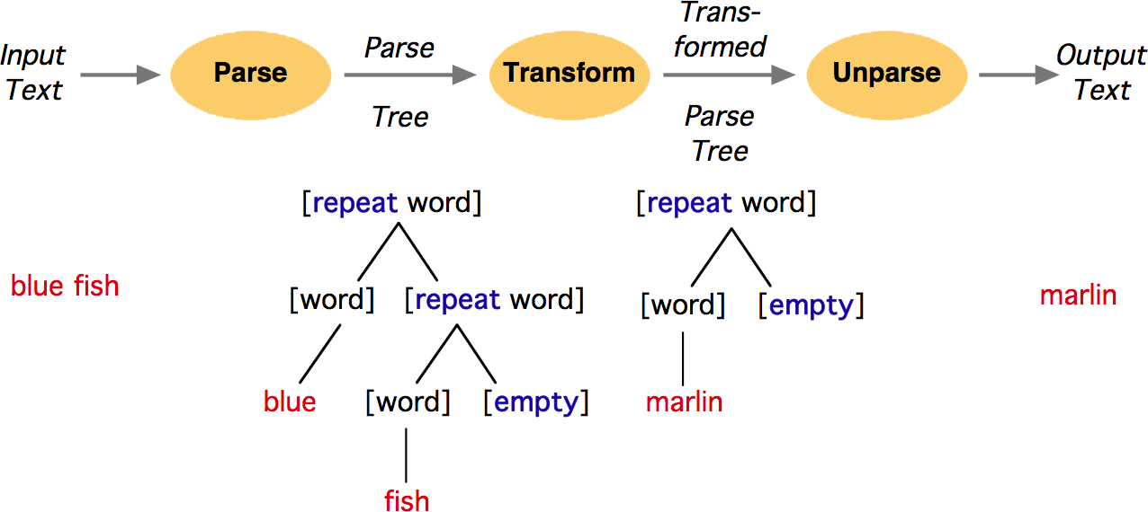
The TXL paradigm: parse, transform, unparse
http://www.txl.ca/docs/TXLintro.pdf

Slide 23
TXL programs
Base grammar
defines tokens and non-terminals
Grammar overrides
extend and modify types from grammar
Transformation rules
rooted set of rules and functions

Slide 24
Expression example
% Part 2. Transformation rules
rule main
replace [expression]
E [expression]
construct NewE [expression]
E [resolveAddition]
[resolveSubtraction]
[resolveMultiplication]
[resolveDivision]
[resolveBracketedExpressions]
where not
NewE [= E]
by
NewE
end rule
rule resolveAddition
replace [expression]
N1 [number] + N2 [number]
by
N1 [+ N2]
end rule
...
rule resolveBracketedExpressions
replace [primary]
( N [number] )
by
N
end rule
File: ExpEval.str
% Part I. Syntax specification
define program
[expression]
end define
define expression
[expression] + [term]
| [expression] - [term]
| [term]
end define
define term
[term] * [primary]
| [term] / [primary]
| [primary]
end define
define primary
[number]
| ( [expression] )
end define
Notes:
NB: TXL reverses the usual BNF convention and puts non-terminals in square brackets while interpreting everything else (except special chars) as terminals.
The default lexical scanner can be modified, but is usually fine for first experiments.

Slide 25
Running the example
File: ultimate-question.txt
1 + 2 * (3 + 4) * 3 - 1
txl Ultimate.Question
TXL v10.5d (1.7.08) (c)1988-2008 Queen's University at Kingston
Compiling Question.Txl ...
Parsing Ultimate.Question ...
Transforming ...
42

Slide 26
Example: TIL — a tiny imperative language
// Find all factors of a given input number
var n;
write "Input n please";
read n;
write "The factors of n are";
var f;
f := 2;
while n != 1 do
while (n / f) * f = n do
write f;
n := n / f;
end
f := f + 1;
end
File: factors.til
http://www.program-transformation.org/Sts/TILChairmarks

Slide 27
TIL Grammar
define program
[statement*]
end define
define statement
[declaration]
| [assignment_statement]
| [if_statement]
| [while_statement]
| [for_statement]
| [read_statement]
| [write_statement]
end define
% Untyped variables
define declaration
'var [id] ; [NL]
end define
define assignment_statement
[id] := [expression] ; [NL]
end define
define if_statement
'if [expression] 'then [IN][NL]
[statement*] [EX]
[opt else_statement]
'end [NL]
end define
...
File: TIL.Grm
% Keywords of TIL
keys
var if then else while
do for read write
end keys
% Compound tokens
compounds
:= !=
end compounds
% Commenting convention
comments
//
end comments
All TXL parsers are also pretty-printers if the grammar includes formatting cues

Slide 28
Pretty-printing TIL
include "TIL.Grm"
function main
match [program]
_ [program]
end function
File: TILparser.Txl
var n;
write "Input n please";
read n;
write "The factors of n are";
var f;
f := 2;
while n != 1 do
while (n / f) * f = n do
write f;
n := n / f;
end
f := f + 1;
end
txl factors.til TILparser.Txl

Slide 29
Generating statistics
include "TIL.Grm"
function main
replace [program]
Program [program]
% Count each kind of statement we're interested in
% by extracting all of each kind from the program
construct Statements [statement*]
_ [^ Program]
construct StatementCount [number]
_ [length Statements] [putp "Total: %"]
construct Declarations [declaration*]
_ [^ Program]
construct DeclarationsCount [number]
_ [length Declarations] [putp "Declarations: %”]
...
by
% nothing
end function
File: TILstats.Txl
Total: 11
Declarations: 2
Assignments: 3
Ifs: 0
Whiles: 2
Fors: 0
Reads: 1
Writes: 3

Slide 30
Tracing
include "TIL.Grm"
...
redefine statement
...
| [traced_statement]
end redefine
define traced_statement
[statement] [attr 'TRACED]
end define
rule main
replace [repeat statement]
S [statement]
Rest [repeat statement]
...
by
'write QuotedS; 'TRACED
S 'TRACED
Rest
end rule
...
File: TILtrace.Txl
write "Trace: var n;";
var n;
write "Trace: write \"Input n please\";";
write "Input n please";
write "Trace: read n;";
read n;
...

Slide 31
TXL vs Stratego
Stratego | TXL
Scannerless GLR parsing | Agile parsing (top-down + bottom-up)
Reusable, generic traversal strategies | Fixed traversals
Separates rewrite rules from traversal strategies | Traversals part of rewrite rules

Slide 32
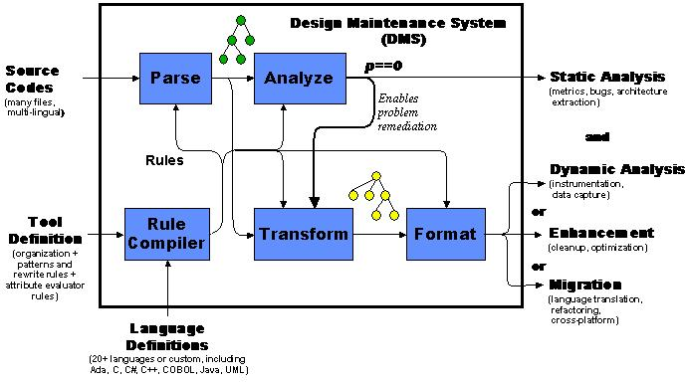
Commercial systems
“The DMS Software Reengineering Toolkit is a set of tools for automating customized source program analysis, modification or translation or generation of software systems, containing arbitrary mixtures of languages.”
http://www.semdesigns.com/Products/DMS/DMSToolkit.html
Notes:
See also http://www.semdesigns.com/Products/DMS/DMSComparison.html for a comparison to other approaches

Slide 33
Roadmap
Program Transformation
Refactoring
Refactoring Engine and Code Critics
Eclipse refactoring plugins
Aspect-Oriented Programming
Outlook

Slide 34
What is Refactoring?
The process of changing a software system in such a way that it does not alter the external behaviour of the code, yet improves its internal structure.
Fowler, et al., Refactoring, 1999.

Slide 35
Rename Method — manual steps
Do it yourself approach:
Check that no method with the new name already exists in any subclass or superclass.
Browse all the implementers (method definitions)
Browse all the senders (method invocations)
Edit and rename all implementers
Edit and rename all senders
Remove all implementers
Test
Automated refactoring is better !

Slide 36
Rename Method
Rename Method (method, new name)
Preconditions
No method with the new name already exists in any subclass or superclass.
No methods with same signature as method outside the inheritance hierarchy of method
PostConditions
method has new name
relevant methods in the inheritance hierarchy have new name
invocations of changed method are updated to new name
Other Considerations
Typed/Dynamically Typed Languages => Scope of the renaming

Slide 37
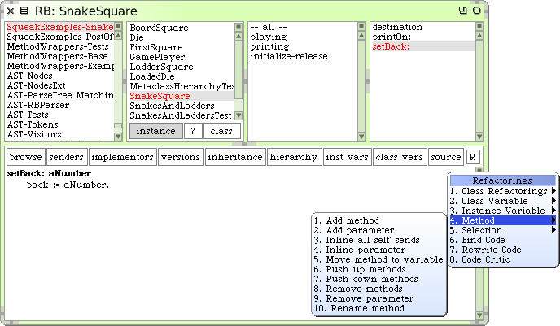
The Refactoring Browser

Slide 38
Typical Refactorings
Class Refactorings | Method Refactorings | Attribute Refactorings
add (sub)class to hierarchy | add method to class | add variable to class
rename class | rename method | rename variable
remove class | remove method | remove variable
 | push method down | push variable down
 | push method up | pull variable up
 | add parameter to method | create accessors
 | move method to component | abstract variable
 | extract code in new method
Bill Opdyke, “Refactoring Object-Oriented Frameworks,” Ph.D. thesis, University of Illinois, 1992.
Don Roberts, “Practical Analysis for Refactoring,” Ph.D. thesis, University of Illinois, 1999.

Slide 39
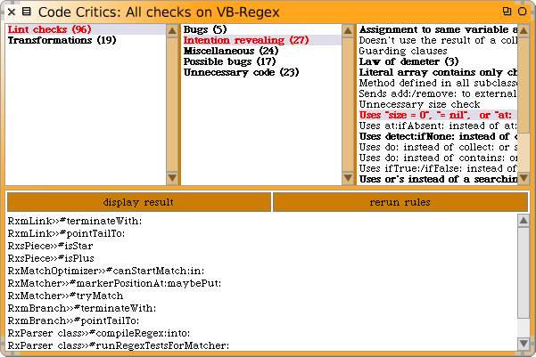
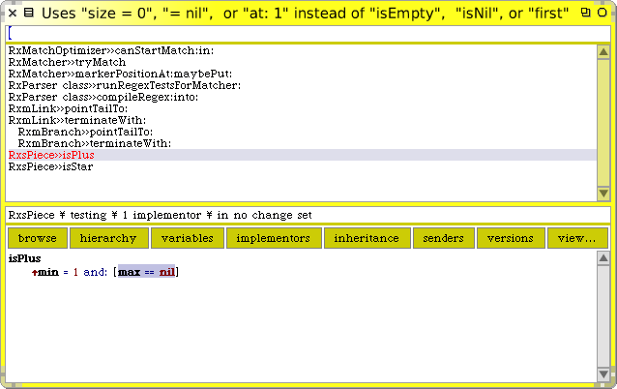
Code Critic — search for common errors

Slide 40
Refactoring Engine — matching trees
Syntax | Type
` | recurse
@ | list
. | statement
# | literal
NB: All metavariables start with `
``@object halt | recursively match send of halt
`@.Statements | match list of statements
Class `@message: `@args | match all sends to Class
Notes:
The first ` is for all meta-variables.

Slide 41
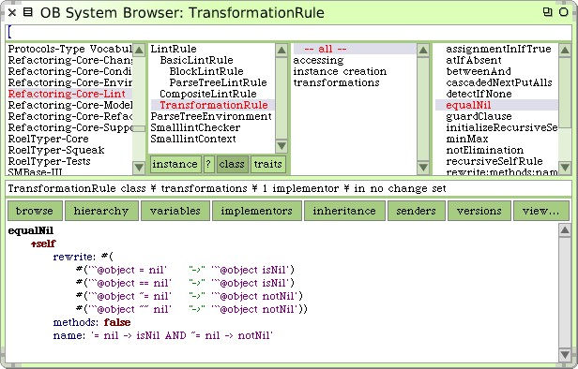
Rewrite rules

Slide 42
Roadmap
Program Transformation
Refactoring
Refactoring Engine and Code Critics
Eclipse refactoring plugins
Aspect-Oriented Programming
Outlook
Thanks to Lea Hänsenberger for the plugin code.

Slide 43
A workbench action delegate
When the workbench action proxy is triggered by the user, it delegates to an instance of this class.
package astexampleplugin.actions;
...
import org.eclipse.ui.IWorkbenchWindowActionDelegate;
public class ChangeAction implements IWorkbenchWindowActionDelegate {
...
public void run( IAction action ) {
for ( ICompilationUnit cu : this.classes ) {
try {
...
parser.setSource( cu );
...
CompilationUnit ast = (CompilationUnit)parser.createAST( null );
...
StackVisitor visitor = new StackVisitor( ast.getAST() );
ast.accept( visitor );
...
} catch ...
}
}
...
}
http://help.eclipse.org/ganymede/index.jsp?topic=/org.eclipse.jdt.doc.isv/guide/jdt_api_manip.htm

Slide 44
A field renaming visitor
package astexampleplugin.ast;
...
import org.eclipse.jdt.core.dom.ASTVisitor;
public class StackVisitor extends ASTVisitor {
private static final String PREFIX = "_";
...
public boolean visit(FieldDeclaration field){
...
}
public boolean visit(FieldAccess fieldAccess){
String oldName = fieldAccess.getName().toString();
String newName = this.fields.get( oldName );
if(newName == null){
newName = PREFIX + oldName;
this.fields.put( oldName , newName );
}
fieldAccess.setName( this.ast.newSimpleName( newName ) );
return true;
}
}
The visitor simply implements the visit method for field declarations and accesses, and prepends an underscore.

Slide 45
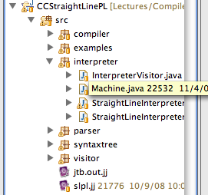
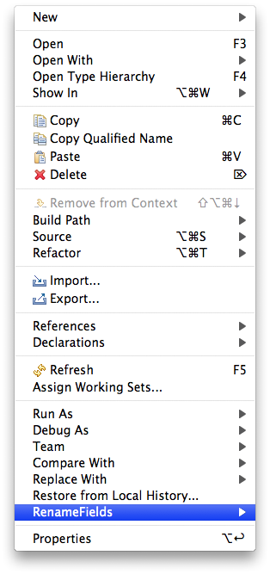
Renaming fields

Slide 46
Roadmap
Program Transformation
Refactoring
Aspect-Oriented Programming
Outlook

Slide 47
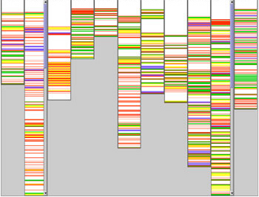
Problem: cross-cutting concerns
Certain features (like logging, persistence and security), cannot usually be encapsulated as classes. They cross-cut code of the system.
“Identifying Cross-Cutting Concerns in Embedded C Code”, Bruntink, van Deursen, Tourwé

Slide 48
Aspect-Oriented Programming
AOP improves modularity by supporting the separation of cross-cutting concerns.
An aspect packages cross-cutting concerns
A pointcut specifies a set of join points in the target system to be affected
Weaving is the process of applying the aspect to the target system

Slide 49
Canonical example — logging
package tjp;
public class Demo {
static Demo d;
public static void main(String[] args){
new Demo().go();
}
void go(){
d = new Demo();
d.foo(1,d);
System.out.println(d.bar(new Integer(3)));
}
void foo(int i, Object o){
System.out.println("Demo.foo(" + i + ", " + o + ")\n");
}
String bar (Integer j){
System.out.println("Demo.bar(" + j + ")\n");
return "Demo.bar(" + j + ")";
}
}
Demo.foo(1, tjp.Demo@939b78e)
Demo.bar(3)
Demo.bar(3)
http://www.eclipse.org/aspectj/downloads.php

Slide 50
A logging aspect
Intercept execution within control flow of Demo.go()
Identify all methods within Demo
aspect GetInfo {
pointcut goCut(): cflow(this(Demo) && execution(void go()));
pointcut demoExecs(): within(Demo) && execution(* *(..));
Object around(): demoExecs() && !execution(* go()) && goCut() {
...
}
...
}
Wrap all methods except Demo.go()

Slide 51
A logging aspect
aspect GetInfo {
...
Object around(): demoExecs() && !execution(* go()) && goCut() {
println("Intercepted message: " +
thisJoinPointStaticPart.getSignature().getName());
println("in class: " +
thisJoinPointStaticPart.getSignature().getDeclaringType().getName());
printParameters(thisJoinPoint);
println("Running original method: \n" );
Object result = proceed();
println(" result: " + result );
return result;
}
...
}
Intercepted message: foo
in class: tjp.Demo
Arguments:
0. i : int = 1
1. o : java.lang.Object = tjp.Demo@c0b76fa
Running original method:
Demo.foo(1, tjp.Demo@c0b76fa)
result: null
Intercepted message: bar
in class: tjp.Demo
Arguments:
0. j : java.lang.Integer = 3
Running original method:
Demo.bar(3)
result: Demo.bar(3)
Demo.bar(3)

Slide 52
Making classes visitable with aspects
public class SumVisitor implements Visitor {
int sum = 0;
public void visit(Nil l) { }
public void visit(Cons l) {
sum = sum + l.head;
l.tail.accept(this);
}
public static void main(String[] args) {
List l = new Cons(5, new Cons(4,
new Cons(3, new Nil())));
SumVisitor sv = new SumVisitor();
l.accept(sv);
System.out.println("Sum = " + sv.sum);
}
}
public interface Visitor {
void visit(Nil l);
void visit(Cons l);
}
We want to write this
public interface List {}
public class Nil implements List {}
public class Cons implements List {
int head;
List tail;
Cons(int head, List tail) {
this.head = head;
this.tail = tail;
}
}
But we are stuck with this …

Slide 53
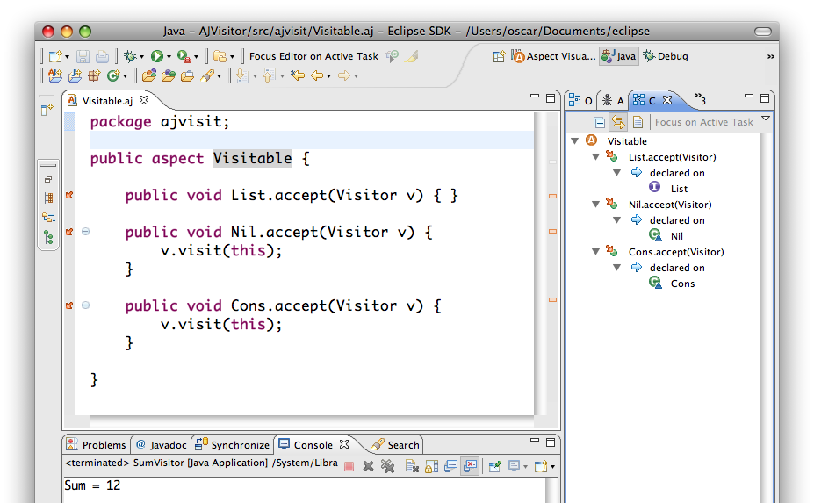
AspectJ

Slide 54
With aspects, who needs visitors?
This would be even cleaner
public class SumList {
public static void main(String[] args) {
List l = new Cons(5, new Cons(4, new Cons(3, new Nil())));
System.out.println("Sum = " + l.sum());
}
}
public aspect Summable {
public int List.sum() {
return 0;
}
public int Nil.sum() {
return 0;
}
public int Cons.sum() {
return head + tail.sum();
}
}
The missing method is just an aspect
Notes:
Dunno why List.sum() needs a body – it should just be an interface signature.

Slide 55
Roadmap
Program Transformation
Refactoring
Aspect-Oriented Programming
Outlook

Slide 56
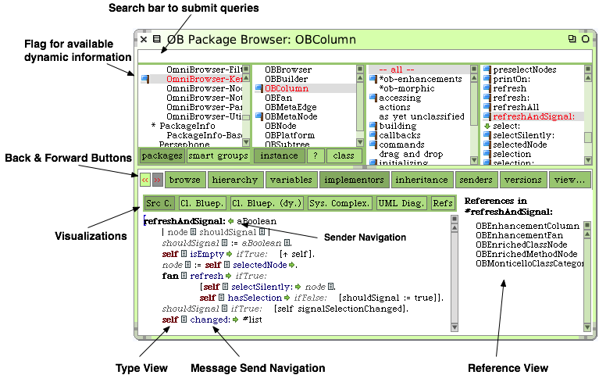
Model-aware IDEs
Notes:
Source code artifacts are transformed and decorated with run-time information

Slide 57
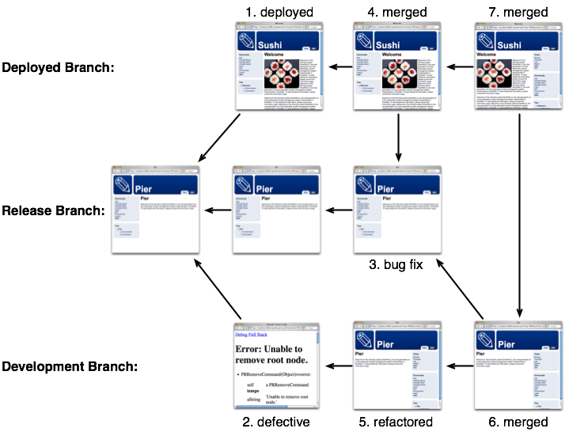
Context-oriented programming with Changeboxes

Slide 58
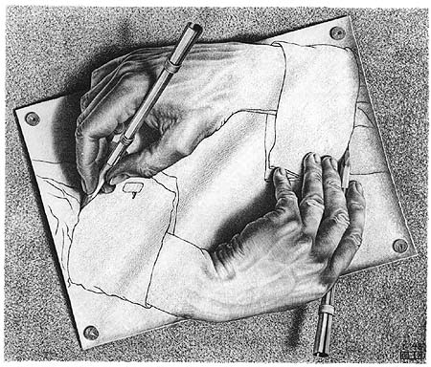
Model-centric development
Directly manipulate models without passing through source code …

Slide 59
What you should know!
What are typical program transformations?
What is the typical architecture of a PT system?
What is the role of term rewriting in PT systems?
How does TXL differ from Stratego/XT?
How does the Refactoring Engine use metavariables to encode rewrite rules?
Why can’t aspects be encapsulated as classes?
What is the difference between a pointcut and a join point?

Slide 60
Can you answer these questions?
How does program transformation differ from metaprogramming?
In what way is optimization a form of PT?
What special care should be taken when pretty-printing a transformed program?
How would you encode typical refactorings like “push method up” using a PT system like TXL?
How could you use a PT system to implement AOP?

Slide 61
License
http://creativecommons.org/licenses/by-sa/3.0/
Attribution-ShareAlike 3.0 Unported
You are free:
to Share — to copy, distribute and transmit the work
to Remix — to adapt the work
Under the following conditions:
Attribution. You must attribute the work in the manner specified by the author or licensor (but not in any way that suggests that they endorse you or your use of the work).
Share Alike. If you alter, transform, or build upon this work, you may distribute the resulting work only under the same, similar or a compatible license.
For any reuse or distribution, you must make clear to others the license terms of this work. The best way to do this is with a link to this web page.
Any of the above conditions can be waived if you get permission from the copyright holder.
Nothing in this license impairs or restricts the author's moral rights.

