Slide 1
Introduction to Software Engineering
2. Requirements Collection

Slide 2
Roadmap
The Requirements Engineering Process
Use Cases
Functional and non-functional requirements
Evolutionary and throw-away prototyping
Requirements checking and reviews

Slide 3
Sources
Software Engineering, I. Sommerville, 7th Edn., 2004.
Software Engineering — A Practitioner’s Approach, R. Pressman, Mc-Graw Hill, 5th Edn., 2001.
Objects, Components and Frameworks with UML, D. D'Souza, A. Wills, Addison-Wesley, 1999

Slide 4
Roadmap
The Requirements Engineering Process
Use Cases
Functional and non-functional requirements
Evolutionary and throw-away prototyping
Requirements checking and reviews

Slide 6
Electronic Time Schedule
“So, basically we need a form for the time schedule that can be distributed by eMail, a place (html) where I can deposit these forms after they have been filled out, and an algorithm that calculates a few possible meeting times, possibly setting priorities to certain persons of each committee (since there will always be some time schedule overlaps). It would also be great if there were a way of checking whether everybody of the relevant committee has really sent their time schedule back and at the same time listing all the ones who have failed to do so. An automatic invitation letter for the committee meeting to all the persons involved, generated through this program, would be even a further asset.”
How can we transform this description into a requirements specification?
Notes:
Spend 10-15 minutes identifying the actors, the use cases, scenarios, technical & non-technical requirements, risks etc.

Slide 7
The Requirements Engineering Process
Feasibility Study
Requirements elicitation and analysis
Requirements specification
Feasibility report
System models
Requirements validation
User and system requirements
Requirements document
© Ian Sommerville 2000
Notes:
Ch6 p 122

Slide 8
Requirements Engineering Activities
Feasibility study | Determine if the user needs can be satisfied with the available technology and budget.
Requirements analysis | Find out what system stakeholders require from the system.
Requirements definition | Define the requirements in a form understandable to the customer.
Requirements specification | Define the requirements in detail. (Written as a contract between client and contractor.)
“Requirements are for users; specifications are for analysts and developers.”

Slide 9
Requirements Analysis
Sometimes called requirements elicitation or requirements discovery
Technical staff work with customers to determine
the application domain,
the services that the system should provide and
the system’s operational constraints.
Involves various stakeholders:
e.g., end-users, managers, engineers involved in maintenance, domain experts, trade unions, etc.

Slide 10
Problems of Requirements Analysis
Various problems typically arise:
Stakeholders don’t know what they really want
Stakeholders express requirements in their own terms
Different stakeholders may have conflicting requirements
Organisational and political factors may influence the system requirements
The requirements change during the analysis process.
New stakeholders may emerge.

Slide 11
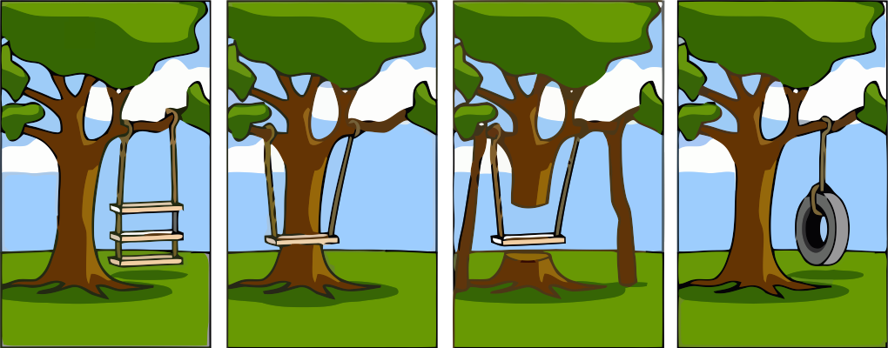
How the Customer explained it
How the Project Leader understood it
How the Analyst designed it
What the Customer really needed

Slide 12
Requirements evolution
Requirements always evolve as a better understanding of user needs is developed and as the organisation’s objectives change
It is essential to plan for change in the requirements as the system is being developed and used

Slide 13
The Requirements Analysis Process
Requirements definition and specification
Requirements validation
Domain understanding
Prioritization
Requirements collection
Conflict resolution
Classification
© Ian Sommerville 2000
Notes:
Ch6 p 125.
Domain understanding: gather & understand domain knowledge
Collection: by interaction w stakeholders
Classification: into coherent clusters
Conflict resolution: ie due to different stakeholders
Prioritization: ie importance, value …
Validation: checking consistency, completeness …

Slide 14
Roadmap
The Requirements Engineering Process
Use Cases
Functional and non-functional requirements
Evolutionary and throw-away prototyping
Requirements checking and reviews

Slide 15
Use Cases and Scenarios
A use case is the specification of a sequence of actions, including variants, that a system (or other entity) can perform, interacting with actors of the system”.
e.g., buy a DVD through the internet
A scenario is a particular trace of action occurrences, starting from a known initial state.
e.g., connect to myDVD.com, go to the “search” page
...

Slide 16
Use Cases and Viewpoints ...
Stakeholders represent different problem viewpoints.
Interview as many different kinds of stakeholders as possible/necessary
Translate requirements into use cases or “stories” about the desired system involving a fixed set of actors (users and system objects)
For each use case, capture both typical and exceptional usage scenarios
Users tend to think about systems in terms of “features”.
You must get them to tell you stories involving those features.
Use cases and scenarios can tell you if the requirements are complete and consistent!

Slide 17
Unified Modeling Language
UML is the industry standard for documenting OO models
Class Diagrams | visualize logical structure of system in terms of classes, objects and relationships
Use Case Diagrams | show external actors and use cases they participate in
Sequence Diagrams | visualize temporal message ordering of a concrete scenario of a use case
Collaboration (Communication) Diagrams | visualize relationships of objects exchanging messages in a concrete scenario
State Diagrams | specify the abstract states of an object and the transitions between the states

Slide 18
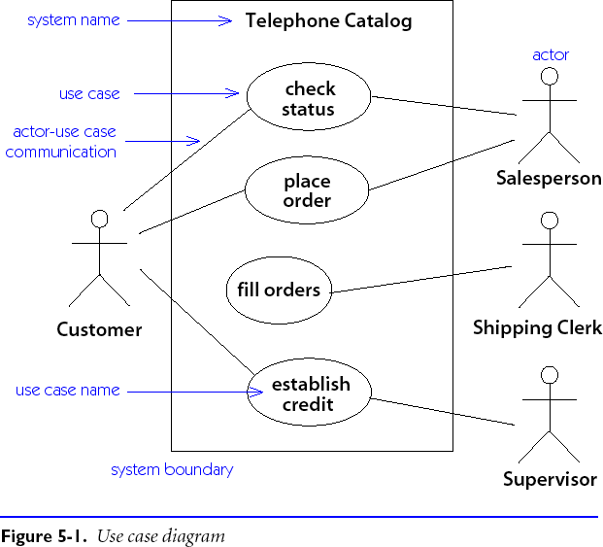
Use Case Diagrams
More on this later …

Slide 19
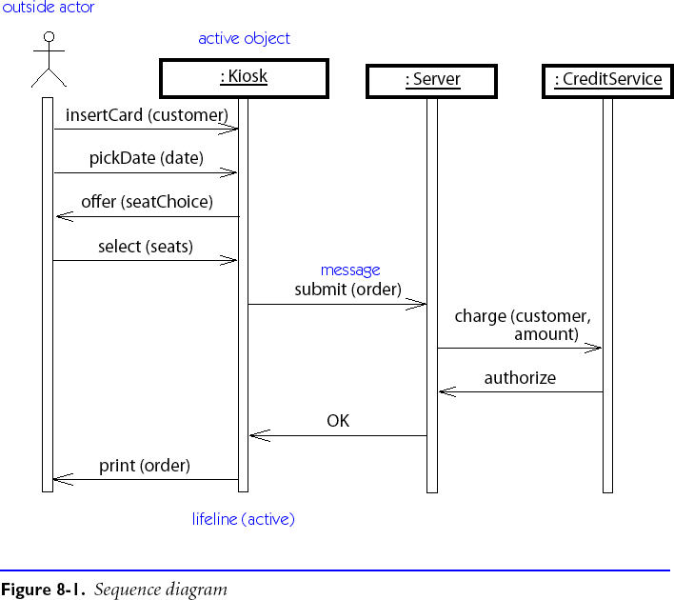
Sequence Diagrams

Slide 20
Writing Requirements Definitions
Requirements definitions usually consist of natural language, supplemented by (e.g., UML) diagrams and tables.
Three types of problems can arise:
Lack of clarity: It is hard to write documents that are both precise and easy-to-read.
Requirements confusion: Functional and non-functional requirements tend to be intertwined.
Requirements amalgamation: Several different requirements may be expressed together.

Slide 21
Roadmap
The Requirements Engineering Process
Use Cases
Functional and non-functional requirements
Evolutionary and throw-away prototyping
Requirements checking and reviews

Slide 22
Functional and Non-functional Requirements
Functional requirements describe system services or functions
Compute sales tax on a purchase
Update the database on the server ...
Non-functional requirements are constraints on the system or the development process
Non-functional requirements may be more critical than functional requirements.
If these are not met, the system is useless!

Slide 23
Non-functional Requirements
Product requirements: | specify that the delivered product must behave in a particular way e.g. execution speed, reliability, etc.
Organisational requirements: | are a consequence of organisational policies and procedures e.g. process standards used, implementation requirements, etc.
External requirements: | arise from factors which are external to the system and its development process e.g. interoperability requirements, legislative requirements, etc.

Slide 24
Types of Non-functional Requirements
Non-functional requirements
Product
requirements
Organizational
requirements
External
requirements
Efficiency
requirements
Reliability
requirements
Portability
requirements
Interoperability
requirements
Ethical
requirements
Usability
requirements
Delivery
requirements
Implementation
requirements
Standards
requirements
Legislative
requirements
Performance
requirements
Space
requirements
Privacy
requirements
Safety
requirements
© Ian Sommerville 2000
Notes:
ch5

Slide 25
Examples of Non-functional Requirements
Product requirement | It shall be possible for all necessary communication between the APSE and the user to be expressed in the standard Ada character set.
Organisational requirement | The system development process and deliverable documents shall conform to the process and deliverables defined in XYZCo-SP-STAN-95.
External requirement | The system shall provide facilities that allow any user to check if personal data is maintained on the system. A procedure must be defined and supported in the software that will allow users to inspect personal data and to correct any errors in that data.

Slide 26
Requirements Verifiability
Requirements must be written so that they can be objectively verified.
Imprecise:
The system should be easy to use by experienced controllers and should be organised in such a way that user errors are minimised.
Terms like “easy to use” and “errors shall be minimised” are useless as specifications.
Verifiable:
Experienced controllers should be able to use all the system functions after a total of two hours training. After this training, the average number of errors made by experienced users should not exceed two per day.

Slide 27
Precise Requirements Measures (I)
Property | Measure
Speed | Processed transactions/second User/Event response time Screen refresh time
Size | K Bytes; Number of RAM chips
Ease of use | Training time Rate of errors made by trained users Number of help frames

Slide 28
Precise Requirements Measures (II)
Property | Measure
Reliability | Mean time to failure Probability of unavailability Rate of failure occurrence
Robustness | Time to restart after failure Percentage of events causing failure Probability of data corruption on failure
Portability | Percentage of target dependent statements Number of target systems

Slide 29
Roadmap
The Requirements Engineering Process
Use Cases
Functional and non-functional requirements
Evolutionary and throw-away prototyping
Requirements checking and reviews

Slide 30
Prototyping Objectives
The objective of evolutionary prototyping is to deliver a working system to end-users.
Development starts with the requirements that are best understood.
The objective of throw-away prototyping is to validate or derive the system requirements.
Prototyping starts with that requirements that are poorly understood.

Slide 31
Evolutionary Prototyping
Must be used for systems where the specification cannot be developed in advance.
e.g., AI systems and user interface systems
Based on techniques which allow rapid system iterations.
e.g., executable specification languages, VHL languages, 4GLs, component toolkits
Verification is impossible as there is no specification.
Validation means demonstrating the adequacy of the system.

Slide 32
Throw-away Prototyping
Used to reduce requirements risk
The prototype is developed from an initial specification, delivered for experiment then discarded
The throw-away prototype should not be considered as a final system
Some system characteristics may have been left out
(e.g., platform requirements may be ignored)
There is no specification for long-term maintenance
The system will be poorly structured and difficult to maintain

Slide 33
Roadmap
The Requirements Engineering Process
Use Cases
Functional and non-functional requirements
Evolutionary and throw-away prototyping
Requirements checking and reviews

Slide 34
Requirements Checking
Validity | Does the system provide the functions which best support the customer’s needs?
Consistency | Are there any requirements conflicts?
Completeness | Are all functions required by the customer included?
Realism | Can the requirements be implemented given available budget and technology?

Slide 35
Requirements Reviews
Regular reviews should be held while the requirements definition is being formulated
Both client and contractor staff should be involved in reviews
Reviews may be formal (with completed documents) or informal.
Good communications between developers, customers and users can resolve problems at an early stage

Slide 36
Review checks
Verifiability | Is the requirement realistically testable?
Comprehensibility | Is the requirement properly understood?
Traceability | Is the origin of the requirement clearly stated?
Adaptability | Can the requirement be changed without a large impact on other requirements?

Slide 37
Sample Requirements Review Checklist
Does the (software) product have a succinct name, and a clearly described purpose?
Are the characteristics of users and of typical usage mentioned? (No user categories missing.)
Are all external interfaces of the software explicitly mentioned? (No interfaces missing.)
Does each specific requirement have a unique identifier ?
Is each requirement atomic and simply formulated ? (Typically a single sentence. Composite requirements must be split.)
Are requirements organized into coherent groups ? (If necessary, hierarchical; not more than about ten per group.)
Is each requirement prioritized ? (Is the meaning of the priority levels clear?)
Are all unstable requirements marked as such? (TBC=`To Be Confirmed', TBD=`To Be Defined')
http://wwwis.win.tue.nl/2M390/rev_req.html

Slide 38
Sample Requirements Review Checklist
Is each requirement verifiable (in a provisional acceptance test)? (Measurable: where possible, quantify; capacity, performance, accuracy)
Are the requirements consistent ? (Non-conflicting.)
Are the requirements sufficiently precise and unambiguous ? (Which interfaces are involved, who has the initiative, who supplies what data, no passive voice.)
Are the requirements complete? Can everything not explicitly constrained indeed be viewed as developer freedom? Is a product that satisfies every requirement indeed acceptable? (No requirements missing.)
Are the requirements understandable to those who will need to work with them later?
Are the requirements realizable within budget?
Do the requirements express actual customer needs (in the language of the problem domain), rather than solutions (in developer jargon)?
http://wwwis.win.tue.nl/2M390/rev_req.html

Slide 39
Traceability
To protect against changes you should be able to trace back from every system component to the original requirement that caused its presence
 | C1 | C2 | … | … | Cm
req1 |  | x
req2 | x
… |  |  |  | x
… |  |  |  |  | x
reqn |  | x | x
A software process should help you keep this virtual table up-to-date
Simple techniques may be quite valuable (naming conventions, ...)

Slide 40
What you should know!
What is the difference between requirements analysis and specification?
Why is it hard to define and specify requirements?
What are use cases and scenarios?
What is the difference between functional and non-functional requirements?
What’s wrong with a requirement that says a product should be “user-friendly”?
What’s the difference between evolutionary and throw-away prototyping?

Slide 41
Can you answer the following questions?
Why isn’t it enough to specify requirements as a set of desired features?
Which is better for specifying requirements: natural language or diagrams?
How would you prototype a user interface for a web-based ordering system?
Would it be an evolutionary or throw-away prototype?
What would you expect to gain from the prototype?
How would you check a requirement for “adaptability”?

Slide 42
License
Attribution-ShareAlike 3.0 Unported
You are free:
to Share — to copy, distribute and transmit the work
to Remix — to adapt the work
Under the following conditions:
Attribution. You must attribute the work in the manner specified by the author or licensor (but not in any way that suggests that they endorse you or your use of the work).
Share Alike. If you alter, transform, or build upon this work, you may distribute the resulting work only under the same, similar or a compatible license.
For any reuse or distribution, you must make clear to others the license terms of this work. The best way to do this is with a link to this web page.
Any of the above conditions can be waived if you get permission from the copyright holder.
Nothing in this license impairs or restricts the author's moral rights.
http://creativecommons.org/licenses/by-sa/3.0/

