Slide 1
Introduction to Software Engineering
3. The Planning Game

Slide 2
Roadmap
XP — coping with change and uncertainty
Customers and Developers — why do we plan?
The Planning Game
Exploration — User stories
Estimation
Commitment
Steering
Iteration
Scrum
Agile lessons from industry
Based on a presentation by Matthias Rieger.

Slide 3
Sources
eXtreme Programming Explained: Embrace Change. Kent Beck. Addison-Wesley Pub Co; ISBN: 0201616416; 1st edition (October 5, 1999)
www.extremeprogramming.org

Slide 4
Roadmap
XP — coping with change and uncertainty
Customers and Developers — why do we plan?
The Planning Game
Exploration — User stories
Estimation
Commitment
Steering
Iteration
Scrum
Agile lessons from industry

Slide 5
Extreme Programming
Planning Game
Product
Simple Design
XP is a set of mutually supportive practices for developing quality software
System Metaphor
Process
Continuous Integration
Teamwork
Testing
Coding
Refactoring
Pair programming
Collective Code Ownership
Coding Standards
40 Hour Week
On-Site Customer
Small Releases
© Joseph Pelrine
See also: www.extremeprogramming.org

Slide 6
Driving Metaphor
Driving a car is not about pointing the car in one direction and holding to it; driving is about making lots of little course corrections.
“Do the simplest thing that could possibly work”

Slide 7
Roadmap
XP — coping with change and uncertainty
Customers and Developers — why do we plan?
The Planning Game
Exploration — User stories
Estimation
Commitment
Steering
Iteration
Scrum
Agile lessons from industry

Slide 8
Why we plan
We want to ensure that
we are always working on the most important things
we are coordinated with other people
when unexpected events occur, we understand the consequences on priorities and coordination
Plans must be
easy to make and update
understandable by everyone that uses them

Slide 9
The Planning Trap
Plans project a likely course of events
Plans must try to create visibility: where is the project
But: A plan does not mean you are in control of things
Events happen
Plans become invalid
Having a plan isn’t everything, planning is.
Keep plans honest and expect them to always change

Slide 10
Customer-Developer Relationships
A well-known experience in Software Development:
The customer and the developer sit in a small boat in the ocean and are afraid of each other.
Customer fears | Developer fears
They won't get what they asked for | They won't be given clear definitions of what needs to be done
They must surrender the control of their careers to techies who don't care | They will be given responsibility without authority
They'll pay too much for too little | They will be told to do things that don't make sense
They won't know what is going on (the plans they see will be fairy tales) | They'll have to sacrifice quality for deadlines
Result: A lot of energy goes into protective measures and politics instead of success

Slide 11
The Customer Bill of Rights
You have the right to an overall plan | To steer a project, you need to know what can be accomplished within time and budget
You have the right to get the most possible value out of every programming week | The most valuable things are worked on first.
You have the right to see progress in a running system. | Only a running system can give exact information about project state
You have the right to change your mind, to substitute functionality and to change priorities without exorbitant costs. | Market and business requirements change. We have to allow change.
You have the right to be informed about schedule changes, in time to choose how to reduce the scope to restore the original date. | XP works to be sure everyone knows just what is really happening.

Slide 12
The Developer Bill of Rights
You have the right to know what is needed, with clear declarations of priority. | Tight communication with the customer. Customer directs by value.
You have the right to produce quality work all the time. | Unit Tests and Refactoring help to keep the code clean
You have the right to ask for and receive help from peers, managers, and customers | No one can ever refuse help to a team member
You have the right to make and update your own estimates. | Programmers know best how long it is going to take them
You have the right to accept your responsibilities instead having them assigned to you | We work most effectively when we have accepted our responsibilities instead of having them thrust upon us

Slide 13
Separation of Roles
Customer makes business decisions
Developers make technical decisions
Business Decisions | Technical Decisions
Scope | Estimates
Dates of the releases | Dates within an iteration
Priority | Team velocity
 | Warnings about technical risks
The Customer owns “what you get” while the Developers own “what it costs”.

Slide 14
Roadmap
XP — coping with change and uncertainty
Customers and Developers — why do we plan?
The Planning Game
Exploration — User stories
Estimation
Commitment
Steering
Iteration
Scrum
Agile lessons from industry

Slide 15
The Planning Game
A game with a set of rules that ensures that Customer and Developers don’t become mortal enemies
Goal:
Maximize the value of the software produced by Developers.
Overview:
Release Planning: Customer selects the scope of the next release
Iteration Planning: Developers decide on what to do and in which order
Notes:
In Release planning, both customers and developers participate to fix the scope of the release.
In Iteration planning, the customer is not involved. The developers decide how to plan the iteration so that they can meet the release goals.

Slide 16
The Release Planning Game
 | Customer | Developers
Exploration Phase | Write Story
 |  | Estimate Story
 | Split Story
Commitment Phase | Sort Stories by Value
 |  | Sort Stories by Risk
 |  | Set Velocity
 | Choose Scope
Steering Phase | Iteration
 |  | Recovery
 | New Story | Reestimate

Slide 17
Roadmap
XP — coping with change and uncertainty
Customers and Developers — why do we plan?
The Planning Game
Exploration — User stories
Estimation
Commitment
Steering
Iteration
Scrum
Agile lessons from industry

Slide 18
Planning Game: Exploration Phase
Purpose:
Get an appreciation for what the system should eventually do.
The Moves:
Customer: Write a story. Discuss it until everybody understands it.
Developers: Estimate a story in terms of effort.
Customer: Split a story, if Developers don’t understand or can’t estimate it.
Developers: Do a spike solution to enable estimation.
Customer: Toss stories that are no longer wanted or are covered by a split story.

Slide 19
User Stories
Principles of good stories:
Customers write stories.
Developers do not write stories.
Stories must be understandable to the customer
The shorter the better. No detailed specification!
Write stories on index cards
Each story must provide something of value to the customer
A story must be testable
then we can know when it is done
Writing stories is an iterative process, requiring interaction between Customer and Developers.

Slide 20
Stories
A story contains:
a name
the story itself
an estimate
Example:
When the GPS has contact with two or fewer satellites for more than 60 seconds, it should display the message “Poor satellite contact”, and wait for confirmation from the user. If contact improves before confirmation, clear the message automatically.

Slide 21
Splitting Stories
Developers ask the Customer to split a story if
They cannot estimate a story because of its complexity
Their estimate is longer than two or three weeks of effort
Why?
Estimates get fuzzy for bigger stories
The smaller the story, the better the control (tight feedback loop)

Slide 22
Roadmap
XP — coping with change and uncertainty
Customers and Developers — why do we plan?
The Planning Game
Exploration — User stories
Estimation
Commitment
Steering
Iteration
Scrum
Agile lessons from industry

Slide 23
Initial Estimation of Stories
With no history, the first plan is the hardest and least accurate (fortunately, you only have to do it once)
How to start estimating:
Begin with the stories that you feel the most comfortable estimating.
Intuitively imagine how long it will take you.
Base other estimates on the comparison with those first stories.
Spike Solutions:
Do a quick implementation of the whole story.
Do not look for the perfect solution!
Just try to find out how long something takes

Slide 24
Estimating Stories
Keys to effective story estimation:
Keep it simple
Use what happened in the past (“Yesterday’s weather”)
Learn from experience
Comparative story estimation:
One story is often an elaboration of a closely related one
Look for stories that have already been implemented
Compare difficulties, not implementation time
“twice as difficult”, “half as difficult”
Discuss estimates in the team. Try to find an agreement.
“Optimism wins”: Choose the more optimistic of two disagreeing estimates.

Slide 25
Roadmap
XP — coping with change and uncertainty
Customers and Developers — why do we plan?
The Planning Game
Exploration — User stories
Estimation
Commitment
Steering
Iteration
Scrum
Agile lessons from industry

Slide 26
Planning Game: Commitment Phase
Purpose:
Customer: to choose scope and date of next delivery
Developers: to confidently commit to deliver the next release
The Moves:
Customer: Sort by stories by value
Stories without which the system will not function
Less essential stories, but still providing significant business value
Nice-to-have stories
Customer wants the release to be as valuable as possible

Slide 27
Commitment Phase …
Developers: Sort stories by risk
Stories that can be estimated precisely (low risk)
Stories that can be estimated reasonably well
Stories that cannot be estimated (high risk)
Developers want to tackle high-risk first, or at least make risk visible
Developers: Set team velocity
How much ideal engineering time per calendar month/week can the team offer?
this is the budget that is available to Customer
Customer: Choose scope of the release, by either
fixing the date and choosing stories based on estimates and velocity
fixing the stories and calculating the delivery date

Slide 28
Roadmap
XP — coping with change and uncertainty
Customers and Developers — why do we plan?
The Planning Game
Exploration — User stories
Estimation
Commitment
Steering
Iteration
Scrum
Agile lessons from industry

Slide 29
Planning Game: Steering Phase
Purpose: Update the plan based on what is learned.
The Moves:
Iteration: Customer picks one iteration worth of the most valuable stories.
see Iteration Planning
Get stories done: Customer should only accept stories that are 100% done.
Recovery: Developers realize velocity is wrong
Developers re-estimate velocity.
Customer can defer (or split) stories to maintain release date.

Slide 30
Planning Game: Steering Phase...
New Story: Customer identifies new, more valuable stories
Developers estimate story
Customer removes estimated points from incomplete part of existing plan, and inserts the new story.
Reestimate: Developers feel that plan is no longer accurate
Developers re-estimate velocity and all stories.
Customer sets new scope plan.

Slide 31
Roadmap
XP — coping with change and uncertainty
Customers and Developers — why do we plan?
The Planning Game
Exploration — User stories
Estimation
Commitment
Steering
Iteration
Scrum
Agile lessons from industry

Slide 32
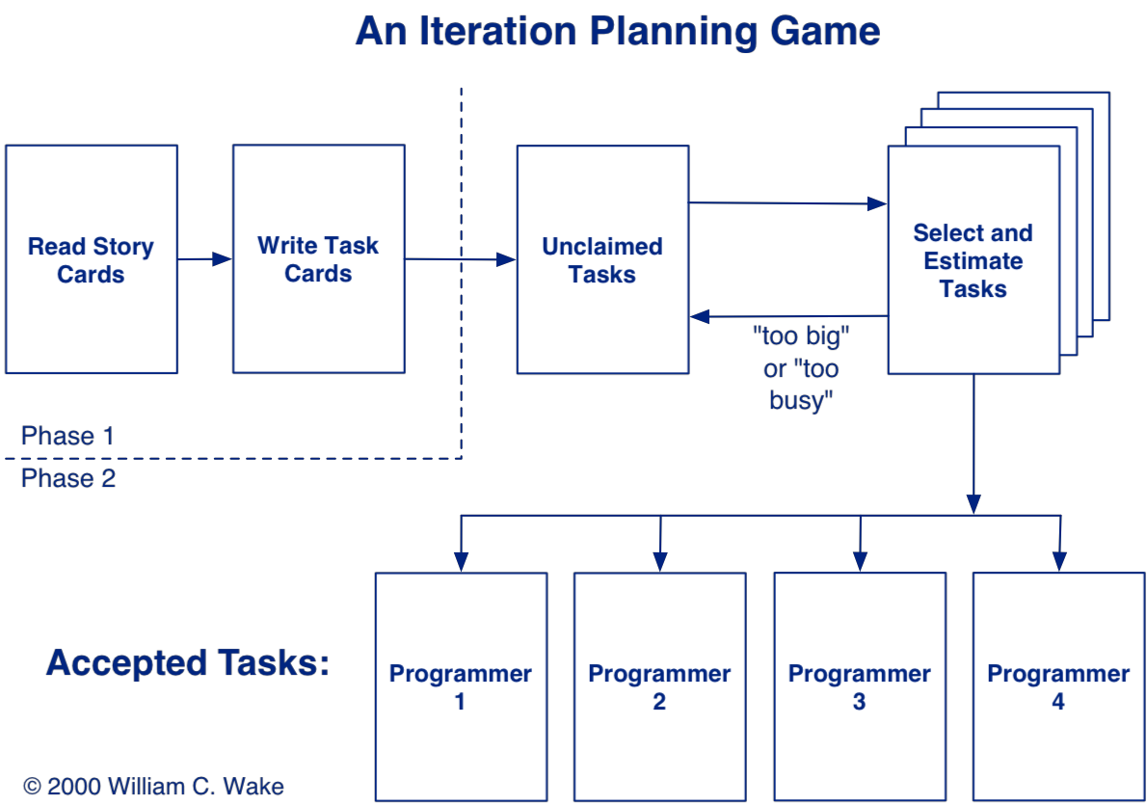
Iteration Planning

Slide 33
Iteration Planning
Customer selects stories to be implemented in this iteration.
Customer explains the stories in detail to the Developers
Resolve ambiguities and unclear parts in discussion
Developers brainstorm engineering tasks
A task is small enough that everybody fully understands it and can estimate it.
Use short CRC or UML sessions to determine how a story is accomplished.
Observing the design process builds common knowledge and confidence throughout the team
Developers /pairs sign up for work and estimates
Assignments are not forced upon anybody (Principle of Accepted Responsibility)
The person responsible for a task gets to do the estimate

Slide 34
Roadmap
XP — coping with change and uncertainty
Customers and Developers — why do we plan?
The Planning Game
Exploration — User stories
Estimation
Commitment
Steering
Iteration
Scrum
Agile lessons from industry

Slide 35
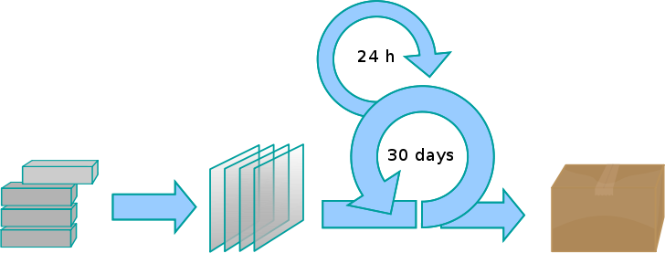
Scrum
The Scrum Software Development Process for Small Teams. In IEEE Software, July 2000
Product backlog
Sprint backlog
Sprint
Working increment
of the software
Scrum is a framework of an agile process to manage software projects
Notes:
http://en.wikipedia.org/wiki/Scrum_(development)
http://members.cox.net/risingl1/Articles/IEEEScrum.pdf

Slide 36
Scrum roles
Scrum Master — manages the process
removes impediments to the team
Product owner — stakeholder
prioritizes product backlog items
Team — ~7 developers (analysis, design etc)
decides which backlog items go into a sprint
Notes:
The team is multi-functional and covers a range of expertise.

Slide 37
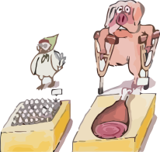
Chickens and Pigs
Pigs are committed to the project
Scrum Master, Product Owner, Team
Part of the Scrum process
Chickens are only involved
Managers, Stakeholders (vendors, customers)
Should be taken into account
Not part of the process!
Notes:
A pig and a chicken are walking down a road. The chicken looks at the pig and says, "Hey, why don't we open a restaurant?" The pig looks back at the chicken and says, "Good idea, what do you want to call it?" The chicken thinks about it and says, "Why don't we call it 'Ham and Eggs'?" "I don't think so," says the pig, "I'd be committed, but you'd only be involved.”
http://www.testertroubles.com/2009/04/scrum-pigs-and-chickens.html

Slide 38
Daily Scrum (standup meeting)
Same time, same place, every day
Start on time
Max 15”
Only pigs may speak
Answer 3 questions
What have I done since yesterday?
What am I planning to do today?
What problems are preventing me from reaching my goal?
Notes:
http://en.wikipedia.org/wiki/File:Rugby_union_scrummage.jpg

Slide 39
Other Scrum meetings
Scrum of scrums
meeting of teams, after the daily scrum
Sprint planning
prepare sprint backlog at start of sprint
Sprint review
review work completed at end of sprint
Sprint retrospective
review sprint process
Notes:
http://en.wikipedia.org/wiki/Scrum_(development)

Slide 40
Roadmap
XP — coping with change and uncertainty
Customers and Developers — why do we plan?
The Planning Game
Exploration — User stories
Estimation
Commitment
Steering
Iteration
Scrum
Agile lessons from industry
Slides by Tamar Richner

Slide 41
Agile Lessons from Industry
Need dedicated team
Willingness to prioritize requirements
Engaged product manager
Clear project governance
Project team should shape the process to its needs
Transparency and openness
Project success measured by delivered value
Notes:
Project gets an (almost) dedicated team
Readiness to prioritize requirements so that only top requirements are considered in the first iterations
Product manager engaged and available throughout project
Clear project governance
Project team should shape the process to its needs
Transparency and openness (acceptance of ‘bad news’)
Project success measured by delivered value, not by adherence to a detailed plan

Slide 42
Ingredients for Success
For the collaboration:
Stakeholders must understand the process
Need efficient decision making process
Someone must translate technical ←→ business
Team must agree on ground rules
Plan time to assess and improve collaboration
Notes:
For the collaboration:
All stakeholders must know and understand the process
Decision making process should ensure quick results
Someone in team needs to translate technical ←→business
Team must agree on ground rules for the collaboration
Plan time to reflect on and improve collaboration
For planning reliability:
Aim for reliable sprint planning (shorter is easier to estimate)
Define clearly what ‚complete‘ means
Put project management and planning work on the sprint backlog

Slide 43
Ingredients for Success
For planning reliability:
Aim for reliable sprint planning
shorter is easier to estimate
Define clearly what “complete” means
Put project management and planning on the sprint backlog
Notes:
For the collaboration:
All stakeholders must know and understand the process
Decision making process should ensure quick results
Someone in team needs to translate technical ←→business
Team must agree on ground rules for the collaboration
Plan time to reflect on and improve collaboration
For planning reliability:
Aim for reliable sprint planning (shorter is easier to estimate)
Define clearly what ‚complete‘ means
Put project management and planning work on the sprint backlog

Slide 44
Agile methods still need classical project management
Leadership is needed to facilitate “self-organization”
Frequent planning is required
Structure and discipline are needed
Continuous dialog with product owner takes time
Not every phase of project can be “agiled”
e.g. product launch and move to operation
Notes:
Leadership is needed to facilitate ‚self-organization‘
Frequent planning is required
Structure and discipline are needed
Continuous dialog with product owner takes time
Not every phase of project can be “agiled”, e.g. product launch and move to operation

Slide 45
What you should know!
Why is planning more important than having a plan?
Why shouldn’t Customers make technical decisions? Why shouldn’t Developers make business decisions?
Why should stories be written on index cards?
Why should the Customer sort stories by value?
Why should the Developer sort stories by risk?
How do you assign stories to Developers?

Slide 46
Can you answer the following questions?
What is “extreme” about XP?
What is the differences between a User Story and a Use Case?
Are Developers allowed to write stories?
What is the ideal time period for one iteration?
How can you improve your skill at estimating stories?

Slide 47
License
Attribution-ShareAlike 3.0 Unported
You are free:
to Share — to copy, distribute and transmit the work
to Remix — to adapt the work
Under the following conditions:
Attribution. You must attribute the work in the manner specified by the author or licensor (but not in any way that suggests that they endorse you or your use of the work).
Share Alike. If you alter, transform, or build upon this work, you may distribute the resulting work only under the same, similar or a compatible license.
For any reuse or distribution, you must make clear to others the license terms of this work. The best way to do this is with a link to this web page.
Any of the above conditions can be waived if you get permission from the copyright holder.
Nothing in this license impairs or restricts the author's moral rights.
http://creativecommons.org/licenses/by-sa/3.0/

