Slide 1
Introduction to Software Engineering
5. Software Validation

Slide 2
Roadmap
Reliability, Failures and Faults
Fault Avoidance
Fault Tolerance
Verification and Validation
The Testing process
Black box testing
White box testing
Statistical testing

Slide 3
Source
Software Engineering, I. Sommerville, 7th Edn., 2004.

Slide 4
Roadmap
Reliability, Failures and Faults
Fault Avoidance
Fault Tolerance
Verification and Validation
The Testing process
Black box testing
White box testing
Statistical testing

Slide 5
Software Reliability, Failures and Faults
The reliability of a software system is a measure of how well it provides the services expected by its users, expressed in terms of software failures.
A software failure is an execution event where the software behaves in an unexpected or undesirable way.
A software fault is an erroneous portion of a software system which may cause failures to occur if it is run in a particular state, or with particular inputs.

Slide 6
Kinds of failures
Failure class | Description
Transient | Occurs only with certain inputs
Permanent | Occurs with all inputs
Recoverable | System can recover without operator intervention
Unrecoverable | Operator intervention is needed to recover from failure
Non-corrupting | Failure does not corrupt data
Corrupting | Failure corrupts system data

Slide 7
Programming for Reliability
Fault avoidance:
development techniques to reduce the number of faults in a system
Fault tolerance:
developing programs that will operate despite the presence of faults

Slide 8
Roadmap
Reliability, Failures and Faults
Fault Avoidance
Fault Tolerance
Verification and Validation
The Testing process
Black box testing
White box testing
Statistical testing

Slide 9
Fault Avoidance
Fault avoidance depends on:
A precise system specification (preferably formal)
Software design based on information hiding and encapsulation
Extensive validation reviews during the development process
An organizational quality philosophy to drive the software process
Planned system testing to expose faults and assess reliability

Slide 10
Common Sources of Software Faults
Several features of programming languages and systems are common sources of faults in software systems:
Goto statements and other unstructured programming constructs make programs hard to understand, reason about and modify.
Use structured programming constructs
Floating point numbers are inherently imprecise and may lead to invalid comparisons.
Fixed point numbers are safer for exact comparisons
Pointers are dangerous because of aliasing, and the risk of corrupting memory
Pointer usage should be confined to abstract data type implementations

Slide 11
Common Sources of Software Faults ...
Parallelism is dangerous because timing differences can affect overall program behaviour in hard-to-predict ways.
Minimize inter-process dependencies
Recursion can lead to convoluted logic, and may exhaust (stack) memory.
Use recursion in a disciplined way, within a controlled scope
Interrupts force transfer of control independent of the current context, and may cause a critical operation to be terminated.
Minimize the use of interrupts; prefer disciplined exceptions

Slide 12
Roadmap
Reliability, Failures and Faults
Fault Avoidance
Fault Tolerance
Verification and Validation
The Testing process
Black box testing
White box testing
Statistical testing

Slide 13
Fault Tolerance
A fault-tolerant system must carry out four activities:
Failure detection: detect that the system has reached a particular state or will result in a system failure
Damage assessment: detect which parts of the system state have been affected by the failure
Fault recovery: restore the state to a known, “safe” state (either by correcting the damaged state, or backing up to a previous, safe state)
Fault repair: modify the system so the fault does not recur (!)
Notes:
Often, system failures are transient, and only require fault recovery

Slide 14
Approaches to Fault Tolerance
N-version Programming:
Multiple versions of the software system are implemented independently by different teams.
The final system:
runs all the versions in parallel,
compares their results using a voting system, and
rejects inconsistent outputs. (At least three versions should be available!)

Slide 15
Approaches to Fault Tolerance ...
Recovery Blocks:
A finer-grained approach in which a program unit contains a test to check for failure, and alternative code to back up and try in case of failure.
alternatives are executed in sequence, not in parallel
the failure test is independent (not by voting)

Slide 16
Defensive Programming
Failure detection:
Use the type system to ensure that variables do not get assigned invalid values.
Use assertions to detect failures and raise exceptions. Explicitly state and check all invariants for abstract data types, and pre- and post-conditions of procedures as assertions. Use exception handlers to recover from failures.
Use damage assessment procedures, where appropriate, to assess what parts of the state have been affected, before attempting to fix the damage.
Fault recovery:
Backward recovery: backup to a previous, consistent state
Forward recovery: make use of redundant information to reconstruct a consistent state from corrupted data
Notes:
Example — procedure to check whether all disk blocks either belong to files in use or to the free list.

Slide 17
Examples
Concurrency control
Pessimistic (locking)
Java synchronization; rcs
Optimistic (check for conflict before commit)
Cvs, Subversion
Distributed
Git, Monticello
Fault recovery
Change logs (rollback and replay)
Smalltalk image and changes
Transactional Memory (software and hardware)
ACID (Atomicy, Consistency, Isolation, Durability)

Slide 18
Roadmap
Reliability, Failures and Faults
Fault Avoidance
Fault Tolerance
Verification and Validation
The Testing process
Black box testing
White box testing
Statistical testing

Slide 19
Verification and Validation
Verification:
Are we building the product right?
i.e., does it conform to specs?
Validation:
Are we building the right product?
i.e., does it meet expectations?
Notes:
— Boehm (1979)

Slide 20
Verification and Validation ...
Static techniques include program inspection, analysis and formal verification.
Dynamic techniques include statistical testing and defect testing ...
Static verification
Requirements specification
High-level design
Formal specification
Detailed design
Program
Prototype
Dynamic Validation
© Ian Sommerville 2000
Notes:
Ch 19

Slide 21
Static Verification
Program Inspections:
Small team systematically checks program code
Inspection checklist often drives this activity
e.g., “Are all invariants, pre- and post-conditions checked?” ...
Static Program Analysers:
Complements compiler to check for common errors
e.g., variable use before initialization
Mathematically-based Verification:
Use mathematical reasoning to demonstrate that program meets specification
e.g., that invariants are not violated, that loops terminate, etc.
e.g., model-checking tools

Slide 22
Roadmap
Reliability, Failures and Faults
Fault Avoidance
Fault Tolerance
Verification and Validation
The Testing process
Black box testing
White box testing
Statistical testing

Slide 23
The Testing Process
Unit testing:
Individual (stand-alone) components are tested to ensure that they operate correctly.
Module testing:
A collection of related components (a module) is tested as a group.
Sub-system testing:
The phase tests a set of modules integrated as a sub-system. Since the most common problems in large systems arise from sub-system interface mismatches, this phase focuses on testing these interfaces.

Slide 24
The Testing Process ...
System testing:
This phase concentrates on (i) detecting errors resulting from unexpected interactions between sub-systems, and (ii) validating that the complete systems fulfils functional and non-functional requirements.
Acceptance testing (alpha/beta testing):
The system is tested with real rather than simulated data.
Testing is iterative! Regression testing is performed when defects are repaired.

Slide 25
Regression testing
Regression testing means testing that everything that used to work still works after changes are made to the system!
tests must be deterministic and repeatable
should test “all” functionality
every interface
all boundary situations
every feature
every line of code
everything that can conceivably go wrong!
It costs extra work to define tests up front, but they pay off in debugging & maintenance!

Slide 26
Test Planning
The preparation of the test plan should begin when the system requirements are formulated, and the plan should be developed in detail as the software is designed.
Requirements specification
System specification
System design
Detailed design
Acceptance test plan
System integration test plan
Sub-system integration test plan
Module and unit code and test
Service
Acceptance test
System integration test
Sub-system integration test
The plan should be revised regularly, and tests should be repeated and extended where the software process iterates.
© Ian Sommerville 2000
Notes:
Ch 19

Slide 27
Top-down Testing
Start with sub-systems, where modules are represented by “stubs”
Similarly test modules, representing functions as stubs
Coding and testing are carried out as a single activity
Design errors can be detected early on, avoiding expensive redesign
Always have a running (if limited) system!
BUT: may be impractical for stubs to simulate complex components

Slide 28
Bottom-up Testing
Start by testing units and modules
Test drivers must be written to exercise lower-level components
Works well for reusable components to be shared with other projects
BUT: pure bottom-up testing will not uncover architectural faults till late in the software process
Typically a combination of top-down and bottom-up testing is best.

Slide 29
Testing vs Correctness
“Program testing can be a very effective way to show the presence of bugs, but is hopelessly inadequate for showing their absence.”
Edsger Dijkstra, The Humble Programmer, ACM Turing lecture, 1972

Slide 30
Defect Testing
Tests are designed to reveal the presence of defects in the system.
Testing should, in principle, be exhaustive, but in practice can only be representative.
Test data are inputs devised to test the system.
Test cases are input/output specifications for a particular function being tested.

Slide 31
Defect Testing ...
Petschenik (1985) proposes:
“Testing a system’s capabilities is more important than testing its components.”
Choose test cases that will identify situations that may prevent users from doing their job.
“Testing old capabilities is more important than testing new capabilities.”
Always perform regression tests when the system is modified.
“Testing typical situations is more important than testing boundary value cases.”
If resources are limited, focus on typical usage patterns.

Slide 32
Roadmap
Reliability, Failures and Faults
Fault Avoidance
Fault Tolerance
Verification and Validation
The Testing process
Black box testing
White box testing
Statistical testing

Slide 33
Functional (black box) testing
Inputs causing anomalous behaviour
Functional testing treats a component as a “black box” whose behaviour can be determined only by studying its inputs and outputs.
I
Input test data
System
Outputs which reveal the presence of defects
Output test results
O_{e}
© Ian Sommerville 2000
Notes:
Ch 20

Slide 34
Coverage Criteria
Test cases are derived from the external specification of the component and should cover:
all exceptions
all data ranges (incl. invalid) generating different classes of output
all boundary values
Test cases can be derived from a component’s interface, by assuming that the component will behave similarly for all members of an equivalence partition ...

Slide 35
Equivalence partitioning
public static void search(int key, int [] elemArray, Result r)
{ … }
Check input partitions:
Do the inputs fulfil the pre-conditions?
is the array sorted, non-empty ...
Is the key in the array?
leads to (at least) 2x2 equivalence classes
Check boundary conditions:
Is the array of length 1?
Is the key at the start or end of the array?
leads to further subdivisions (not all combinations make sense)

Slide 36
Test Cases and Test Data
Generate test data that cover all meaningful equivalence partitions.
Test Cases | Test Data
Array length 0 | key = 17, elements = { }
Array not sorted | key = 17, elements = { 33, 20, 17, 18 }
Array size 1, key in array | key = 17, elements = { 17 }
Array size 1, key not in array | key = 0, elements = { 17 }
Array size > 1, key is first element | key = 17, elements = { 17, 18, 20, 33 }
Array size > 1, key is last element | key = 33, elements = { 17, 18, 20, 33 }
Array size > 1, key is in middle | key = 20, elements = { 17, 18, 20, 33 }
Array size > 1, key not in array | key = 50, elements = { 17, 18, 20, 33 }
...

Slide 37
Roadmap
Reliability, Failures and Faults
Fault Avoidance
Fault Tolerance
Verification and Validation
The Testing process
Black box testing
White box testing
Statistical testing

Slide 38
Structural (white box) Testing
Structural testing treats a component as a “white box” or “glass box” whose structure can be examined to generate test cases.
Derive test cases to maximize coverage of that structure, yet minimize the number of test cases.
Test data
Tests
Derives
Component code
Test outputs
© Ian Sommerville 2000
Notes:
Ch 20

Slide 39
Coverage criteria
every statement at least once
all portions of control flow at least once
all possible values of compound conditions at least once
all portions of data flow at least once
for all loops L, with n allowable passes:
skip the loop;
1 pass through the loop
2 passes
m passes where 2 < m < n
n-1, n, n+1 passes
Path testing is a white-box strategy which exercises every independent execution path through a component.

Slide 40
class BinSearch {
// This is an encapsulation of a binary search function that takes an array of
// ordered objects and a key and returns an object with 2 attributes namely
// index - the value of the array index
// found - a boolean indicating whether or not the key is in the array
// An object is returned because it is not possible in Java to pass basic types by
// reference to a function and so return two values
// the key is -1 if the element is not found
public static void search (int key, int [] elemArray, Result r)
{
int bottom = 0;
int top = elemArray.length - 1;
int mid;
r.found = false; r.index = -1; (1)
while ( bottom <= top) (2)
{
mid = (top + bottom) / 2;
if (elemArray [mid] == key) (3)
{
r.index = mid; (8)
r.found = true;
return ; -> (9)
} // if part
else
{
if (elemArray [mid] < key) (4)
bottom = mid + 1; (5)
else
top = mid -i; (6)
} (7)
} //while loop
} //search (9)
} //BinSearch
© Ian Sommerville 2000

Slide 41
Program flow graphs
Each branch is shown as a separate path and loops are shown by arrows looping back to the loop condition node
The number of tests to test all control statements equals the cyclomatic complexity
Cyclomatic complexity = Number of edges - Number of nodes +2

Slide 42
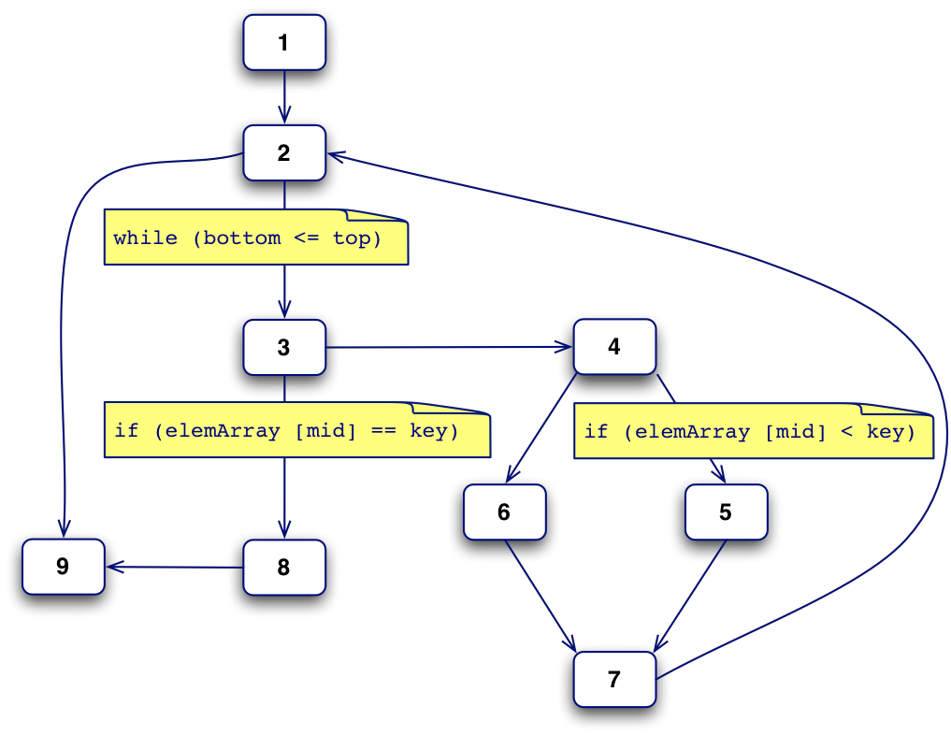
Path Testing
Test cases should be chosen to cover all independent paths through a routine:
1, 2, 9
1, 2, 3, 8, 9
1, 2, 3, 4, 5, 7, 2, 9
1, 2, 3, 4, 6, 7, 2, 9
(Each path traverses at least one new edge)
Notes:
Ch 20

Slide 43
Roadmap
Reliability, Failures and Faults
Fault Avoidance
Fault Tolerance
Verification and Validation
The Testing process
Black box testing
White box testing
Statistical testing

Slide 44
Statistical Testing
The objective of statistical testing is to determine the reliability of the software, rather than to discover faults.
Reliability may be expressed as:
probability of failure on demand
i.e., for safety-critical systems
rate of failure occurrence
i.e., #failures/time unit
mean time to failure
i.e., for a stable system
availability
i.e., fraction of time, for e.g. telecom systems

Slide 45
Statistical Testing ...
Tests are designed to reflect the frequency of actual user inputs and, after running the tests, an estimate of the operational reliability of the system can be made:
Determine usage patterns of the system (classes of input and probabilities)
Select or generate test data corresponding to these patterns
Apply the test cases, recording execution time to failure
Based on a statistically significant number of test runs, compute reliability

Slide 46
When to Stop?
When are we done testing? When do we have enough tests?
Cynical Answers (sad but true)
You’re never done: each run of the system is a new test
Each bug-fix should be accompanied by a new regression test
You’re done when you are out of time/money
Include testing in the project plan and do not give in to pressure
... in the long run, tests save time

Slide 47
When to Stop? ...
Statistical Testing
Test until you’ve reduced the failure rate to fall below the risk threshold
Testing is like an insurance company calculating risks
Errors per
test hour
Execution Time

Slide 48
What you should know!
What is the difference between a failure and a fault?
What kinds of failure classes are important?
How can a software system be made fault-tolerant?
How do assertions help to make software more reliable?
What are the goals of software validation and verification?
What is the difference between test cases and test data?
How can you develop test cases for your programs?
What is the goal of path testing?

Slide 49
Can you answer the following questions?
When would you combine top-down testing with bottom-up testing?
When would you combine black-box testing with white-box testing?
Is it acceptable to deliver a system that is not 100% reliable?

Slide 50
License
Attribution-ShareAlike 3.0 Unported
You are free:
to Share — to copy, distribute and transmit the work
to Remix — to adapt the work
Under the following conditions:
Attribution. You must attribute the work in the manner specified by the author or licensor (but not in any way that suggests that they endorse you or your use of the work).
Share Alike. If you alter, transform, or build upon this work, you may distribute the resulting work only under the same, similar or a compatible license.
For any reuse or distribution, you must make clear to others the license terms of this work. The best way to do this is with a link to this web page.
Any of the above conditions can be waived if you get permission from the copyright holder.
Nothing in this license impairs or restricts the author's moral rights.
http://creativecommons.org/licenses/by-sa/3.0/

