Slide 1
Introduction to Software Engineering
7. Modeling Behaviour

Slide 2
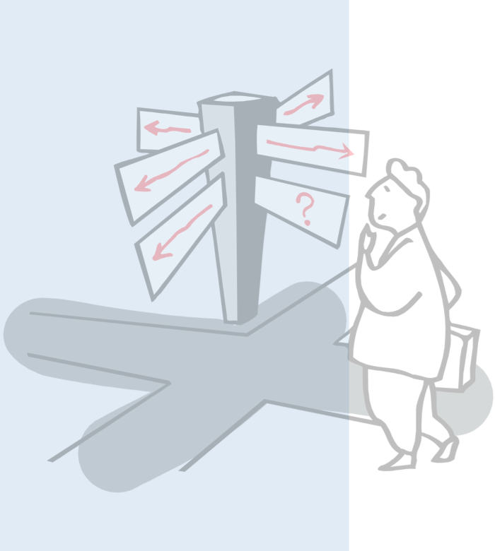
Roadmap
Use Case Diagrams
Sequence Diagrams
Collaboration (Communication) Diagrams
Statechart Diagrams
Nested statecharts
Concurrent substates
Using UML

Slide 3
Source
The Unified Modeling Language Reference Manual, James Rumbaugh, Ivar Jacobson and Grady Booch, Addison Wesley, 1999.

Slide 4
Roadmap
Use Case Diagrams
Sequence Diagrams
Collaboration (Communication) Diagrams
Statechart Diagrams
Nested statecharts
Concurrent substates
Using UML

Slide 5
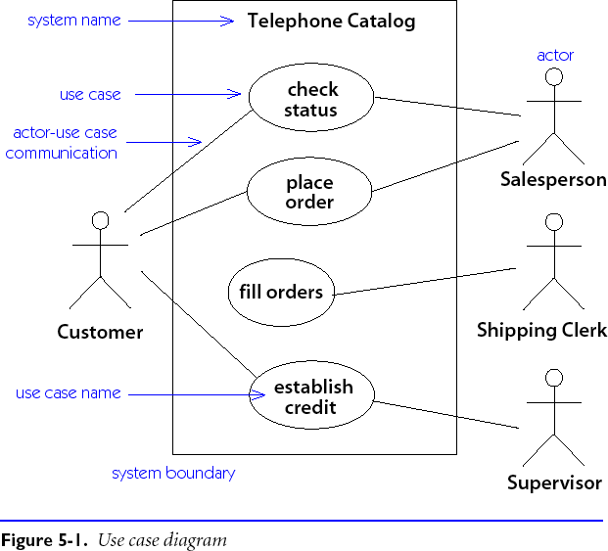
Use Case Diagrams
A use case is a generic description of an entire transaction involving several actors.
A use case diagram presents a set of use cases (ellipses) and the external actors that interact with the system.
Dependencies and associations between use cases may be indicated.

Slide 6
Using Use Case Diagrams
“A use case is a snapshot of one aspect of your system. The sum of all use cases is the external picture of your system …”
UML Distilled
“As use cases appear, assess their impact on the domain model.”
Use cases can drive domain modeling by highlighting the important concepts.
Notes:
P 9, 21

Slide 7
Roadmap
Use Case Diagrams
Sequence Diagrams
Collaboration (Communication) Diagrams
Statechart Diagrams
Nested statecharts
Concurrent substates
Using UML

Slide 8
Scenarios
A scenario is an instance of a use case showing a typical example of its execution.
Scenarios can be presented in UML using either sequence diagrams or collaboration diagrams.
Note that a scenario only describes an example of a use case, so conditionality cannot be expressed!

Slide 9
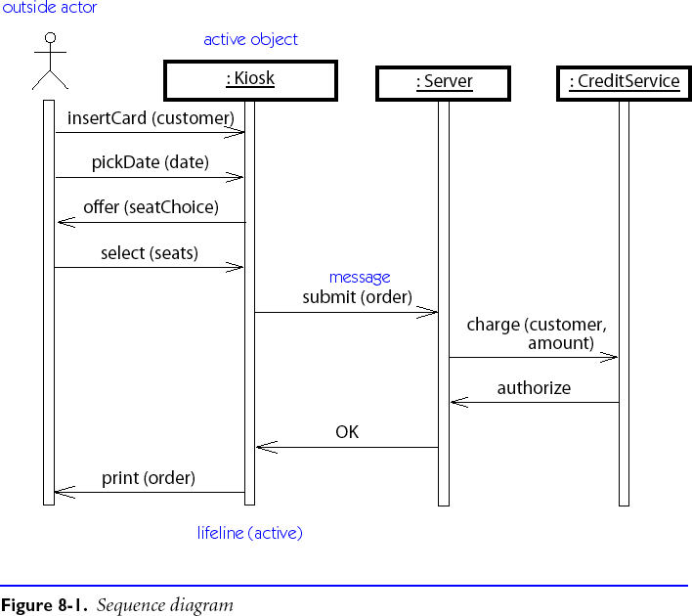
Sequence Diagrams
A sequence diagram depicts a scenario by showing the interactions among a set of objects in temporal order.
Objects (not classes!) are shown as vertical bars. Events or message dispatches are shown as horizontal (or slanted) arrows from the sender to the receiver.

Slide 10
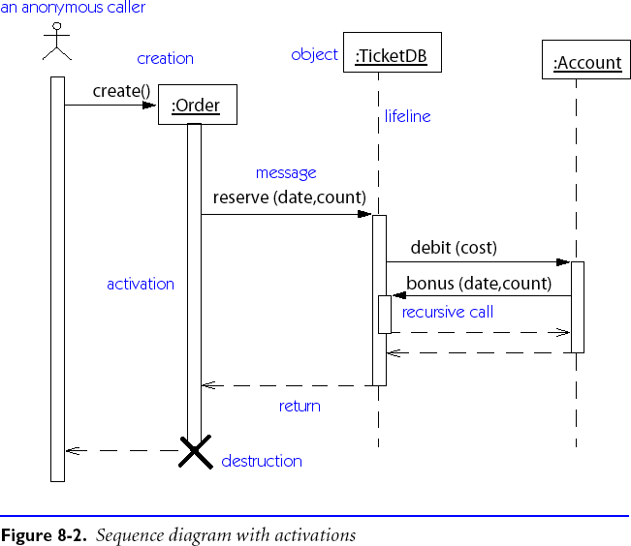
Activations
Avoid returns in sequence diagrams unless they add clarity.
Notes:
UML Distilled p 105

Slide 11
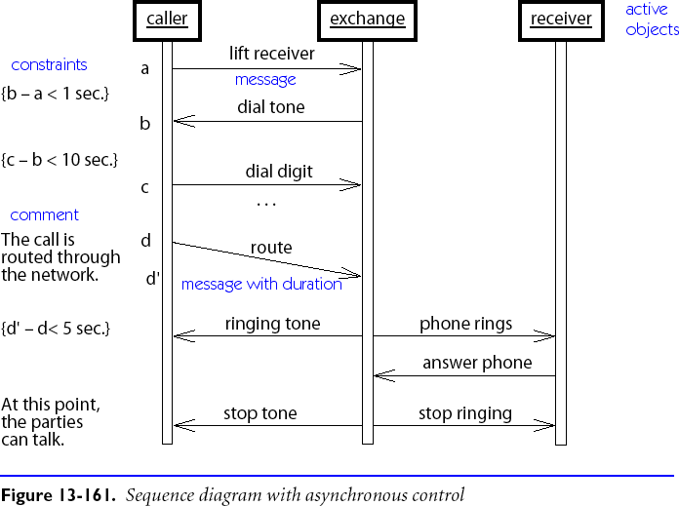
Asynchrony and Constraints

Slide 12
Roadmap
Use Case Diagrams
Sequence Diagrams
Collaboration (Communication) Diagrams
Statechart Diagrams
Nested statecharts
Concurrent substates
Using UML

Slide 13
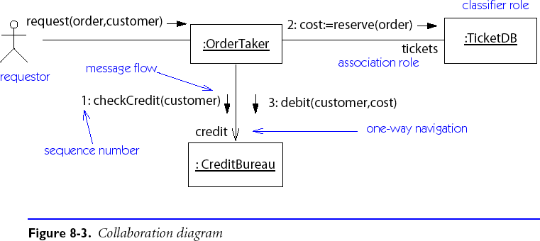
Collaboration Diagrams
Collaboration diagrams (called Communication diagrams in UML 2.0) depict scenarios as flows of messages between objects:

Slide 14
Message Labels
Messages from one object to another are labelled with text strings showing the direction of message flow and information indicating the message sequence.
Prior messages from other threads (e.g. “[A1.3, B6.7.1]”)
only needed with concurrent flow of control
Dot-separated list of sequencing elements
sequencing integer (e.g., “3.1.2” is invoked by “3.1” and follows “3.1.1”)
letter indicating concurrent threads (e.g., “1.2a” and “1.2b”)
iteration indicator (e.g., “1.1*[i=1..n]”)
conditional indicator (e.g., “2.3 [#items = 0]”)
Return value binding (e.g., “status :=”)
Message name
event or operation name
Argument list

Slide 15
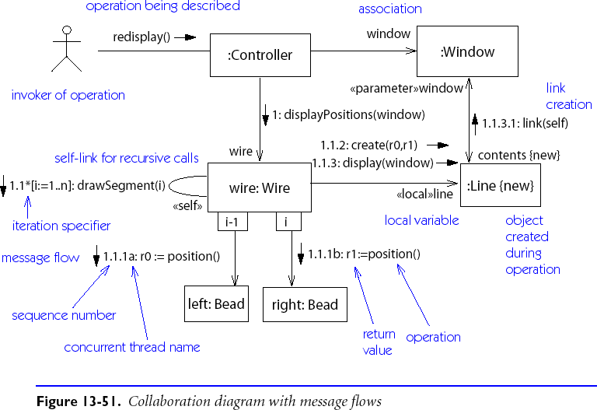
Nested Message Flows

Slide 16
Roadmap
Use Case Diagrams
Sequence Diagrams
Collaboration (Communication) Diagrams
Statechart Diagrams
Nested statecharts
Concurrent substates
Using UML

Slide 17
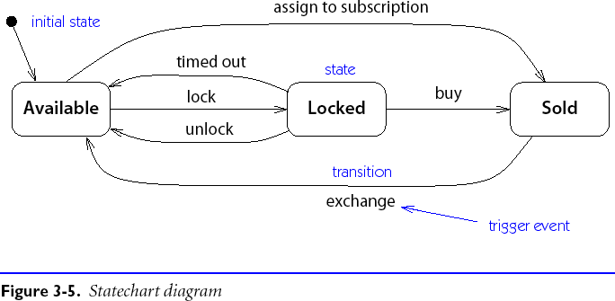
Statechart Diagrams

Slide 18
Statechart Diagram Notation
A Statechart Diagram describes the temporal evolution of an object of a given class in response to interactions with other objects inside or outside the system.
An event is a one-way (asynchronous) communication from one object to another:
atomic (non-interruptible)
includes events from hardware and real-world objects e.g., message receipt, input event, elapsed time, ...
notation: eventName(parameter: type, ...)
may cause object to make a transition between states

Slide 19
Statechart Diagram Notation ...
A state is a period of time during which an object is waiting for an event to occur:
depicted as rounded box with (up to) three sections:
name — optional
state variables — name: type = value (valid only for that state)
triggered operations — internal transitions and ongoing operations
may be nested

Slide 20
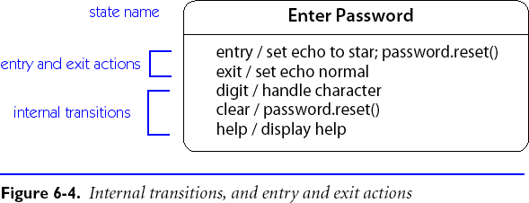
State Box with Regions
The entry event occurs whenever a transition is made into this state, and the exit operation is triggered when a transition is made out of this state.
The help and character events cause internal transitions with no change of state, so the entry and exit operations are not performed.

Slide 21
Transitions
A transition is an response to an external event received by an object in a given state
May invoke an operation, and cause the object to change state
May send an event to an external object
Transition syntax (each part is optional): event(arguments) [condition] / ^target.sendEvent operation(arguments)
External transitions label arcs between states
Internal transitions are part of the triggered operations of a state

Slide 22
Operations and Activities
An operation is an atomic action invoked by a transition
Entry and exit operations can be associated with states
An activity is an ongoing operation that takes place while object is in a given state
Modelled as “internal transitions” labelled with the pseudo-event do

Slide 23
Roadmap
Use Case Diagrams
Sequence Diagrams
Collaboration (Communication) Diagrams
Statechart Diagrams
Nested statecharts
Concurrent substates
Using UML

Slide 24
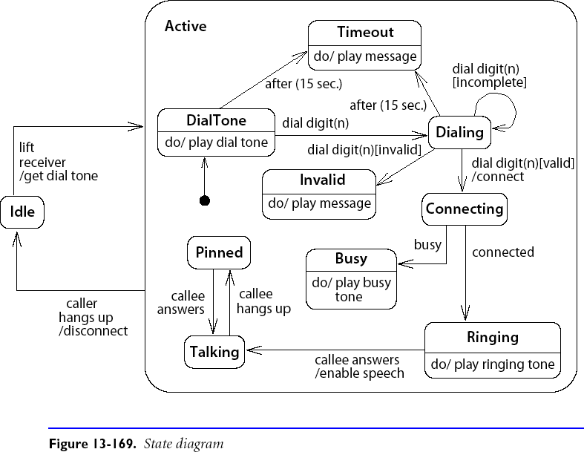
Nested Statecharts

Slide 25
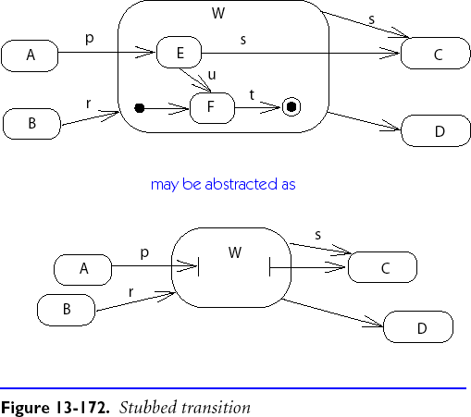
Composite States
Composite states may depicted either as high-level or low-level views.
“Stubbed transitions” indicate the presence of internal states:
Initial and terminal substates are shown as black spots and “bulls-eyes”

Slide 26
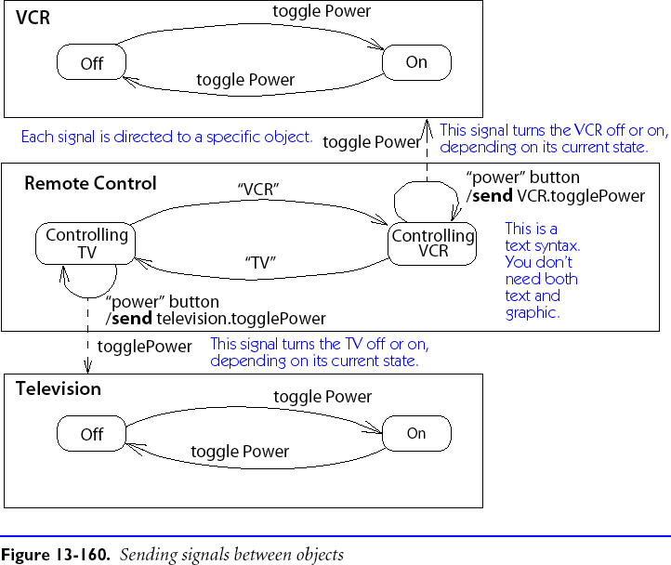
Sending Events between Objects

Slide 27
Roadmap
Use Case Diagrams
Sequence Diagrams
Collaboration (Communication) Diagrams
Statechart Diagrams
Nested statecharts
Concurrent substates
Using UML

Slide 28
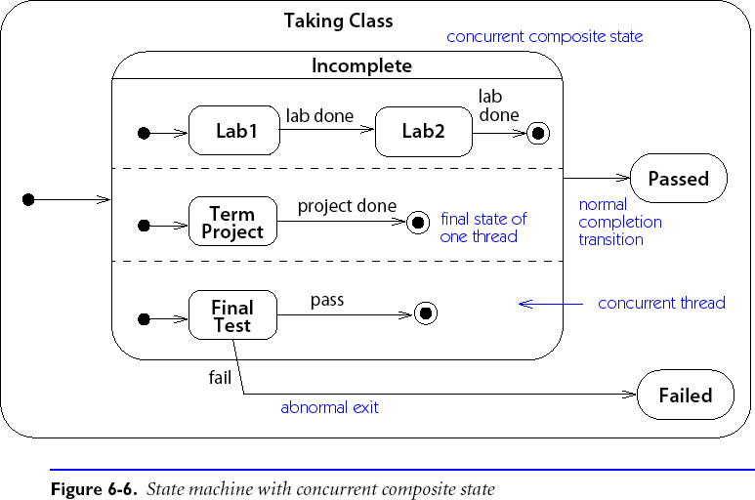
Concurrent Substates

Slide 29
Branching and Merging
Entering concurrent states:
Entering a state with concurrent substates means that each of the substates is entered concurrently (one logical thread per substate).
Leaving concurrent states:
A labelled transition out of any of the substates terminates all of the substates.
An unlabelled transition out of the overall state waits for all substates to terminate.

Slide 30
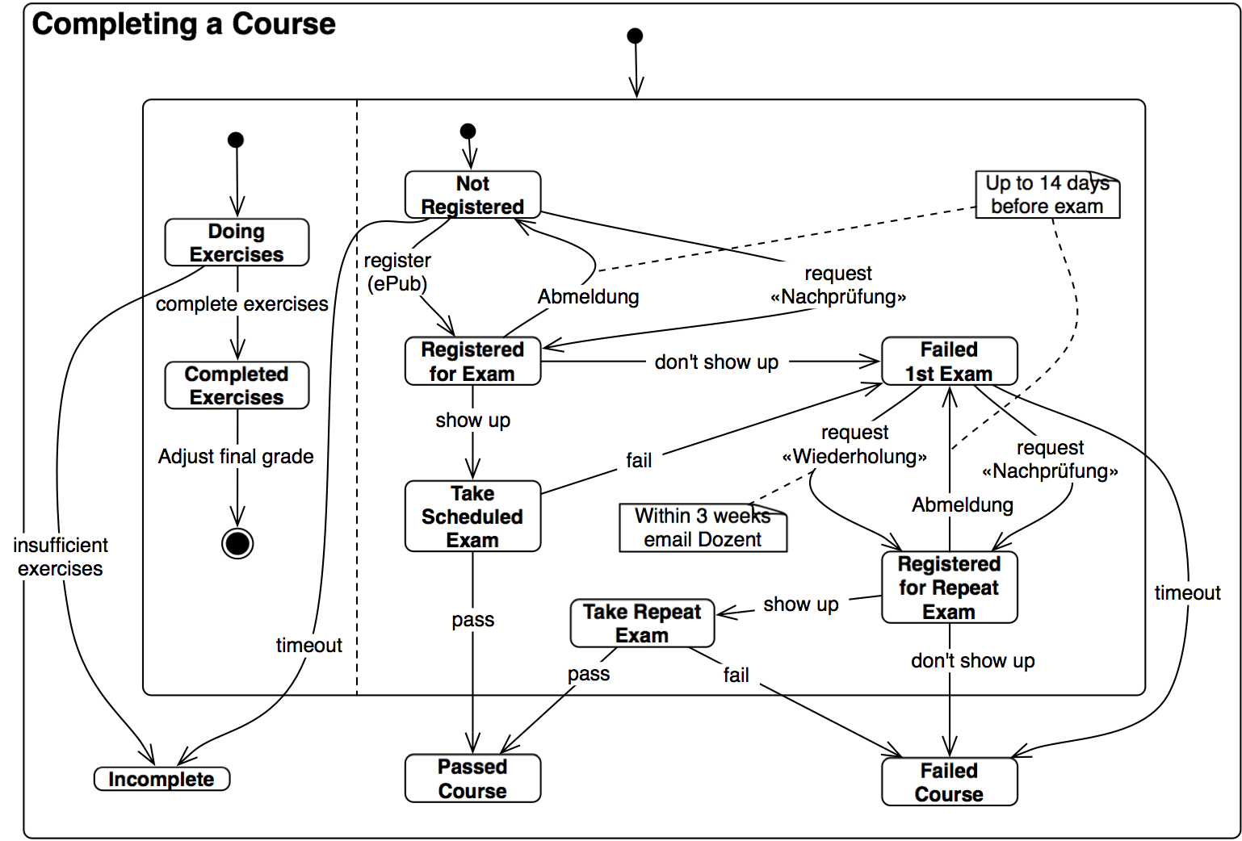
Is it correct?

Slide 31
Roadmap
Use Case Diagrams
Sequence Diagrams
Collaboration (Communication) Diagrams
Statechart Diagrams
Nested statecharts
Concurrent substates
Using UML

Slide 32
Perspectives
Three perspectives in drawing UML diagrams:
Conceptual
Represent domain concepts
Ignore software issues
Specification
Focus on visible interfaces and behaviour
Ignore internal implementation
Implementation
Document implementation choices
Most common, but least useful perspective(!)
UML Distilled
Notes:
UML Distilled p 55

Slide 33
Using the Notations
The diagrams introduced here complement class and object diagrams.
During Analysis:
Use case, sequence and collaboration diagrams document use cases and their scenarios during requirements specification
During Design:
Sequence and collaboration diagrams can be used to document implementation scenarios or refine use case scenarios
State diagrams document internal behaviour of classes and must be validated against the specified use cases

Slide 34
What you should know!
What is the purpose of a use case diagram?
Why do scenarios depict objects but not classes?
How can timing constraints be expressed in scenarios?
How do you specify and interpret message labels in a scenario?
How do you use nested state diagrams to model object behaviour?
What is the difference between “external” and “internal” transitions?
How can you model interaction between state diagrams for several classes?

Slide 35
Can you answer the following questions?
Can a sequence diagram always be translated to an collaboration diagram?
Or vice versa?
Why are arrows depicted with the message labels rather than with links?
When should you use concurrent substates?

Slide 36
License
Attribution-ShareAlike 3.0 Unported
You are free:
to Share — to copy, distribute and transmit the work
to Remix — to adapt the work
Under the following conditions:
Attribution. You must attribute the work in the manner specified by the author or licensor (but not in any way that suggests that they endorse you or your use of the work).
Share Alike. If you alter, transform, or build upon this work, you may distribute the resulting work only under the same, similar or a compatible license.
For any reuse or distribution, you must make clear to others the license terms of this work. The best way to do this is with a link to this web page.
Any of the above conditions can be waived if you get permission from the copyright holder.
Nothing in this license impairs or restricts the author's moral rights.
http://creativecommons.org/licenses/by-sa/3.0/

