Slide 1
Introduction to Software Engineering
9. Project Management

Slide 2
Roadmap
Risk management
Scoping and estimation
Planning and scheduling
Dealing with delays
Staffing, directing, teamwork

Slide 3
Literature
Sources
Software Engineering, I. Sommerville, 7th Edn., 2004.
Software Engineering — A Practitioner’s Approach, R. Pressman, Mc-Graw Hill, 5th Edn., 2001.
Recommended Reading
The Mythical Man-Month, F. Brooks, Addison-Wesley, 1975
Peopleware, Productive Projects and Teams (2nd edition), Tom DeMarco and Timothy Lister, Dorset House, 1999.
Succeeding with Objects: Decision Frameworks for Project Management, A. Goldberg and K. Rubin, Addison-Wesley, 1995
Extreme Programming Explained: Embrace Change, Kent Beck, Addison Wesley, 1999
Notes:
Also Object Lessons, T. Love, SIGS Books, 1993

Slide 4
Roadmap
Risk management
Scoping and estimation
Planning and scheduling
Dealing with delays
Staffing, directing, teamwork

Slide 5
Why Project Management?
Almost all software products are obtained via projects. (as opposed to manufactured products)
Project Concern = Deliver on time and within budget
Achieve Interdependent &
Conflicting Goals
Limited Resources
The Project Team is the
primary Resource!

Slide 6
What is Project Management?
Project Management = Plan the work and work the plan
Management Functions
Planning: Estimate and schedule resources
Organization: Who does what
Staffing: Recruiting and motivating personnel
Directing: Ensure team acts as a whole
Monitoring (Controlling): Detect plan deviations + corrective actions

Slide 7
Risk Management
If you don’t actively attack risks, they will actively attack you.
— Tom Gilb
Project risks
budget, schedule, resources, size, personnel, morale ...
Technical risks
implementation technology, verification, maintenance ...
Business risks
market, sales, management, commitment ...
Notes:
Pressman pp 44, 96

Slide 8
Risk Management …
Management must:
identify risks as early as possible
assess whether risks are acceptable
take appropriate action to mitigate and manage risks
e.g., training, prototyping, iteration, ...
monitor risks throughout the project

Slide 9
Risk Management Techniques
Risk Items | Risk Management Techniques
Personnel shortfalls | Staffing with top talent; team building; cross-training; pre-scheduling key people
Unrealistic schedules and budgets | Detailed multi-source cost & schedule estimation; incremental development; reuse; re-scoping
Developing the wrong software functions | User-surveys; prototyping; early users’s manuals

Slide 10
Risk Management Techniques …
Risk Items | Risk Management Techniques
Continuing stream of requirements changes | High change threshold; information hiding; incremental development
Real time performance shortfalls | Simulation; benchmarking; modeling; prototyping; instrumentation; tuning
Straining computer science capabilities | Technical analysis; cost-benefit analysis; prototyping; reference checking

Slide 11
Roadmap
Risk management
Scoping and estimation
Planning and scheduling
Dealing with delays
Staffing, directing, teamwork

Slide 12
Focus on Scope
For decades, programmers have been whining, “The customers can’t tell us what they want. When we give them what they say they want, they don’t like it.” Get over it. This is an absolute truth of software development. The requirements are never clear at first. Customers can never tell you exactly what they want.
— Kent Beck

Slide 13
Myth: Scope and Objectives
Myth
“A general statement of objectives is enough to start coding.”
Reality
Poor up-front definition is the major cause of project failure.
Notes:
Myth found at Pressman, page 18, Treatment: See Pressman page 67-68

Slide 14
Scope and Objectives
In order to plan, you must set clear scope & objectives
Objectives identify the general goals of the project, not how they will be achieved.
Scope identifies the primary functions that the software is to accomplish, and bounds these functions in a quantitative manner.
Goals must be realistic and measurable
Constraints, performance, reliability must be explicitly stated
Customer must set priorities

Slide 15
Estimation Strategies
These strategies are simple but risky:
Expert judgement | Consult experts and compare estimates  cheap, but unreliable
Estimation by analogy | Compare with other projects in the same application domain  limited applicability
Parkinson's Law | Work expands to fill the time available  pessimistic management strategy
Pricing to win | You do what you can with the budget available  requires trust between parties

Slide 16
Estimation Techniques
“Decomposition” and “Algorithmic cost modeling” are used together
Decomposition | Estimate costs for components + integration  top-down or bottom-up estimation
Algorithmic cost modeling | Exploit database of historical facts to map size on costs  requires correlation data

Slide 17
Measurement-based Estimation
A. Measure
C. Interpret
Develop a
system model
Adapt the effort with
and measure its size
respect to a specific
Development Project Plan
B. Estimate
Determine the effort with
respect to an
empirical
database
of measurements
from
similar projects
More on this later (Metrics lecture) …
Notes:
NB: can be applied in a very informal or a formal way ...

Slide 18
Estimation and Commitment
Example: The XP process
a. Customers write stories and b. Programmers estimate stories
else ask the customers to split/rewrite stories
Programmers measure the team load factor, the ratio of ideal programming time to the calendar
Customers sort stories by priority
Programmers sort stories by risk
a. Customers pick date, programmers calculate budget, customers pick stories adding up to that number, or b. Customers pick stories, programmers calculate date (customers complain, programmers ask to reduce scope, customers complain some more but reduce scope anyway) …

Slide 19
Roadmap
Risk management
Scoping and estimation
Planning and scheduling
Dealing with delays
Staffing, directing, teamwork

Slide 20
Some Laws of Project Management
A carelessly planned project will take three times longer to complete than expected. A carefully planned project will only take twice as long.
Project teams detest progress reporting because it manifests their lack of progress.
Projects progress quickly until they are 90% complete. Then they remain at 90% complete forever.
If project content is allowed to change freely, the rate of change will exceed the rate of progress.

Slide 21
Planning and Scheduling
Good planning depends largely on project manager’s intuition and experience!
Split project into tasks.
Tasks into subtasks etc.
For each task, estimate the time.
Define tasks small enough for reliable estimation.
Significant tasks should end with a milestone.
Milestone = A verifiable goal that must be met after task completion
Clear unambiguous milestones are a necessity! (“80% coding finished” is a meaningless statement)
Monitor progress via milestones

Slide 22
Planning and Scheduling ...
Define dependencies between project tasks
Total time depends on longest (= critical) path in activity graph
Minimize task dependencies to avoid delays
Organize tasks concurrently to make optimal use of workforce
Planning is iterative
monitor and revise schedules during the project!

Slide 23
Myth: Deliverables and Milestones
Myth
“The only deliverable for a successful project is the working program.”
Reality
Documentation of all aspects of software development are needed to ensure maintainability.

Slide 24
Deliverables and Milestones
Project deliverables are results that are delivered to the customer.
E.g.:
initial requirements document
UI prototype
architecture specification
Milestones and deliverables help to monitor progress
Should be scheduled roughly every 2-3 weeks
NB: Deliverables must evolve as the project progresses!

Slide 25
Example: Task Durations and Dependencies
Task | Duration (days) | Dependencies
T1 | 8
T2 | 15
T3 | 15 | T1
T4 | 10
T5 | 10 | T2, T4
T6 | 5 | T1, T2
T7 | 20 | T1
T8 | 25 | T4
T9 | 15 | T3, T6
T10 | 15 | T5, T7
T11 | 7 | T9
T12 | 10 | T11
What is the minimum total duration of this project?

Slide 26
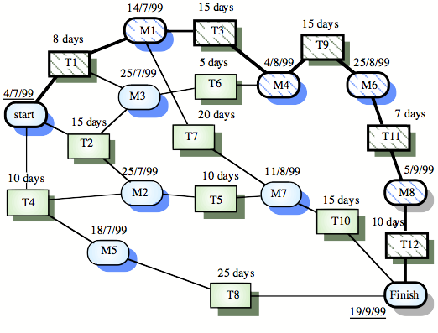
Pert Chart: Activity Network
Task
Milestone
© Ian Sommerville 2000
Notes:
Ch 4

Slide 27
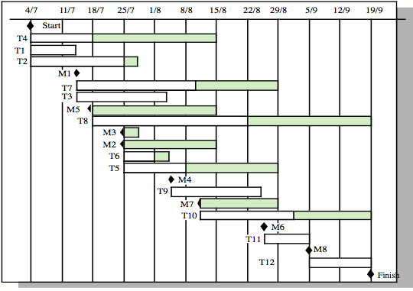
Gantt Chart: Activity Timeline
Planned completion
Latest completion
© Ian Sommerville 2000
Notes:
Ch 4

Slide 28
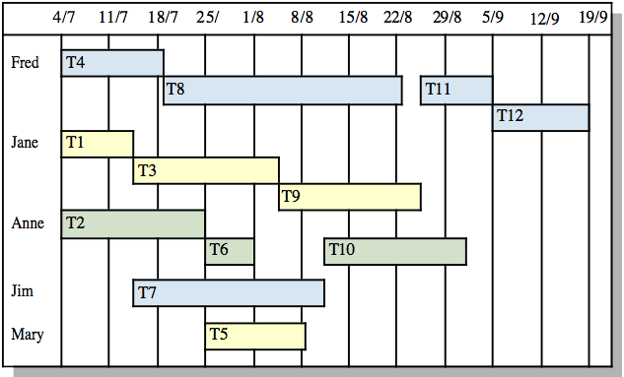
Gantt Chart: Staff Allocation
© Ian Sommerville 2000
Notes:
Ch 4

Slide 29
Roadmap
Risk management
Scoping and estimation
Planning and scheduling
Dealing with delays
Staffing, directing, teamwork

Slide 30
Myth: Delays
Myth
“If we get behind schedule, we can add more programmers and catch up.”
Reality
Adding more people typically slows a project down.
Notes:
Pressman p 20 ...

Slide 31
Scheduling problems
Estimating the difficulty of problems and the cost of developing a solution is hard
Productivity is not proportional to the number of people working on a task
Adding people to a late project makes it later due to communication overhead
The unexpected always happens. Always allow contingency in planning
Cutting back in testing and reviewing is a recipe for disaster
Working overnight? Only short term benefits!
Notes:
Pressman p 20 ...

Slide 32
Planning under uncertainty
State clearly what you know and don’t know
State clearly what you will do to eliminate unknowns
Make sure that all early milestones can be met
Plan to replan

Slide 33
Dealing with Delays
Spot potential delays as soon as possible
... then you have more time to recover
How to spot?
Earned value analysis
planned time is the project budget
time of a completed task is credited to the project budget
...

Slide 34
Dealing with Delays ...
How to recover?
A combination of following 3 actions
Adding senior staff for well-specified tasks
outside critical path to avoid communication overhead
Prioritize requirements and deliver incrementally
deliver most important functionality on time
testing remains a priority (even if customer disagrees)
Extend the deadline

Slide 35
Gantt Chart: Slip Line
Visualize slippage
Shade time line = portion of task completed
Draw a slip line at current date, connecting endpoints of the shaded areas
bending to the right = ahead of schedule
to the left = behind schedule
J
F
M
A
M
J
J
A
S
O
N
D
J
F
M
A
M
J
J
A
1.Start
2.Design
3.Implementation
3.1.build scanner
ahead of schedule
3.2.build parser
3.3. build code generator
4.Integrate & Test
behind
5.Write manual
6. Reviewing
7. Finish

Slide 36
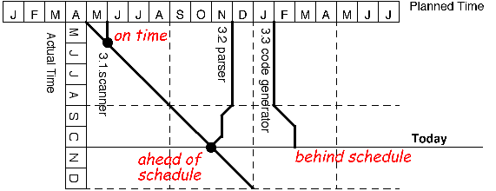
Timeline Chart
Visualise slippage evolution
downward lines represent planned completion time as they vary in current time
bullets at the end of a line represent completed tasks

Slide 37
Slip Line vs. Timeline
Slip Line | Monitors current slip status of project tasks many tasks only for 1 point in time include a few slip lines from the past to illustrate evolution
Timeline | Monitors how the slip status of project tasks evolves few tasks crossing lines quickly clutter the figure colours can be used to show more tasks complete time scale

Slide 38
Roadmap
Risk management
Scoping and estimation
Planning and scheduling
Dealing with delays
Staffing, directing, teamwork

Slide 39
Software Teams
Team organisation
Teams should be relatively small (< 8 members)
minimize communication overhead
team quality standard can be developed
members can work closely together
programs are regarded as team property (“egoless programming”)
continuity can be maintained if members leave
Break big projects down into multiple smaller projects
Small teams may be organised in an informal, democratic way
Chief programmer teams try to make the most effective use of skills and experience

Slide 40
Chief Programmer Teams (example)
Consist of a kernel of specialists helped by others as required
chief programmer takes full responsibility for design, programming, testing and installation of system
backup programmer keeps track of CP’s work and develops test cases
librarian manages all information
others may include: project administrator, toolsmith, documentation editor, language/system expert, tester, and support programmers …
Reportedly successful but problems are:
Can be difficult to find talented chief programmers
Might disrupt normal organizational structures
May be de-motivating for those who are not chief programmers

Slide 41
Egoless Programming (example)
No code “ownership”
Frequent code reviews to expose defects
Review the code, not the developer
Promotes more “democratic”, less hierarchical team structure

Slide 42
Directing Teams
Managers serve their team
Managers ensure that team has the necessary information and resources
“The manager’s function is not to make people work, it is to make it possible for people to work”
— Tom DeMarco
Responsibility demands authority
Managers must delegate
Trust your own people and they will trust you.

Slide 43
Directing Teams ...
Managers manage
Managers cannot perform tasks on the critical path
Especially difficult for technical managers!
Developers control deadlines
A manager cannot meet a deadline to which the developers have not agreed

Slide 44
What you should know!
How can prototyping help to reduce risk in a project?
What are milestones, and why are they important?
What can you learn from an activity network? An activity timeline?
What’s the difference between the 0/100; the 50/50 and the milestone technique for calculating the earned value.
Why should programming teams have no more than about 8 members?

Slide 45
Can you answer these questions?
What will happen if the developers, not the customers, set the project priorities?
What is a good way to measure the size of a project (based on requirements alone)?
When should you sign a contract with the customer?
Would you consider bending slip lines as a good sign or a bad sign? Why?
How would you select and organize the perfect software development team?

Slide 46
License
Attribution-ShareAlike 3.0 Unported
You are free:
to Share — to copy, distribute and transmit the work
to Remix — to adapt the work
Under the following conditions:
Attribution. You must attribute the work in the manner specified by the author or licensor (but not in any way that suggests that they endorse you or your use of the work).
Share Alike. If you alter, transform, or build upon this work, you may distribute the resulting work only under the same, similar or a compatible license.
For any reuse or distribution, you must make clear to others the license terms of this work. The best way to do this is with a link to this web page.
Any of the above conditions can be waived if you get permission from the copyright holder.
Nothing in this license impairs or restricts the author's moral rights.
http://creativecommons.org/licenses/by-sa/3.0/

