Slide 1
Introduction to Software Engineering
10. Software Architecture

Slide 2
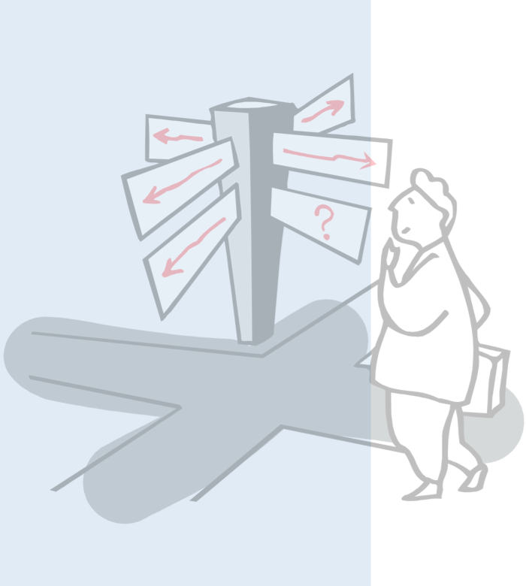
Roadmap
What is Software Architecture?
Coupling and Cohesion
Architectural styles:
Layered
Client-Server
Blackboard, Dataflow, ...
Model-Driven Architecture
UML diagrams for architectures

Slide 3
Sources
Software Engineering, I. Sommerville, 7th Edn., 2004.
Objects, Components and Frameworks with UML, D. D'Souza, A. Wills, Addison-Wesley, 1999
Pattern-Oriented Software Architecture — A System of Patterns, F. Buschmann, et al., John Wiley, 1996
Software Architecture: Perspectives on an Emerging Discipline, M. Shaw, D. Garlan, Prentice-Hall, 1996

Slide 4
Roadmap
What is Software Architecture?
Coupling and Cohesion
Architectural styles:
Layered
Client-Server
Blackboard, Dataflow, ...
Model-Driven Architecture
UML diagrams for architectures

Slide 5
What is Software Architecture?
A neat-looking drawing of some boxes, circles, and lines, laid out nicely in Powerpoint or Word, does not constitute an architecture.
— D’Souza & Wills

Slide 6
What is Software Architecture?
The architecture of a system consists of:
the structure(s) of its parts
including design-time, test-time, and run-time hardware and software parts
the externally visible properties of those parts
modules with interfaces, hardware units, objects
the relationships and constraints between them
in other words:
The set of design decisions about any system (or subsystem) that keeps its implementors and maintainers from exercising “needless creativity”.

Slide 7
How Architecture Drives Implementation
Use a 3-tier client-server architecture: all business logic must be in the middle tier, presentation and dialogue on the client, and data services on the server; that way you can scale the application server processing independently of persistent store.
Use Corba for all distribution, using Corba event channels for notification and the Corba relationship service; do not use the Corba messaging service as it is not yet mature.

Slide 8
How Architecture Drives Implementation ...
Use Collection Galore’s collections for representing any collections; by default use their List class, or document your reason otherwise.
Use Model-View-Controller with an explicit ApplicationModel object to connect any UI to the business logic and objects.
Notes:
Catalysis

Slide 9
Sub-systems, Modules and Components
A sub-system is a system in its own right whose operation is independent of the services provided by other sub-systems.
A module is a system component that provides services to other components but would not normally be considered as a separate system.
A component is an independently deliverable unit of software that encapsulates its design and implementation and offers interfaces to the out-side, by which it may be composed with other components to form a larger whole.
Notes:
Sommerville ch 13, Catalysis 0.2

Slide 10
Roadmap
What is Software Architecture?
Coupling and Cohesion
Architectural styles:
Layered
Client-Server
Blackboard, Dataflow, ...
Model-Driven Architecture
UML diagrams for architectures

Slide 11
Cohesion
Cohesion is a measure of how well the parts of a component “belong together”.
Cohesion is weak if elements are bundled simply because they perform similar or related functions (e.g., java.lang.Math).
Cohesion is strong if all parts are needed for the functioning of other parts (e.g. java.lang.String).
Strong cohesion promotes maintainability and adaptability by limiting the scope of changes to small numbers of components.
There are many definitions and interpretations of cohesion.
Most attempts to formally define it are inadequate!
Notes:
Sommerville ch 12

Slide 12
Coupling
Coupling is a measure of the strength of the interconnections between system components.
Coupling is tight between components if they depend heavily on one another, (e.g., there is a lot of communication between them).
Coupling is loose if there are few dependencies between components.
Loose coupling promotes maintainability and adaptability since changes in one component are less likely to affect others.
Notes:
Sommerville ch 12

Slide 13
Tight Coupling
Subsystem A
Subsystem B
Subsystem C
Subsystem D
Shared data area
© Ian Sommerville 2000
Notes:
Ch 12 (1995)

Slide 14
Loose Coupling
Subsystem A
A’s data
Subsystem B
Subsystem A
B’s data
C’s data
Subsystem A
D’s data
© Ian Sommerville 2000
Notes:
Ch 12 (1995)

Slide 15
Roadmap
What is Software Architecture?
Coupling and Cohesion
Architectural styles:
Layered
Client-Server
Blackboard, Dataflow, ...
Model-Driven Architecture
UML diagrams for architectures

Slide 16
Architectural Parallels
Architects are the technical interface between the customer and the contractor building the system
A bad architectural design for a building cannot be rescued by good construction — the same is true for software
There are specialized types of building and software architects
There are schools or styles of building and software architecture
Notes:
Sommerville ch 13

Slide 17
Architectural Styles
An architectural style defines a family of systems in terms of a pattern of structural organization. More specifically, an architectural style defines a vocabulary of components and connector types, and a set of constraints on how they can be combined.
— Shaw and Garlan

Slide 18
Roadmap
What is Software Architecture?
Coupling and Cohesion
Architectural styles:
Layered
Client-Server
Blackboard, Dataflow, ...
Model-Driven Architecture
UML diagrams for architectures

Slide 19
Layered Architectures
A layered architecture organises a system into a set of layers each of which provide a set of services to the layer “above”.
Normally layers are constrained so elements only see
other elements in the same layer, or
elements of the layer below
Callbacks may be used to communicate to higher layers
Supports the incremental development of sub-systems in different layers.
When a layer interface changes, only the adjacent layer is affected
Notes:
Sommerville ch 13

Slide 20
Version management system
Version management
Object management
Database system
Operating system
© Ian Sommerville 2000
Notes:
Ch 10

Slide 21
OSI reference model
Application
Application
Presentation
Presentation
Session
Session
Transport
Transport
Network
Network
Network
Data link
Data link
Data link
Physical
Physical
Physical
Communications medium
© Ian Sommerville 2000

Slide 22
Roadmap
What is Software Architecture?
Coupling and Cohesion
Architectural styles:
Layered
Client-Server
Blackboard, Dataflow, ...
Model-Driven Architecture
UML diagrams for architectures

Slide 23
Client-Server Architectures
A client-server architecture distributes application logic and services respectively to a number of client and server sub-systems, each potentially running on a different machine and communicating through the network (e.g, by RPC).
Advantages
Distribution of data is straightforward
Makes effective use of networked systems. May require cheaper hardware
Easy to add new servers or upgrade existing servers
Disadvantages
No shared data model so sub-systems use different data organisation. Data interchange may be inefficient
Redundant management in each server
May require a central registry of names and services — it may be hard to find out what servers and services are available
Notes:
Sommerville ch 13 (adapted!)

Slide 24
Film and picture library
Client 1
Client 2
Client 3
Client 4
Wide area network
Video server
Music server
Photo server
Web server
© Ian Sommerville 2000
Notes:
Ch 10

Slide 25
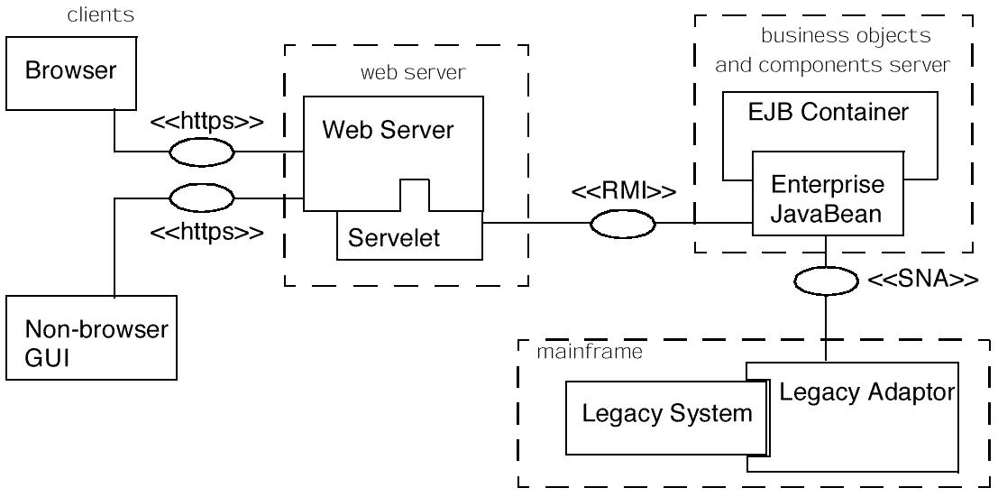
Four-Tier Architectures
© D'Souza, Wills, 1999

Slide 26
Roadmap
What is Software Architecture?
Coupling and Cohesion
Architectural styles:
Layered
Client-Server
Blackboard, Dataflow, ...
Model-Driven Architecture
UML diagrams for architectures

Slide 27
Blackboard Architectures
A blackboard architecture distributes application logic to a number of independent sub-systems, but manages all data in a single, shared repository (or “blackboard”).
Advantages
Efficient way to share large amounts of data
Sub-systems need not be concerned with how data is produced, backed up etc.
Sharing model is published as the repository schema
Disadvantages
Sub-systems must agree on a repository data model
Data evolution is difficult and expensive
No scope for specific management policies
Difficult to distribute efficiently
Notes:
Sommerville ch 13, Buschmann

Slide 28
CASE toolset architecture
Design editor
Code generator
Design translator
Project repository
Program editor
Design analyzer
Report generator
© Ian Sommerville 2000

Slide 29
Event-driven Systems
In an event-driven architecture components perform services in reaction to external events generated by other components.
In broadcast models an event is broadcast to all sub-systems. Any sub-system which can handle the event may do so.
In interrupt-driven models real-time interrupts are detected by an interrupt handler and passed to some other component for processing.
Notes:
Sommerville ch 13

Slide 30
Broadcast model
Effective in integrating sub-systems on different computers in a network
Can be implemented using a publisher-subscriber pattern:
Sub-systems register an interest in specific events
When these occur, control is transferred to the subscribed sub-systems
Control policy is not embedded in the event and message handler. Sub-systems decide on events of interest to them
However, sub-systems don’t know if or when an event will be handled

Slide 31
Selective Broadcasting
Subsystem 1
Subsystem 2
Subsystem 3
Subsystem 4
Event and message handler
© Ian Sommerville 2000

Slide 32
Dataflow Models
In a dataflow architecture each component performs functional transformations on its inputs to produce outputs.
Highly effective for reducing latency in parallel or distributed systems
No call/reply overhead
But, fast processes must wait for slower ones
Not really suitable for interactive systems
Dataflows should be free of cycles

Slide 33
Pipes and Filters
Domain | Data source | Filter | Data sink
Unix | tar cf - . | gzip -9 | rsh picasso dd
CGI | HTML Form | CGI Script | generated HTML page

Slide 34
Invoice Processing System
Read issued invoices
Invoices
Identify payments
Find payments due
Payments
Issue receipts
Issue payment reminder
Receipts
Reminders
© Ian Sommerville 2000

Slide 35
Compilers as Dataflow Architectures
Symbol table
Lexical analysis
Syntactic analysis
Semantic analysis
Code generation
© Ian Sommerville 2000

Slide 36
Compilers as Blackboard Architectures
Syntactic analysis
Lexical analysis
Semantic analysis
Pretty printer
Repository
Optimizer
Abstract syntax tree
Grammar definition
Symbol table
Output definition
Code generation
Editor
© Ian Sommerville 2000

Slide 37
Roadmap
What is Software Architecture?
Coupling and Cohesion
Architectural styles:
Layered
Client-Server
Blackboard, Dataflow, ...
Model-Driven Architecture
UML diagrams for architectures

Slide 38
The Vision of MDA
Platform
Independent
Model
software
developer
automatic
translation
C. Atkinson, U Mannheim

Slide 39
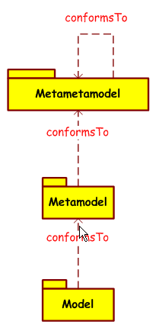
MDA in a nutshell
M³
M²
- One unique Metametamodel (the MOF)
- An important library of compatible Metamodels, each defining a DSL
- Each of the models is defined in the language of its unique metamodel
M¹
J. Bézivin, ATLAS group, U Nantes

Slide 40
The OMG/MDA Stack
the MOF
μ
c2
M₃
The MOF
meta-meta
model
Class
source
Association
M³
μ
destination
The UML metamodel ++
μ
μ
M₂
c2
μ
metamodel
the UML MetaModel
Some UML Models ++
1
M²
M₁
Class
*
Attribute
model
c2
μ
μ
Various usages
of these models
a UML Model
M₀
"the real world"
Client
M¹
Name : String

Slide 41
Write Once, Run Anywhere Model Once, Generate Anywhere
Multi-target
code generation
Platform-Independent
Model
PIM
etc.
CORBA
data grid computing
pervasive computing
cluster computing
SMIL/Flash
Java/EJB
C#/DotNet
Web/XML/SOAP
+ SVG, GML, Delphi, ASP, MySQL, PHP, etc.

Slide 42
Roadmap
What is Software Architecture?
Coupling and Cohesion
Architectural styles:
Layered
Client-Server
Blackboard, Dataflow, ...
Model-Driven Architecture
UML diagrams for architectures

Slide 43
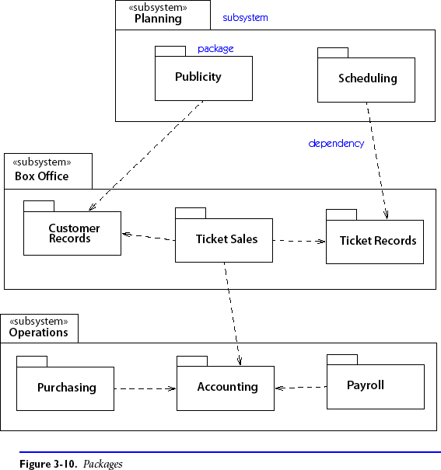
UML support: Package Diagram
Decompose system into packages (containing any other UML element, incl. packages)

Slide 44
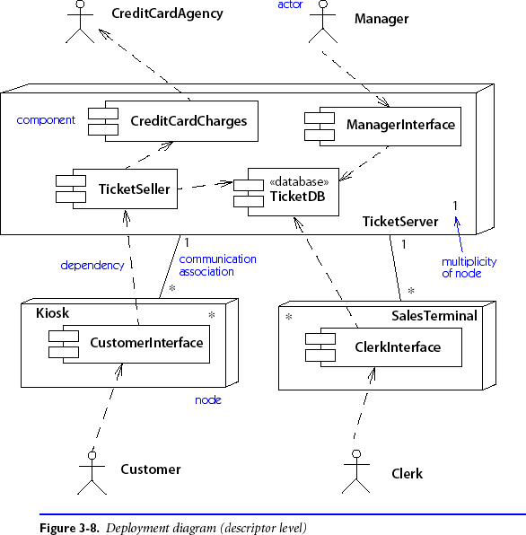
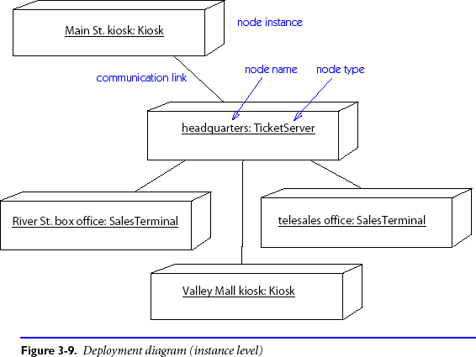
UML support: Deployment Diagram
Physical layout of run-time components on hardware nodes.

Slide 45
What you should know!
How does software architecture constrain a system?
How does choosing an architecture simplify design?
What are coupling and cohesion?
What is an architectural style?
Why shouldn’t elements in a software layer “see” the layer above?
What kinds of applications are suited to event-driven architectures?

Slide 46
Can you answer the following questions?
What is meant by a “fat client” or a “thin client” in a 4-tier architecture?
What kind of architectural styles are supported by the Java AWT? by RMI?
How do callbacks reduce coupling between software layers?
How would you implement a dataflow architecture in Java?
Is it easier to understand a dataflow architecture or an event-driven one?
What are the coupling and cohesion characteristics of each architectural style?

Slide 47
License
Attribution-ShareAlike 3.0 Unported
You are free:
to Share — to copy, distribute and transmit the work
to Remix — to adapt the work
Under the following conditions:
Attribution. You must attribute the work in the manner specified by the author or licensor (but not in any way that suggests that they endorse you or your use of the work).
Share Alike. If you alter, transform, or build upon this work, you may distribute the resulting work only under the same, similar or a compatible license.
For any reuse or distribution, you must make clear to others the license terms of this work. The best way to do this is with a link to this web page.
Any of the above conditions can be waived if you get permission from the copyright holder.
Nothing in this license impairs or restricts the author's moral rights.
http://creativecommons.org/licenses/by-sa/3.0/

