Slide 1
Introduction to Software Engineering
13. Software Evolution

Slide 2

Roadmap
Lehman’s Laws of Software Evolution
Forward and Reverse Engineering
Reengineering Patterns
The Moose software analysis platform

Slide 3

Literature
Demeyer, Ducasse, and Nierstrasz. Object-Oriented Reengineering Patterns, Square Bracket Associates, 2008.
http://scg.unibe.ch/download/oorp/

Slide 4
Roadmap
Lehman’s Laws of Software Evolution
Forward and Reverse Engineering
Reengineering Patterns
The Moose software analysis platform

Slide 5
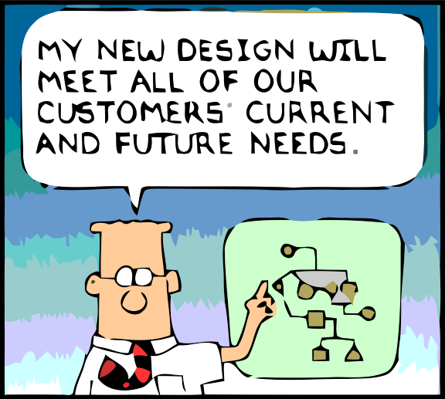
MY NEW DESIGN WILL MEET ALL OF OUR CUSTOMERS’ CURRENT AND FUTURE NEEDS
What is wrong with this picture?
Notes:
Dilbert is either the smartest or the dumbest engineer in the world.
There are fundamental reasons why what he claims is impossible.

Slide 6
Lehman’s Laws
Continuing change
  A program that is used in a real-world environment must change, or become progressively less useful in that environment.
Increasing complexity
  As a program evolves, it becomes more complex, and extra resources are needed to preserve and simplify its structure.
Lehman, Belady. Program Evolution: Processes of Software Change, London Academic Press, London, 1985

Slide 7
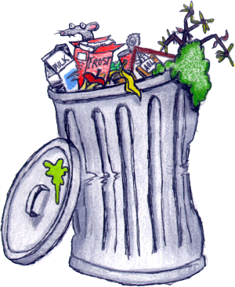
The Dilemma of Legacy Software
A legacy system is a piece of software that:
  you have inherited, and
  is valuable to you.
Symptoms
  Loss of knowledge
  Architecture & design drift
  Hard to make changes
  …
You can’t afford to throw it out, but it is too expensive to change

Slide 8
OO Legacy
Object-oriented legacy systems are successful OO systems whose architecture and design no longer respond to changing requirements

Slide 9
Common Symptoms
Lack of Knowledge
obsolete or no documentation
departure of the original developers or users
disappearance of inside knowledge about the system
limited understanding of entire system
⇒ missing tests
Process symptoms
too long to turn things over to production
need for constant bug fixes
maintenance dependencies
difficulties separating products
⇒ simple changes take too long
Code symptoms
duplicated code
code smells
⇒ big build times
Notes:
How can you ASSESS WHETHER A SYSTEM NEEDS REENGINEERING (i.e., when is it time to take the second path ?)
In fact, there are QUITE A LOT OF SYMPTOMS as you can see on this slide
I won't go into detail for each of them,
RATHER, I will point you to the ones I ASK FOR EACH TIME I FACE A NEW SYSTEM
missing tests, simple changes take too long. big build times
The reason I looked for those is because they are MEASURABLE.
This is especially important, because during a reengineering project, there will ALWAYS COME A TIME WHEN YOU WILL BE CHALLENGED. Opponents will try to cancel you project and start again from scratch.
Therefore, its is good to have some QUANTIFYABLE GOALS, to show that you are making progress, EVEN IF THE REENGINEERING IS NOT FINISHED

Slide 10
Common Problems
Architectural Problems
insufficient documentation
= non-existent or out-of-date
improper layering
= too few or too many layers
lack of modularity
= strong coupling
duplicated code
= copy, paste & edit code
duplicated functionality
= similar functionality
by separate teams
Refactoring opportunities
misuse of inheritance
= code reuse vs polymorphism
missing inheritance
= duplication, case-statements
misplaced operations
= operations outside classes
violation of encapsulation
= type-casting; C++ "friends"
class abuse
= classes as namespaces
Notes:
We have been facing quite a lot of systems that NEEDED REENGINEERING.
We learned that all of them have different MOTIVATIONS,
however there seems to be a COMMON SET OF PROBLEMS THAT REAPPEAR IN ALL projects
... READ SLIDE ...

Slide 11
Continuous Development
4.1% Other
data from [Lien78a]
18.2% Adaptive
(new platforms or OS)
17.4% Corrective
(fixing reported errors)
60.3% Perfective
(new functionality)
The bulk of the maintenance cost is due to new functionality
⇒ even with better requirements, it is hard to predict new functions
Notes:
Well, better requirements engineering indeed helped to identify stable ground in the muddle of CHANGING REQUIREMENTS.
Unfortunately, an empirical survey done by Lientz and Swanson revealed that the majority of changes requested have to do with EXTRA FUNCTIONALITY.
That’s why modern requirements engineering tries to define SCENARIOs FOR FUTURE EXTENSIONS so that the designers can accommodate their designs. That’s why we try to define good DOMAIN MODELS, so that most of the changes will fit our design.
Unfortunately, no matter how good our requirements engineering, we will never be able TO PREDICT THE FUTURE
Therefore, there will always be changes that DO NOT FIT OUR ORIGINAL DESIGN, and depending on our problem domain this may be quite a lot.
By the way, that’s one of the reasons why AGILE DEVELOPMENT METHODS are so popular nowadays. They observed that for certain problem domains you cannot make good predictions about the 60% perfective maintenance here (POINT TO SLIDE). When that’s the case, its useless to invest in a good design because you don’t know which variation points to build into your design. Half of the times, you will guess wrong and then you loose twice – once for creating a variation point you didn’t use, and once for extending the design with a new variation point.

Slide 12
The cost of change
We need to reduce the cost of change over time …
x 200
cost
cost
— cf., XP Explained
time
time

Slide 13
Roadmap
Lehman’s Laws of Software Evolution
Forward and Reverse Engineering
Reengineering Patterns
The Moose software analysis platform

Slide 14
Some Terminology
“Forward Engineering is the traditional process of moving from high-level abstractions and logical, implementation-independent designs to the physical implementation of a system.”
“Reverse Engineering is the process of analyzing a subject system to identify the system’s components and their interrelationships and create representations of the system in another form or at a higher level of abstraction.”
“Reengineering ... is the examination and alteration of a subject system to reconstitute it in a new form and the subsequent implementation of the new form.”
— Chikofsky and Cross [in Arnold, 1993]

Slide 15
Goals of Reverse Engineering
Cope with complexity
  need techniques to understand large, complex systems
Generate alternative views
  automatically generate different ways to view systems
Recover lost information
  extract what changes have been made and why
Detect side effects
  help understand ramifications of changes
Synthesize higher abstractions
  identify latent abstractions in software
Facilitate reuse
  detect candidate reusable artifacts and components
— Chikofsky and Cross [in Arnold, 1993]

Slide 16
Reverse Engineering Techniques
Redocumentation
  pretty printers
  diagram generators
  cross-reference listing generators
Design recovery
  software metrics
  browsers, visualization tools
  static analyzers
  dynamic (trace) analyzers

Slide 17
Goals of Reengineering
Unbundling
  split a monolithic system into parts that can be separately marketed
Performance
  “first do it, then do it right, then do it fast” — experience shows this is the right sequence!
Port to other Platform
  the architecture must distinguish the platform dependent modules
Design extraction
  to improve maintainability, portability, etc.
Exploitation of New Technology
  i.e., new language features, standards, libraries, etc.

Slide 18
Reengineering Techniques
Restructuring
  automatic conversion from unstructured to structured code
  source code translation
  — Chikofsky and Cross
Data reengineering
  integrating and centralizing multiple databases
  unifying multiple, inconsistent representations
  upgrading data models
  — Sommerville, ch 32
Refactoring
  renaming/moving methods/classes etc.

Slide 19
Roadmap
Lehman’s Laws of Software Evolution
Forward and Reverse Engineering
Reengineering Patterns
The Moose software analysis platform

Slide 20
The Reengineering Life-Cycle
(0) requirement
analysis
Requirements
(2) problem
detection
(3) problem
resolution
Designs
people centric
lightweight
(1) model
capture
Code
(4) program transformation
Notes:
To tackle these problems, you need some kind of GENERIC REENGINEERING PROCESS
Here is the one that we propose, WHICH WE WILL USE TROUGHOUT THIS TALK
Note that you should see this as a way to describe the various activities that take place during a project, but not necessarily a STRICT ORDER ON when these activities must take place.
(0) Requirement analysis: analyse on WHICH PARTS OF YOUR REQUIREMENTS HAVE CHANGED
Model capture: REVERSE ENGINEER from the source-code into a MORE ABSTRACT FORM, typically some form of a design model. How abstract depends on the kind of problem you want to solve
problem detection: IDENTIFY DESIGN PROBLEMS in that abstract model
problem resolution: PROPOSE AN ALTERNATIVE DESIGN that will solve the identified problem
program transformations: MAKE THE NECESSARY CHANGES TO THE CODE, so that it adheres to the new design YET PRESERVES ALL THE REQUIED FUNCTIONALITY
Here TESTING will play an important role
In the REMAINDER OF THE TALK, we will use this picture to ILLUSTRATE WHERE the various techniques and tools FIT IN.
While doing that, we will emphasize the role of THE HUMAN IN THE LOOP, because we believe that reengineering is a very PEOPLE CENTRIC activity.
Also, we will show some lightweight techniques and tools, because we experienced that you can achieve quite a lot with rather inexpensive technology.

Slide 21

Reengineering Patterns
In software engineering, a design pattern is a general solution to a common problem in software design. A design pattern isn't a finished design that can be transformed directly into code; it is a description or template for how to solve a problem that can be used in many different situations.
Reverse engineering patterns encode expertise and trade-offs in extracting design from source code, running systems and people.
  Even if design documents exist, they are typically out of sync with reality.
Reengineering patterns encode expertise and trade-offs in transforming legacy code to resolve problems that have emerged.
  These problems are typically not apparent in original design but are due to architectural drift as requirements evolve

Slide 22
A Map of Reengineering Patterns
Tests: Your Life Insurance
Detailed Model Capture
Migration Strategies
Initial Understanding
Detecting Duplicated Code
Redistribute Responsibilities
First Contact
Transform Conditionals to Polymorphism
Setting Direction
Notes:
We documented most of our techniques in the form of REENGINEERING PATTERNS
Here is a map of these patterns, as they appeared in ou book

Slide 23
Setting Direction
Set direction
Where to start
Agree on Maxims
Maintain
direction
Coordinate
direction
Most Valuable First
Appoint a
Navigator
Speak to the
Round Table
What to do
What not to do
Fix Problems,
Not Symptoms
If It Ain't Broke
Don't Fix It
Principles & Guidelines for Software project management especially relevant for reengineering projects
How to do it
Keep it Simple

Slide 24
Most Valuable First
Problem: Which problems should you focus on first?
Solution: Work on aspects that are most valuable to your customer
Maximize commitment, early results; build confidence
Difficulties and hints:
  Which stakeholder do you listen to?
  What measurable goal to aim for?
  Consult change logs for high activity
  Play the Planning Game
  Wrap, refactor or rewrite? — Fix Problems, not Symptoms
Vs. Fix the Buggiest First?

Slide 25
First Contact
Feasibility assessment (one week time)
System experts
Talk with
developers
Talk with
end users
Talk about it
Chat with the
Maintainers
Interview
during Demo
Software System
Verify what
you hear
Read it
Read about it
Compile it
Read All the Code
in One Hour
Skim the
Documentation
Do a Mock
Installation

Slide 26
Initial Understanding
Top down
Recover design
Speculate about Design
understand ⇒
Obtain a higher-level model
Analyze the Persistent Data
Study the Exceptional Entities
Read it
Compile it
Bottom up

Slide 27
Pattern: Study the Exceptional Entities
Problem
  How can you quickly gain insight into complex software?
Solution
  Measure software entities and study the anomalous ones
Steps
  Use simple metrics
  Visualize metrics to get an overview
  Browse the code to get insight into the anomalies

Slide 28
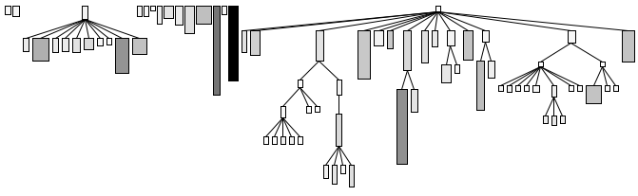
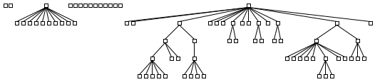
System Complexity View
System Complexity View
Width Metric
Nodes = Classes
Edges = Inheritance Relationships
Height
Metric
Width = Number of Attributes
Height = Number of Methods
Color = Number of Lines of Code
Position
Metrics
Color
Metric

Slide 29
Detailed Model Capture
Tie Code and Questions
Expose the design & make sure it remains exposed
Expose design
Keep track of
your understanding
Refactor to Understand
Expose collaborations
Step through the Execution
Write Tests
to Understand
Expose contracts
Look for the Contracts
Expose evolution
Use Your Tools
Look for Key Methods
Look for Constructor Calls
Look for Template/Hook Methods
Look for Super Calls
Learn from the Past

Slide 30
Tests: Your Life Insurance
Write Tests to Enable Evolution
Use a Testing
Framework
Managing tests
Grow Your Test
Base Incrementally
Designing
tests
Test the Interface,
Not the Implementation
Record Business
Rules as Tests
Write Tests
to Understand
Test Fuzzy features
Test Old Bugs
Retest Persistent Problems
Regression Test
after Every Change
Migration Strategies

Slide 31
Migration
Involve the Users
Build Confidence
How
Why
Why
Migrate Systems
Incrementally
Conserve
Familiarity
Where to
How
Use Profiler
before Optimizing
Prototype the
Target Solution
How
Always Have a
Running Version
Present the
Right Interface
Make a Bridge
to the New Town
Deprecate
Obsolete Interfaces
Regression Test
after Every Change
Tests, your
Life-Insurance
Distinguish Public
from Published Interfaces

Slide 32
Detecting Duplicated Code
Detect
Compare Code Mechanically
Understand
Visualize Code as Dotplots
Redistribute Responsibilities
Transform Conditionals to Polymorphism

Slide 33
Pattern: Visualize Code as Dotplots
Problem
  How can you effectively identify significant duplication in a complex software system?
Solution
  Visualize the code as a dotplot, where dots represent duplication.
Steps
  Normalize the source files
  Compare files line-by-line
  Visualize and interpret the dotplots

Slide 34
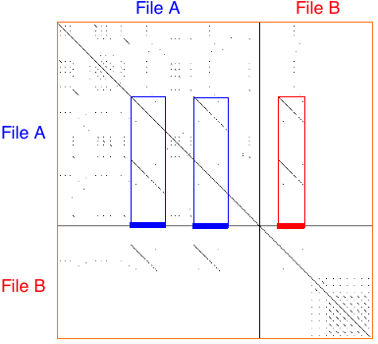
Clone detection by string-matching
Solid diagonals indicate significant duplication between or within source files.

Slide 35
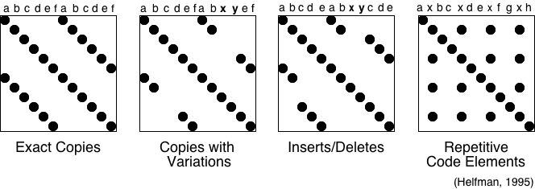
Dotplot Visualization
Sample Dot Configurations:

Slide 36
Redistribute Responsibilities
Chains of data
containers
Monster client of
data containers
Split Up God Class
Eliminate Navigation Code
Data containers
Move Behaviour Close to Data

Slide 37
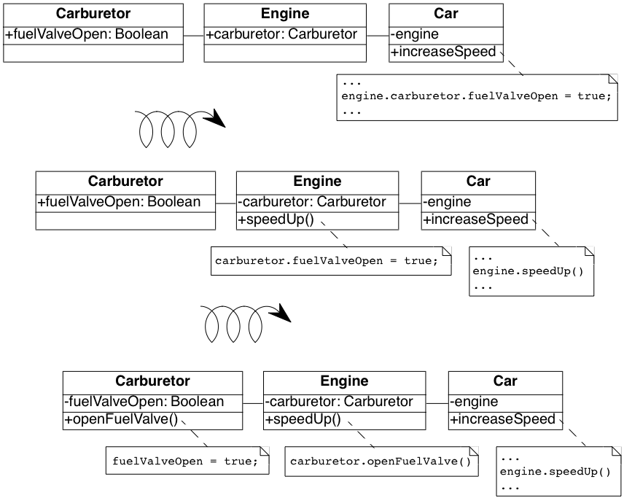
High-level refactorings
High-level refactorings make use of many low-level refactorings

Slide 38
Transform Conditionals to Polymorphism
Test provider
type
Test self type
Test external
attribute
Transform
Client Type Checks
Transform
Self Type Checks
Transform Conditionals
into Registration
Test object state
Test
null values
Factor Out Strategy
Introduce
Null Object
Factor Out State

Slide 39
Roadmap
Lehman’s Laws of Software Evolution
Forward and Reverse Engineering
Reengineering Patterns
The Moose software analysis platform

Slide 40
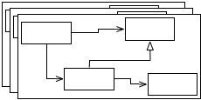



Moose — an extensible platform for software and data analysis
FAMIX meta-models family
Import/export format for models
Data parsing support
…more
Notes:
Moose offers several services like: FAMIX a family of meta-models for different languages, the MSE file format to import/export meta-models in and from moose, a support for parsing different languages and data.

Slide 41
Explicit metamodels enable change
ConAn
Van
Hapax
...
CodeCrawler
Smalltalk
Extensible meta model
Java
External
Parser
CDIF
Model repository
COBOL
Navigation
C++
Metrics
…
Querying
XMI
Grouping
Smalltalk
The Story of Moose: an Agile Reengineering Environment. Nierstrasz, Ducasse, Gîrba. ESEC/FSE 2005
Notes:
Moose is based on a small and simple metamodel to represent object-oriented software source code. Much of the power of Moose lies in the fact that the metamodel can easily be extended by tools to represent new kinds of information (such as dynamic information, history, features, and so on).

Slide 42
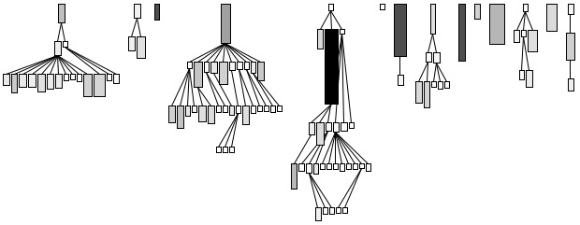
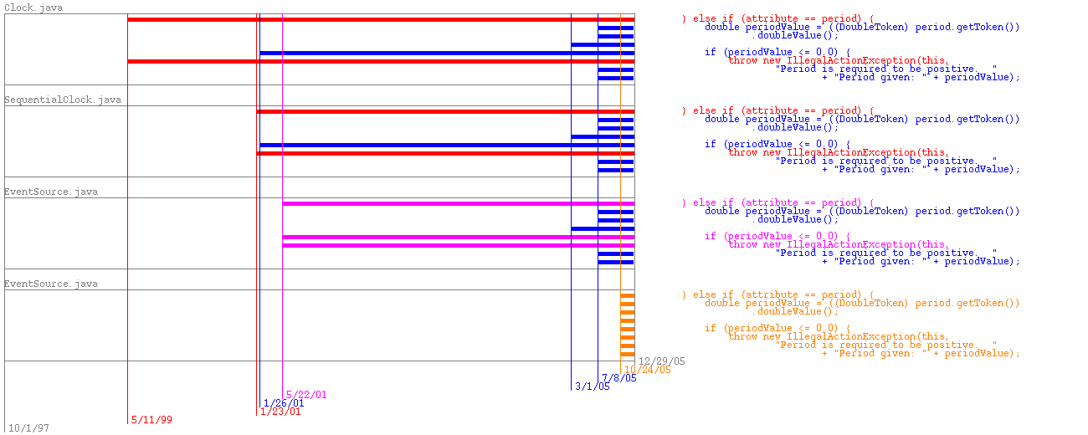
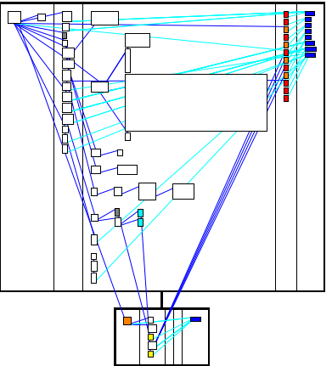
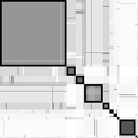
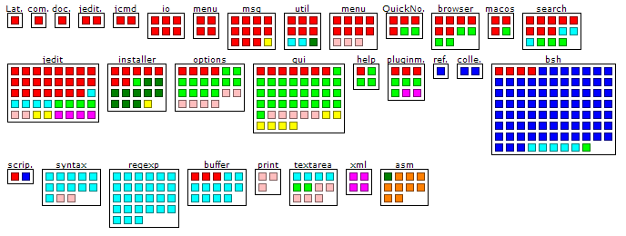
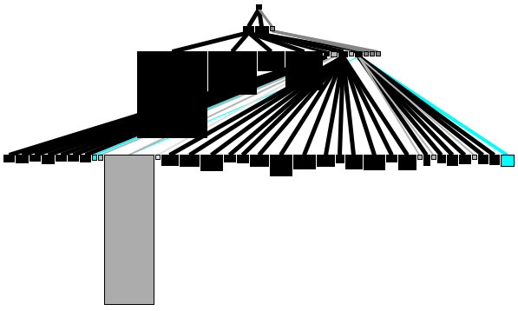
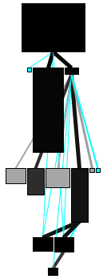
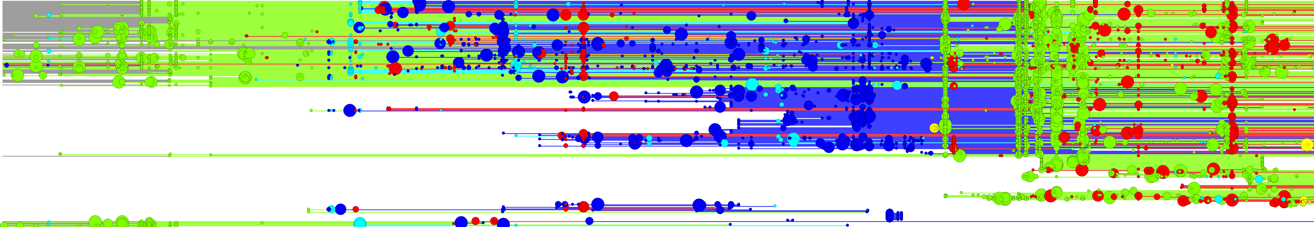

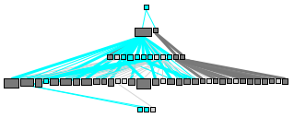
Moose visualizations
Notes:
System complexity - Clone evolution view
Class blueprint - Topic Correlation Matrix - Distribution Map for topics spread over classes in packages
Hierarchy Evolution view - Ownership Map

Slide 43
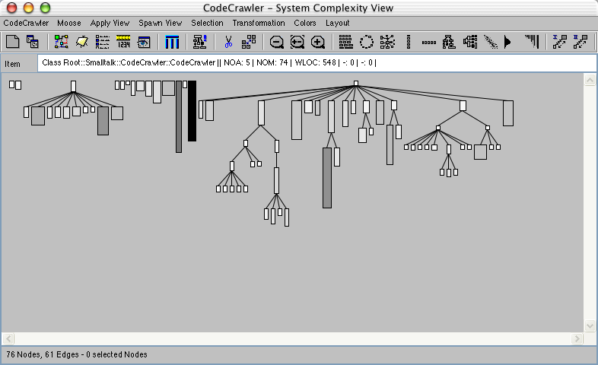
Programming visualizations with CodeCrawler
Notes:
CodeCrawler was the original visualization engine in Moose for “polymetric views”, which map software metrics to simple graphics. CodeCrawler was essentially a framework, so defining new visualizations entailed subclassing existing CodeCrawler classes and specializing them.

Slide 44
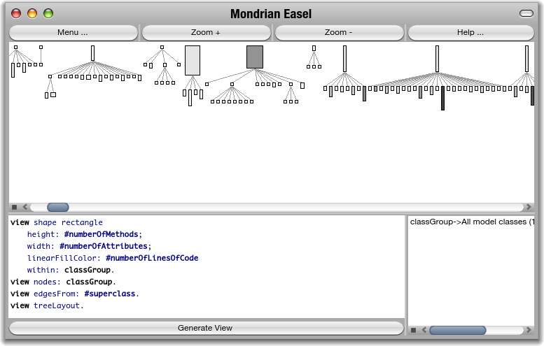
Scripting visualizations with Mondrian
Mondrian: An Agile Visualization Framework. Meyer, Gîrba, Lungu. SoftVis 2006
Notes:
DEMO. Mondrian takes a different, component-based approach. Instead of subclassing, you instantiate and configure Mondrian components, which makes it much easier to define new visualizations. We will see how to define a System Complexity view, and we will see how Mondrian is integrated into Moose.

Slide 45
Data navigation through generic or dedicated browsers

Slide 46
Scripting browsers with Glamour
Notes:
DEMO. Mondrian takes a different, component-based approach. Instead of subclassing, you instantiate and configure Mondrian components, which makes it much easier to define new visualizations. We will see how to define a System Complexity view, and we will see how Mondrian is integrated into Moose.

Slide 47
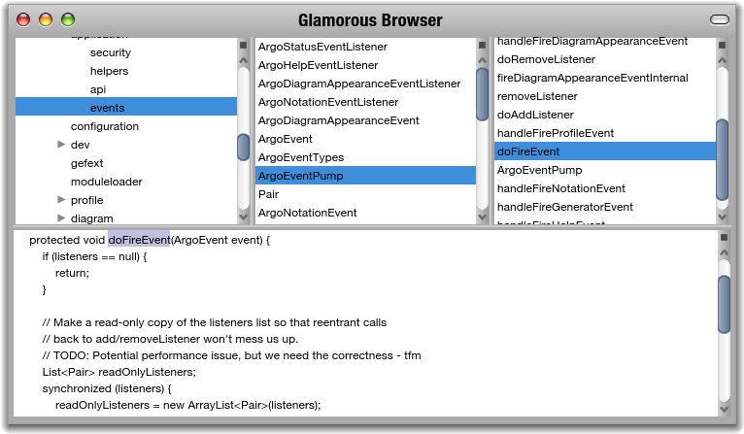
Scripting browsers with Glamour
Notes:
DEMO. Mondrian takes a different, component-based approach. Instead of subclassing, you instantiate and configure Mondrian components, which makes it much easier to define new visualizations. We will see how to define a System Complexity view, and we will see how Mondrian is integrated into Moose.

Slide 48
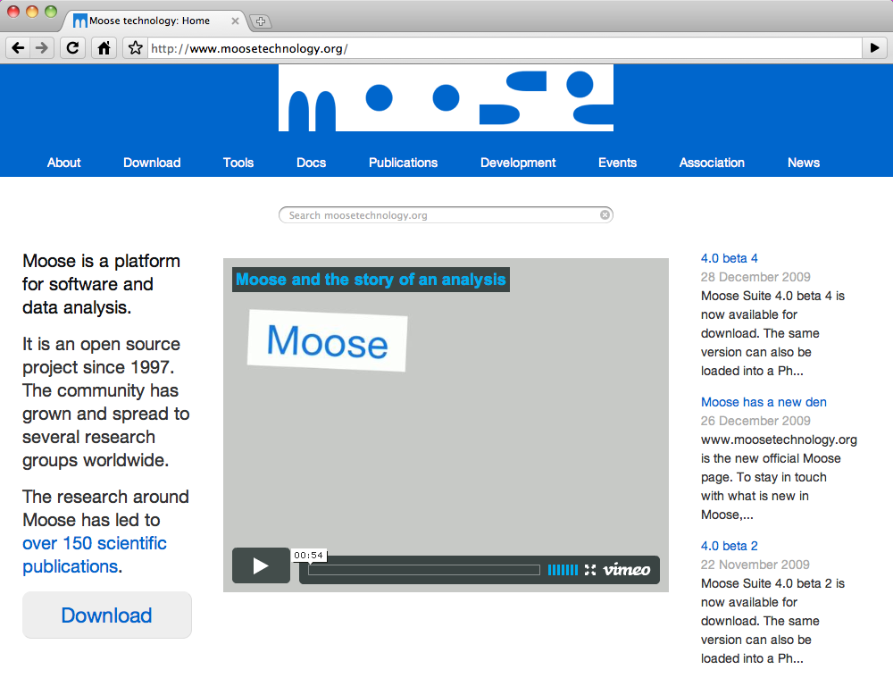
Moose — a platform for collaborative research
Notes:
Moose is still in development, but is available for free download.

Slide 49
Roadmap
Lehman’s Laws of Software Evolution
Forward and Reverse Engineering
Reengineering Patterns
The Moose software analysis platform

Slide 50
Conclusion
Valuable software inevitably changes
Reverse and reengineering are necessary activities throughout the lifecycle of a software system
Simple techniques go a long way

Slide 51
What you should know!
What is Lehman’s Laws of Continuing Change?
Why do software systems become more complex over time?
Why is duplicated code considered to be a bad code smell?
How can you reduce the cost of software maintenance?
What is meant by “reverse engineering”?
How can studying exceptional entities help you to understand a software system?

Slide 52
Can you answer the following questions?
Is a legacy software system a good thing or a bad thing to have?
How can you ensure that documentation stays in sync with implementation?
When should you start a reengineering project?
What are the dangers of trying to fix the buggiest code first?

Slide 53

License
Attribution-ShareAlike 3.0 Unported
You are free:
  to Share — to copy, distribute and transmit the work
  to Remix — to adapt the work
Under the following conditions:
  Attribution. You must attribute the work in the manner specified by the author or licensor (but not in any way that suggests that they endorse you or your use of the work).
  Share Alike. If you alter, transform, or build upon this work, you may distribute the resulting work only under the same, similar or a compatible license.
For any reuse or distribution, you must make clear to others the license terms of this work. The best way to do this is with a link to this web page.
Any of the above conditions can be waived if you get permission from the copyright holder.
Nothing in this license impairs or restricts the author's moral rights.
http://creativecommons.org/licenses/by-sa/3.0/

