Slide 1
5. Semantic Analysis
Prof. O. Nierstrasz
Thanks to Jens Palsberg and Tony Hosking for their kind permission to reuse and adapt the CS132 and CS502 lecture notes.
http://www.cs.ucla.edu/~palsberg/
http://www.cs.purdue.edu/homes/hosking/

Slide 2
Roadmap
Context-sensitive analysis
Strategies for semantic analysis
Attribute grammars
Symbol tables and type-checking
See, Modern compiler implementation in Java (Second edition), chapter 5.

Slide 3
Roadmap
Context-sensitive analysis
Strategies for semantic analysis
Attribute grammars
Symbol tables and type-checking

Slide 4
Semantic Analysis
The compilation process is driven by the syntactic structure of the program as discovered by the parser
Semantic routines:
interpret meaning of the program based on its syntactic structure
two purposes:
finish analysis by deriving context-sensitive information
begin synthesis by generating the IR or target code
associated with individual productions of a context free grammar or sub-trees of a syntax tree

Slide 5
Context-sensitive analysis
What context-sensitive questions might the compiler ask?
Is x scalar, an array, or a function?
Is x declared before it is used?
Are any names declared but not used?
Which declaration of x is being referenced?
Is an expression type-consistent?
Does the dimension of a reference match the declaration?
Where can x be stored? (heap, stack, ...)
Does *p reference the result of a malloc()?
Is x defined before it is used?
Is an array reference in bounds?
Does function foo produce a constant value?
Can p be implemented as a memo-function?
These questions cannot be answered with a context-free grammar

Slide 6
Context-sensitive analysis
Why is context-sensitive analysis hard?
answers depend on values, not syntax
questions and answers involve non-local information
answers may involve computation
Several alternatives:
symbol tables: central store for facts; express checking code
abstract syntax tree (attribute grammars): specify non-local computations; automatic evaluators
language design: simplify language; avoid problems
Notes:
automatic evaluators?

Slide 7
Roadmap
Context-sensitive analysis
Strategies for semantic analysis
Attribute grammars
Symbol tables and type-checking

Slide 8
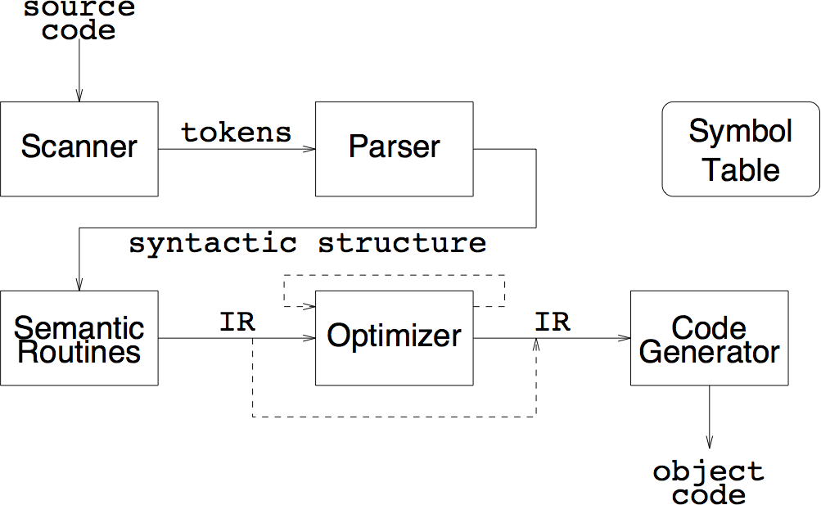
Alternatives for semantic processing
one-pass: compiler and synthesis
two-pass: compiler + peephole
two-pass: compiler & IR synthesis + code generation pass
multi-pass analysis
multi-pass synthesis
language-independent and re-targetable compilers

Slide 9
One-pass compilers
interleave scanning, parsing and translation
no explicit IR
generate target code directly
emit short sequences of instructions on each parser action
little or no optimization possible (minimal context)
can add peephole optimization pass
extra pass over generated code through small window (“peephole”) of instructions
smoothes out “rough edges” between code emitted by subsequent calls to code generator

Slide 10
Two-pass: analysis & IR synthesis + code generation
Generate explicit IR as interface to code generator
linear (e.g., tuples)
can emit multiple tuples at a time for better code context
Advantages
easier retargeting (IR must be expressive enough for different machines!)
can add optimization pass later (multi-pass synthesis)

Slide 11
Multi-pass analysis
Several passes, read/write intermediate files
scan source file, generate tokens
place identifiers and constants in symbol table
parse token file
generate semantic actions or linearized parse tree
process declarations to symbol table
semantic checking with IR synthesis
Motivations:
Historical: constrained address spaces
Language: e.g., declaration after use
Multiple analyses over IR tree

Slide 12
Multi-pass synthesis
Passes operate on linear or tree-structured IR
Options:
code generation and peephole optimization
multi-pass IR transformation
machine-independent then dependent optimizations
high-level to low-level IR transformation before code generation
e.g., in gcc high-level trees drive generation of low-level Register Transfer Language for machine-independent optimization
language-independent front ends
retargetable back ends

Slide 13
Roadmap
Context-sensitive analysis
Strategies for semantic analysis
Attribute grammars
Symbol tables and type-checking

Slide 14
Attribute grammars
Add attributes to the syntax tree:
can add attributes (fields) to each node
specify equations to define values
propagate values up (synthesis) or down (inheritance)
Example: ensuring that constants are immutable
add type and class attributes to expression nodes
add rules to production for :=
check that LHS.class is variable (not constant)
check that LHS.type and RHS.type are compatible

Slide 15
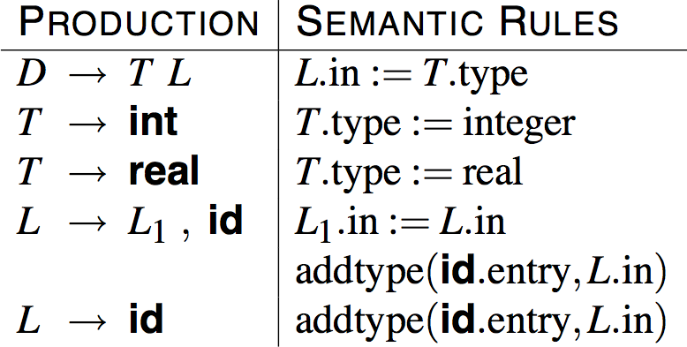
Attribute grammar actions
tree attributes specified by grammar
productions associated with attribute assignments
each attribute defined uniquely and locally
identical terms are labeled uniquely

Slide 16
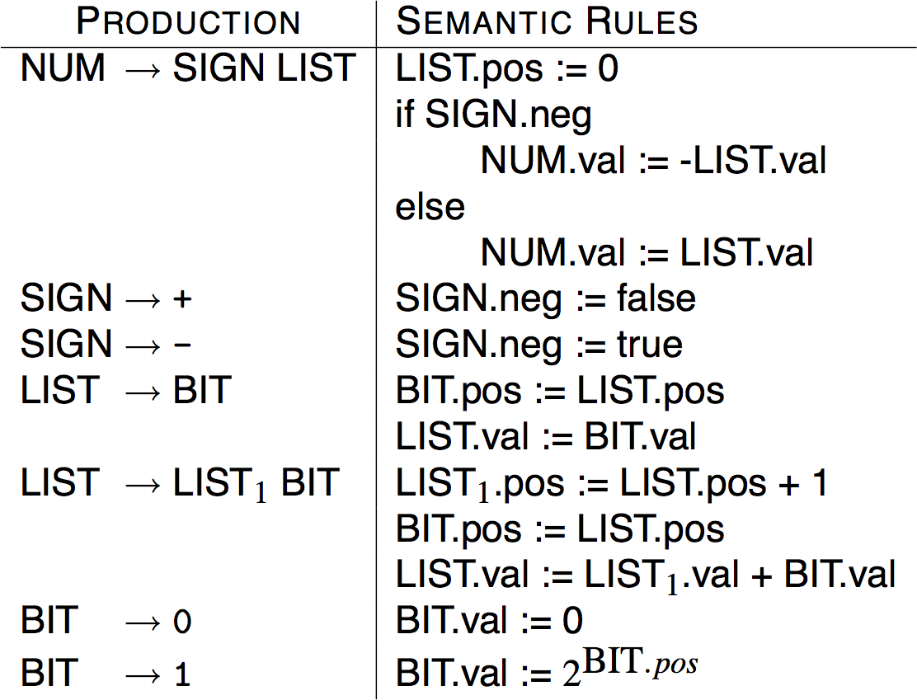
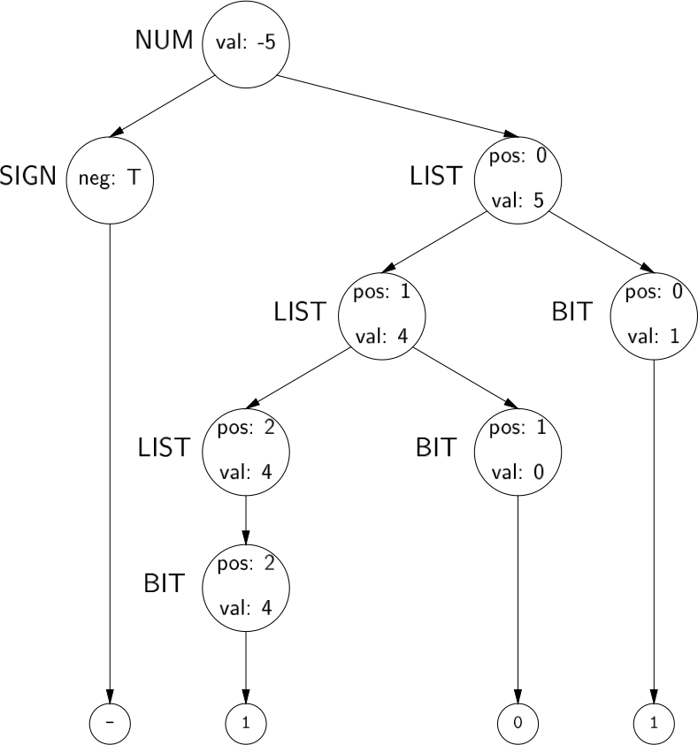
Example: evaluate signed binary numbers
Attributed parse tree for -101
val and neg are synthetic attributes
pos is an inherited attribute

Slide 17
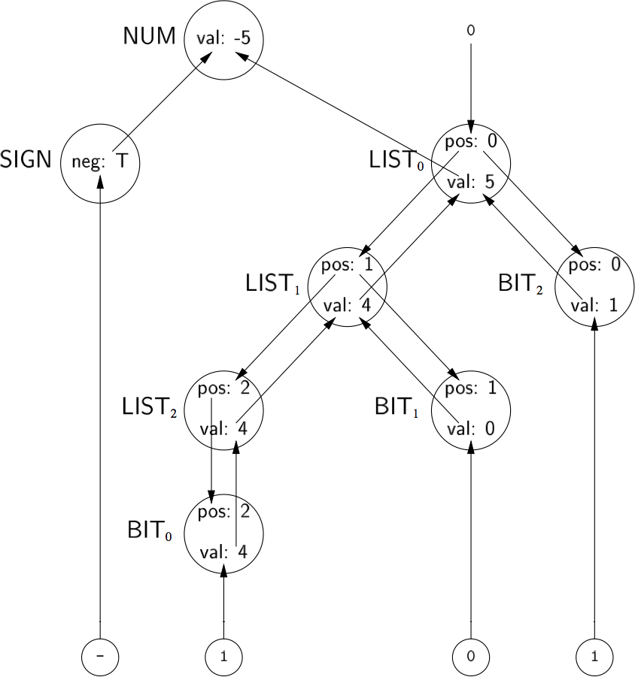
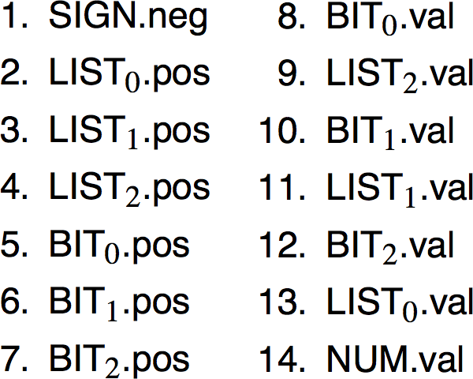
Attribute dependency graph
nodes represent attributes
edges represent flow of values
graph must be acyclic
topologically sort to order attributes
use this order to evaluate rules
order depends on both grammar and input string!
Evaluating in this order yields NUM.val = -5
Notes:
In this case we traverse the tree depth-first from left to right.

Slide 18
Evaluation strategies
Parse-tree methods
build the parse tree
build the dependency graph
topologically sort the graph
evaluate it
Rule-based methods
analyse semantic rules at compiler-construction time
determine static ordering for each production’s attributes
evaluate its attributes in that order at compile time
Oblivious methods
ignore the parse tree and the grammar
choose a convenient order (e.g., left-to-right traversal) and use it
repeat traversal until no more attribute values can be generated

Slide 19
Attribute grammars in practice
Advantages
clean formalism
automatic generation of evaluator
high-level specification
Disadvantages
evaluation strategy determines efficiency
increase space requirements
parse tree evaluators need dependency graph
results distributed over tree
circularity testing
Historically, attribute grammars have been judged too large and expensive for industrial-strength compilers.

Slide 20
Roadmap
Context-sensitive analysis
Strategies for semantic analysis
Attribute grammars
Symbol tables and type-checking

Slide 21
Symbol tables
For compile-time efficiency, compilers often use a symbol table:
associates lexical names (symbols) with their attributes
What items should be entered?
variable names
defined constants
procedure and function names
literal constants and strings
source text labels
compiler-generated temporaries (we’ll get there)
Separate table of structure layouts for types (field offsets and lengths)
A symbol table is a compile-time structure

Slide 22
Symbol table information
What kind of information might the compiler need?
textual name
data type
dimension information (for aggregates)
declaring procedure
lexical level of declaration
storage class (base address)
offset in storage
if record, pointer to structure table
if parameter, by-reference or by-value?
can it be aliased? to what other names?
number and type of arguments to functions
Notes:
storage class = heap, stack, text etc?

Slide 23
Lexical Scoping
class C {
int x;
void m(int y) {
int z;
if (y>x) {
int w=z+y;
return w;
}
return y;
}
}
With lexical scoping the definition of a name is determined by its static scope. A stack suffices to track the current definitions.
scope of y and z
scope of w
scope of x
Notes:
Some older languages provided dynamic scoping, but it is much harder to reason about.
Nowadays only exception handlers are dynamically scoped.

Slide 24
Nested scopes: block-structured symbol tables
What information is needed?
when we ask about a name, we want the most recent declaration
the declaration may be from the current scope or some enclosing scope
innermost scope overrides declarations from outer scopes
Key point: new declarations (usually) occur only in current scope
What operations do we need?
void put(Symbol key, Object value) — bind key to value
Object get(Symbol key) — return value bound to key
void beginScope() — remember current state of table
void endScope() — restore table to state at most recent scope that has not been ended
May need to preserve list of locals for the debugger

Slide 25
Checking variable declarations in a hierarchical symbol table
int x=1;
{
int y = x;
x = x+y;
}
{
y = x – y;
}
x : int
y : int
-

Slide 26
Attribute information
Attributes are internal representation of declarations
Symbol table associates names with attributes
Names may have different attributes depending on their meaning:
variables: type, procedure level, frame offset
types: type descriptor, data size/alignment
constants: type, value
procedures: formals (names/types), result type, block information (local decls.), frame size

Slide 27
Static and Dynamic Typing
A language is statically typed if it is always possible to determine the (static) type of an expression based on the program text alone.
A language is dynamically typed if only values have fixed type. Variables and parameters may take on different types at run-time, and must be checked immediately before they are used.
A language is “strongly typed” if it is impossible to perform an operation on the wrong kind of object.
Type consistency may be assured by
compile-time type-checking,
type inference, or
dynamic type-checking.
See: Programming Languages course

Slide 28
Type expressions
Type expressions are a textual representation for types:
basic types: boolean, char, integer, real, etc.
type names
constructed types (constructors applied to type expressions):
array(I,T) denotes array of elements type T, index type I e.g., array (1...10,integer)
T₁ × T₂ denotes Cartesian product of type expressions T₁ and T₂
record(…) denotes record with named ﬁelds e.g., record((a × integer), (b × real))
pointer(T) denotes the type “pointer to object of type T”
D → R denotes type of function mapping domain D to range R e.g., integer × integer → integer

Slide 29
Type descriptors
Type descriptors are compile-time structures representing type expressions
e.g., char × char → pointer(integer)

Slide 30
Type compatibility
Type checking needs to determine type equivalence
Two approaches:
Name equivalence: each type name is a distinct type
Structural equivalence: two types are equivalent iff they have the same structure (after substituting type expressions for type names)
s ≡ t iff s and t are the same basic types
array(s₁,s₂) ≡ array(t₁,t₂) iff s₁ ≡ t₁ and s₂ ≡ t₂
s₁ × s₂ ≡ t₁ × t₂ iff s₁ ≡ t₁ and s₂ ≡ t₂
pointer(s) ≡ pointer (t) iff s ≡ t
s₁ → s₂ ≡ t₁ → t₂ iff s₁ ≡ t₁ and s₂ ≡ t₂
Notes:
Java uses nominal, not structural types. Structural typing could lead to accidental equivalence of types that should be considered different.

Slide 31
Type compatibility: example
Consider:
type link = ^cell
var next : link;
var last : link;
var p : ^cell;
var q, r : ^cell;
Under name equivalence:
next and last have the same type
p, q and r have the same type
p and next have different type
Under structural equivalence all variables have the same type
Ada/Pascal/Modula-2 are somewhat confusing: they treat distinct type definitions as distinct types, so
p has different type from q and r (!)

Slide 32
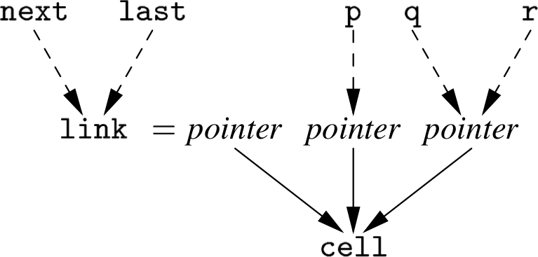
Type compatibility: Pascal-style name equivalence
Build compile-time structure called a type graph:
each constructor or basic type creates a node
each name creates a leaf (associated with the type’s descriptor)
Type expressions are equivalent if they are represented by the same node in the graph

Slide 33
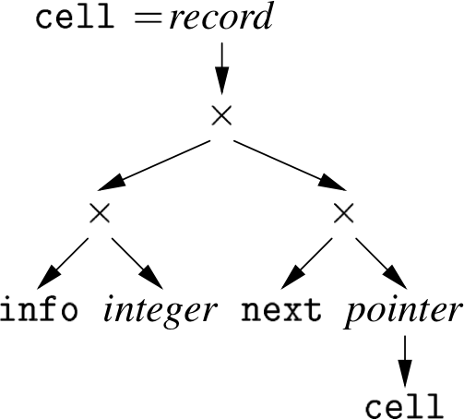
Type compatibility: recursive types
Consider:
type link = ^cell
var cell = record
info : integer;
next : link;
end
Expanding link in the type graph yields:

Slide 34
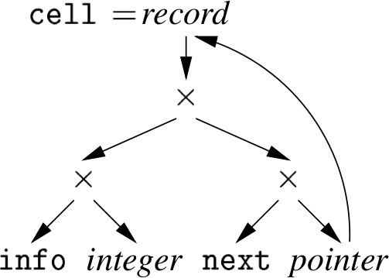
Type compatibility: recursive types
Allowing cycles in the type graph eliminates cell:

Slide 35
Type rules
Type-checking rules can be formalized to prove soundness and correctness.
f : A → B, x : A
If f is a function from A to B, and x is of type A, then f(x) is a value of type B.
f(x) : B

Slide 36
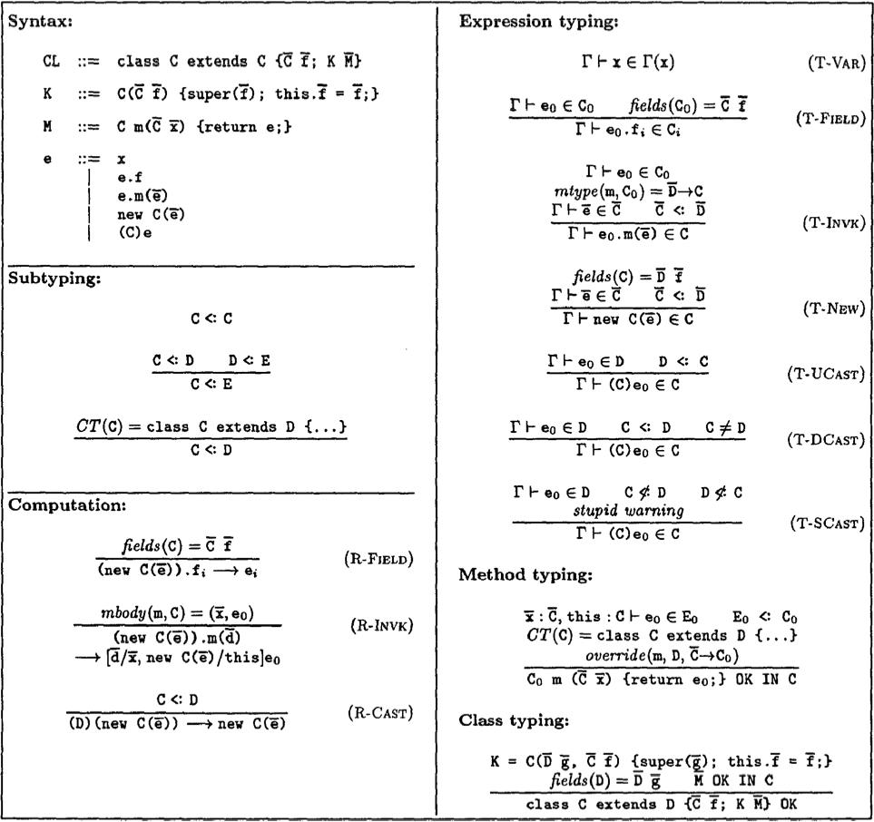
Example: Featherweight Java
Used to prove that generics could be added to Java without breaking the type system.
Igarashi, Pierce and Wadler, “Featherweight Java: a minimal core calculus for Java and GJ”, OOPSLA ’99
doi.acm.org/10.1145/320384.320395

Slide 37
What you should know!
Why is semantic analysis mostly context-sensitive?
What is “peephole optimization”?
Why was multi-pass semantic analysis introduced?
What is an attribute grammar? How can it be used to support semantic analysis?
What kind of information is stored in a symbol table?
How is type-checking performed?

Slide 38
Can you answer these questions?
Why can semantic analysis be performed by the parser?
What are the pros and cons of introducing an IR?
Why must an attribute dependency graph be acyclic?
Why would be the use of a symbol table at run-time?
Why does Java adopt nominal (name-based) rather than structural type rules?

Slide 39
License
http://creativecommons.org/licenses/by-sa/3.0/
Attribution-ShareAlike 3.0 Unported
You are free:
to Share — to copy, distribute and transmit the work
to Remix — to adapt the work
Under the following conditions:
Attribution. You must attribute the work in the manner specified by the author or licensor (but not in any way that suggests that they endorse you or your use of the work).
Share Alike. If you alter, transform, or build upon this work, you may distribute the resulting work only under the same, similar or a compatible license.
For any reuse or distribution, you must make clear to others the license terms of this work. The best way to do this is with a link to this web page.
Any of the above conditions can be waived if you get permission from the copyright holder.
Nothing in this license impairs or restricts the author's moral rights.

