Slide 1
8. Code Generation
Prof. O. Nierstrasz
Thanks to Jens Palsberg and Tony Hosking for their kind permission to reuse and adapt the CS132 and CS502 lecture notes.
http://www.cs.ucla.edu/~palsberg/
http://www.cs.purdue.edu/homes/hosking/

Slide 2
Roadmap
Runtime storage organization
Procedure call conventions
Instruction selection
Register allocation
Example: generating Java bytecode
See, Modern compiler implementation in Java (Second edition), chapters 6 & 9.

Slide 3
Roadmap
Runtime storage organization
Procedure call conventions
Instruction selection
Register allocation
Example: generating Java bytecode

Slide 4
Runtime organization
The procedure abstraction supports separate compilation
build large programs
keep compile times reasonable
independent procedures
The linkage convention:
a “social contract” — procedures inherit a valid run-time environment and restore one for their parents
machine dependent — code generated at compile time
distributes responsibility — executes at run time

Slide 5
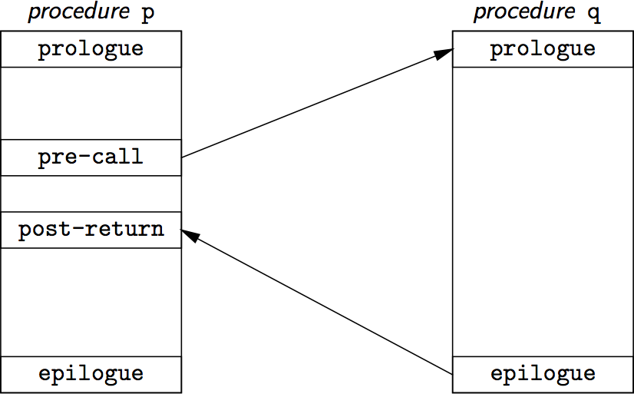
The procedure abstraction
on entry, establish p’s environment
when calling q, preserve p’s environment
on exit, tear down p’s environment

Slide 6
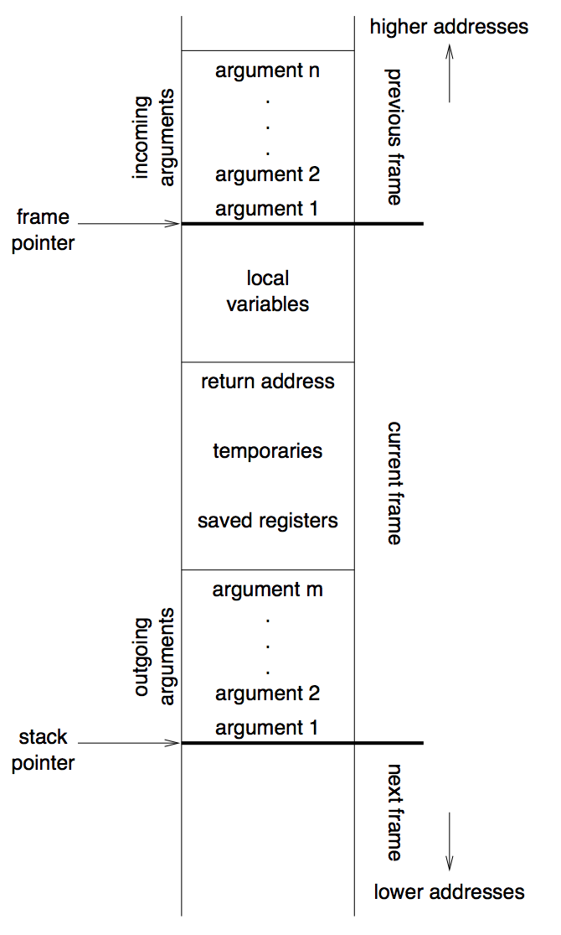
Procedure linkages
Each procedure activation has an activation record or stack frame

Slide 7
Procedure linkage contract
 | Caller | Callee
Call | pre-call allocate basic frame evaluate & store parameters store return address jump to child | prologue save registers, state store FP (dynamic link) set new FP store static link to outer scope extend basic frame for local data initialize locals fall through to code
Return | post-call copy return value de-allocate basic frame restore parameters (if copy out) | epilogue store return value restore state cut back to basic frame restore parent’s FP jump to return address
Notes:
At compile time, generate code to do this
At run time, code manipulates frame and data areas
Basic frame does not have space for local data
The static link is for nested functions – the static link points to the frame of the enclosing function (if any) [p 124]

Slide 8
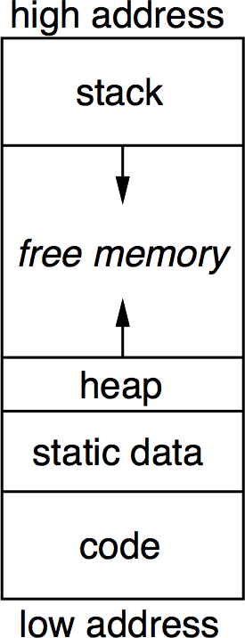
Typical run-time storage organization
Heap grows “up”, stack grows “down”.
Allows both stack and heap maximal freedom.
Code and static data may be separate or intermingled.
Notes:
NB: Code memory pages may be protected.

Slide 9
Variable scoping
Who sees local variables? Where can they be allocated?
Downward exposure
called procedures see my variables?
dynamic scoping vs. lexical scoping
Upward exposure
can I return a reference to my variables?
functions that return functions
continuation-passing style
Only with downward exposure can the compiler allocate local variables in frames on the run-time stack.

Slide 10
Storage classes
Static variables
addresses compiled into code
usually allocated at compile-time (fixed-size objects)
naming scheme to control access
Global variables
similar to static variables
layout may be important
universal access
Procedure local variables
allocated on stack …
if fixed size, limited lifetime, and values not preserved
Dynamically allocated variables
call-by-reference implies non-local lifetime
usually explicit allocation
de-allocation explicit or implicit
Notes:
Why would layout of global variables be important? (not clear)

Slide 11
Access to non-local data
Map name to (level, offset) pair
reflects lexical scoping
look up name to find most recent declaration
If level = current level then variable is local,
else must generate code to look up stack
Must maintain access links to previous stack frame
Alternative: use display (table of access links)
http://en.wikipedia.org/wiki/Call_stack
Notes:
Again, this is needed for nested scopes

Slide 12
Roadmap
Runtime storage organization
Procedure call conventions
Instruction selection
Register allocation
Example: generating Java bytecode

Slide 13
Calls: Saving and restoring registers
 | callee saves | caller saves
caller’s registers | Call includes bitmap of caller’s registers to be saved/restored. Best: saves fewer registers, compact call sequences | Caller saves and restores own registers. Unstructured returns (e.g., exceptions) cause some problems to locate and execute restore code.
callee’s registers | Backpatch code to save registers used in callee on entry, restore on exit. Non-local gotos/exceptions must unwind dynamic chain to restore callee-saved registers. | Bitmap in callee’s stack frame is used by caller to save/restore. Unwind dynamic chain as at left.
all registers | Easy. Non-local gotos/exceptions must restore all registers from “outermost callee” | Easy. (Use utility routine to keep calls compact.) Non-local gotos/exceptions need only restore original registers.
Notes:
top-left corner is the usual approach

Slide 14
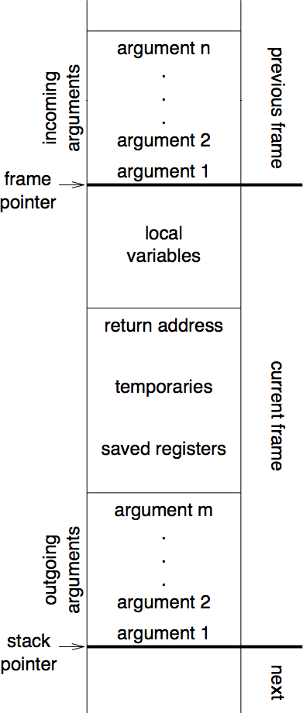
Call/return (callee saves)
caller pushes space for return value
caller pushes SP (stack pointer)
caller pushes space for: return address, static chain, saved registers
caller evaluates and pushes actuals onto stack
caller sets return address, callee’s static chain, performs call
callee saves registers in register-save area
callee copies by-value arrays/records using addresses passed as actuals
callee allocates dynamic arrays as needed
on return, callee restores saved registers
callee jumps to return address

Slide 15
MIPS registers
Name | Number | Use | Callee must preserve?
$zero | $0 | constant 0 | N/A
$at | $1 | assembler temporary | no
$v0–$v1 | $2–$3 | Values for function returns and expression evaluation | no
$a0–$a3 | $4–$7 | function arguments | no
$t0–$t7 | $8–$15 | temporaries | no
$s0–$s7 | $16–$23 | saved temporaries | yes
$t8–$t9 | $24–$25 | temporaries | no
$k0–$k1 | $26–$27 | reserved for OS kernel | no
$gp | $28 | global pointer | yes
$sp | $29 | stack pointer | yes
$fp | $30 | frame pointer | yes
$ra | $31 | return address | N/A
http://en.wikipedia.org/wiki/MIPS_architecture
Notes:
Microprocessor without Interlocked Pipeline Stages

Slide 16
MIPS procedure call convention
Philosophy:
Use full, general calling sequence only when necessary
Omit portions of it where possible (e.g., avoid using FP register whenever possible)
Classify routines:
non-leaf routines call other routines
leaf routines don’t
identify those that require stack storage for locals
and those that don’t

Slide 17
MIPS procedure call convention
Pre-call:
Pass arguments: use registers a0 . . . a3; remaining arguments are pushed on the stack along with save space for a0 . . . a3
Save caller-saved registers if necessary
Execute a jal instruction:
jumps to target address (callee’s first instruction), saves return address in register ra
Notes:
jal = jump and link

Slide 18
MIPS procedure call convention
Prologue:
Leaf procedures that use the stack and non-leaf procedures:
Allocate all stack space needed by routine:
local variables
saved registers
arguments to routines called by this routine
subu $sp, framesize
Save registers (ra etc.), e.g.:
sw $31, framesize+frameoffset($sp)
sw $17, framesize+frameoffset-4($sp)
sw $16, framesize+frameoffset-8($sp)
where framesize and frameoffset (usually negative) are compile- time constants
Emit code for routine
Notes:
subu = subtract unsigned
sw = store word

Slide 19
MIPS procedure call convention
Epilogue:
Copy return values into result registers (if not already there)
Restore saved registers
lw $31, framesize+frameoffset-N($sp)
Get return address
lw $31, framesize+frameoffset($sp)
Clean up stack
addu $sp,framesize
Return
j $31
Notes:
lw = load word
addu = add unsigned
j = jump

Slide 20
Roadmap
Runtime storage organization
Procedure call conventions
Instruction selection
Register allocation
Example: generating Java bytecode

Slide 21
Instruction selection
Simple approach:
Macro-expand each IR tuple/subtree to machine instructions
Expanding independently leads to poor code quality
Mapping may be many-to-one
“Maximal munch” works well with RISC
Interpretive approach:
Model target machine state as IR is expanded
Notes:
wikipedia: the "maximal munch" principle is the rule that as much of the input as possible should be processed when creating some construct.
In this case, try to macro expand the largest IR munch that you can match

Slide 22
Register and temporary allocation
Limited # hard registers
assume pseudo-register for each temporary
register allocator chooses temporaries to spill
allocator generates mapping
allocator inserts code to spill/restore pseudo-registers to/from storage as needed
Notes:
NB: analogy with page faults

Slide 23
IR tree patterns
A tree pattern characterizes a fragment of the IR corresponding to a machine instruction
Instruction selection means tiling the IR tree with a minimal set of tree patterns

Slide 24
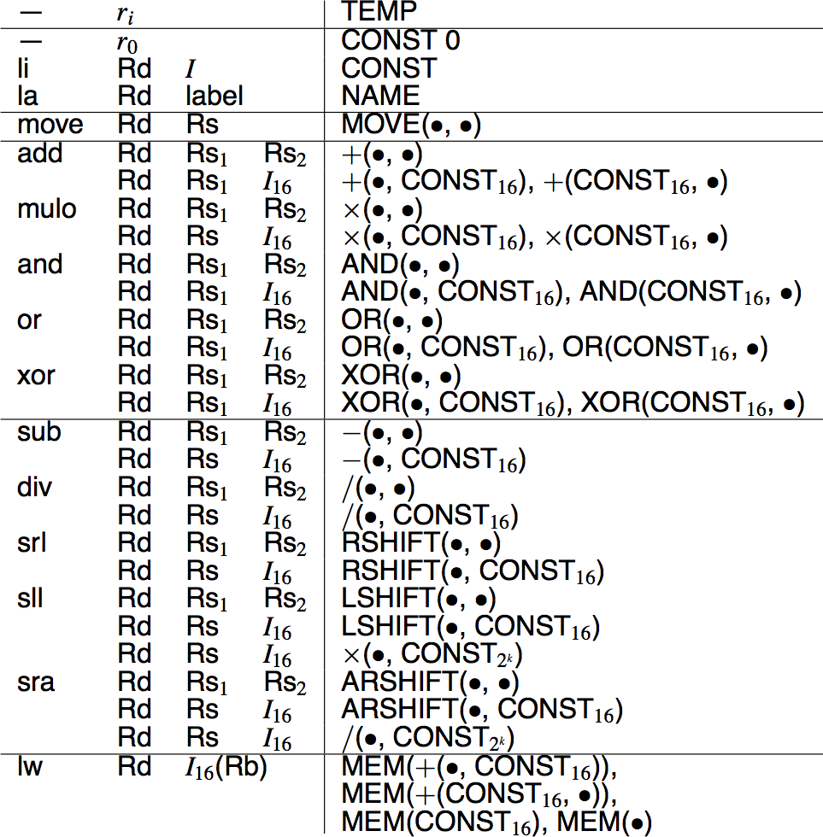
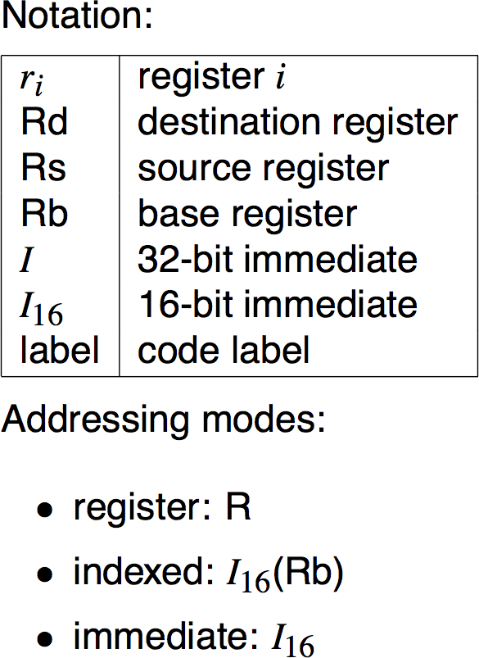
MIPS tree patterns (example)
…
Notes:
At right are tree patterns to match; at left is the code to be emitted.
rest of example elided

Slide 25
Optimal tiling
“Maximal munch”
Start at root of tree
Tile root with largest tile that fits
Repeat for each subtree
NB: (locally) optimal ≠ (global) optimum
optimum: least cost instructions sequence (shortest, fewest cycles)
optimal: no two adjacent tiles combine to a lower cost tile
CISC instructions have complex tiles ⇒ optimal ≠ optimum
RISC instructions have small tiles ⇒ optimal ≈ optimum

Slide 26
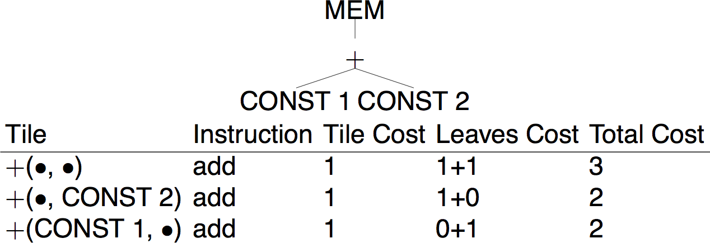
Optimum tiling
Dynamic programming
Assign cost to each tree node — sum of instruction costs of best tiling for that node (including best tilings for children)
http://en.wikipedia.org/wiki/Dynamic_programming

Slide 27
Roadmap
Runtime storage organization
Procedure call conventions
Instruction selection
Register allocation
Example: generating Java bytecode

Slide 28
Register allocation
Want to have value in register when used
limited resources
changes instruction choices
can move loads and stores
optimal allocation is difficult (NP-complete)

Slide 29
Liveness analysis
Problem:
IR has unbounded # temporaries
Machines has bounded # registers
Approach:
Temporaries with disjoint live ranges can map to same register
If not enough registers, then spill some temporaries (i.e., keep in memory)
The compiler must perform liveness analysis for each temporary
It is live if it holds a value that may still be needed

Slide 30
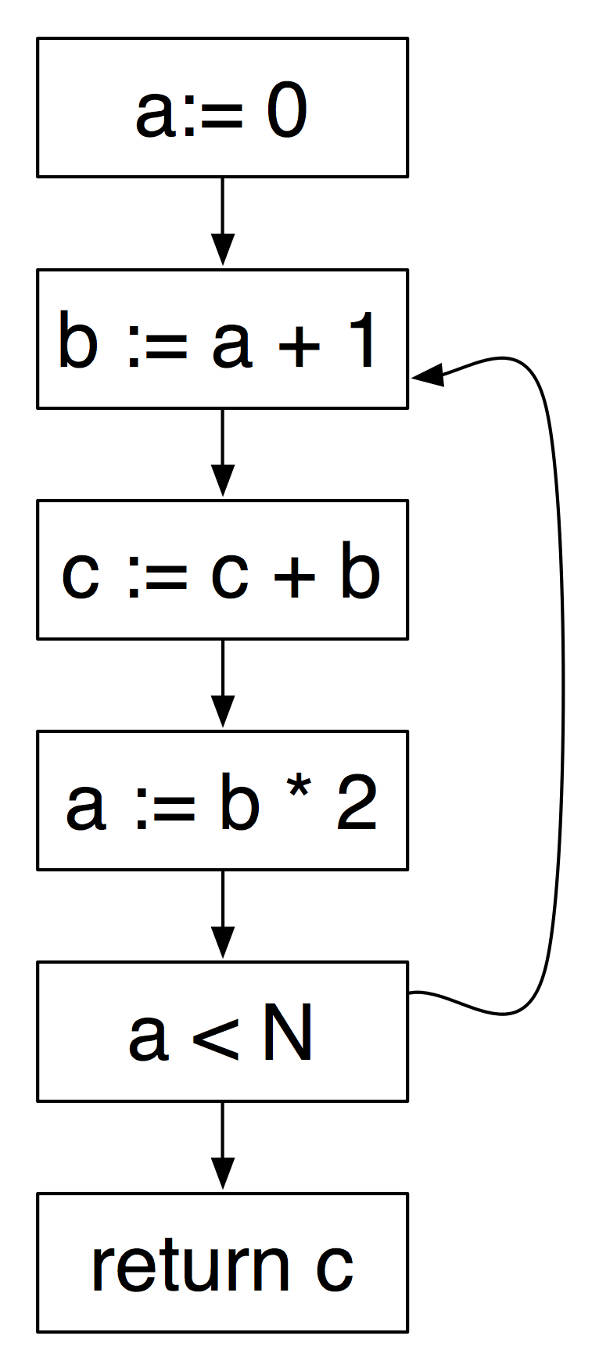
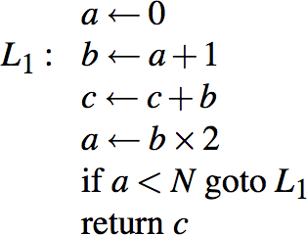
Control flow analysis
Liveness information is a form of data flow analysis over the control flow graph (CFG):
Nodes may be individual program statements or basic blocks
Edges represent potential flow of control

Slide 31
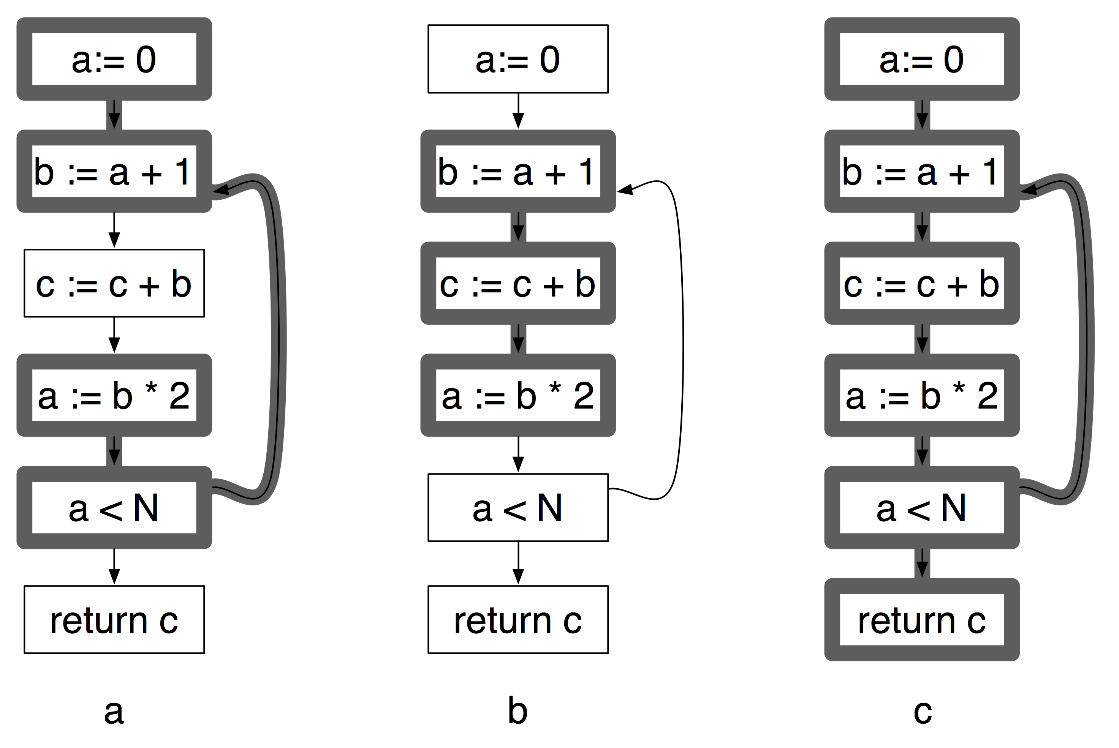
Liveness
A variable v is live on edge e if there is a path from e to a use of v not passing through a definition of v
a and b are never live at the same time, so two registers suffice to hold a, b and c
Notes:
a and b are not live at the same time, so two registers suffice: one for a and b and the other for c
See chapter 10 of Appel (2nd edition) for this example and details of algorithms
NB: liveness analysis might also reveal errors — e.g., if c is a local, then it has not been initialized

Slide 32
Roadmap
Runtime storage organization
Procedure call conventions
Instruction selection
Register allocation
Example: generating Java bytecode

Slide 33
The visitor
package compiler;
...
public class CompilerVisitor extends DepthFirstVisitor {
Generator gen;
public CompilerVisitor(String className) {
gen = new Generator(className);
}
public void visit(Assignment n) {
n.f0.accept(this);
n.f1.accept(this);
n.f2.accept(this);
String id = n.f0.f0.tokenImage;
gen.assignValue(id);
}
public void visit(PrintStm n) {
n.f0.accept(this);
gen.prepareToPrint();
n.f1.accept(this);
n.f2.accept(this);
n.f3.accept(this);
gen.stopPrinting();
}
...
}
This time the visitor is responsible for generating bytecode.

Slide 34
Bytecode generation with BCEL
package compiler;
...
import org.apache.bcel.generic.*;
import org.apache.bcel.Constants;
public class Generator {
private Hashtable<String,Integer> symbolTable;
private InstructionFactory factory;
private ConstantPoolGen cp;
private ClassGen cg;
private InstructionList il;
private MethodGen method;
private final String className;
public Generator (String className) {
this.className = className;
symbolTable = new Hashtable<String,Integer>();
cg = new ClassGen(className, "java.lang.Object", className + ".java",
Constants.ACC_PUBLIC | Constants.ACC_SUPER, new String[] {});
cp = cg.getConstantPool();
factory = new InstructionFactory(cg, cp);
il = new InstructionList();
method = new MethodGen(Constants.ACC_PUBLIC | Constants.ACC_STATIC,
Type.VOID, new Type[] { new ArrayType(Type.STRING, 1) },
new String[] { "arg0" }, "main", className, il, cp);
}
...
We introduce a separate class to introduce a higher-level interface for generating bytecode
Creates a class with a static main!

Slide 35
Invoking print methods
private void genPrintTopNum() {
il.append(factory.createInvoke("java.io.PrintStream", "print",
Type.VOID, new Type[] { Type.INT }, Constants.INVOKEVIRTUAL));
}
private void genPrintString(String s) {
pushSystemOut();
il.append(new PUSH(cp, s));
il.append(factory.createInvoke("java.io.PrintStream", "print",
Type.VOID, new Type[] { Type.STRING }, Constants.INVOKEVIRTUAL));
}
private void pushSystemOut() {
il.append(factory.createFieldAccess(
"java.lang.System", "out",
new ObjectType("java.io.PrintStream"), Constants.GETSTATIC));
}
public void prepareToPrint() {
pushSystemOut();
}
public void printValue() {
genPrintTopNum();
genPrintString(" ");
}
public void stopPrinting() {
genPrintTopNum();
genPrintString("\n");
}
To print, we must push System.out on the stack, push the arguments, then invoke print.

Slide 36
Binary operators
public void add() {
il.append(new IADD());
}
public void subtract() {
il.append(new ISUB());
}
public void multiply() {
il.append(new IMUL());
}
public void divide() {
il.append(new IDIV());
}
public void pushInt(int val) {
il.append(new PUSH(cp, val));
}
Operators simply consume the top stack items and push the result back on the stack.

Slide 37
Variables
public void assignValue(String id) {
il.append(factory.createStore(Type.INT, getLocation(id)));
}
public void pushId(String id) {
il.append(factory.createLoad(Type.INT, getLocation(id)));
}
private int getLocation(String id) {
if(!symbolTable.containsKey(id)) {
symbolTable.put(id, 1+symbolTable.size());
}
return symbolTable.get(id);
}
Variables must be translated to locations.
BCEL keeps track of the needed space.

Slide 38
Code generation
public void generate(File folder) throws IOException {
il.append(InstructionFactory.createReturn(Type.VOID));
method.setMaxStack();
method.setMaxLocals();
cg.addMethod(method.getMethod());
il.dispose();
OutputStream out =
new FileOutputStream(new File(folder, className + ".class"));
cg.getJavaClass().dump(out);
}
Finally we generate the return statement, add the method, and dump the bytecode.

Slide 39
Generated class files
public class Eg3 {
public static void main(java.lang.String[] arg0);
0 getstatic java.lang.System.out : java.io.PrintStream [12]
3 iconst_1
4 istore_1
5 iload_1
6 iload_1
7 iload_1
8 imul
9 iadd
10 iload_1
11 iadd
12 istore_1
13 iload_1
14 invokevirtual java.io.PrintStream.print(int) : void [18]
17 getstatic java.lang.System.out : java.io.PrintStream [12]
20 ldc <String " "> [20]
22 invokevirtual java.io.PrintStream.print(java.lang.String) : void [23]
25 getstatic java.lang.System.out : java.io.PrintStream [12]
28 iload_1
29 iconst_1
30 iadd
31 invokevirtual java.io.PrintStream.print(int) : void [18]
34 getstatic java.lang.System.out : java.io.PrintStream [12]
37 ldc <String "\n"> [25]
39 invokevirtual java.io.PrintStream.print(java.lang.String) : void [23]
42 return
}
Generated from:
"print((a := 1; a := a+a*a+a, a),a+1)"

Slide 40
What you should know!
How is the run-time stack typically organized?
What is the “procedure linkage contract”?
What is the difference between the FP and the SP?
What are storage classes for variables?
What is “maximal munch”?
Why is liveness analysis useful to allocate registers?
How does BCEL simplify code generation?

Slide 41
Can you answer these questions?
Why does the run-time stack grow down and not up?
In Java, which variables are stored on the stack?
Does Java support downward or upward exposure of local variables?
Why is optimal tiling not necessarily the optimum?
What semantic analysis have we forgotten to perform in our straightline to bytecode compiler?

Slide 42
License
http://creativecommons.org/licenses/by-sa/3.0/
Attribution-ShareAlike 3.0 Unported
You are free:
to Share — to copy, distribute and transmit the work
to Remix — to adapt the work
Under the following conditions:
Attribution. You must attribute the work in the manner specified by the author or licensor (but not in any way that suggests that they endorse you or your use of the work).
Share Alike. If you alter, transform, or build upon this work, you may distribute the resulting work only under the same, similar or a compatible license.
For any reuse or distribution, you must make clear to others the license terms of this work. The best way to do this is with a link to this web page.
Any of the above conditions can be waived if you get permission from the copyright holder.
Nothing in this license impairs or restricts the author's moral rights.

