Slide 1
Compiler Construction
1. Introduction
Prof. O. Nierstrasz
Spring Semester 2011

Slide 2
Compiler Construction
Lecturer | Prof. Oscar Nierstrasz Oscar.Nierstrasz@iam.unibe.ch Schützenmattstr. 14/103 Tel. 031 631.4618
Assistant | Toon Verwaest, Raffael Krebs
Lectures | E8 003, Fridays @ 10h15-12h00
Exercises | E8 003, Fridays @ 12h00-13h00
WWW | scg.unibe.ch/teaching/cc

Slide 3
Roadmap
Overview
Front end
Back end
Multi-pass compilers
Example: compiler and interpreter for a toy language
See Modern compiler implementation in Java (Second edition), chapter 1.

Slide 4
Roadmap
Overview
Front end
Back end
Multi-pass compilers
Example: compiler and interpreter for a toy language

Slide 5
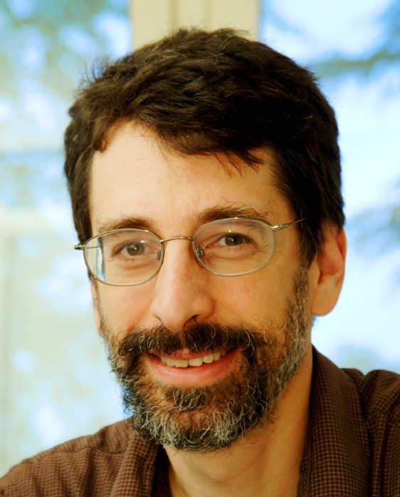
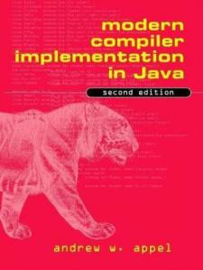
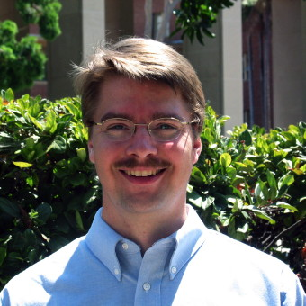
Textbook
Andrew W. Appel, Modern compiler implementation in Java (Second edition), Cambridge University Press, New York, NY, USA, 2002, with Jens Palsberg.
Thanks to Jens Palsberg and Tony Hosking for their kind permission to reuse and adapt the CS132 and CS502 lecture notes.
http://www.cs.ucla.edu/~palsberg/
http://www.cs.purdue.edu/homes/hosking/

Slide 6
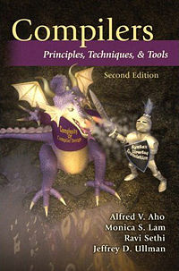
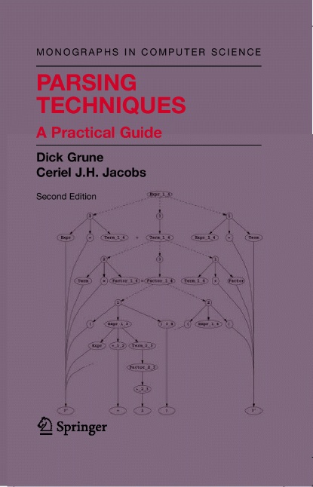
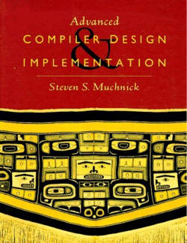
Other recommended sources
Compilers: Principles, Techniques, and Tools, Aho, Sethi and Ullman
http://dragonbook.stanford.edu/
Parsing Techniques, Grune and Jacobs
http://www.cs.vu.nl/~dick/PT2Ed.html
Advanced Compiler Design and Implementation, Muchnik

Slide 7
Schedule
1 | 25-Feb-11 | Introduction
2 | 04-Mar-11 | Lexical Analysis
3 | 11-Mar-11 | Parsing
4 | 18-Mar-11 | Parsing in Practice
5 | 25-Mar-11 | Semantic Analysis
6 | 01-Apr-11 | Intermediate Representation
7 | 08-Apr-11 | SSA and Optimization
8 | 15-Apr-11 | Code Generation
 | 22-Apr-11 | Good Friday
 | 29-Apr-11 | Spring break
9 | 06-May-11 | Bytecode and Virtual Machines
10 | 13-May-11 | PEGs, Packrats and Parser Combinators
11 | 20-May-11 | Pinocchio (Toon Verwaest)
12 | 27-May-11 | Program Transformation
 | 03-Jun-11 | Final Exam

Slide 8
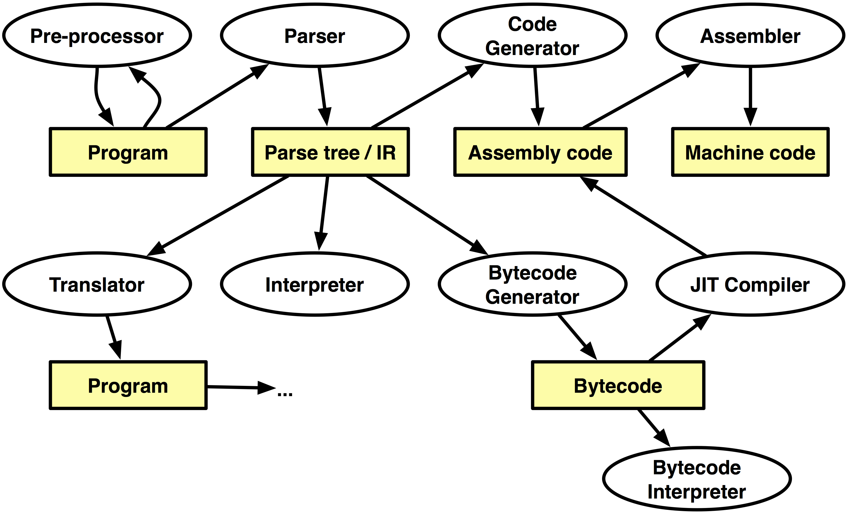
Compilers, Interpreters …

Slide 9
What is a compiler?
a program that translates an executable program in one language into an executable program in another language
Notes:
Translates “source code” into “target code”
we expect the program produced by the compiler to be “better”, in some way, than the original

Slide 10
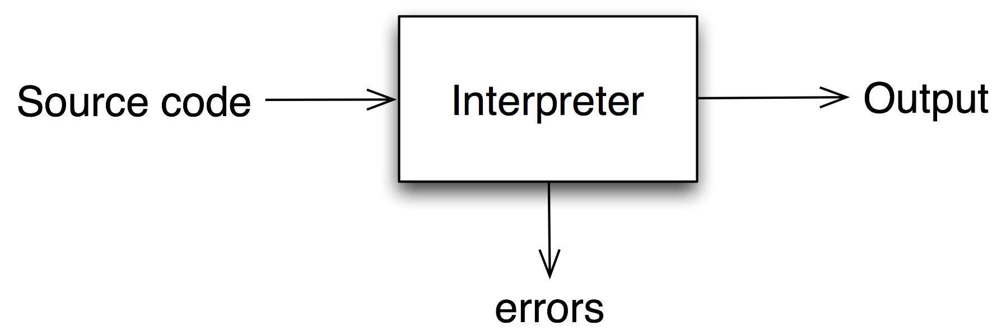
What is an interpreter?
a program that reads an executable program and produces the results of running that program
Notes:
usually, this involves executing the source program in some fashion

Slide 11
Why do we care?
artificial intelligence | greedy algorithms learning algorithms
algorithms | graph algorithms union-find dynamic programming
theory | DFAs for scanning parser generators lattice theory for analysis
systems | allocation and naming locality synchronization
architecture | pipeline management hierarchy management instruction set use
Compiler construction is a microcosm of computer science
Inside a compiler, all these things come together

Slide 12
Isn’t it a solved problem?
Machines are constantly changing
Changes in architecture ⇒ changes in compilers
new features pose new problems
changing costs lead to different concerns
old solutions need re-engineering
Innovations in compilers should prompt changes in architecture
New languages and features
Notes:
Computationally expensive but simpler scannerless parsing techniques are undergoing a renaissance.

Slide 13
What qualities are important in a compiler?
Correct code
Output runs fast
Compiler runs fast
Compile time proportional to program size
Support for separate compilation
Good diagnostics for syntax errors
Works well with the debugger
Good diagnostics for ﬂow anomalies
Cross language calls
Consistent, predictable optimization
Notes:
Each of these shapes your feelings about the correct contents of this course

Slide 14
A bit of history
1952: First compiler (linker/loader) written by Grace Hopper for A-0 programming language
1957: First complete compiler for FORTRAN by John Backus and team
1960: COBOL compilers for multiple architectures
1962: First self-hosting compiler for LISP
Notes:
http://en.wikipedia.org/wiki/Compiler ;-)

Slide 15
A compiler was originally a program that “compiled” subroutines [a link-loader]. When in 1954 the combination “algebraic compiler” came into use, or rather into misuse, the meaning of the term had already shifted into the present one.
— Bauer and Eickel [1975]

Slide 16
Abstract view
recognize legal (and illegal) programs
generate correct code
manage storage of all variables and code
agree on format for object (or assembly) code
Big step up from assembler — higher level notations

Slide 17
Traditional two pass compiler
intermediate representation (IR)
front end maps legal code into IR
back end maps IR onto target machine
simplify retargeting
allows multiple front ends
multiple passes ⇒ better code

Slide 18
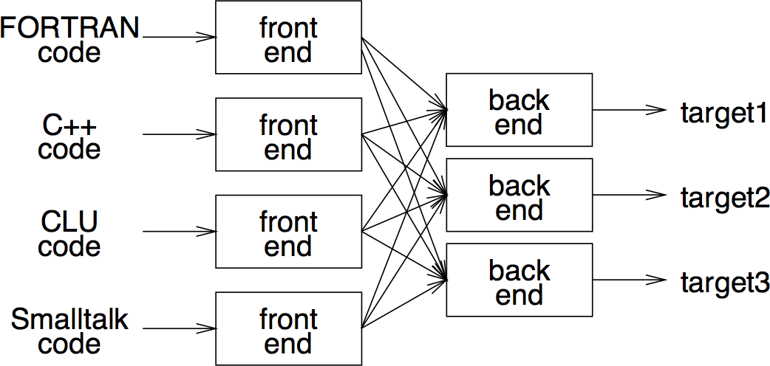
A fallacy!
Front-end, IR and back-end must encode knowledge needed for all n×m combinations!
Notes:
- must encode all the knowledge in each front end
- must represent all the features in one IR
must handle all the features in each back end
Limited success with low-level IRs

Slide 19
Roadmap
Overview
Front end
Back end
Multi-pass compilers
Example: compiler and interpreter for a toy language

Slide 20
Front end
recognize legal code
report errors
produce IR
preliminary storage map
shape code for the back end
Much of front end construction can be automated
Notes:
preliminary storage map => not only prepare symbol table, but decide what part of storage different names (entities) should be mapped to
shape code for the back end => decide how different parts of code are organized (in the IR)

Slide 21
Scanner
map characters to tokens
character string value for a token is a lexeme
eliminate white space
x = x + y
<id,x> = <id,x> + <id,y>
Notes:
character string value for a token is a lexeme
Typical tokens: id, number, do, end …
Key issue is speed

Slide 22
Parser
recognize context-free syntax
guide context-sensitive analysis
construct IR(s)
produce meaningful error messages
attempt error correction
Parser generators mechanize much of the work

Slide 23
Context-free grammars
<goal> := <expr>
<expr> := <expr> <op> <term>
| <term>
<term> := number
| id
<op> := +
| -
Context-free syntax is specified with a grammar, usually in Backus-Naur form (BNF)
A grammar G = (S,N,T,P)
S is the start-symbol
N is a set of non-terminal symbols
T is a set of terminal symbols
P is a set of productions — P: N → (N ∪T)*
Notes:
Called “context-free” because rules for non-terminals can be written without regard for the context in which they appear.

Slide 24
Deriving valid sentences
Production | Result
 | <goal>
1 | <expr>
2 | <expr> <op> <term>
5 | <expr> <op> y
7 | <expr> - y
2 | <expr> <op> <term> - y
4 | <expr> <op> 2 - y
6 | <expr> + 2 - y
3 | <term> + 2 - y
5 | x + 2 - y
Given a grammar, valid sentences can be derived by repeated substitution.
To recognize a valid sentence in some CFG, we reverse this process and build up a parse.
Notes:
The parse is the sequence of productions needed to parse the input.
The parse tree is something else …

Slide 25
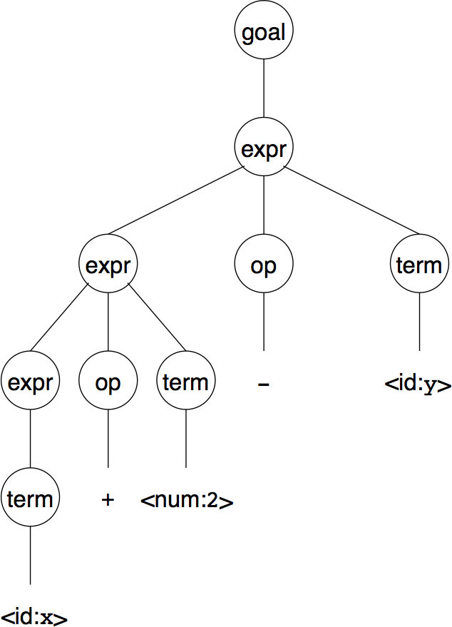
Parse trees
A parse can be represented by a tree called a parse tree (or syntax tree).
Obviously, this contains a lot of unnecessary information

Slide 26
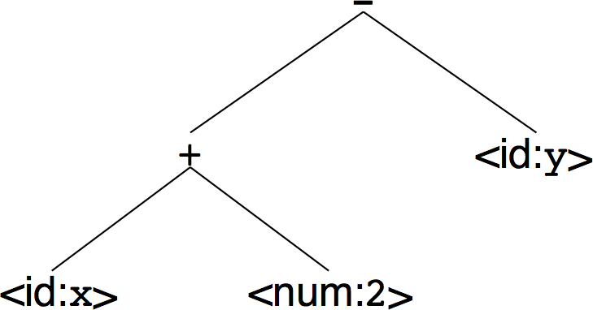
Abstract syntax trees
So, compilers often use an abstract syntax tree (AST).
ASTs are often used as an IR.

Slide 27
Roadmap
Overview
Front end
Back end
Multi-pass compilers
Example: compiler and interpreter for a toy language

Slide 28
Back end
translate IR into target machine code
choose instructions for each IR operation
decide what to keep in registers at each point
ensure conformance with system interfaces
Automation has been less successful here

Slide 29
Instruction selection
produce compact, fast code
use available addressing modes
pattern matching problem
ad hoc techniques
tree pattern matching
string pattern matching
dynamic programming

Slide 30
Register allocation
have value in a register when used
limited resources
changes instruction choices
can move loads and stores
optimal allocation is difficult
Modern allocators often use an analogy to graph coloring

Slide 31
Roadmap
Overview
Front end
Back end
Multi-pass compilers
Example: compiler and interpreter for a toy language

Slide 32
Traditional three-pass compiler
analyzes and changes IR
goal is to reduce runtime (optimization)
must preserve results
Notes:
Code improvement and optimization

Slide 33
Optimizer (middle end)
Modern optimizers are usually built as a set of passes
constant expression propagation and folding
code motion
reduction of operator strength
common sub-expression elimination
redundant store elimination
dead code elimination
Notes:
constant propagation and folding (evaluate and propagate constant expressions at compile time)
code motion (move code that does not need to be reevaluated out of loops)
reduction of operator strength (replace slow operations by equivalent faster ones)
common sub-expression elimination (evaluate once and store)
redundant store elimination (detect when values are stored repeatedly and eliminate)
dead code elimination (eliminate code that can never be executed)

Slide 34
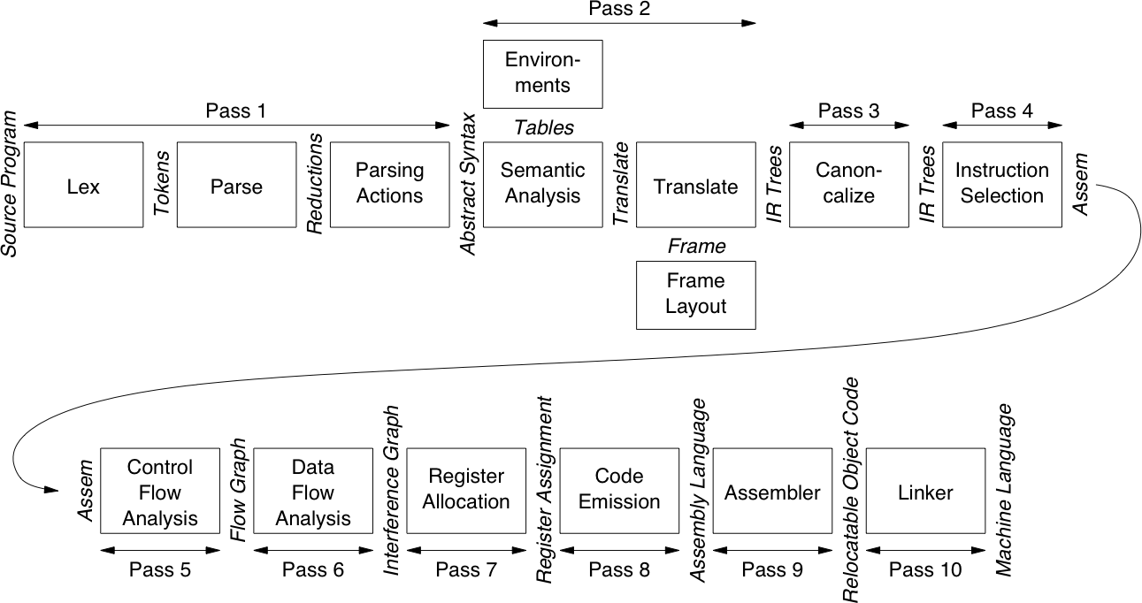
The MiniJava compiler
Notes:
Cf. MCIJ 2d edn p 4

Slide 35
Compiler phases
Lex | Break source ﬁle into individual words, or tokens
Parse | Analyse the phrase structure of program
Parsing Actions | Build a piece of abstract syntax tree for each phrase
Semantic Analysis | Determine what each phrase means, relate uses of variables to their definitions, check types of expressions, request translation of each phrase
Frame Layout | Place variables, function parameters, etc., into activation records (stack frames) in a machine-dependent way
Translate | Produce intermediate representation trees (IR trees), a notation that is not tied to any particular source language or target machine
Canonicalize | Hoist side effects out of expressions, and clean up conditional branches, for convenience of later phases
Instruction Selection | Group IR-tree nodes into clumps that correspond to actions of target-machine instructions
Control Flow Analysis | Analyse sequence of instructions into control ﬂow graph showing all possible flows of control program might follow when it runs
Data Flow Analysis | Gather information about flow of data through variables of program; e.g., liveness analysis calculates places where each variable holds a still-needed (live) value
Register Allocation | Choose registers for variables and temporary values; variables not simultaneously live can share same register
Code Emission | Replace temporary names in each machine instruction with registers

Slide 36
Roadmap
Overview
Front end
Back end
Multi-pass compilers
Example: compiler and interpreter for a toy language

Slide 37
A straight-line programming language (no loops or conditionals):
Stm | → | Stm ; Stm | CompoundStm
Stm | → | id := Exp | AssignStm
Stm | → | print ( ExpList ) | PrintStm
Exp | → | id | IdExp
Exp | → | num | NumExp
Exp | → | Exp Binop Exp | OpExp
Exp | → | ( Stm , Exp ) | EseqExp
ExpList | → | Exp , ExpList | PairExpList
ExpList | → | Exp | LastExpList
Binop | → | + | Plus
Binop | → | − | Minus
Binop | → | × | Times
Binop | → | / | Div
a := 5 + 3; b := (print(a,a—1),10×a); print(b)
8 7
80
prints

Slide 38
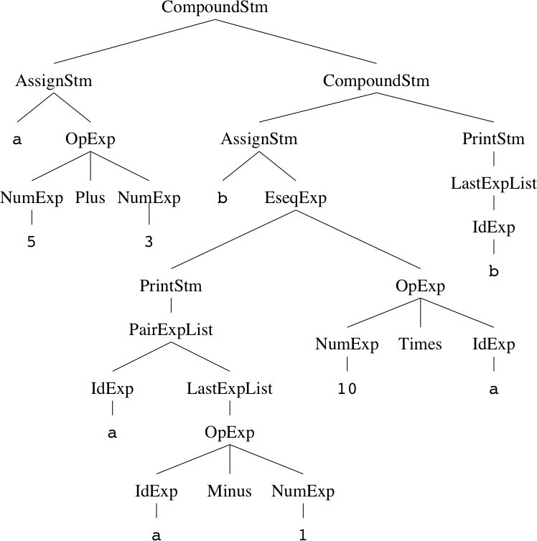
Tree representation
a := 5 + 3; b := (print(a,a—1),10×a); print(b)

Slide 39
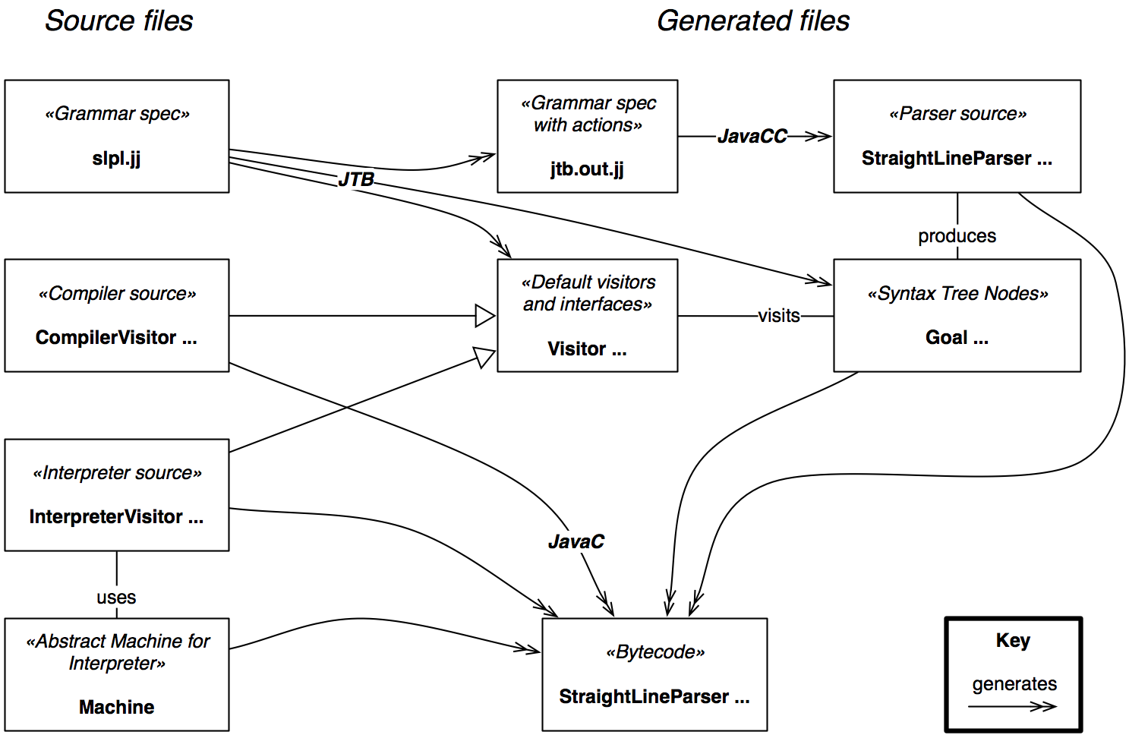
Straightline Interpreter and Compiler Files

Slide 40
Java classes for trees
abstract class Stm {}
class CompoundStm extends Stm {
Stm stm1, stm2;
CompoundStm(Stm s1, Stm s2)
{stm1=s1; stm2=s2;}
}
class AssignStm extends Stm {
String id; Exp exp;
AssignStm(String i, Exp e)
{id=i; exp=e;}
}
class PrintStm extends Stm {
ExpList exps;
PrintStm(ExpList e) {exps=e;}
}
abstract class Exp {}
class IdExp extends Exp {
String id;
IdExp(String i) {id=i;}
}
class NumExp extends Exp {
int num;
NumExp(int n) {num=n;}
}
class OpExp extends Exp {
Exp left, right; int oper;
final static int Plus=1,Minus=2,Times=3,Div=4;
OpExp(Exp l, int o, Exp r)
{left=l; oper=o; right=r;}
}
class EseqExp extends Exp {
Stm stm; Exp exp;
EseqExp(Stm s, Exp e) {stm=s; exp=e;}
}
abstract class ExpList {}
class PairExpList extends ExpList {
Exp head; ExpList tail;
public PairExpList(Exp h, ExpList t)
{head=h; tail=t;}
}
class LastExpList extends ExpList {
Exp head;
public LastExpList(Exp h) {head=h;}
}

Slide 41
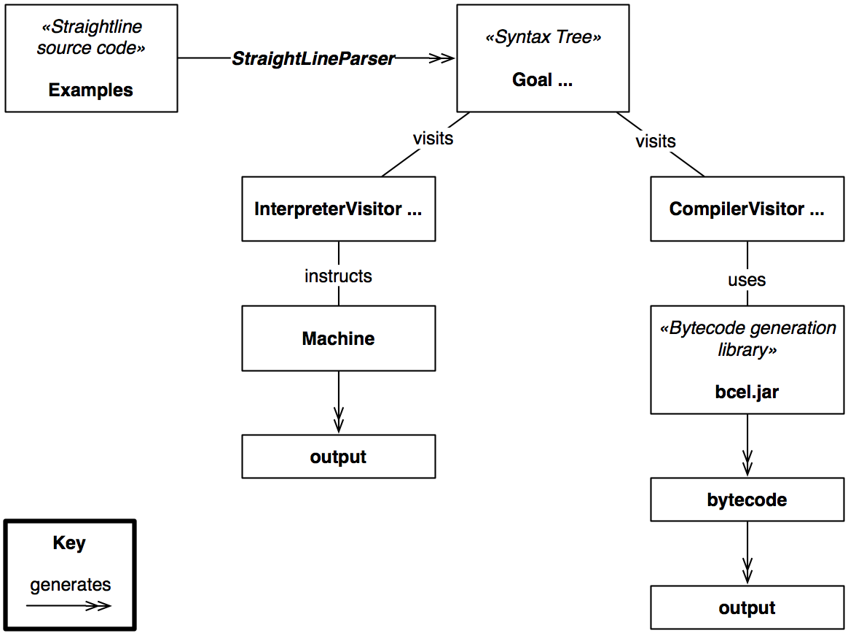
Straightline Interpreter and Compiler Runtime

Slide 42
What you should know!
What is the difference between a compiler and an interpreter?
What are important qualities of compilers?
Why are compilers commonly split into multiple passes?
What are the typical responsibilities of the different parts of a modern compiler?
How are context-free grammars specified?
What is “abstract” about an abstract syntax tree?
What is intermediate representation and what is it for?
Why is optimization a separate activity?

Slide 43
Can you answer these questions?
Is Java compiled or interpreted? What about Smalltalk? Ruby? PHP? Are you sure?
What are the key differences between modern compilers and compilers written in the 1970s?
Why is it hard for compilers to generate good error messages?
What is “context-free” about a context-free grammar?

Slide 44
License
http://creativecommons.org/licenses/by-sa/3.0/
Attribution-ShareAlike 3.0 Unported
You are free:
to Share — to copy, distribute and transmit the work
to Remix — to adapt the work
Under the following conditions:
Attribution. You must attribute the work in the manner specified by the author or licensor (but not in any way that suggests that they endorse you or your use of the work).
Share Alike. If you alter, transform, or build upon this work, you may distribute the resulting work only under the same, similar or a compatible license.
For any reuse or distribution, you must make clear to others the license terms of this work. The best way to do this is with a link to this web page.
Any of the above conditions can be waived if you get permission from the copyright holder.
Nothing in this license impairs or restricts the author's moral rights.

