Slide 1
2. Lexical Analysis
Prof. O. Nierstrasz
Thanks to Jens Palsberg and Tony Hosking for their kind permission to reuse and adapt the CS132 and CS502 lecture notes.
http://www.cs.ucla.edu/~palsberg/
http://www.cs.purdue.edu/homes/hosking/

Slide 2
Roadmap
Regular languages
Finite automata recognizers
From regular expressions to deterministic finite automata, and back
Limits of regular languages
See, Modern compiler implementation in Java (Second edition), chapter 2.

Slide 3
Roadmap
Regular languages
Finite automata recognizers
From regular expressions to deterministic finite automata, and back
Limits of regular languages

Slide 4
Scanner
map characters to tokens
character string value for a token is a lexeme
eliminates white space (tabs, blanks, comments etc.)
a key issue is speed ⇒ use specialized recognizer
x = x + y
<id,x> = <id,x> + <id,y>

Slide 5
Specifying patterns
A scanner must recognize various parts of the language’s syntax
White space
<ws> ::= <ws> ’ ’
| <ws> ’\t’
| ’ ’
| ’\t’
Keywords and operators
specified as literal patterns: do, end
Comments
opening and closing delimiters: /* … */
Some parts are easy:

Slide 6
Specifying patterns
Other parts are much harder:
Identifiers
alphabetic followed by k alphanumerics (_, $, &, …))
Numbers
integers: 0 or digit from 1-9 followed by digits from 0-9
decimals: integer ’.’ digits from 0-9
reals: (integer or decimal) ’E’ (+ or —) digits from 0-9
complex: ’(’ real ’,’ real ’)’
We need an expressive notation to specify these patterns!

Slide 7
Operations on languages
A language is a set of strings
Operation | Definition
Union | L ∪ M = { s ⏐ s ∈ L or s ∈ M }
Concatenation | LM = { st ⏐ s ∈ L and t ∈ M }
Kleene closure | L* = ∪_{I=0,∞} L^{i}
Positive closure | L⁺ = ∪_{I=1,∞} L^{i}

Slide 8
Regular expressions describe regular languages
Regular expressions over an alphabet Σ:
ε is a RE denoting the set {ε}
If a ∈ Σ, then a is a RE denoting {a}
If r and s are REs denoting L(r) and L(s), then:
(r) is a RE denoting L(r)
(r)⏐(s) is a RE denoting L(r) ∪L(s)
(r)(s) is a RE denoting L(r)L(s)
(r)* is a RE denoting L(r)*
If we adopt a precedence for operators, the extra parentheses can go away. We assume closure, then concatenation, then alternation as the order of precedence.
Notes:
Patterns are often speciﬁed as regular languages.
Notations used to describe a regular language (or a regular set) include both regular expressions and regular grammars

Slide 9
Examples
identifier
letter → (a ⏐b ⏐ c ⏐… ⏐z ⏐ A ⏐ B ⏐ C ⏐ … ⏐ Z )
digit → (0⏐1⏐2⏐3⏐4⏐5⏐6⏐7⏐8⏐9)
id → letter ( letter ⏐ digit )*
numbers
integer → (+⏐—⏐ ε) (0⏐(1⏐2⏐3⏐… ⏐9) digit * )
decimal → integer . ( digit )*
real → ( integer ⏐ decimal ) E (+ ⏐—) digit *
complex → ’(‘ real ’,’ real ’)’
We can use REs to build scanners automatically.
Notes:
Numbers can get much more complicated.
Most programming language tokens can be described with REs.

Slide 10
Algebraic properties of REs
r⏐s = s⏐r | ⏐ is commutative
r⏐(s⏐t) = (r⏐s)⏐t | ⏐ is associative
r (st) = (rs)t | concatenation is associative
r(s⏐t) = rs⏐rt (s⏐t)r = sr⏐tr | concatenation distributes over ⏐
εr = r rε = r | ε is the identity for concatenation
r * = (r⏐ε)* | ε is contained in *
r ** = r* | * is idempotent

Slide 11
Examples
Let Σ = {a,b}
a⏐b denotes {a,b}
(a⏐b) (a⏐b) denotes {aa,ab,ba,bb}
a* denotes {ε,a,aa,aaa,…}
(a⏐b)* denotes the set of all strings of a’s and b’s (including ε), i.e., (a⏐b)* = (a*⏐b*)*
a⏐a*b denotes {a,b,ab,aab,aaab,aaaab,…}

Slide 12
Roadmap
Regular languages
Finite automata recognizers
From regular expressions to deterministic finite automata, and back
Limits of regular languages

Slide 13
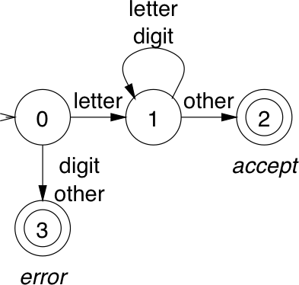
Recognizers
From a regular expression we can construct a deterministic finite automaton (DFA)
letter → (a ⏐b ⏐ c ⏐… ⏐z ⏐ A ⏐ B ⏐ C ⏐ … ⏐ Z )
digit → (0⏐1⏐2⏐3⏐4⏐5⏐6⏐7⏐8⏐9)
id → letter ( letter ⏐ digit )*

Slide 14
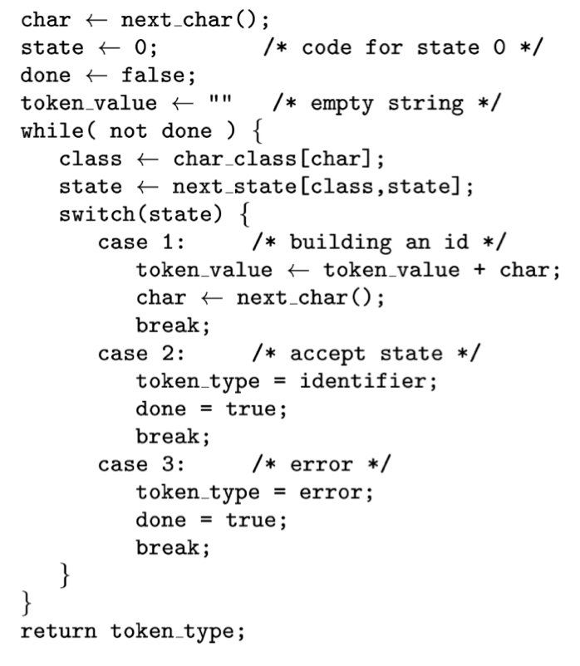
Code for the recognizer

Slide 15
Tables for the recognizer
Two tables control the recognizer
char | a-z | A-Z | 0-9 | other
value | letter | letter | digit | other
char_class
 | 0 | 1 | 2 | 3
letter | 1 | 1 | — | —
digit | 3 | 1 | — | —
other | 3 | 2 | — | —
next_state
To change languages, we can just change tables

Slide 16
Automatic construction
Scanner generators automatically construct code from regular expression-like descriptions
construct a DFA
use state minimization techniques
emit code for the scanner (table driven or direct code )
A key issue in automation is an interface to the parser
lex is a scanner generator supplied with UNIX
emits C code for scanner
provides macro definitions for each token (used in the parser)

Slide 17
Grammars for regular languages
Regular grammars generate regular languages
Provable fact:
For any RE r, there exists a grammar g such that L(r) = L(g)
Deﬁnition:
In a regular grammar, all productions have one of two forms:
A → aA
A → a
where A is any non-terminal and a is any terminal symbol
These are also called type 3 grammars (Chomsky)

Slide 18
Aside: The Chomsky Hierarchy
Type 0: α → β
Unrestricted grammars generate recursively enumerable languages, recognizable by Turing machines
Type 1: αAβ → αγβ
Context-sensitive grammars generate context-sensitive languages, recognizable by linear bounded automata
Type 2: A → γ
Context-free grammars generate context-free languages, recognizable by non-deterministic push-down automata
Type 3: A → b and A → aB
Regular grammars generate regular languages, recognizable by finite state automata
NB: A is a non-terminal; α, β, γ are strings of terminals and non-terminals

Slide 19
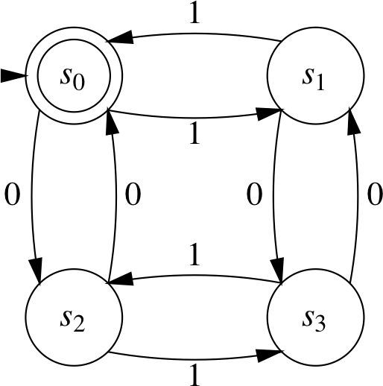
More regular languages
Example: the set of strings containing an even number of zeros and an even number of ones
The RE is (00⏐11)*((01⏐10)(00⏐11)*(01⏐10)(00⏐11)*)*
Notes:
NB: The states capture whether there are an even number of 0s or 1s => 4 possible states.
Note how the RE walks through the DFA.

Slide 20
More regular expressions
What about the RE (a⏐b)*abb ?
State s₀ has multiple transitions on a!
This is a non-deterministic finite automaton

Slide 21
Review: Finite Automata
A non-deterministic ﬁnite automaton (NFA) consists of:
a set of states S = { s₀ , … , s_{n} }
a set of input symbols Σ (the alphabet)
a transition function move mapping state-symbol pairs to sets of states
a distinguished start state s₀
a set of distinguished accepting (final) states F
A Deterministic Finite Automaton (DFA) is a special case of an NFA:
no state has a ε-transition, and
for each state s and input symbol a, there is at most one edge labeled a leaving s.
A DFA accepts x iff there exists a unique path through the transition graph from the s₀ to an accepting state such that the labels along the edges spell x.

Slide 22
DFAs and NFAs are equivalent
DFAs are clearly a subset of NFAs
Any NFA can be converted into a DFA, by simulating sets of simultaneous states:
each DFA state corresponds to a set of NFA states
NB: possible exponential blowup

Slide 23
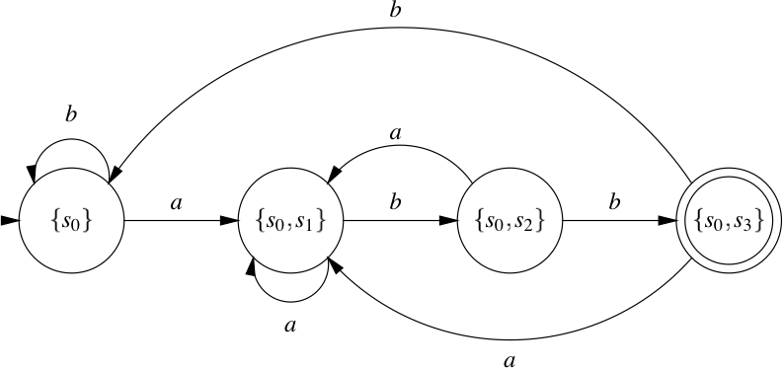
NFA to DFA using the subset construction

Slide 24
Roadmap
Regular languages
Finite automata recognizers
From regular expressions to deterministic finite automata, and back
Limits of regular languages

Slide 25
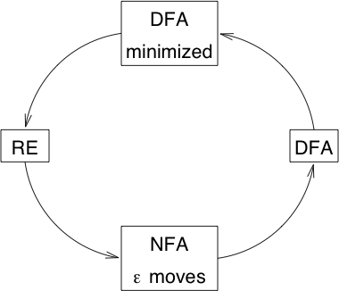
Constructing a DFA from a regular expression
RE → NFA
Build NFA for each term; connect with ε moves
NFA → DFA
Simulate the NFA using the subset construction
DFA → minimized DFA
Merge equivalent states
DFA → RE
Construct R^{k}_{ij} = R^{k-1}_{ik} (R^{k-1}_{kk})* R^{k-1}_{kj} ∪ R^{k-1}_{ij}
Or convert via Generalized NFA (GNFA)

Slide 26
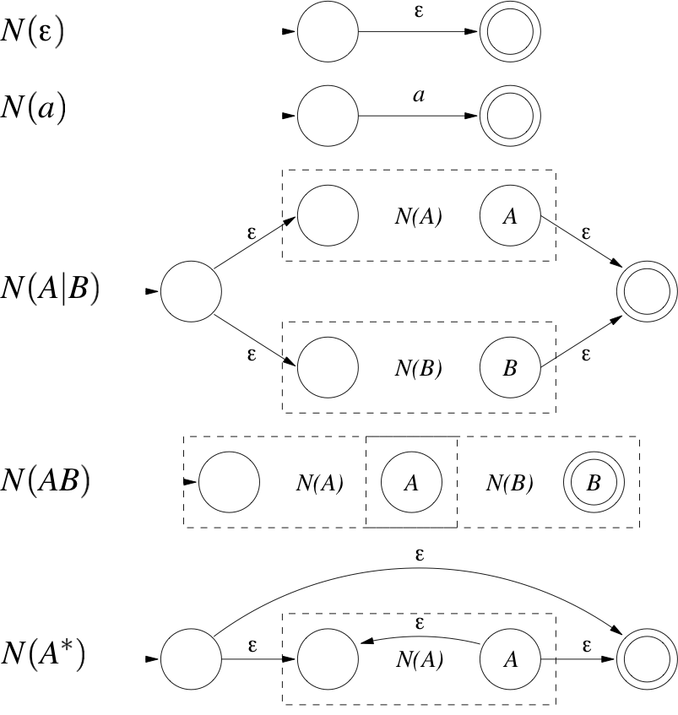
RE to NFA

Slide 27
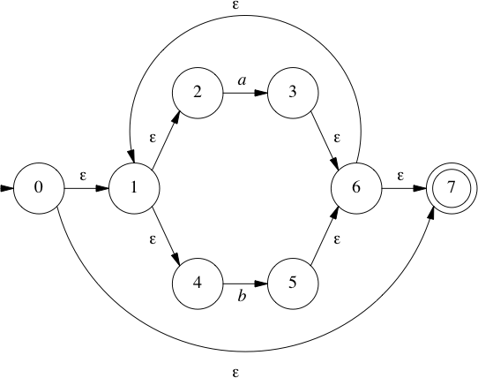
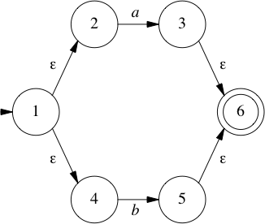
RE to NFA example: (a⏐b)*abb
(a⏐b)
(a⏐b)*
abb

Slide 28
NFA to DFA: the subset construction
Input: NFA N
Output: DFA D with states S_{D} and transitions T_{D} such that L(D) = L(N)
Method: Let s be a state in N and P be a set of states. Use the following operations:
ε-closure(s) — set of states of N reachable from s by ε transitions alone
ε-closure(P) — set of states of N reachable from some s in P by ε transitions alone
move(T,a) — set of states of N to which there is a transition on input a from some s in P
add state P = ε-closure(s₀) unmarked to S_{D}
while ∃ unmarked state P in S_{D}
mark P
for each input symbol a
U = ε-closure(move(P,a))
if U ∉ S_{D}
then add U unmarked to S_{D}
T_{D}[T,a] = U
end for
end while
ε-closure(s₀) is the start state of D
A state of D is accepting if it contains an accepting state of N
Notes:
Renamed some terms from Palsberg/Hosking slide

Slide 29
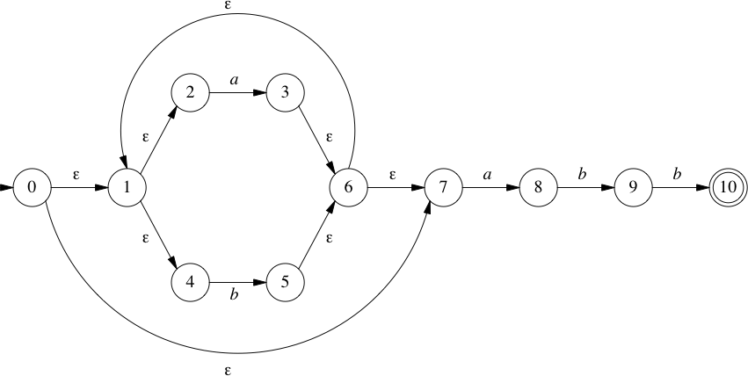
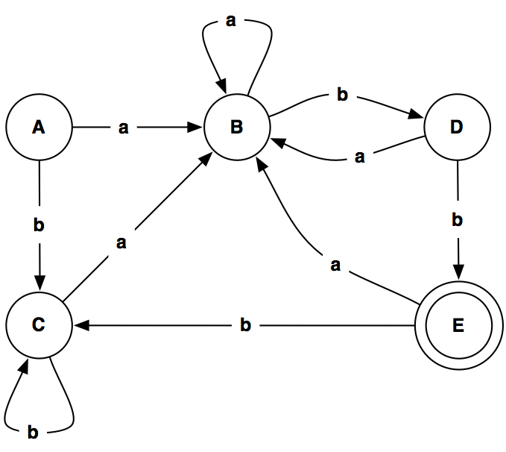
NFA to DFA using subset construction: example
A = {0,1,2,4,7}
B = {1,2,3,4,6,7,8}
C = {1,2,4,5,6,7}
D = {1,2,4,5,6,7,9}
E = {1,2,4,5,6,7,10}

Slide 30
DFA Minimization
Theorem: For each regular language that can be accepted by a DFA, there exists a DFA with a minimum number of states.
Minimization approach: merge equivalent states.
States A and C are indistinguishable, so they can be merged!
http://en.wikipedia.org/wiki/DFA_minimization
Notes:
After b*a we always end up in state B.
Details of minimization algorithms are out of the scope of this lecture, but see any standard text.

Slide 31
DFA Minimization algorithm
Create lower-triangular table DISTINCT, initially blank
For every pair of states (p,q):
If p is final and q is not, or vice versa
DISTINCT(p,q) = ε
Loop until no change for an iteration:
For every pair of states (p,q) and each symbol α
If DISTINCT(p,q) is blank and DISTINCT( δ(p,α), δ(q,α) ) is not blank
DISTINCT(p,q) = α
Combine all states that are not distinct

Slide 32
Minimization in action
C and A are indistinguishable
so can be merged

Slide 33
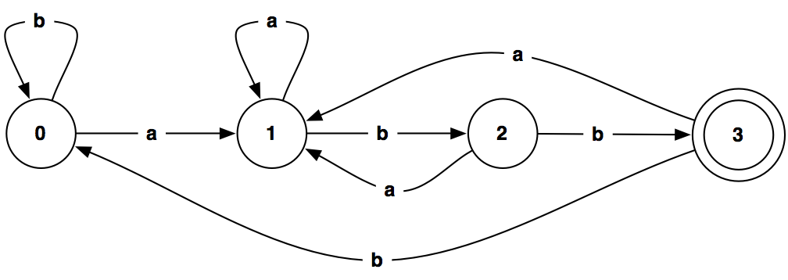
DFA Minimization example
It is easy to see that this is in fact the minimal DFA for (a⏐b)*abb …
Notes:
Actually it is easy to see that this is the minimal DFA:
Start with the path abb. This gives us 4 states. Now add the missing arrows.
Any a transition brings us to state 1, since we must follow with bb.
Any b not in the path brings us back to state 0, since we must follow with abb.

Slide 34
DFA to RE via GNFA
A Generalized NFA is an NFA where transitions may have any RE as labels
Conversion algorithm:
Add a new start state and accept state with ε-transitions to/from the old start/end states
Merge multiple transitions between two states to a single RE choice transition
Add empty ∅−transitions between states where missing
Iteratively “rip out” old states and replace “dangling transitions” with appropriately labeled transitions between remaining states
STOP when all old states are gone and only the new start and accept states remain

Slide 35
GNFA conversion algorithm
Let k be the number of states of G, k≥2
If k=2, then RE is the label found between q_{s} and q_{a} (start and accept states of G)
While k>2, select q_{rip} ≠ q_{s} or q_{a}
Q´ = Q – {q_{rip}}
For any q_{i} ∈ Q´ — {q_{a}} let δ´(q_{i},q_{j}) = R₁ R₂* R₃ ∪ R₄ where: R₁ = δ´(q_{i},q_{rip}), R₂ = δ´(q_{rip},q_{rip}), R₂ = δ´(q_{rip},q_{j}), R₄ = δ´(q_{i},q_{j})
Replace G by G´

Slide 36
The initial DFA

Slide 37
Add new start and accept states

Slide 38
Add missing empty transitions
(we’ll just pretend they’re there)
Notes:
This means “you can’t get there from here”

Slide 39
Delete an arbitrary state

Slide 40
Fix dangling transitions s→1 and 3→1
Don’t forget to merge the existing transitions!

Slide 41
Simplify the RE
Delete another state
NB: bb*a|a = (bb*|ε)a = b*a

Slide 47
Hm … not what we expected
Notes:
Note that b*aa*b = b*a*ab
And so b*aa*b (b*aa*b)* b = (b*a*ab)* b*a*abb
It remains to be shown that (b*a*ab)* b*a* = (a|b)* …

Slide 48
b*aa*b (b*aa*b)* b = (a|b)*abb ?
We can rewrite:
b*aa*b (b*aa*b)* b
b*a*ab (b*a*ab)* b
(b*a*ab)* b*a* abb
But does this hold?
(b*a*ab)* b*a* = (a|b)*
We can show that the minimal DFAs for these REs are isomorphic …
Notes:
Proof: Split any string in (a|b)* by occurrences of ab. This will match (Xab)*X, where X does not contain ab. X is clearly b*a*. QED
Proof #2 by @grammarware: (b*a*ab)*b*a* = (b*a⁺b)*b*a* = b*(a⁺b⁺)*a* = b*(b*|(a⁺b⁺)*)a* = b*(b*|(a⁺b⁺)*|a*)a* = b*(a|b)*a* = (a|b)*a* = (a|b)*

Slide 49
Roadmap
Regular languages
Finite automata recognizers
From regular expressions to deterministic finite automata, and back
Limits of regular languages

Slide 50
Limits of regular languages
Not all languages are regular!
One cannot construct DFAs to recognize these languages:
L = { p^{k}q^{k} }
L = { wcw^{r} | w ∈ Σ*, w^{r} is w reversed }
In general, DFAs cannot count!
However, one can construct DFAs for:
Alternating 0’s and 1’s:
(ε | 1)(01)*(ε | 0)
Sets of pairs of 0’s and 1’s
(01 | 10)⁺

Slide 51
So, what is hard?
Certain language features can cause problems:
Reserved words
PL/I had no reserved words
if then then then = else; else else = then
Significant blanks
FORTRAN and Algol68 ignore blanks
do 10 i = 1,25
do 10 i = 1.25
String constants
Special characters in strings
Newline, tab, quote, comment delimiter
Finite limits
Some languages limit identifier lengths
Add state to count length
FORTRAN 66 — 6 characters(!)

Slide 52
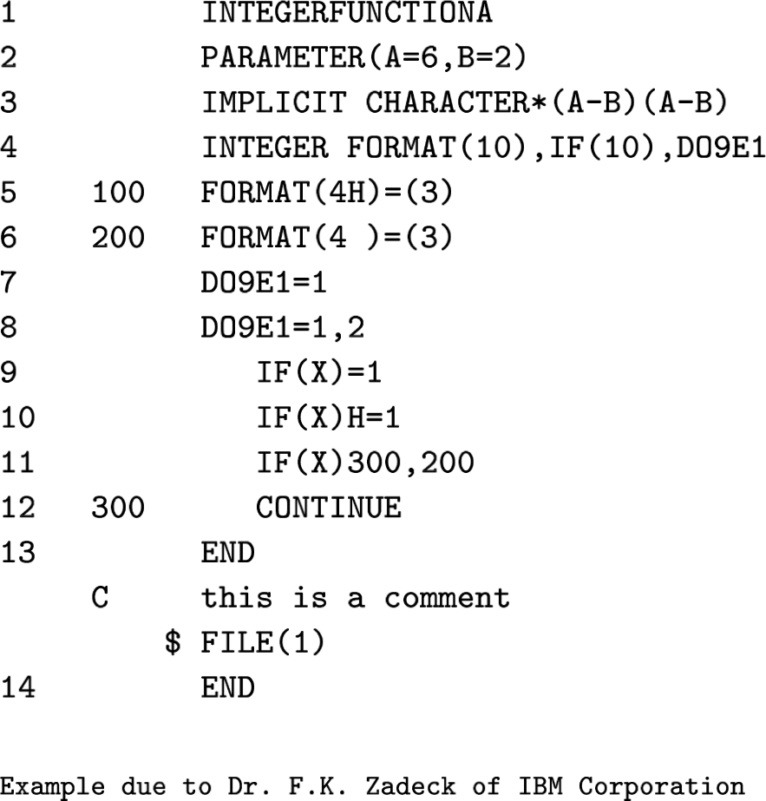
How bad can it get?
Compiler needs context to distinguish variables from control constructs!

Slide 53
What you should know!
What are the key responsibilities of a scanner?
What is a formal language? What are operators over languages?
What is a regular language?
Why are regular languages interesting for defining scanners?
What is the difference between a deterministic and a non-deterministic finite automaton?
How can you generate a DFA recognizer from a regular expression?
Why aren’t regular languages expressive enough for parsing?

Slide 54
Can you answer these questions?
Why do compilers separate scanning from parsing?
Why doesn’t NFA → DFA translation normally result in an exponential increase in the number of states?
Why is it necessary to minimize states after translation a NFA to a DFA?
How would you program a scanner for a language like FORTRAN?

Slide 55
License
http://creativecommons.org/licenses/by-sa/3.0/
Attribution-ShareAlike 3.0 Unported
You are free:
to Share — to copy, distribute and transmit the work
to Remix — to adapt the work
Under the following conditions:
Attribution. You must attribute the work in the manner specified by the author or licensor (but not in any way that suggests that they endorse you or your use of the work).
Share Alike. If you alter, transform, or build upon this work, you may distribute the resulting work only under the same, similar or a compatible license.
For any reuse or distribution, you must make clear to others the license terms of this work. The best way to do this is with a link to this web page.
Any of the above conditions can be waived if you get permission from the copyright holder.
Nothing in this license impairs or restricts the author's moral rights.

