Slide 1
4. Parsing in Practice
Prof. O. Nierstrasz
Thanks to Jens Palsberg and Tony Hosking for their kind permission to reuse and adapt the CS132 and CS502 lecture notes.
http://www.cs.ucla.edu/~palsberg/
http://www.cs.purdue.edu/homes/hosking/

Slide 2

Roadmap
Bottom-up parsing
LR(k) grammars
JavaCC, Java Tree Builder and the Visitor pattern
Example: a straightline interpreter
See, Modern compiler implementation in Java (Second edition), chapters 3-4.

Slide 3
Roadmap
Bottom-up parsing
LR(k) grammars
JavaCC, Java Tree Builder and the Visitor pattern
Example: a straightline interpreter

Slide 4
Some definitions
Recall:
For a grammar G, with start symbol S, any string α such that S ⇒* α is called a sentential form
  If α ∈ V_{t}*, then α is called a sentence in L(G)
  Otherwise it is just a sentential form (not a sentence in L(G))
A left-sentential form is a sentential form that occurs in the leftmost derivation of some sentence.
A right-sentential form is a sentential form that occurs in the rightmost derivation of some sentence.

Slide 5
Bottom-up parsing
Goal:
  Given an input string w and a grammar G, construct a parse tree by starting at the leaves and working to the root.
The parser repeatedly matches a right-sentential form from the language against the tree’s upper frontier.
At each match, it applies a reduction to build on the frontier:
  each reduction matches an upper frontier of the partially built tree to the RHS of some production
  each reduction adds a node on top of the frontier
The final result is a rightmost derivation, in reverse.
Notes:
Why rightmost?

Slide 6
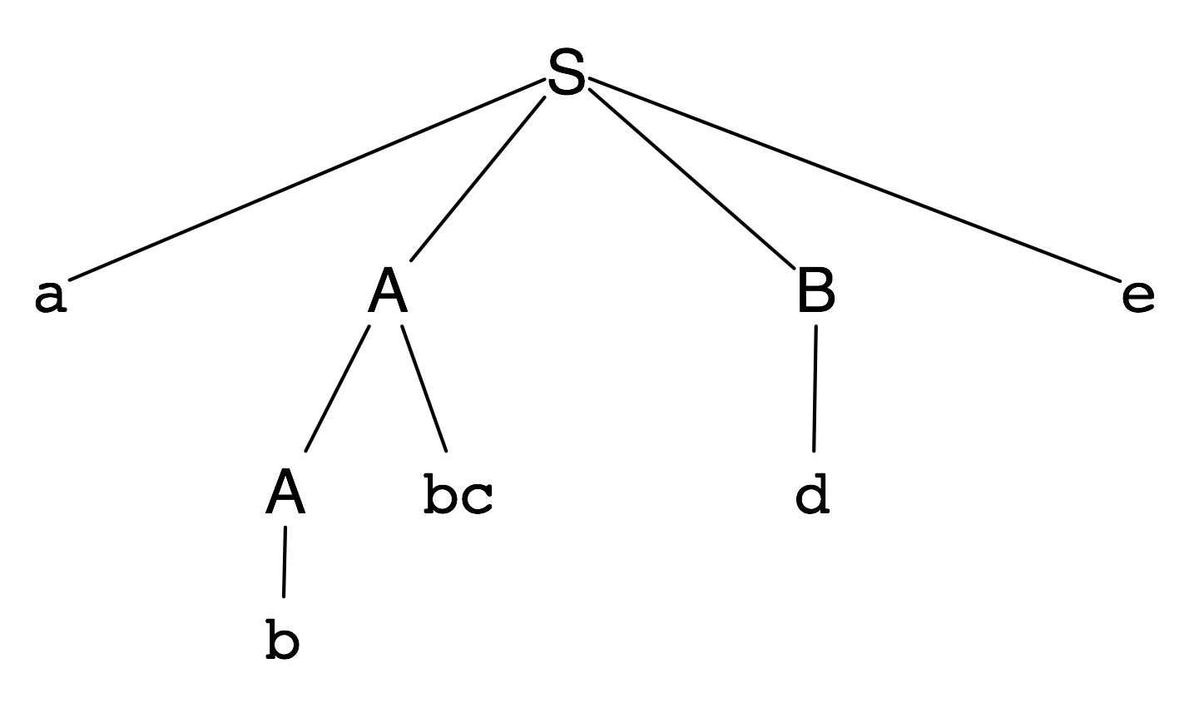
Example
Consider the grammar:
and the input string: abbcde
S → aABe
A → Abc
| b
B → d
Production | Sentential Form
3 | abbcde
2 | aAbcde
4 | aAde
1 | aABe
 | S
The trick appears to be scanning the input and finding valid sentential forms.
Notes:
Parse bottom up, replacing terms by non-terminals.
NB: Reading in reverse, we have a rightmost derivation, first replacing S, then B, A and A again.
TO FIX:
REMOVE the note (it’s confusing)
Instead:
need to show the stack and a lookahead table as in slide 56 of lecture 3
SHIFT a (ie push)
does a match, no so SHIFT
now b on top — it’s a handle so prune it (put A back on stack)
aA on stack does not match, so SHIFT b
could prune b, but lookahead tells us to shift c (not explained in this version of the slide!)
now prune Abc to A
SHIFT d
prune d to B
SHIFT e
prune S
Note that you have more context than with top-down since you may have a whole AST on the stack (A)

Slide 7
Handles
A handle of a right-sentential form γ is a production A → β and a position in γ where β may be found and replaced by A to produce the previous right-sentential form in a rightmost derivation of γ
  Suppose: S ⇒* αAw ⇒ αβw
  Then A → β in the position following α is a handle of αβw
NB: Because γ is a right-sentential form, the substring to the right of a handle contains only terminal symbols.

Slide 8
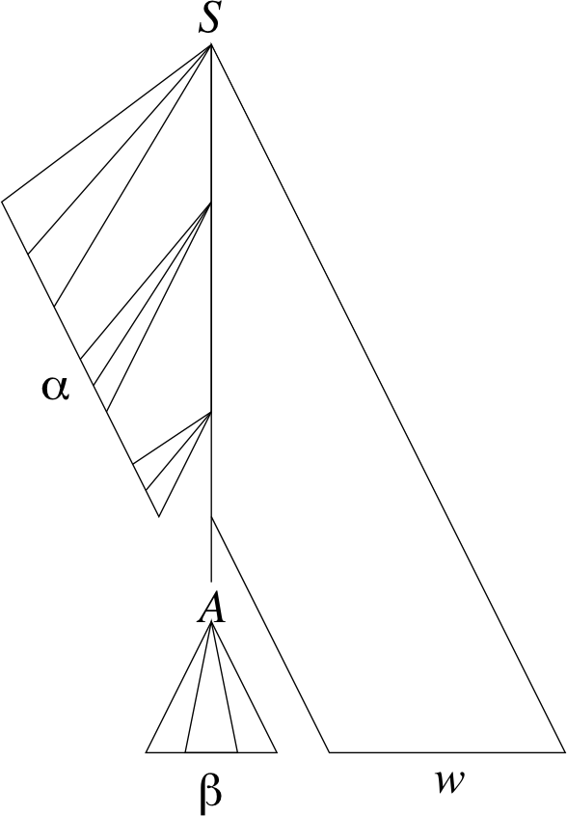
Handles
The handle A → β in the parse tree for αβw
Notes:
What are the handles in our previous example?

Slide 9
Handles
Theorem:
  If G is unambiguous then every right-sentential form has a unique handle.
Proof: (by definition)
  G is unambiguous ⇒ rightmost derivation is unique
  ⇒ a unique production A → β applied to take γ_{i—1} to γ_{i}
  ⇒ a unique position k at which A → β is applied
  ⇒ a unique handle A → β

Slide 10
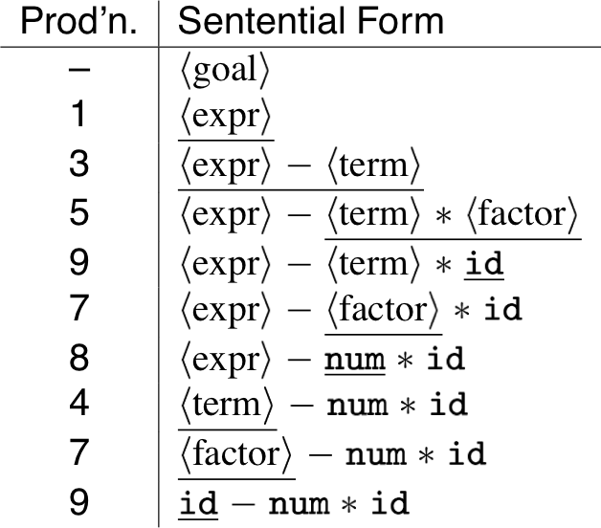
Example
The left-recursive expression grammar (original form)
<goal> ::= <expr>
<expr> ::= <expr> + <term>
| <expr> - <term>
| <term>
<term> ::= <term> * <factor>
| <term> / <factor>
| <factor>
<factor> ::= num
| id

Slide 11
Handle-pruning
The process to construct a bottom-up parse is called handle-pruning
To construct a rightmost derivation
S = γ₀ ⇒ γ₁ ⇒ γ₂ ⇒ … ⇒ γ_{n—1} ⇒ γ_{n} = w
we set i to n and apply the following simple algorithm:
  For i = n down to 1
  Find the handle A_{i} → β_{i} in γ_{i}
  Replace β_{i} with A_{i} to generate γ_{i—1}
This takes 2n steps, where n is the length of the derivation

Slide 12
Stack implementation
One scheme to implement a handle-pruning, bottom-up parser is called a shift-reduce parser.
Shift-reduce parsers use a stack and an input buffer
  initialize stack with $
  Repeat until the top of the stack is the goal symbol and the input token is $
    Find the handle.
    If we don’t have a handle on top of the stack, shift (push) an input symbol onto the stack
    Prune the handle.
    If we have a handle A → β on the stack, reduce
      Pop |β| symbols off the stack
      Push A onto the stack
NB: In practice we also lookahead to determine whether to shift or reduce!
Notes:
Actually, this is an LR(0) parser algorithm, since no lookahead is used.

Slide 13
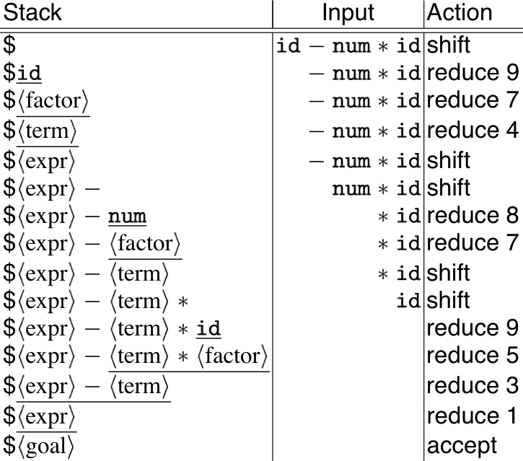
Example: back to x—2*y
<goal> ::= <expr>
<expr> ::= <expr> + <term>
| <expr> - <term>
| <term>
<term> ::= <term> * <factor>
| <term> / <factor>
| <factor>
<factor> ::= num
| id
Shift until top of stack is the right end of a handle
Find the left end of the handle and reduce
5 shifts + 9 reduces + 1 accept
Notes:
Why does <expr>—<term> produce a shift rather than a reduce?
Actually we need to lookahead at least one character (LR(1)) to decide whether to shift or reduce.

Slide 14
Shift-reduce parsing
A shift-reduce parser has just four canonical actions:
shift | next input symbol is shifted (pushed) onto the top of the stack
reduce | right end of handle is on top of stack; locate left end of handle within the stack; pop handle off stack and push appropriate non-terminal LHS
accept | terminate parsing and signal success
error | call an error recovery routine
Notes:
The key problem: to recognize handles (not covered in this course).
Ugh! Where is this covered?

Slide 15
Roadmap
Bottom-up parsing
LR(k) grammars
JavaCC, Java Tree Builder and the Visitor pattern
Example: a straightline interpreter

Slide 16
LR(k) grammars
A grammar G is LR(k) iff:
  S ⇒_{rm}* αAw ⇒_{rm} αβw
  S ⇒_{rm}* γBx ⇒_{rm} αβy
  FIRST_{k}(w) = FIRST_{k}(y) ⇒ αAy = γBx
I.e., if αβw and αβy have the same k-symbol lookahead, then there is a unique handle to reduce in the rightmost derivation.
Notes:
Obscure!
How to explain better?
Assume sentential forms αβw and αβy, with common preﬁx αβ and common k-symbol lookahead FIRST_{k}(w) = FIRST_{k}(y), such that αβw reduces to αAw and αβy reduces to γBx.
But, the common prefix means αβy also reduces to αAy, for the same result.
Thus αAy = γBx

Slide 17
Why study LR grammars?
LR(1) grammars are used to construct LR(1) parsers.
  everyone’s favorite parser
  virtually all context-free programming language constructs can be expressed in an LR(1) form
  LR grammars are the most general grammars parsable by a deterministic, bottom-up parser
  efficient parsers can be implemented for LR(1) grammars
  LR parsers detect an error as soon as possible in a left-to-right scan of the input
  LR grammars describe a proper superset of the languages recognized by predictive (i.e., LL) parsers
LL(k): recognize use of a production A → β seeing first k symbols of β
LR(k): recognize occurrence of β (the handle) having seen all of what is derived from β plus k symbols of look-ahead

Slide 18
Left versus right recursion
Right Recursion:
  needed for termination in predictive parsers
  requires more stack space
  right associative operators
Left Recursion:
  works fine in bottom-up parsers
  limits required stack space
  left associative operators
Rule of thumb:
  right recursion for top-down parsers
  left recursion for bottom-up parsers

Slide 19
Parsing review
Recursive descent
  A hand coded recursive descent parser directly encodes a grammar (typically an LL(1) grammar) into a series of mutually recursive procedures. It has most of the linguistic limitations of LL(1).
LL(k):
  must be able to recognize the use of a production after seeing only the first k symbols of its right hand side.
LR(k):
  must be able to recognize the occurrence of the right hand side of a production after having seen all that is derived from that right hand side with k symbols of look-ahead.
The dilemmas:
  LL dilemma: pick A → b or A → c ?
  LR dilemma: pick A → b or B → b ?

Slide 20
Roadmap
Bottom-up parsing
LR(k) grammars
JavaCC, Java Tree Builder and the Visitor pattern
Example: a straightline interpreter

Slide 21
The Java Compiler Compiler
“Lex and Yacc for Java.”
Based on LL(k) rather than LR(1) or LALR(1).
Grammars are written in EBNF.
Transforms an EBNF grammar into an LL(k) parser.
Supports embedded action code written in Java (just like Yacc supports embedded C action code)
The look-ahead can be changed by writing LOOKAHEAD(…)
The whole input is given in just one file (not two).
Notes:
LALR parsers start with an LR(0) state machine and then compute lookahead *sets* for all rules in the grammar, checking for ambiguity.

Slide 22
The JavaCC input format
Single file:
  header
  token specifications for lexical analysis
  grammar

Slide 23
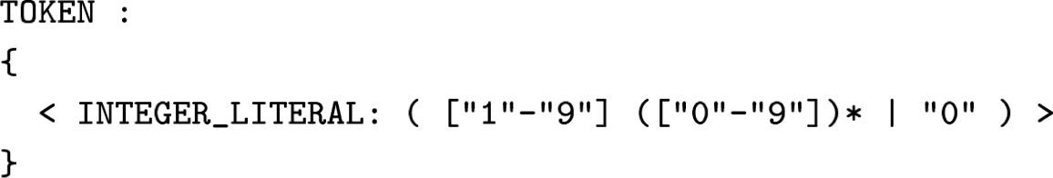
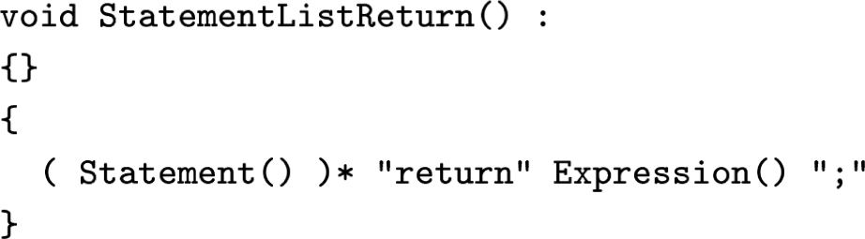
Examples
Token specification:
Production:

Slide 24
Generating a parser with JavaCC
javacc fortran.jj // generates a parser
javac Main.java // Main.java calls the parser
java Main < prog.f // parses the program prog.f
NB: JavaCC is just one of many tools available …
See: http://catalog.compilertools.net/java.html

Slide 25
The Visitor Pattern
Intent:
  Represent an operation to be performed on the elements of an object structure. Visitor lets you define a new operation without changing the classes of the elements on which it operates.
Design Patterns, 1995, Gamma, Helm, Johnson, Vlissides

Slide 26
Sneak Preview
When using the Visitor pattern,
  the set of classes must be fixed in advance, and
  each class must have an accept method.

Slide 27
First Approach: instanceof and downcasts
The running Java example: summing an integer list.
public interface List {}
public class Nil implements List {}
public class Cons implements List {
int head;
List tail;
Cons(int head, List tail) {
this.head = head;
this.tail = tail;
}
}
public class SumList {
public static void main(String[] args) {
List l = new Cons(5, new Cons(4,
new Cons(3, new Nil())));
int sum = 0;
boolean proceed = true;
while (proceed) {
if (l instanceof Nil) {
proceed = false;
} else if (l instanceof Cons) {
sum = sum + ((Cons) l).head;
l = ((Cons) l).tail;
}
}
System.out.println("Sum = " + sum);
}
}
Advantage: The code does not touch the classes Nil and Cons.
Drawback: The code must use downcasts and instanceof to check what kind of List object it has.

Slide 28
Second Approach: Dedicated Methods
The classical OO approach is to offer dedicated methods through a common interface.
public interface List {
public int sum();
}
public class Nil implements List {
public int sum() {
return 0;
}
}
public class Cons implements List {
int head;
List tail;
Cons(int head, List tail) {
this.head = head;
this.tail = tail;
}
public int sum() {
return head + tail.sum();
}
}
public class SumList {
public static void main(String[] args) {
List l = new Cons(5, new Cons(4,
new Cons(3, new Nil())));
System.out.println("Sum = “
+ l.sum());
}
}
Advantage: Downcasts and instanceof calls are gone, and the code can be written in a systematic way.
Disadvantage: For each new operation on List-objects, new dedicated methods have to be written, and all classes must be recompiled.

Slide 29
Third Approach: The Visitor Pattern
The Idea:
  Divide the code into an object structure and a Visitor
  Insert an accept method in each class. Each accept method takes a Visitor as argument.
  A Visitor contains a visit method for each class (overloading!).
  A method for a class C takes an argument of type C.
Notes:
NB: In a dynamically typed language you would introduce a visitC method for each class C.

Slide 30
Third Approach: The Visitor Pattern
public interface List {
public void accept(Visitor v);
}
public class Nil implements List {
public void accept(Visitor v) {
v.visit(this);
}
}
public class Cons implements List {
int head;
List tail;
Cons(int head, List tail) { … }
public void accept(Visitor v) {
v.visit(this);
}
}
public interface Visitor {
void visit(Nil l);
void visit(Cons l);
}
public class SumVisitor implements Visitor {
int sum = 0;
public void visit(Nil l) { }
public void visit(Cons l) {
sum = sum + l.head;
l.tail.accept(this);
}
public static void main(String[] args) {
List l = new Cons(5, new Cons(4,
new Cons(3, new Nil())));
SumVisitor sv = new SumVisitor();
l.accept(sv);
System.out.println("Sum = " + sv.sum);
}
}
NB: The visit methods capture both (1) actions, and (2) access of subobjects.

Slide 31
Comparison
The Visitor pattern combines the advantages of the two other approaches.
 | Frequent downcasts? | Frequent recompilation?
instanceof + downcasting | Yes | No
dedicated methods | No | Yes
Visitor pattern | No | No
JJTree (Sun) and Java Tree Builder (Purdue/UCLA) are front-ends for JavaCC that are based on Visitors

Slide 32
Visitors: Summary
A visitor gathers related operations.
  It also separates unrelated ones.
  Visitors can accumulate state.
Visitor makes adding new operations easy.
  Simply write a new visitor.
Adding new classes to the object structure is hard.
  Key consideration: are you most likely to change the algorithm applied over an object structure, or are you most like to change the classes of objects that make up the structure?
Visitor can break encapsulation.
  Visitor’s approach assumes that the interface of the data structure classes is powerful enough to let visitors do their job. As a result, the pattern often forces you to provide public operations that access internal state, which may compromise its encapsulation.

Slide 33
The Java Tree Builder (JTB)
front-end for The Java Compiler Compiler.
supports the building of syntax trees which can be traversed using visitors.
transforms a bare JavaCC grammar into three components:
  a JavaCC grammar with embedded Java code for building a syntax tree;
  one class for every form of syntax tree node; and
  a default visitor which can do a depth-first traversal of a syntax tree.
http://compilers.cs.ucla.edu/jtb/

Slide 34
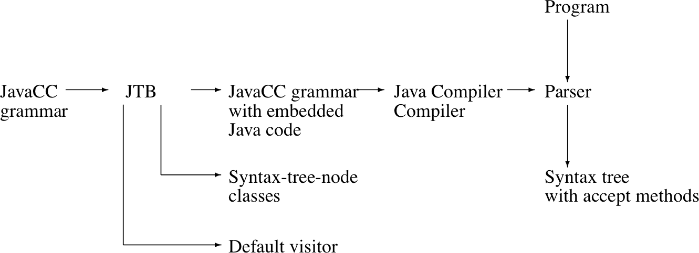
The Java Tree Builder
The produced JavaCC grammar can then be processed by the Java Compiler Compiler to give a parser which produces syntax trees.
The produced syntax trees can now be traversed by a Java program by writing subclasses of the default visitor.

Slide 35
Using JTB
jtb fortran.jj // generates jtb.out.jj
javacc jtb.out.jj // generates a parser
javac Main.java // Main.java calls the parser and visitors
java Main < prog.f // builds a syntax tree and executes visitors

Slide 36
Roadmap
Bottom-up parsing
LR(k) grammars
JavaCC, Java Tree Builder and the Visitor pattern
Example: a straightline interpreter

Slide 37
Recall our straight-line grammar
Stm | → | Stm ; Stm | CompoundStm
Stm | → | id := Exp | AssignStm
Stm | → | print ( ExpList ) | PrintStm
Exp | → | id | IdExp
Exp | → | num | NumExp
Exp | → | Exp Binop Exp | OpExp
Exp | → | ( Stm , Exp ) | EseqExp
ExpList | → | Exp , ExpList | PairExpList
ExpList | → | Exp | LastExpList
Binop | → | + | Plus
Binop | → | − | Minus
Binop | → | × | Times
Binop | → | / | Div

Slide 38
Tokens
options {
JAVA_UNICODE_ESCAPE = true;
}
PARSER_BEGIN(StraightLineParser)
package parser;
public class StraightLineParser {}
PARSER_END(StraightLineParser)
SKIP : /* WHITE SPACE */
{ " " | "\t" | "\n" | "\r" | "\f" }
TOKEN :
{ < SEMICOLON: ";" >
| < ASSIGN: ":=" >
...
}
TOKEN : /* LITERALS */
{ < INTEGER_LITERAL: ( ["1"-"9"] (["0"-"9"])*
| "0" ) >
}
TOKEN : /* IDENTIFIERS */
{ < IDENTIFIER: <LETTER> (<LETTER>|<DIGIT>)* >
| < #LETTER: [ "a"-"z", "A"-"Z" ] >
| < #DIGIT: ["0"-"9" ] >
}
slpl.jj starts with the scanner declarations
more tokens here!

Slide 39
Rewriting our grammar
Goal | → | StmList
StmList | → | Stm ( ; Stm ) *
Stm | → | id := Exp
 | ⎜ | print “(” ExpList “)”
Exp | → | MulExp (( + ⎜ - ) MulExp ) *
MulExp | → | PrimExp ((* ⎜ /) PrimExp ) *
PrimExp | → | id
 | ⎜ | num
 | ⎜ | “(” StmList , Exp “)”
ExpList | → | Exp ( , Exp ) *
We introduce a start rule, eliminate all left-recursion, and establish precedence.

Slide 40
Grammar rules
void Goal() : {} { StmList() <EOF> }
void StmList() : {}{ Stm() ( ";" Stm() ) * }
void Stm() : {} { Assignment() | PrintStm() }
/* distinguish reading and writing Id */
void Assignment() : {} { WriteId() ":=" Exp() }
void WriteId() : {} { <IDENTIFIER> }
void PrintStm() : {} { "print" "(" ExpList() ")" }
void ExpList() : {} { Exp() ( AppendExp() ) * }
void AppendExp() : {} { "," Exp() }
void Exp() : {} { MulExp() ( PlusOp() | MinOp() ) * }
void PlusOp() : {} { "+" MulExp() }
void MinOp() : {} { "-" MulExp() }
void MulExp() : {} { PrimExp() ( MulOp() | DivOp() ) * }
void MulOp() : {} { "*" PrimExp() }
void DivOp() : {} { "/" PrimExp() }
void PrimExp() : {}{ ReadId() | Num() | StmExp() }
void ReadId() : {}{ <IDENTIFIER> }
void Num() : {} { <INTEGER_LITERAL> }
void StmExp() : {}{ "(" StmList() "," Exp() ")" }
The grammar rules directly reflect our BNF!
NB: We add some non-terminals to help our visitors.

Slide 41
Java Tree Builder
// Generated by JTB 1.3.2
options {
JAVA_UNICODE_ESCAPE = true;
}
PARSER_BEGIN(StraightLineParser)
package parser;
import syntaxtree.*;
import java.util.Vector;
public class StraightLineParser
{
}
…
Goal Goal() :
{
StmList n0;
NodeToken n1;
Token n2;
}
{
n0=StmList()
n2=<EOF> {
n2.beginColumn++; n2.endColumn++;
n1 = JTBToolkit.makeNodeToken(n2);
}
{ return new Goal(n0,n1); }
}
...
JTB automatically generates actions to build the syntax tree, and visitors to visit it.
original source LOC | 441
generated source LOC | 4912

Slide 42
The interpreter
package interpreter;
import ...;
public class StraightLineInterpreter {
Goal parse;
StraightLineParser parser;
public static void main(String [] args) {
System.out.println(new StraightLineInterpreter(System.in).interpret());
}
public StraightLineInterpreter(InputStream in) {
parser = new StraightLineParser(in);
this.initParse();
}
private void initParse() {
try { parse = parser.Goal(); }
catch (ParseException e) { ... }
}
public String interpret() {
assert(parse != null);
Visitor visitor = new Visitor();
visitor.visit(parse);
return visitor.result();
}
}
The interpreter simply runs the parser and visits the parse tree.

Slide 43
An abstract machine for straight line code
package interpreter;
import java.util.*;
public class Machine {
private Hashtable<String,Integer> store; // current values of variables
private StringBuffer output; // print stream so far
private int value; // result of current expression
private Vector<Integer> vlist; // list of expressions computed
public Machine() {
store = new Hashtable<String,Integer>();
output = new StringBuffer();
setValue(0);
vlist = new Vector<Integer>();
}
void assignValue(String id) { store.put(id, getValue()); }
void appendExp() { vlist.add(getValue()); }
void printValues() {...}
void setValue(int value) {...}
int getValue() { return value; }
void readValueFromId(String id) {
assert isDefined(id); // precondition
this.setValue(store.get(id));
}
private boolean isDefined(String id) { return store.containsKey(id); }
String result() { return this.output.toString(); }
}
The Visitor interacts with this machine as it visits nodes of the program.

Slide 44
The visitor
package interpreter;
import visitor.DepthFirstVisitor;
import syntaxtree.*;
public class Visitor extends DepthFirstVisitor {
Machine machine;
public Visitor() { machine = new Machine(); }
public String result() { return machine.result(); }
public void visit(Assignment n) {
n.f0.accept(this);
n.f1.accept(this);
n.f2.accept(this);
String id = n.f0.f0.tokenImage;
machine.assignValue(id);
}
public void visit(PrintStm n) { ... }
public void visit(AppendExp n) { ... }
public void visit(PlusOp n) { ... }
public void visit(MinOp n) { ... }
public void visit(MulOp n) { ... }
public void visit(DivOp n) { ... }
public void visit(ReadId n) { ... }
public void visit(Num n) { ... }
}
The Visitor interprets interesting nodes by directly interacting with the abstract machine.
f0 → WriteId()
f1 → “:=”
f2 → Exp()

Slide 45
What you should know!
Why do bottom-up parsers yield rightmost derivations?
What is a “handle”? How is it used?
What is “handle-pruning”?How does a shift-reduce parser work?
When is a grammar LR(k)?
Which is better for hand-coded parsers, LL(1) or LR(1)?
What kind of parsers does JavaCC generate?
How does the Visitor pattern help you to implement parsers?

Slide 46
Can you answer these questions?
What are “shift-reduce” errors?
How do you eliminate them?
Which is more expressive? LL(k) or LR(k)?
How would you implement the Visitor pattern in a dynamic language (without overloading)?
How can you manipulate your grammar to simplify your JTB-based visitors?

Slide 47

License
http://creativecommons.org/licenses/by-sa/3.0/
Attribution-ShareAlike 3.0 Unported
You are free:
  to Share — to copy, distribute and transmit the work
  to Remix — to adapt the work
Under the following conditions:
  Attribution. You must attribute the work in the manner specified by the author or licensor (but not in any way that suggests that they endorse you or your use of the work).
  Share Alike. If you alter, transform, or build upon this work, you may distribute the resulting work only under the same, similar or a compatible license.
For any reuse or distribution, you must make clear to others the license terms of this work. The best way to do this is with a link to this web page.
Any of the above conditions can be waived if you get permission from the copyright holder.
Nothing in this license impairs or restricts the author's moral rights.

