Slide 1
Introduction to Software Engineering
4. Responsibility-Driven Design

Slide 2
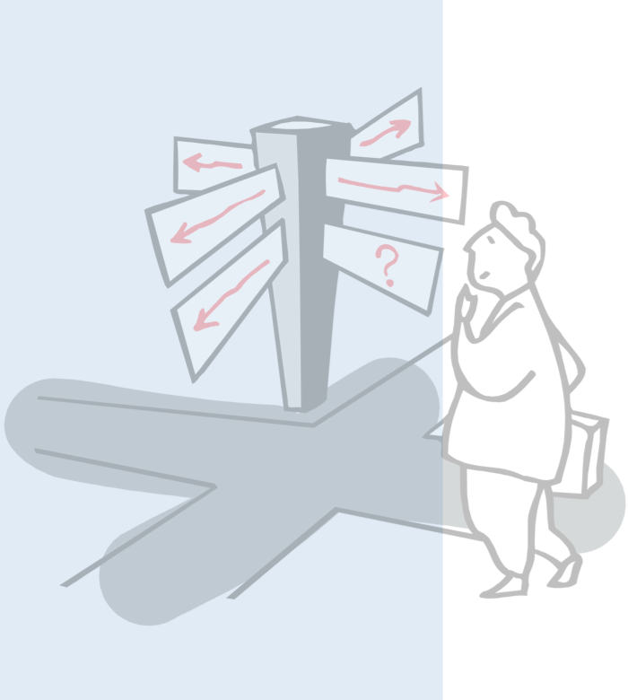
Roadmap
Why use Responsibility-Driven Design?
Finding Classes
Class Selection Rationale
CRC sessions
Identifying Responsibilities
Finding Collaborations
Structuring Inheritance Hierarchies

Slide 3
Source
Designing Object-Oriented Software, R. Wirfs-Brock, B. Wilkerson, L. Wiener, Prentice Hall, 1990.

Slide 4
Roadmap
Why use Responsibility-Driven Design?
Finding Classes
Class Selection Rationale
CRC sessions
Identifying Responsibilities
Finding Collaborations
Structuring Inheritance Hierarchies

Slide 5
Why Responsibility-driven Design?
Functional Decomposition:
Good in a “waterfall” approach: stable requirements and one monolithic function
However
Naive: Modern systems perform more than one function
Maintainability: system functions evolve ⇒ redesign affect whole system
Interoperability: interfacing with other system is difficult
Decompose according to the functions a system is supposed to perform.

Slide 6
Why Responsibility-driven Design?
Object-Oriented Decomposition:
Better for complex and evolving systems
However
How to find the objects?
Decompose according to the objects a system is supposed to manipulate.

Slide 7
Iteration in Object-Oriented Design
The result of the design process is not a final product:
design decisions may be revisited, even after implementation
design is not linear but iterative
The design process is not algorithmic:
a design method provides guidelines, not fixed rules
“a good sense of style often helps produce clean, elegant designs — designs that make a lot of sense from the engineering standpoint”
Responsibility-driven design is an (analysis and) design technique that works well in combination with various methods and notations.

Slide 8
Roadmap
Why use Responsibility-Driven Design?
Finding Classes
Class Selection Rationale
CRC sessions
Identifying Responsibilities
Finding Collaborations
Structuring Inheritance Hierarchies

Slide 9
The Initial Exploration
Find the classes in your system
Determine the responsibilities of each class
Determine how objects collaborate with each other to fulfil their responsibilities

Slide 10
The Detailed Analysis
Factor common responsibilities to build class hierarchies
Streamline collaborations between objects
Is message traffic heavy in parts of the system?
Are there classes that collaborate with everybody?
Are there classes that collaborate with nobody?
Are there groups of classes that can be seen as subsystems?
Turn class responsibilities into fully specified signatures

Slide 11
Finding Classes
Start with requirements specification:
What are the goals of the system being designed, its expected inputs and desired responses?
Look for noun phrases:
separate into obvious classes, uncertain candidates, and nonsense

Slide 12
Finding Classes ...
Refine to a list of candidate classes. Some guidelines are:
Model physical objects — e.g. disks, printers
Model conceptual entities — e.g. windows, files
Choose one word for one concept — what does it mean within the system
Be wary of adjectives — is it really a separate class?
Be wary of missing or misleading subjects — rephrase in active voice
Model categories of classes — delay modelling of inheritance
Model interfaces to the system — e.g., user interface, program interfaces
Model attribute values, not attributes — e.g., Point vs. Centre

Slide 13
Drawing Editor Requirements Specification
The drawing editor is an interactive graphics editor. With it, users can create and edit drawings composed of lines, rectangles, ellipses and text.
Tools control the mode of operation of the editor. Exactly one tool is active at any given time.
Two kinds of tools exist: the selection tool and creation tools. When the selection tool is active, existing drawing elements can be selected with the cursor. One or more drawing elements can be selected and manipulated; if several drawing elements are selected, they can be manipulated as if they were a single element. Elements that have been selected in this way are referred to as the current selection. The current selection is indicated visually by displaying the control points for the element. Clicking on and dragging a control point modifies the element with which the control point is associated.
When a creation tool is active, the current selection is empty. The cursor changes in different ways according to the specific creation tool, and the user can create an element of the selected kind. After the element is created, the selection tool is made active and the newly created element becomes the current selection.
The text creation tool changes the shape of the cursor to that of an I-beam. The position of the first character of text is determined by where the user clicks the mouse
button. The creation tool is no longer active when the user clicks the mouse button outside the text element. The control points for a text element are the four corners of the region within which the text is formatted. Dragging the control points changes this region. The other creation tools allow the creation of lines, rectangles and ellipses. They change the shape of the cursor to that of a crosshair. The appropriate element starts to be created when the mouse button is pressed, and is completed when the mouse button is released. These two events create the start point and the stop point.
The line creation tool creates a line from the start point to the stop point. These are the control points of a line. Dragging a control point changes the end point.
The rectangle creation tool creates a rectangle such that these points are diagonally opposite corners. These points and the other corners are the control points. Dragging a control point changes the associated corner.
The ellipse creation tool creates an ellipse fitting within the rectangle defined by the two points described above. The major radius is one half the width of the rectangle, and the minor radius is one half the height of the rectangle. The control points are at the corners of the bounding rectangle. Dragging control points changes the associated corner.

Slide 14
Drawing Editor: noun phrases
The drawing editor is an interactive graphics editor. With it, users can create and edit drawings composed of lines, rectangles, ellipses and text.
Tools control the mode of operation of the editor. Exactly one tool is active at any given time.
Two kinds of tools exist: the selection tool and creation tools. When the selection tool is active, existing drawing elements can be selected with the cursor. One or more drawing elements can be selected and manipulated; if several drawing elements are selected, they can be manipulated as if they were a single element. Elements that have been selected in this way are referred to as the current selection. The current selection is indicated visually by displaying the control points for the element. Clicking on and dragging a control point modifies the element with which the control point is associated.
When a creation tool is active, the current selection is empty. The cursor changes in different ways according to the specific creation tool, and the user can create an element of the selected kind. After the element is created, the selection tool is made active and the newly created element becomes the current selection.
…

Slide 15
The text creation tool changes the shape of the cursor to that of an I-beam. The position of the first character of text is determined by where the user clicks the mouse button. The creation tool is no longer active when the user clicks the mouse button outside the text element. The control points for a text element are the four corners of the region within which the text is formatted. Dragging the control points changes this region. The other creation tools allow the creation of lines, rectangles and ellipses. They change the shape of the cursor to that of a crosshair. The appropriate element starts to be created when the mouse button is pressed, and is completed when the mouse button is released. These two events create the start point and the stop point.
The line creation tool creates a line from the start point to the stop point. These are the control points of a line. Dragging a control point changes the end point.
The rectangle creation tool creates a rectangle such that these points are diagonally opposite corners. These points and the other corners are the control points. Dragging a control point changes the associated corner.
The ellipse creation tool creates an ellipse fitting within the rectangle defined by the two points described above. The major radius is one half the width of the rectangle, and the minor radius is one half the height of the rectangle. The control points are at the corners of the bounding rectangle. Dragging control points changes the associated corner.

Slide 16
Roadmap
Why use Responsibility-Driven Design?
Finding Classes
Class Selection Rationale
CRC sessions
Identifying Responsibilities
Finding Collaborations
Structuring Inheritance Hierarchies

Slide 17
Class Selection Rationale
Model physical objects:
mouse button [event or attribute]
Model conceptual entities:
ellipse, line, rectangle
Drawing, Drawing Element
Tool, Creation Tool, Ellipse Creation Tool, Line Creation Tool, Rectangle Creation Tool, Selection Tool, Text Creation Tool
text, Character
Current Selection

Slide 18
Class Selection Rationale ...
Choose one word for one concept:
Drawing Editor ⇒ editor, interactive graphics editor
Drawing Element ⇒ element
Text Element ⇒ text
Ellipse Element, Line Element, Rectangle Element ⇒ ellipse, line, rectangle

Slide 19
Class Selection Rationale ...
Be wary of adjectives:
Ellipse Creation Tool, Line Creation Tool, Rectangle Creation Tool, Selection Tool, Text Creation Tool
all have different requirements
bounding rectangle, rectangle, region ⇒ Rectangle
common meaning, but different from Rectangle Element
Point ⇒ end point, start point, stop point
Control Point
more than just a coordinate
corner ⇒ associated corner, diagonally opposite corner
no new behaviour

Slide 20
Class Selection Rationale ...
Be wary of sentences with missing or misleading subjects:
“The current selection is indicated visually by displaying the control points for the element.”
by what? Assume Drawing Editor ...
Model categories:
Tool, Creation Tool
Model interfaces to the system: — no good candidates here ...
user — don’t need to model user explicitly
cursor — cursor motion handled by operating system

Slide 21
Class Selection Rationale ...
Model values of attributes, not attributes themselves:
height of the rectangle, width of the rectangle
major radius, minor radius
position — of first text character; probably Point attribute
mode of operation — attribute of Drawing Editor
shape of the cursor, I-beam, crosshair — attributes of Cursor
corner — attribute of Rectangle
time — an implicit attribute of the system

Slide 22
Candidate Classes
Preliminary analysis yields the following candidates:
Character | Line Element
Control Point | Point
Creation Tool | Rectangle
Current Selection | Rectangle Creation Tool
Drawing | Rectangle Element
Drawing Editor | Selection Tool
Drawing Element | Text Creation Tool
Ellipse Creation Tool | Text Element
Ellipse Element | Tool
Line Creation Tool
Expect the list to evolve as design progresses.

Slide 23
Roadmap
Why use Responsibility-Driven Design?
Finding Classes
Class Selection Rationale
CRC sessions
Identifying Responsibilities
Finding Collaborations
Structuring Inheritance Hierarchies

Slide 24
CRC Cards
Use CRC cards to record candidate classes:
Record the candidate Class Name and superclass (if known)
Record each Responsibility and the Collaborating classes
compact, easy to manipulate, easy to modify or discard!
easy to arrange, reorganize
easy to retrieve discarded classes
Text Creation Tool subclass of Tool
Editing Text | Text Element

Slide 25
CRC Sessions
CRC cards are not a specification of a design.
They are a tool to explore possible designs.
Prepare a CRC card for each candidate class
Get a team of Developers to sit around a table and distribute the cards to the team
The team walks through scenarios, playing the roles of the classes.
This exercise will uncover:
unneeded classes and responsibilities
missing classes and responsibilities

Slide 26
Roadmap
Why use Responsibility-Driven Design?
Finding Classes
Class Selection Rationale
CRC sessions
Identifying Responsibilities
Finding Collaborations
Structuring Inheritance Hierarchies

Slide 27
Responsibilities
What are responsibilities?
the knowledge an object maintains and provides
the actions it can perform
Responsibilities represent the public services an object may provide to clients (but not the way in which those services may be implemented)
specify what an object does, not how it does it
don’t describe the interface yet, only conceptual responsibilities

Slide 28
Identifying Responsibilities
Study the requirements specification:
highlight verbs and determine which represent responsibilities
perform a walk-though of the system
explore as many scenarios as possible
identify actions resulting from input to the system
Study the candidate classes:
class names ⇒ roles ⇒ responsibilities
recorded purposes on class cards ⇒ responsibilities
Notes:
each class exists because of an implied responsibility

Slide 29
How to assign responsibility?
Pelrine’s Laws:
“Don't do anything you can push off to someone else.”
“Don't let anyone else play with you.”

Slide 30
Assigning Responsibilities
Evenly distribute system intelligence
avoid procedural centralization of responsibilities
keep responsibilities close to objects rather than their clients
State responsibilities as generally as possible
“draw yourself” vs. “draw a line/rectangle etc.”
leads to sharing
Keep behaviour together with any related information
principle of encapsulation

Slide 31
Assigning Responsibilities ...
Keep information about one thing in one place
if multiple objects need access to the same information
a new object may be introduced to manage the information, or
one object may be an obvious candidate, or
the multiple objects may need to be collapsed into a single one
Share responsibilities among related objects
break down complex responsibilities
Notes:
A Drawing Editor knows when the drawing has changed; the Drawing knows which elements to display; each Drawing Element knows how and where its presentation should be drawn ...

Slide 32
Relationships Between Classes
Additional responsibilities can be uncovered by examining relationships between classes, especially:
The “Is-Kind-Of” Relationship:
classes sharing a common attribute often share a common superclass
common superclasses suggest common responsibilities
e.g., to create a new Drawing Element, a Creation Tool must:
accept user input implemented in subclass
determine location to place it generic
instantiate the element implemented in subclass

Slide 33
Relationships Between Classes ...
The “Is-Analogous-To” Relationship:
similarities between classes suggest as-yet-undiscovered superclasses
The “Is-Part-Of” Relationship:
distinguish (don’t share) responsibilities of part and of whole
Difficulties in assigning responsibilities suggest:
missing classes in design, or — e.g., Group Element
free choice between multiple classes

Slide 34
Example Relationships
Drawing element is-part-of Drawing
Drawing Element has-knowledge-of Control Points
Rectangle Tool is-kind-of Creation Tool

Slide 35
Roadmap
Why use Responsibility-Driven Design?
Finding Classes
Class Selection Rationale
CRC sessions
Identifying Responsibilities
Finding Collaborations
Structuring Inheritance Hierarchies

Slide 36
Collaborations
What are collaborations?
collaborations are client requests to servers needed to fulfil responsibilities
collaborations reveal control and information flow and, ultimately, subsystems
collaborations can uncover missing responsibilities
analysis of communication patterns can reveal misassigned responsibilities

Slide 37
Finding Collaborations
For each responsibility:
Can the class fulfil the responsibility by itself?
If not, what does it need, and from what other class can it obtain what it needs?
For each class:
What does this class know?
What other classes need its information or results? Check for collaborations.
Classes that do not interact with others should be discarded. (Check carefully!)

Slide 38
Listing Collaborations
Drawing
Knows which elements it contains
Maintains order of elements | Drawing Element

Slide 39
Roadmap
Why use Responsibility-Driven Design?
Finding Classes
Class Selection Rationale
CRC sessions
Identifying Responsibilities
Finding Collaborations
Structuring Inheritance Hierarchies

Slide 40
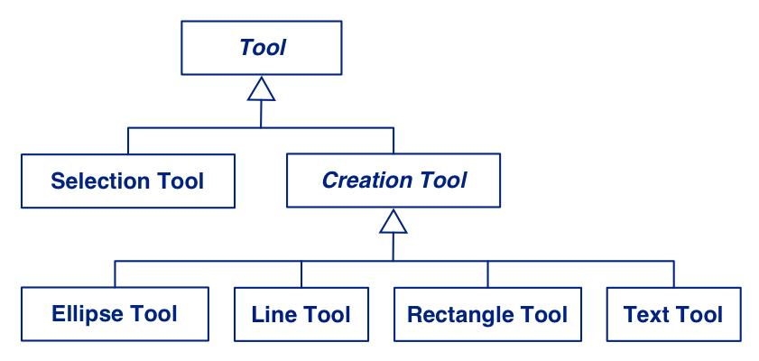
Finding Abstract Classes
Abstract classes factor out common behaviour shared by other classes
group related classes with common attributes
introduce abstract superclasses to represent the group
“categories” are good candidates for abstract classes
Warning: beware of premature classification; your hierarchy will evolve!

Slide 41
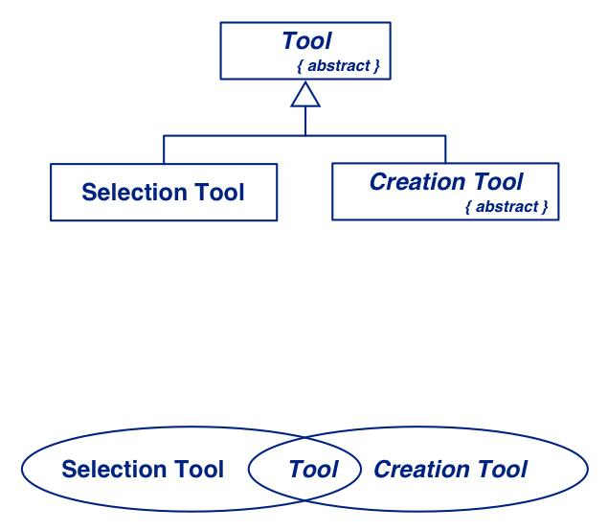
Sharing Responsibilities
Concrete classes may be both instantiated and inherited from.
Abstract classes may only be inherited from.
Note on class cards and on class diagram.
Venn Diagrams can be used to visualize shared responsibilities.
(Warning: not part of UML!)

Slide 42
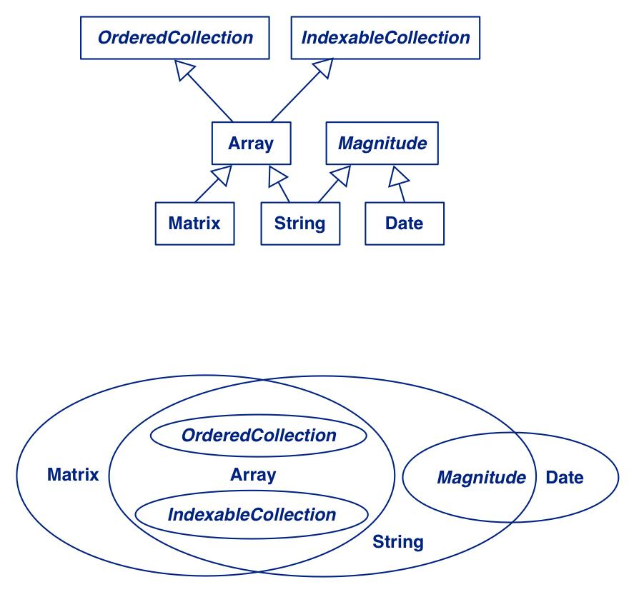
Multiple Inheritance
Decide whether a class will be instantiated to determine if it is abstract or concrete.
Responsibilities of subclasses are larger than those of superclasses.
Intersections represent common superclasses.

Slide 43
Building Good Hierarchies
Model a “kind-of” hierarchy:
Subclasses should support all inherited responsibilities, and possibly more
Factor common responsibilities as high as possible:
Classes that share common responsibilities should inherit from a common abstract superclass; introduce any that are missing

Slide 44
Building Good Hierarchies …
Make sure that abstract classes do not inherit from concrete classes:
Eliminate by introducing common abstract superclass: abstract classes should support responsibilities in an implementation-independent way
Eliminate classes that do not add functionality:
Classes should either add new responsibilities, or a particular way of implementing inherited ones

Slide 45
Building Kind-Of Hierarchies
Correctly Formed Subclass Responsibilities:
C assumes all the responsibilities of both A and B

Slide 46
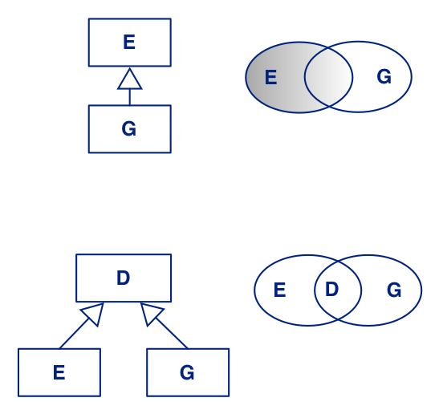
Building Kind-Of Hierarchies ...
Incorrect Subclass/Superclass Relationships
G assumes only some of the responsibilities inherited from E
Revised Inheritance Relationships
Introduce abstract superclasses to encapsulate common responsibilities

Slide 47
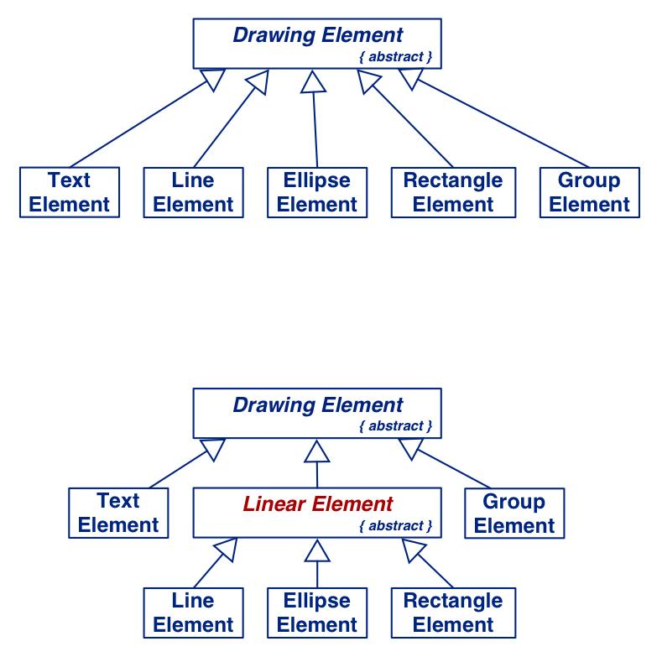
Refactoring Responsibilities
Lines, Ellipses and Rectangles are responsible for keeping track of the width and colour of the lines they are drawn with.
This suggests a common superclass.

Slide 48
Protocols
A protocol is a set of signatures (i.e., an interface) to which a class will respond.
Generally, protocols are specified for public responsibilities
Protocols for private responsibilities should be specified if they will be used or implemented by subclasses
Construct protocols for each class
Write a design specification for each class and subsystem
Write a design specification for each contract

Slide 49
What you should know!
What criteria can you use to identify potential classes?
How can CRC cards help during analysis and design?
How can you identify abstract classes?
What are class responsibilities, and how can you identify them?
How can identification of responsibilities help in identifying classes?
What are collaborations, and how do they relate to responsibilities?
How can you identify abstract classes?
What criteria can you use to design a good class hierarchy?
How can refactoring responsibilities help to improve a class hierarchy?

Slide 50
Can you answer the following questions?
When should an attribute be promoted to a class?
Why is it useful to organize classes into a hierarchy?
How can you tell if you have captured all the responsibilities and collaborations?
What use is multiple inheritance during design if your programming language does not support it?

Slide 51
License
Attribution-ShareAlike 3.0 Unported
You are free:
to Share — to copy, distribute and transmit the work
to Remix — to adapt the work
Under the following conditions:
Attribution. You must attribute the work in the manner specified by the author or licensor (but not in any way that suggests that they endorse you or your use of the work).
Share Alike. If you alter, transform, or build upon this work, you may distribute the resulting work only under the same, similar or a compatible license.
For any reuse or distribution, you must make clear to others the license terms of this work. The best way to do this is with a link to this web page.
Any of the above conditions can be waived if you get permission from the copyright holder.
Nothing in this license impairs or restricts the author's moral rights.
http://creativecommons.org/licenses/by-sa/3.0/

