Slide 1
Introduction to Software Engineering
6. Modeling Objects and Classes

Slide 2
Roadmap
UML Overview
Classes, attributes and operations
UML Lines and Arrows
Parameterized Classes, Interfaces and Utilities
Objects, Associations
Inheritance
Patterns, Constraints and Contracts

Slide 3
Sources
The Unified Modeling Language Reference Manual, James Rumbaugh, Ivar Jacobson and Grady Booch, Addison Wesley, 1999.
UML Distilled, Martin Fowler, Kendall Scott, Addison-Wesley, Second Edition, 2000.

Slide 4
Roadmap
UML Overview
Classes, attributes and operations
UML Lines and Arrows
Parameterized Classes, Interfaces and Utilities
Objects, Associations
Inheritance
Patterns, Constraints and Contracts

Slide 5
UML
What is UML?
uniform notation: Booch + OMT + Use Cases (+ state charts)
UML is not a method or process
… The Unified Development Process is
Why a Graphical Modeling Language?
Software projects are carried out in team
Team members need to communicate
... sometimes even with the end users
“One picture conveys a thousand words”
the question is only which words
Need for different views on the same software artifact

Slide 6
Why UML?
Why UML?
Reduces risks by documenting assumptions
domain models, requirements, architecture, design, implementation …
Represents industry standard
more tool support, more people understand your diagrams, less education
Is reasonably well-defined
... although there are interpretations and dialects
Is open
stereotypes, tags and constraints to extend basic constructs
has a meta-meta-model for advanced extensions

Slide 7
UML History
1994: Grady Booch (Booch method) + James Rumbaugh (OMT) at Rational
1994: Ivar Jacobson (OOSE, use cases) joined Rational
“The three amigos”
1996: Rational formed a consortium to support UML
1997: UML1.0 submitted to OMG by consortium
1997: UML 1.1 accepted as OMG standard
However, OMG names it UML1.0
1998-…: Revisions UML1.2 - 1.5
2005: Major revision to UML2.0, includes OCL

Slide 8
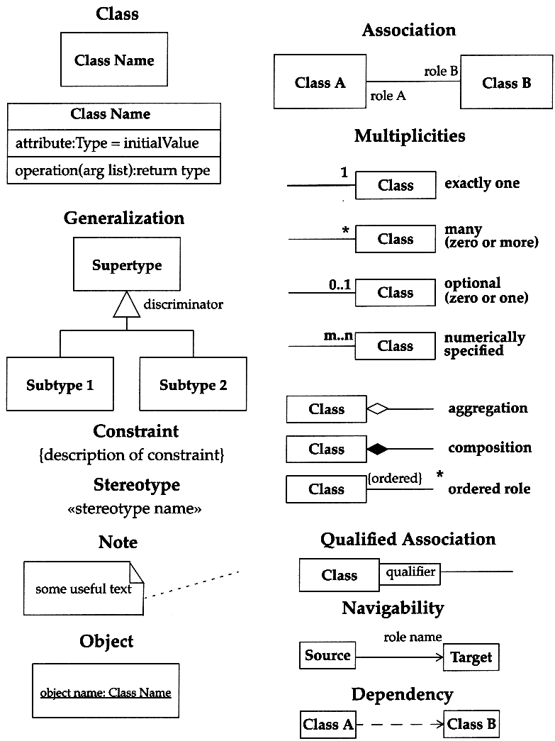
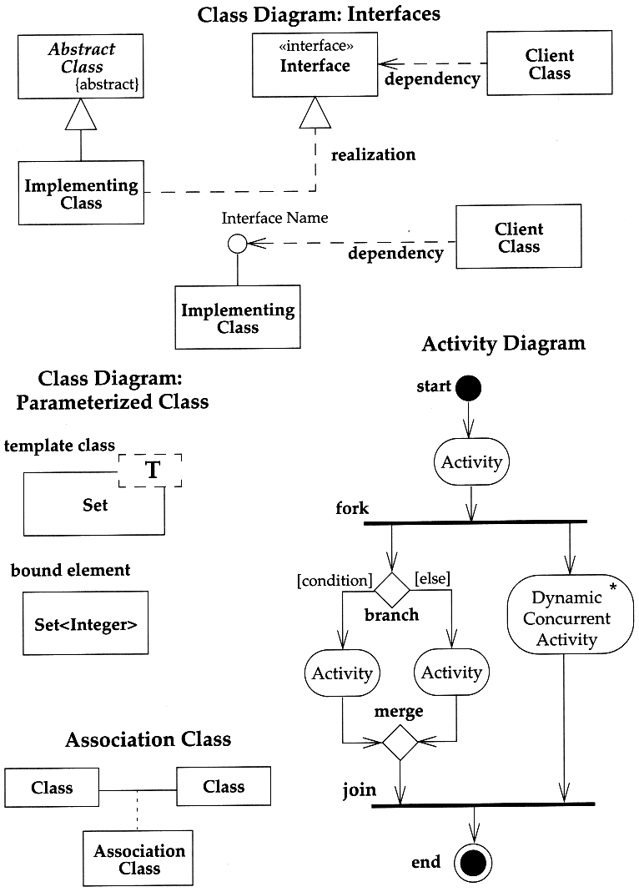
© 2000 Addison-Wesley
UML Distilled

Slide 9
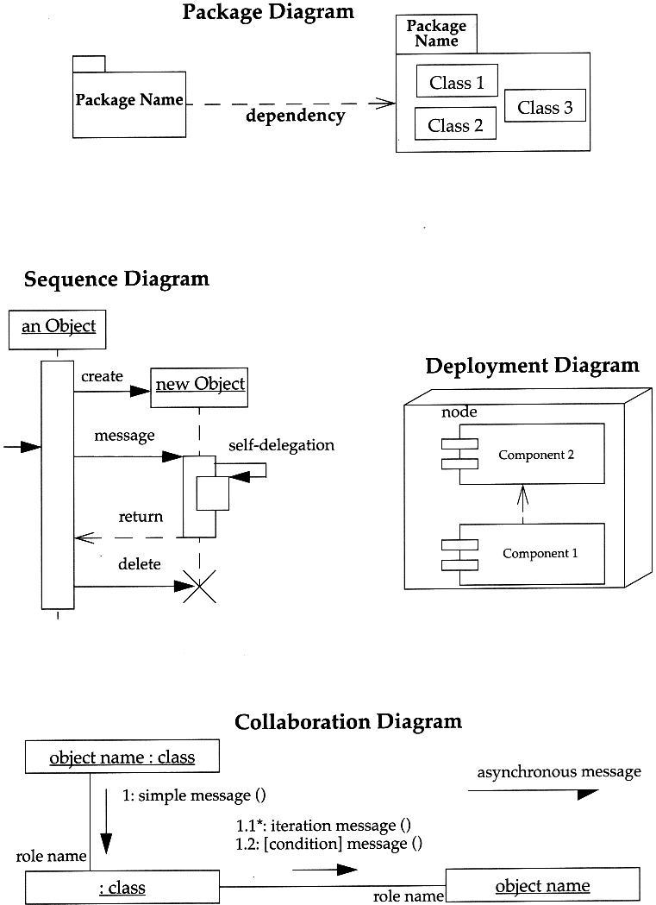
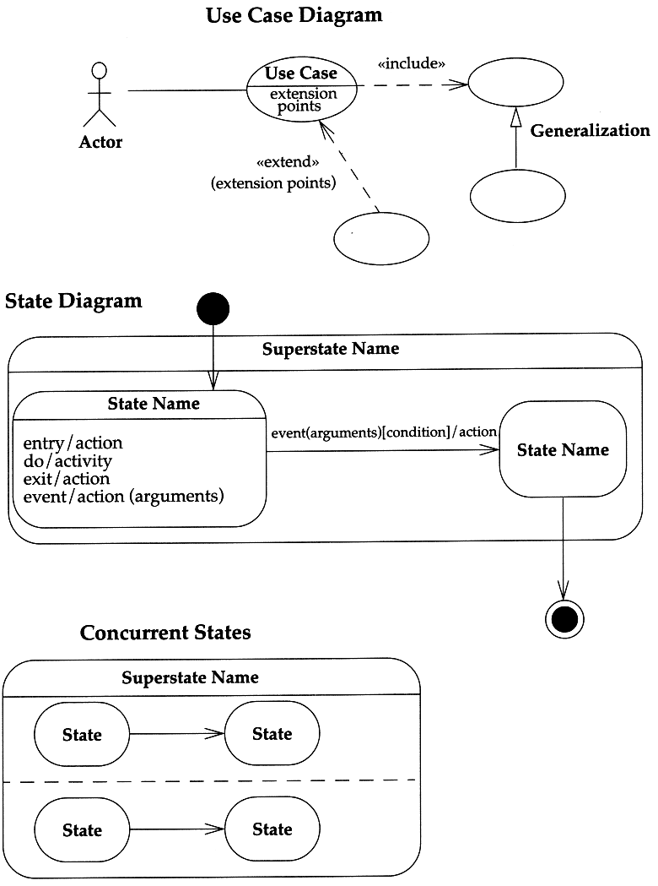
© 2000 Addison-Wesley
UML Distilled

Slide 10
Roadmap
UML Overview
Classes, attributes and operations
UML Lines and Arrows
Parameterized Classes, Interfaces and Utilities
Objects, Associations
Inheritance
Patterns, Constraints and Contracts

Slide 11
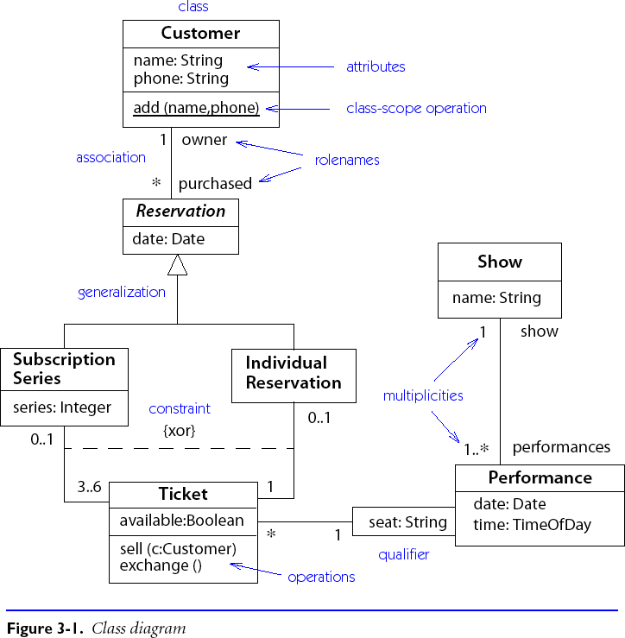
Class Diagrams
“Class diagrams show generic descriptions of possible systems, and object diagrams show particular instantiations of systems and their behaviour.”
Attributes and operations are also collectively called features.
Danger: class diagrams risk turning into data models.
Be sure to focus on behaviour
Notes:
UML distilled p8, par 4

Slide 12
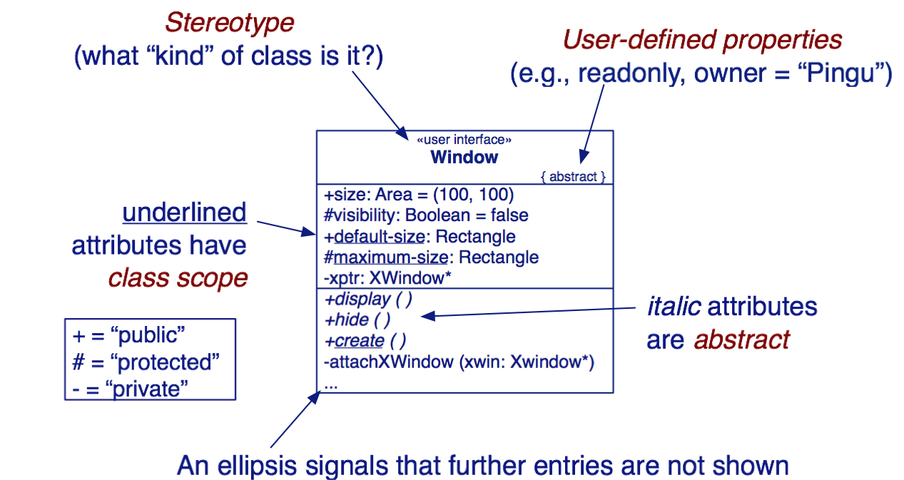
Visibility and Scope of Features
Don’t worry about visibility too early!

Slide 13
Attributes and Operations
Attributes are specified as:
name: type = initialValue { property string }
Operations are specified as:
name (param: type = defaultValue, ...) : resultType

Slide 14
Roadmap
UML Overview
Classes, attributes and operations
UML Lines and Arrows
Parameterized Classes, Interfaces and Utilities
Objects, Associations
Inheritance
Patterns, Constraints and Contracts

Slide 15
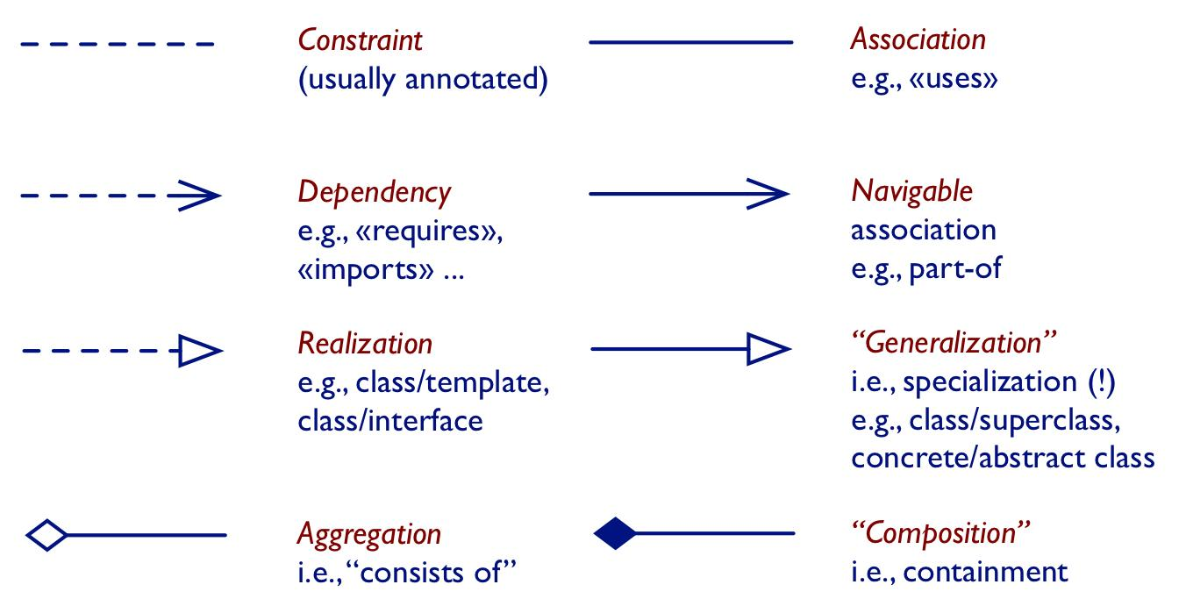
UML Lines and Arrows

Slide 16
Roadmap
UML Overview
Classes, attributes and operations
UML Lines and Arrows
Parameterized Classes, Interfaces and Utilities
Objects, Associations
Inheritance
Patterns, Constraints and Contracts

Slide 17
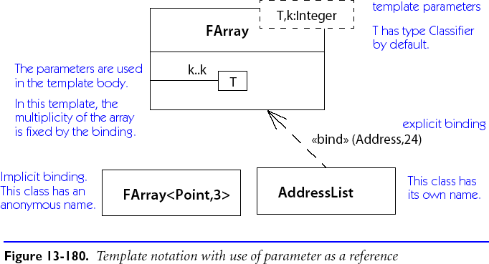
Parameterized Classes
Parameterized (aka “template” or “generic”) classes are depicted with their parameters shown in a dashed box.

Slide 18
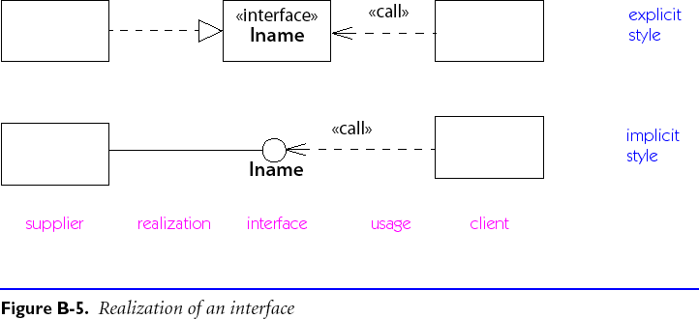
Interfaces
Interfaces, equivalent to abstract classes with no attributes, are represented as classes with the stereotype «interface» or, alternatively, with the “Lollipop-Notation”:

Slide 19
Utilities
A utility is a grouping of global attributes and operations. It is represented as a class with the stereotype «utility». Utilities may be parameterized.
NB: A utility’s attributes are already interpreted as being in class scope, so it is redundant to underline them.
A “note” is a text comment associated with a view, and represented as box with the top right corner folded over.

Slide 20
Roadmap
UML Overview
Classes, attributes and operations
UML Lines and Arrows
Parameterized Classes, Interfaces and Utilities
Objects, Associations
Inheritance
Patterns, Constraints and Contracts

Slide 21
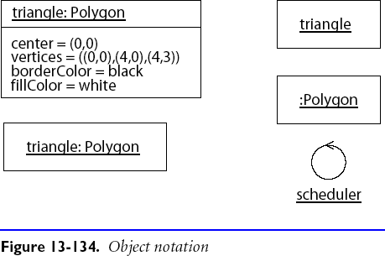
Objects
Objects are shown as rectangles with their name and type underlined in one compartment, and attribute values, optionally, in a second compartment.
At least one of the name or the type must be present.
Notes:
The cycle icon represents an instance of a control class. (Specific to a use case.)

Slide 22
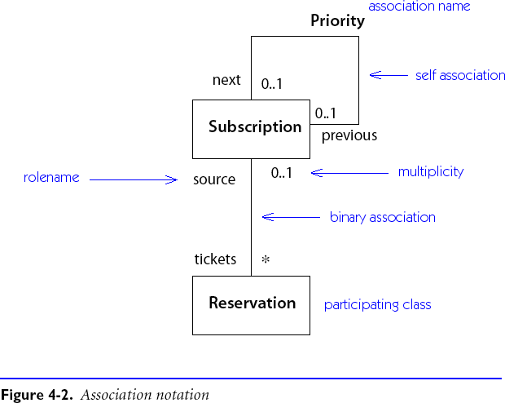
Associations
Associations represent structural relationships between objects
usually binary (but may be ternary etc.)
optional name and direction
(unique) role names and multiplicities at end-points

Slide 23
Multiplicity
The multiplicity of an association constrains how many entities one may be associated with
Examples:
0..1 | Zero or one entity
1 | Exactly one entity
* | Any number of entities
1..* | One or more entities
1..n | One to n entities
 | And so on …

Slide 24
Associations and Attributes
Associations may be implemented as attributes
But need not be …

Slide 25
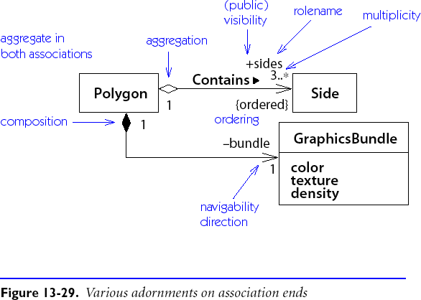
Aggregation and Composition
Aggregation is denoted by a diamond and indicates a part-whole dependency:
A hollow diamond indicates a reference; a solid diamond an implementation (i.e., ownership).
Aggregation: parts may be shared.
Composition: one part belongs to one whole.

Slide 26
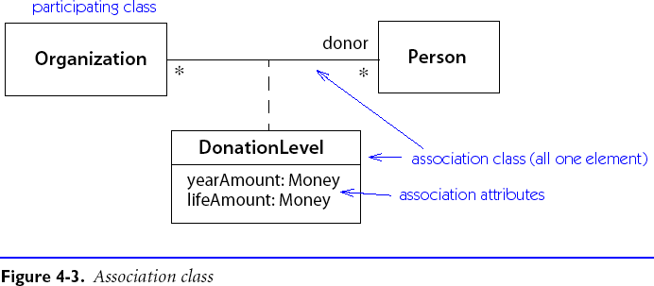
Association Classes
An association may be an instance of an association class:
In many cases the association class only stores attributes, and its name can be left out.

Slide 27
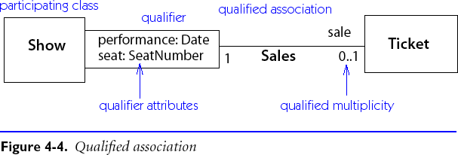
Qualified Associations
A qualified association uses a special qualifier value to identify the object at the other end of the association.
NB: Qualifiers are part of the association, not the class

Slide 28
Roadmap
UML Overview
Classes, attributes and operations
UML Lines and Arrows
Parameterized Classes, Interfaces and Utilities
Objects, Associations
Inheritance
Patterns, Constraints and Contracts

Slide 29
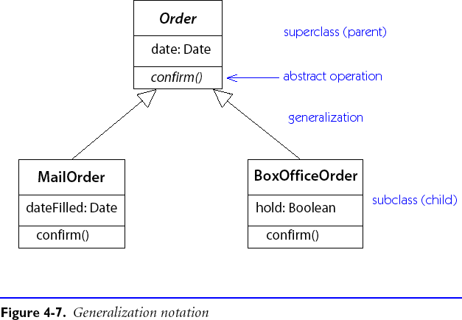
Generalization
A subclass specializes its superclass:

Slide 30
What is Inheritance For?
New software often builds on old software by imitation, refinement or combination.
Similarly, classes may be extensions, specializations or combinations of existing classes.

Slide 31
Generalization expresses ...
Conceptual hierarchy:
conceptually related classes can be organized into a specialization hierarchy
people, employees, managers
geometric objects ...
Polymorphism:
objects of distinct, but related classes may be uniformly treated by clients
array of geometric objects
Software reuse:
related classes may share interfaces, data structures or behaviour
geometric objects ...

Slide 32
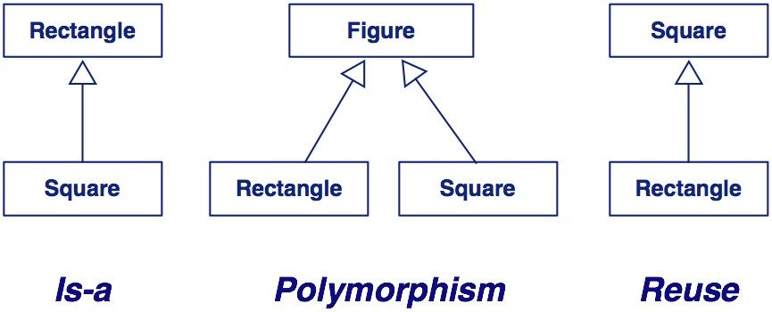
The different faces of inheritance

Slide 33
Roadmap
UML Overview
Classes, attributes and operations
UML Lines and Arrows
Parameterized Classes, Interfaces and Utilities
Objects, Associations
Inheritance
Patterns, Constraints and Contracts

Slide 34
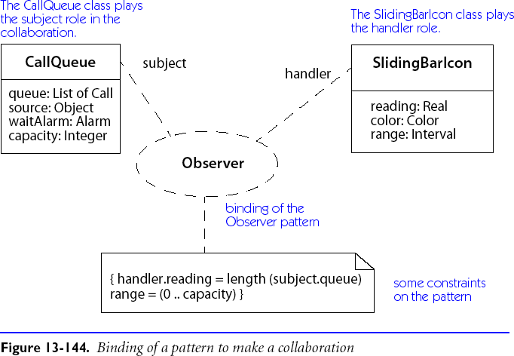
Design Patterns as Collaborations

Slide 35
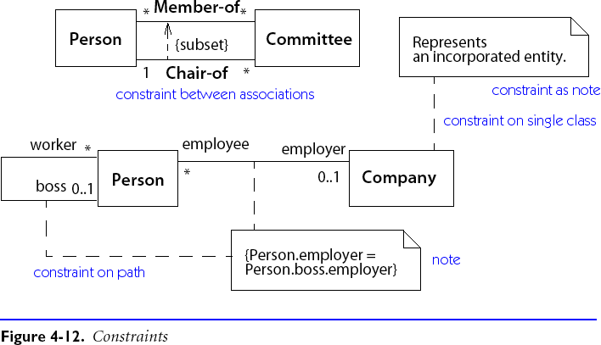
Constraints
Constraints are restrictions on values attached to classes or associations.

Slide 36
OCL — Object Constraint Language
Used to express queries and constraints over UML diagrams
Navigate associations:
Person.boss.employer
Select subsets:
Company.employee->select(title=“Manager”)
Boolean and arithmetic operators:
Person.salary < Person.boss.salary
www.omg.org

Slide 37
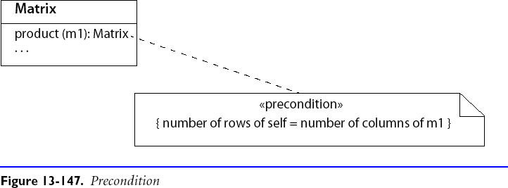
Design by Contract in UML
Combine constraints with stereotypes:
NB: «invariant», «precondition», and «postcondition» are predefined in UML.

Slide 38
Using the Notation
During Analysis:
Capture classes visible to users
Document attributes and responsibilities
Identify associations and collaborations
Identify conceptual hierarchies
Capture all visible features
During Design:
Specify contracts and operations
Decompose complex objects
Factor out common interfaces and functionalities
The graphical notation is only one part of the analysis or design document. For example, a data dictionary cataloguing and describing all names of classes, roles, associations, etc. must be maintained throughout the project.

Slide 39
What you should know!
How do you represent classes, objects and associations?
How do you specify the visibility of attributes and operations to clients?
How is a utility different from a class? How is it similar?
Why do we need both named associations and roles?
Why is inheritance useful in analysis? In design?
How are constraints specified?

Slide 40
Can you answer the following questions?
Why would you want a feature to have class scope?
Why don’t you need to show operations when depicting an object?
Why aren’t associations drawn with arrowheads?
How is aggregation different from any other kind of association?
How are associations realized in an implementation language?

Slide 41
License
Attribution-ShareAlike 3.0 Unported
You are free:
to Share — to copy, distribute and transmit the work
to Remix — to adapt the work
Under the following conditions:
Attribution. You must attribute the work in the manner specified by the author or licensor (but not in any way that suggests that they endorse you or your use of the work).
Share Alike. If you alter, transform, or build upon this work, you may distribute the resulting work only under the same, similar or a compatible license.
For any reuse or distribution, you must make clear to others the license terms of this work. The best way to do this is with a link to this web page.
Any of the above conditions can be waived if you get permission from the copyright holder.
Nothing in this license impairs or restricts the author's moral rights.
http://creativecommons.org/licenses/by-sa/3.0/

