Slide 1
Introduction to Software Engineering
12. Software Metrics

Slide 2

Roadmap
What are metrics? Why do we need them?
Metrics for cost estimation
Metrics for software quality evaluation
Object-Oriented metrics in practice

Slide 3
Sources
Software Engineering, I. Sommerville, Addison-Wesley, Fifth Edn., 1996.
Software Metrics: A Rigorous & Practical Approach, Norman E. Fenton, Shari l. Pfleeger, Thompson Computer Press, 1996.

Slide 4
Roadmap
What are metrics? Why do we need them?
Metrics for cost estimation
Metrics for software quality evaluation
Object-Oriented metrics in practice

Slide 5
Why Metrics?
  When you can measure what you are speaking about and express it in numbers, you know something about it; but when you cannot measure, when you cannot express it in numbers, your knowledge is of a meagre and unsatisfactory kind: it may be the beginning of knowledge, but you have scarcely, in your thoughts, advanced to the stage of science.
— Lord Kelvin

Slide 6
Why Measure Software?
Estimate cost and effort | measure correlation between specifications and final product
Improve productivity | measure value and cost of software
Improve software quality | measure usability, efficiency, maintainability ...
Improve reliability | measure mean time to failure, etc.
Evaluate methods and tools | measure productivity, quality, reliability ...
“You cannot control what you cannot measure” — De Marco, 1982
“What is not measurable, make measurable” — Galileo

Slide 7
What are Software Metrics?
Software metrics
Any type of measurement which relates to a software system, process or related documentation
  Lines of code in a program
  the Fog index (calculates readability of a piece of documentation)
  0.4 × (# words / # sentences) + (% words ≥ 3 syllables)
  number of person-days required to implement a use-case

Slide 8
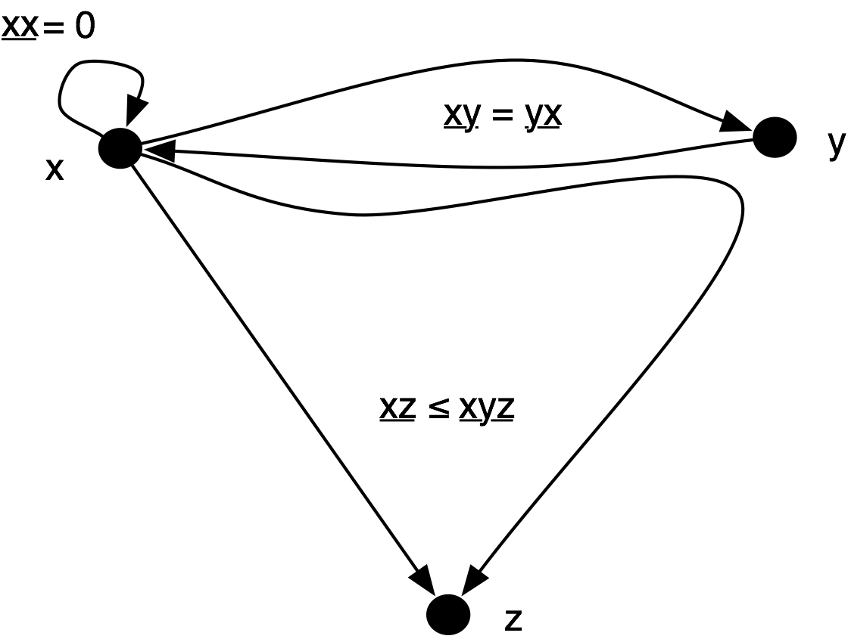
(Measures vs Metrics)
Mathematically, a metric is a function m measuring the distance between two objects such that:
∀ x, m(x,x) = 0
∀ x, y, m(x,y) = m(y,x)
∀ x, y, z, m(x,z) ≤ m(x,y) + m(y,z)
So, technically “software metrics” is an abuse of terminology, and we should instead talk about “software measures”.

Slide 9
Direct and Indirect Measures
Direct Measures
Measured directly in terms of the observed attribute (usually by counting)
  Length of source-code, Duration of process, Number of defects discovered
Indirect Measures
Calculated from other direct and indirect measures
  Module Defect Density = Number of defects discovered / Length of source
  Temperature (usually derived from the length of a liquid column)

Slide 10
Measurement Mapping
Measure & Measurement
A measure is a function mapping an attribute of a real world entity (= the domain) onto a symbol in a set with known mathematical relations (= the range).
A measurement is the symbol assigned to the real world attribute by the measure.
1.80
Frank
1.65
Joe
Laura
1.73
Example: measure mapping height
attribute of person on a number
representing height in meters.
Purpose: Manipulate symbol(s) in the range to draw conclusions about attribute(s) in the domain

Slide 11
Preciseness
To be precise, the definition of the measure must specify:
domain: do we measure people’s height or width?
range: do we measure height in centimetres or inches?
mapping rules: do we allow shoes to be worn?

Slide 12
Possible Problems
Example: Compare productivity in lines of code per time unit.
Do we use the same units to compare? | What is a “line of code”? What is the “time unit”?
Is the context the same? | Were programmers familiar with the language?
Is “code size” really what we want to produce? | What about code quality?
How do we want to interpret results? | Average productivity of a programmer? Programmer X is twice as productive as Y?
What do we want to do with the results? | Do you reward “productive” programmers? Do you compare productivity of software processes?

Slide 13
GQM
Goal — Question — Metrics approach
[Basili et al. 1984]
Define Goal
  e.g., “How effective is the coding standard XYZ?”
Break down into Questions
  “Who is using XYZ?”
  “What is productivity/quality with/without XYZ?”
Pick suitable Metrics
  Proportion of developers using XYZ
  Their experience with XYZ ...
  Resulting code size, complexity, robustness ...

Slide 14
Validity and reliability
A good metric is both valid (measures what it is intended to measure) and reliable (yields consistent results)
Reliable but not valid
Valid but not reliable
Valid and reliable
See: Stephen H. Kan, Metrics and Models in Software Quality Engineering, Addison Wesley, 2002. Ch. 3.4

Slide 15
Some Desirable Properties of Metrics
Valid and reliable (consistent)
Objective, precise
Intuitive
Robust (failure-tolerant)
Automatable and economical (practical)
…
Caveat: Attempts to define formally desirable properties have been heavily disputed …
See: 2.Brian Henderson-Sellers, Object-Oriented Metrics: Measures of Complexity, Prentice-Hall, 1996, Ch. 2.6

Slide 16
Weyuker’s Axioms for Software Complexity Measures
At least two programs have different measures
Only finitely many programs have the same complexity
There exist multiple programs with the same complexity
There exist equivalent programs with different complexity
The complexity of P is less than or equal to an extension of P
…
But, also useless metrics satisfy these properties!
“in practice, almost any complexity measure can be successfully used in software development”
Weyuker. Evaluating Software Complexity Measures. IEEE TSE 14(9) p. 1357—1365, 1988
Cherniavsky, Smith. On Weyuker's Axioms for Software Complexity Measures. IEEE TSE 17 p. 636—638, June 1991
Notes:
Cherniavsky and Smith give an example of a nonsensical metric that satisfies the 9 properties

Slide 17
Roadmap
What are metrics? Why do we need them?
Metrics for cost estimation
Metrics for software quality evaluation
Object-Oriented metrics in practice

Slide 18
Cost estimation objectives
Cost estimation and planning/scheduling are closely related activities
Goals
To establish a budget for a software project
To provide a means of controlling project costs
To monitor progress against the budget
  comparing planned with estimated costs
To establish a cost database for future estimation

Slide 19
Estimation techniques
Expert judgement | cheap, but risky!
Estimation by analogy | limited applicability
Parkinson's Law | unlimited risk!
Pricing to win | i.e., you do what you can with the money
Top-down estimation | may miss low-level problems
Bottom-up estimation | may underestimate integration costs
Algorithmic cost modelling | requires correlation data
Each method has strengths and weaknesses!
Estimation should be based on several methods

Slide 20
Algorithmic cost modelling
Cost is estimated as a mathematical function of product, project and process attributes whose values are estimated by project managers
The function is derived from a study of historical costing data
Most commonly used product attribute for cost estimation is LOC (code size)
Most models are basically similar but with different attribute values

Slide 21
Measurement-based estimation
A. Measure
C. Interpret
Develop a
system model
Adapt the effort with
and measure its size
respect to a specific
Development Project Plan
B. Estimate
Determine the effort with
respect to an
empirical
database
of measurements
from
similar projects

Slide 22
Lines of code
Lines of Code as a measure of system size?
Easy to measure; but not well-defined for modern languages
  What's a line of code?
A poor indicator of productivity
  Ignores software reuse, code duplication, benefits of redesign
  The lower level the language, the more productive the programmer!
  The more verbose the programmer, the higher the productivity!

Slide 23
Function points
Function Points (Albrecht, 1979)
Based on a combination of program characteristics:
  external inputs and outputs
  user interactions
  external interfaces
  files used by the system
A weight is associated with each of these
The function point count is computed by multiplying each raw count by the weight and summing all values
Function point count modified by complexity of the project

Slide 24
Function points
Good points, bad points
Can be measured already after design
FPs can be used to estimate LOC depending on the average number of LOC per FP for a given language
LOC can vary wildly in relation to FP
FPs are very subjective — depend on the estimator. They cannot be counted automatically

Slide 25
Programmer productivity
A measure of the rate at which individual engineers involved in software development produce software and associated documentation
Productivity metrics
Size-related measures based on some output from the software process. This may be lines of delivered source code, object code instructions, etc.
Function-related measures based on an estimate of the functionality of the delivered software. Function-points are the best known of this type of measure
…

Slide 26
Programmer productivity …
Productivity estimates
Real-time embedded systems, 40-160 LOC/P-month
Systems programs , 150-400 LOC/P-month
Commercial applications, 200-800 LOC/P-month
Quality and productivity
All metrics based on volume/unit time are flawed because they do not take quality into account
  Productivity may generally be increased at the cost of quality
  It is not clear how productivity/quality metrics are related

Slide 27
The COCOMO model
Developed at TRW, a US defence contractor
Based on a cost database of more than 60 different projects
Exists in three stages
  Basic — Gives a “ball-park” estimate based on product attributes
  Intermediate — Modifies basic estimate using project and process attributes
  Advanced — Estimates project phases and parts separately

Slide 28
Basic COCOMO Formula
Effort = C × PM^{S} × M
  Effort is measured in person-months
  C is a complexity factor
  PM is a product metric (size or functionality, usually KLOC)
  exponent S is close to 1, but increasing for large projects
  M is a multiplier based on process, product and development attributes (~ 1)

Slide 29
COCOMO Project classes
Organic mode: small teams, familiar environment, well-understood applications, no difficult non-functional requirements (EASY) | Effort = 2.4 (KDSI) ^{1.05} × M
Semi-detached mode: Project team may have experience mixture, system may have more significant non-functional constraints, organization may have less familiarity with application (HARDER) | Effort = 3 (KDSI) ^{1.12} × M
Embedded: Hardware/software systems, tight constraints, unusual for team to have deep application experience (HARD) | Effort = 3.6 (KDSI) ^{1.2} × M
KDSI = Kilo Delivered Source Instructions

Slide 30
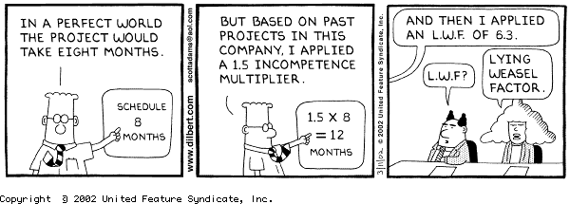
COCOMO assumptions and problems
Implicit productivity estimate
  Organic mode = 16 LOC/day
  Embedded mode = 4 LOC/day
Time required is a function of total effort not team size
Not clear how to adapt model to personnel availability
http://en.wikipedia.org/wiki/Fair_use

Slide 31
COCOMO assumptions and problems ...
Staff required can’t be computed by dividing the development time by the required schedule
The number of people working on a project varies depending on the phase of the project
The more people who work on the project, the more total effort is usually required (!)
Very rapid build-up of people often correlates with schedule slippage

Slide 32
Roadmap
What are metrics? Why do we need them?
Metrics for cost estimation
Metrics for software quality evaluation
Object-Oriented metrics in practice

Slide 33
Quantitative Quality Model
Quality according to ISO 9126 standard
Divide-and conquer approach via “hierarchical quality model”
Leaves are simple metrics, measuring basic attributes
Functionality
Error tolerance
Reliability
Accuracy
defect density
Software
Efficiency
= #defects / size
Quality
Consistency
Usability
Simplicity
correction time
Maintainability
Modularity
correction impact
Portability
= #components
changed
ISO 9126
Factor
Characteristic
Metric

Slide 34
“Define your own” Quality Model
Define the quality model with the development team
Team chooses the characteristics, design principles, metrics ... and the thresholds
design class as an
number of private
abstract data-type
attributes ]2, 10[
Maintainability
Modularity
encapsulate all
number of public
attributes
attributes ]0, 0[
number of public
avoid complex
methods ]5, 30[
interfaces
average number of
arguments [0, 4[
Factor
Characteristic
Design Principle
Metric

Slide 35
Sample Size (and Inheritance) Metrics
Inheritance Metrics
Class Size Metrics
- hierarchy nesting level (HNL)
- # methods (NOM)
- # immediate children (NOC)
- # attributes, instance/class
- # inherited methods, unmodified (NMI)
(NIA, NCA)
- #overridden methods (NMO)
- #
S
of method size (WMC)
Class
inherits
belongsTo
access
Method
Attribute
Method Size Metrics
invokes
- # invocations (NOI)
- # statements (NOS)
- # lines of code (LOC)
- # arguments (NOA)

Slide 36
Sample Coupling & Cohesion Metrics
The following definitions stem from [Chid91a], later republished as [Chid94a]
Coupling Between Objects (CBO)
CBO = number of other classes to which given class is coupled
Interpret as “number of other classes a class requires to compile”
Lack of Cohesion in Methods (LCOM)
LCOM = number of disjoint sets (= not accessing same attribute) of local methods

Slide 37
Coupling & Cohesion Metrics
Beware!
Researchers disagree whether coupling/cohesion methods are valid
Classes that are observed to be cohesive may have a high LCOM value
  due to accessor methods
Classes that are not much coupled may have high CBO value
  no distinction between data, method or inheritance coupling

Slide 38
Sample Quality Metrics (I)
Productivity (Process Metric)
functionality / time
functionality in LOC or FP; time in hours, weeks, months
  be careful to compare: the same unit does not always represent the same
Does not take into account the quality of the functionality!

Slide 39
Sample Quality Metrics (II)
Reliability (Product Metric)
mean time to failure =
mean of probability density function PDF
  for software one must take into account the fact that repairs will influence the rest of the function ⇒ quite complicated formulas
average time between failures = # failures / time
  time in execution time or calendar time
  necessary to calibrate the probability density function
mean time between failure = MTTF + mean time to repair
  to know when your system will be available, take into account repair

Slide 40
Sample Quality Metrics (III)
Correctness (Product Metric)
“a system is correct or not, so one cannot measure correctness”
defect density = # known defects / product size
  product size in LOC or FP
  # known defects is a time based count!
do not compare across projects unless your data collection is sound!

Slide 41
Sample Quality Metrics (IV)
Maintainability (Product Metric)
#time to repair certain categories of changes
“mean time to repair” vs. “average time to repair”
  similar to “mean time to failure” and “average time between failures”
beware of the units
  “categories of changes” is subjective
  time =?
  problem recognition time + administrative delay time + problem analysis time + change time + testing & reviewing time

Slide 42
Roadmap
What are metrics? Why do we need them?
Metrics for cost estimation
Metrics for software quality evaluation
Object-Oriented metrics in practice
Michele Lanza and Radu Marinescu, Object-Oriented Metrics in Practice, Springer-Verlag, 2006

Slide 43
Pattern: Study the Exceptional Entities
Problem
  How can you quickly gain insight into complex software?
Solution
  Measure software entities and study the anomalous ones
Steps
  Use simple metrics
  Visualize metrics to get an overview
  Browse the code to get insight into the anomalies

Slide 44
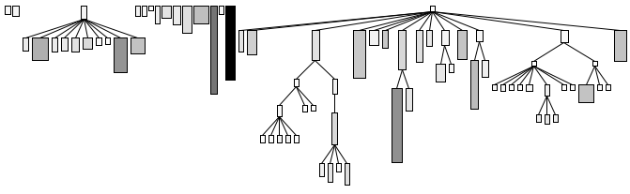
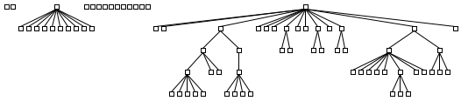
System Complexity View
System Complexity View
Width Metric
Nodes = Classes
Edges = Inheritance Relationships
Height
Metric
Width = Number of Attributes
Height = Number of Methods
Color = Number of Lines of Code
Position
Metrics
Color
Metric

Slide 45
Detection strategy
A detection strategy is a metrics-based predicate to identify candidate software artifacts that conform to (or violate) a particular design rule

Slide 46
Filters and composition
A data filter is a predicate used to focus attention on a subset of interest of a larger data set
  Statistical filters
    I.e., top and bottom 25% are considered outliers
  Other relative thresholds
    I.e., other percentages to identify outliers (e.g., top 10%)
  Absolute thresholds
    I.e., fixed criteria, independent of the data set
A useful detection strategy can often be expressed as a composition of data filters

Slide 47
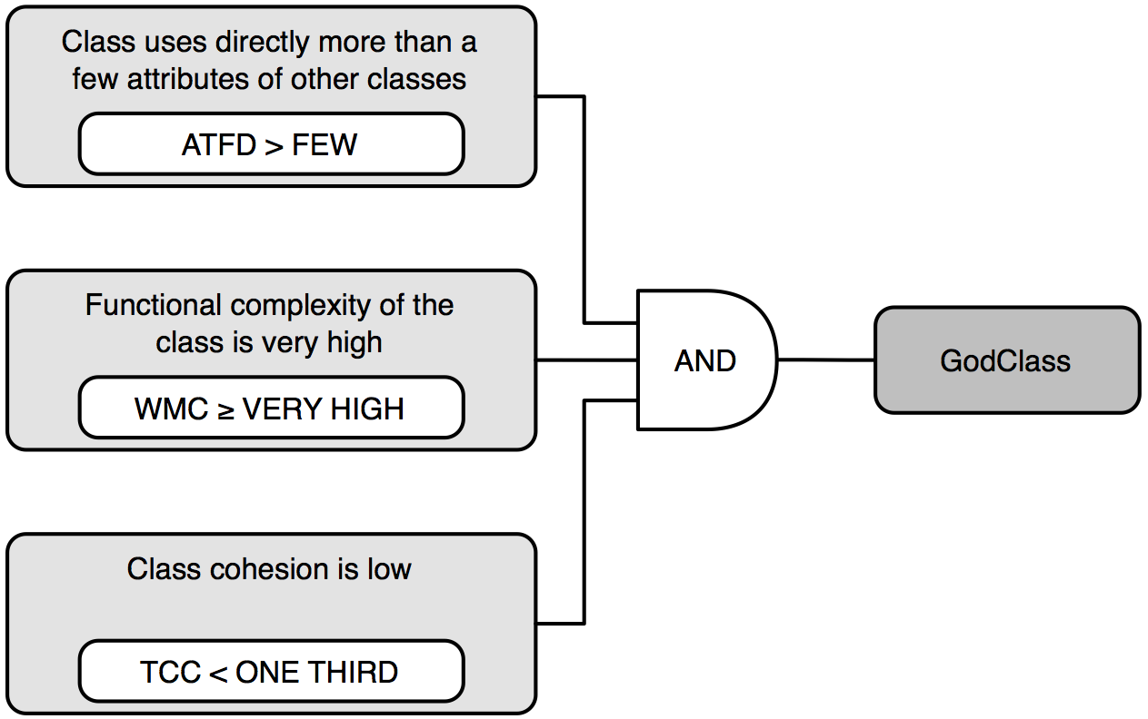
God Class
A God Class centralizes intelligence in the system
  Impacts understandibility
  Increases system fragility

Slide 48
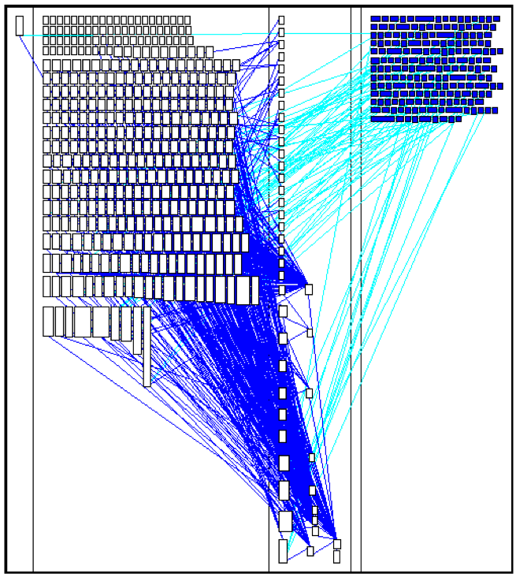
ModelFacade (ArgoUML)
453 methods
114 attributes
over 3500 LOC
all methods and all attributes are static

Slide 49
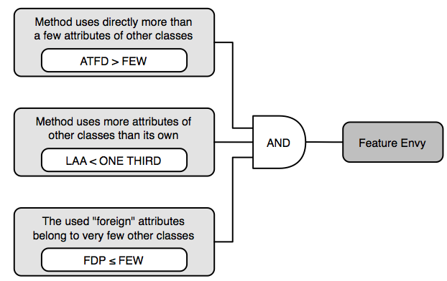
Feature Envy
Methods that are more interested in data of other classes than their own [Fowler et al. 99]

Slide 50
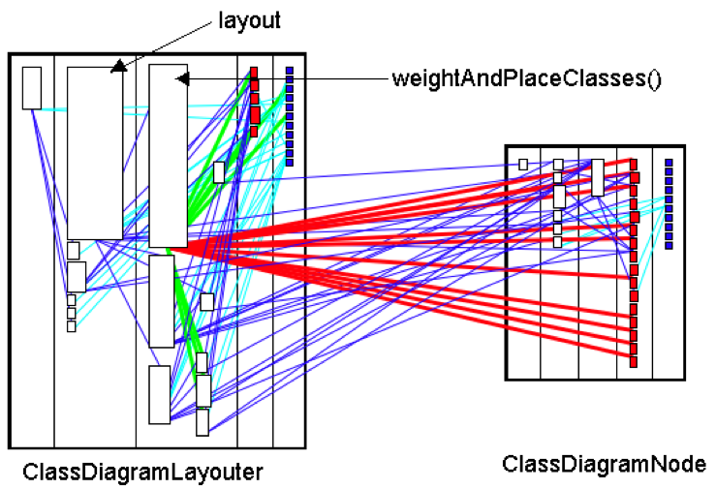
ClassDiagramLayouter

Slide 51
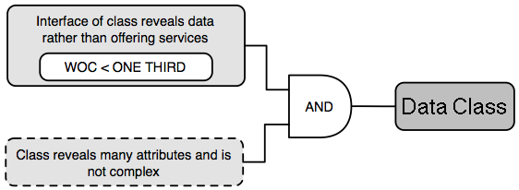
Data Class
A Data Class provides data to other classes but little or no functionality of its own

Slide 52
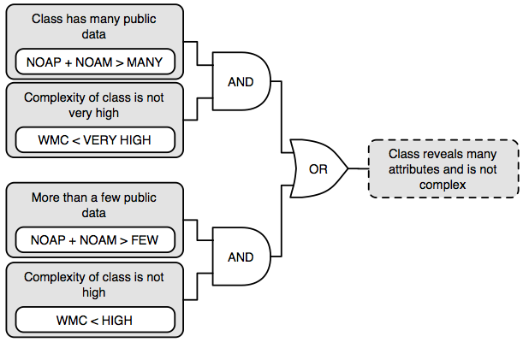
Data Class (2)

Slide 53
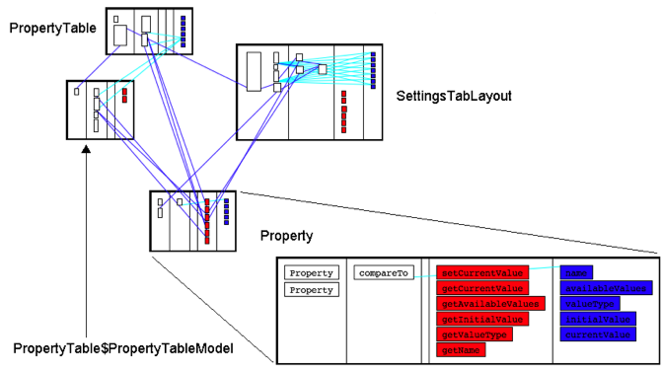
Property

Slide 54
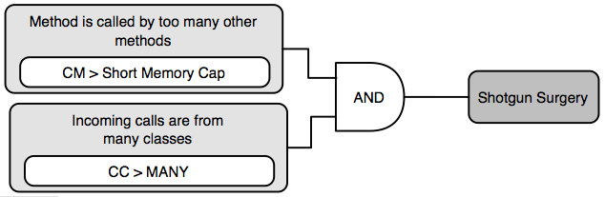
Shotgun Surgery
A change in an operation implies many (small) changes to a lot of different operations and classes

Slide 55
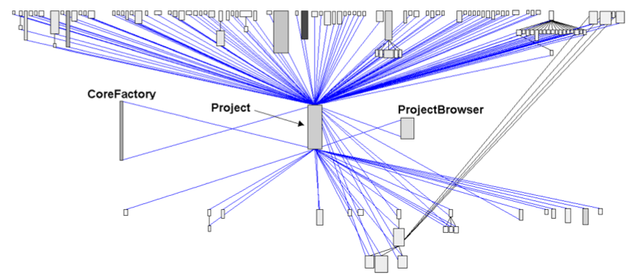
Project

Slide 56
What you should know!
What is a measure? What is a metric?
What is GQM?
What are the three phases of algorithmic cost modelling?
What problems arise when using LOC as a software metric?
What are the key ideas behind COCOMO?
What’s the difference between “Mean time to failure” and “Average time between failures”? Why is the difference important?

Slide 57
Can you answer the following questions?
During which phases in a software project would you use metrics?
Is the Fog index a “good” metric?
How would you measure your own software productivity?
Why are coupling/cohesion metrics important? Why then are they so rarely used?

Slide 58

License
Attribution-ShareAlike 3.0 Unported
You are free:
  to Share — to copy, distribute and transmit the work
  to Remix — to adapt the work
Under the following conditions:
  Attribution. You must attribute the work in the manner specified by the author or licensor (but not in any way that suggests that they endorse you or your use of the work).
  Share Alike. If you alter, transform, or build upon this work, you may distribute the resulting work only under the same, similar or a compatible license.
For any reuse or distribution, you must make clear to others the license terms of this work. The best way to do this is with a link to this web page.
Any of the above conditions can be waived if you get permission from the copyright holder.
Nothing in this license impairs or restricts the author's moral rights.
http://creativecommons.org/licenses/by-sa/3.0/

